Slide 1
Comparison of Tools for Information Extraction from Electronic Medical Record (EMR)
Yiwen Meng

Slide 2
Motivation
EMR is the dominant way to keep track of patient’s health history in the hospital
EMRs or patient discharge summaries are written in a narrative way by doctors or physicians
They are lengthy and with many medical jargons; difficult to interpret
Example: “obstructive sleep apnea”
Strong need for NLP tool to facilitate understanding and information extraction for EMR

Slide 3
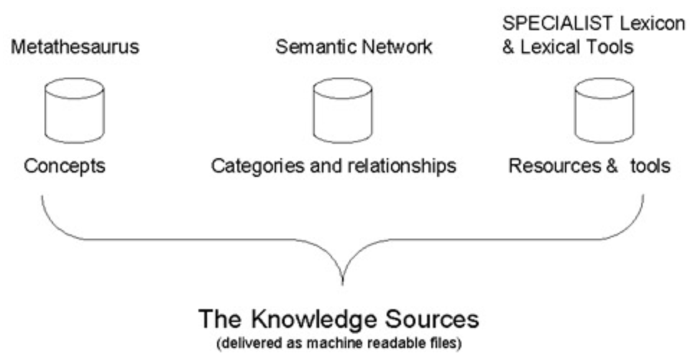
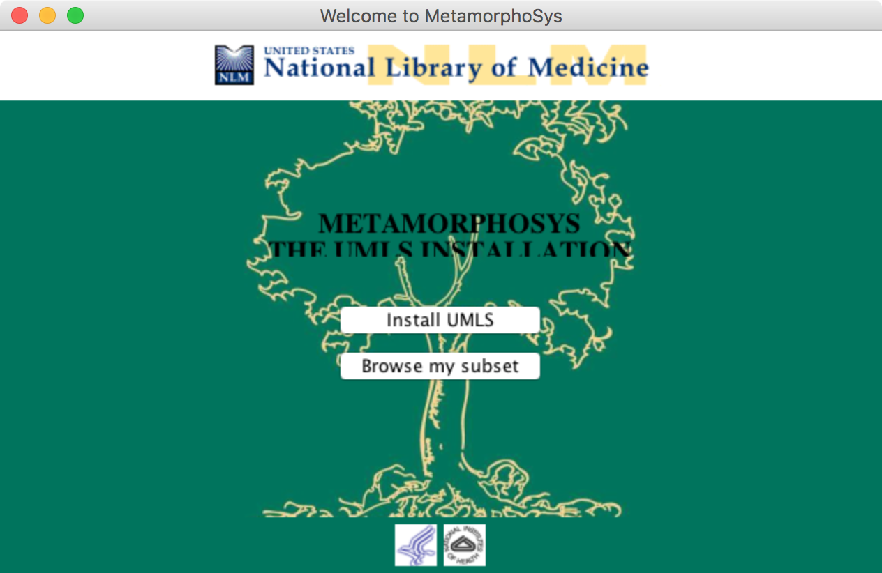
Unified Medical Language System (UMLS)
There are three UMLS Knowledge Sources:
The Metathesaurus, which contains over one million biomedical concepts from over 100 source vocabularies
The Semantic Network, which defines 133 broad categories and fifty-four relationships between categories for labeling the biomedical domain
The SPECIALIST Lexicon & Lexical Tools, which provide lexical information and programs for language processing
https://www.nlm.nih.gov/research/umls/

Slide 4
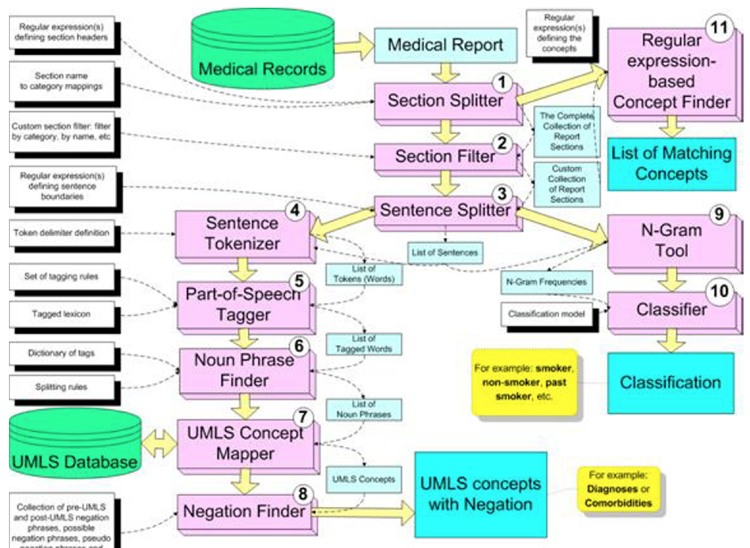
Health Information Text Extraction (HITEx)
11 NLP modules:
Section splitter
Section filter
Sentence splitter
Sentence tokenizer
POS tagger
Noun phrase finder
UMLS concept finder
Negation finder
N-gram tool
Classifier
Regular expression-based concept finder

Slide 5
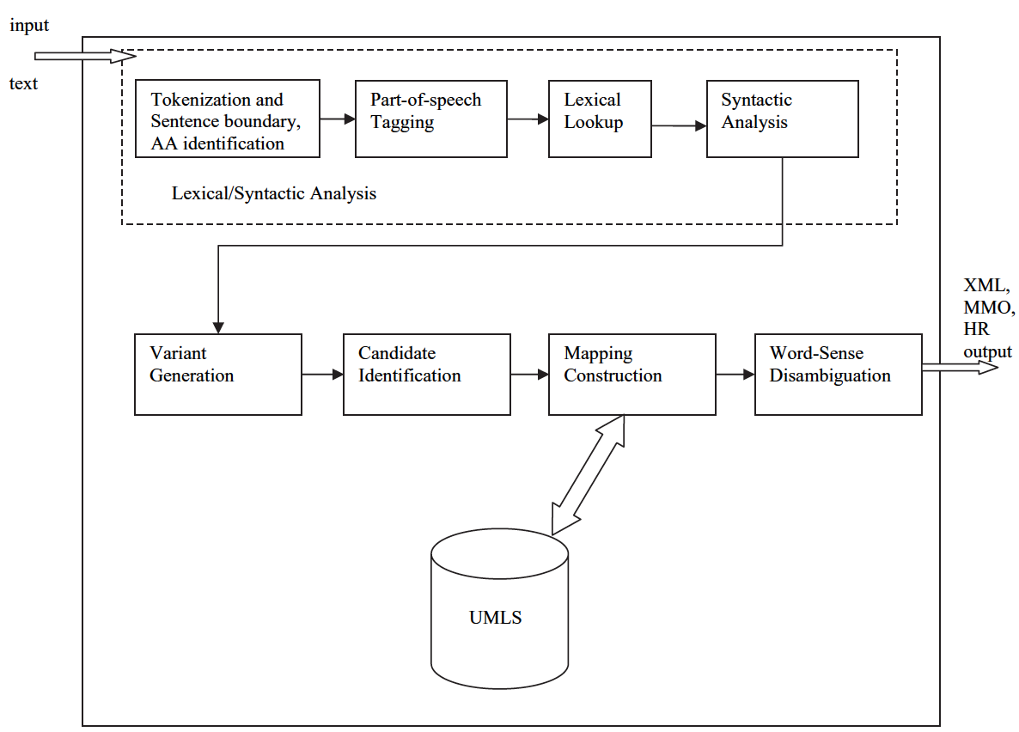
MetaMap
Advantage:
Strong lexical and syntactic analyses and metric of scoring for UMLS concepts
Compact and versatile interface
Constructing partial, compound mappings of UMLS concepts
Disadvantage:
English-centric nature
No negation detection

Slide 6
NegEx: Simple Negation Algorithm
Identify UMLS terms from input sentences
Match negative phrases with the pre-defined 35 negation phrase
Two groups of negation phrases
Pseudo-negation: no, gram negative, denied, without, not necessarily
Two expressions:
phrase + <UMLS>: no sign of, not demonstrate, no evidence of, ruled out
<UMLS> + phrase: declined, unlikely
Example: “ The chest X-ray showed no infiltrates and EKG revealed
sinus tachycardia”

Slide 7
Results
NLP Tool | Patient data type and number | Result
HITEx | 150 reports of asthma and Chronic Obstructive Pulmonary Disease (OCPD) | Accuracy for principal diagnosis extraction was 82% and for comorbidities was 87% and for smoking status extraction was 90%
MetaMap | 2 K documents to 99 K documents and for two entity types, biological processes and diseases | Overall, the precision and recall is 85% and 82%
NegEx | 1000 sentences from ICU report, contained 1235 occurrences of UMLS terms | In total, the sensitivity and specificity are 77.84% and 94.51% respectively

