Slide 1
PPM introduction

Slide 2
Problem introduction
Business background
Current status of client’s system
Pain point
Requirement

Slide 3

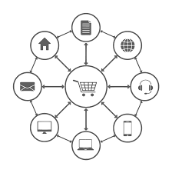


Problem introduction
Business background:
Client’s industry: Smart device Manufacturing
Sells multiple device models in different segments (release new model in yearly basis)
Has a large customer base (millions customers in total)
Carried out a huge number of marketing campaigns (more than 1,000 campaigns per year)
There are 3 main marketing channels (Email, Push, and SMS)
Current approach: mass targeting on both pre-launching & post launching phase
Pain point: Ineffective marketing (low conversion rate)
Demand: an effective mechanism for customer targeting/marketing planning
Multiple models
millions customers
1,000+ MKT campaigns/year
Multiple MKT channels
Current Marketing Process – Mass Marketing (New Product Launch)
Teaser
Unpack
Pre-order
Launch Phase
Post-Launch Phase
Notes:
Teaser:
Unpack:

Slide 4
Input data
What data is available on client’s side?
Is external data applicable?

Slide 5
What data is available on client’s side?
Interaction history data
User id
Campaign id
Interaction count
….
Purchase history data (2001-2020, for other series & model too)
User id
Purchase date
Product info (series, model)
….
Marketing campaign data (2011-2020, for target series only)
Campaign id
Start, end date
Campaign type (pre/ post)
Product info (series, model)
….
User data
User id
Date of birth
Gender
….

Slide 6
What data is available on client’s side?
Purchase history data
User id
Purchase date
Product info (series, model)
….
User data
User id
Date of birth
Gender
….
Interaction history data
User id
Campaign id
Interaction count
….
Marketing campaign data
Campaign id
Start, end date
Campaign type (pre/ post)
Product info (series, model)
….

Slide 7
Is external data applicable?
Due to privacy policy, user identity can not be exposed, so mapping user info with external data is impossible.
Social network activities may helpful to understand customer purchase propensity (view, like/ dislike, comment, …)

Slide 8
PPM approach
What is PPM? What is prediction target?
Evaluation metric
Feature engineering approach
Train-validation-test split strategy
Integration with client’s system
PPM in practice

Slide 9
What is Purchase Propensity Model (PPM)?
PPM identifies prospective customers who have high propensity to buy products by making estimation on probability of purchasing a new product for each customer
Data Source
Purchase Propensity Model
Purpose
Analytical Process
Product Purchasing Factors
Customer Profiling
Product Registration prediction
Understanding of Product Purchased Customer Characteristic
Prospective Customer Indexing (Customer Scoring)
Customer
Brand Experience
Target
Product
Feedback
Customer Score (Purchase Propensity Based)
Purchase
Behavior
Product Experience
X
Y
Z
Owned
Behavior
Response
Speed
Compressing Target
Customer Behavior
Customer Scoring
Compress marketing campaign target customer base
Prevent customer marketing fatigue
Campaign Feedback
Big Data Analysis Platform
Notes:
Owned Behavior:
Marketing fatigue: 広告疲れ

Slide 10
What is Purchase Propensity Model (PPM)?
Purpose:
Better Targeting/Marketing Planning
Compressing marketing target customer
Scope:
2 smart device series ('A', 'B' series)
4 channel types: Email, Push, SMS, All
Scenario: New model is released once a year. Pre-launch (mass targeting) & post-launch (PPM targeting) marketing campaigns are conducted before & after launching date. Historical data + user interaction in current pre-launch phase is used as input for PPM.
Marketing Campaign (New launch)
Teaser
Unpack
Pre-order
Launch Phase
Post-Launch Phase
1 month
Collect data on customer interaction with marketing campaign
Mass Marketing
PPM Target marketing
Mass Target
Scale of PPM target corresponds to given marketing budget
“Identify the best opportunities among the higher propensity customers.”
PPM Target
Notes:
1 month: 問題設定、目的を追記！プロセスと勘違いされないように！
PPMに絞っていることがわかるように色とかつける。商品ロンチ後

Slide 11
System integration approach
Client side
Marketing
Management
System
Data Warehouse
PPM server
Channel, Series, Sales target
Recommended Score
Recommended Score
Marketing operator
User list

Slide 12
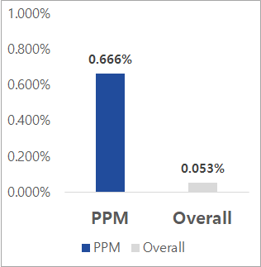
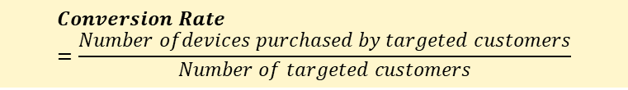
PPM in Practice
PPM helps improve conversion rate, up to ∼13 times compared to natural conversion!
$$Conversion Rate=\frac{Number ofdevices purchased by targeted customers}{Number of targeted customers}$$
Prospective Customer Prediction Result
Conversion Rate Comparison
PPM Target
Conversion among PPM target
Conversion Rate
100%
10M人
7%
0.7M人
88.85%
4703台
4703/0.7M
= 0.666%
(4703+590)/10M
= 0.053%
PPM Conversion rate
Natural conversion rate
93%
9.3M人
(n=1.2Mn)
(n=8.5Mn)
(n=1.1Mn)
11.14%
590台
Total Customer
PPM Target
% of Total devices sold
Compared to conversion rate in Mass-targeting (all) customer
Conversion Rate: 12.69 times Improvement (Evaluate on test set)
By applying PPM model, targeting to about 7% of the total customer population could achieve 88.85% of total sales result.
Notes:
学習データの期間、テストデータの期間
2011-2020:学習、2021: テスト
キャンペーン期間平均：in demo it is 2 months for pre-launching campaign & 1 month for post-launching campaign
→ 結果（目標）を先頭に書いたほうが良い！

