Slide 1
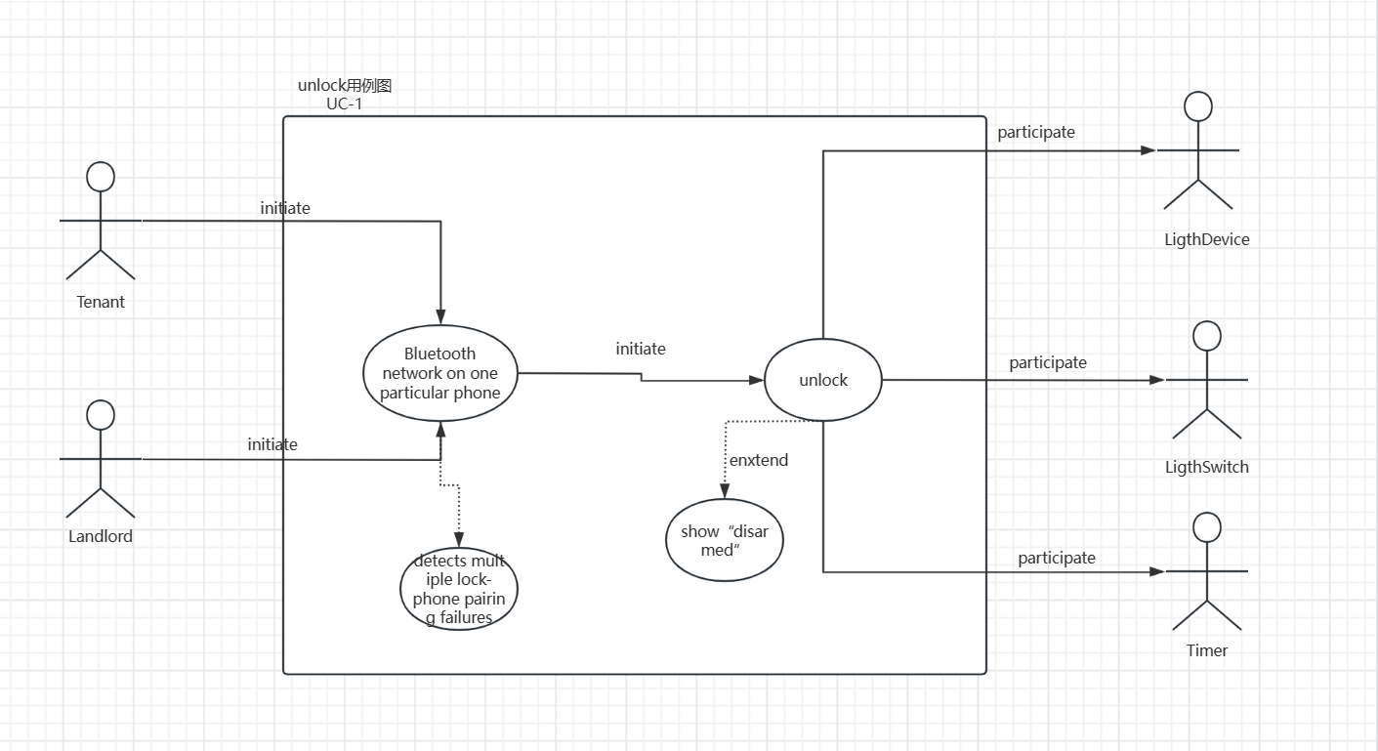

Slide 2
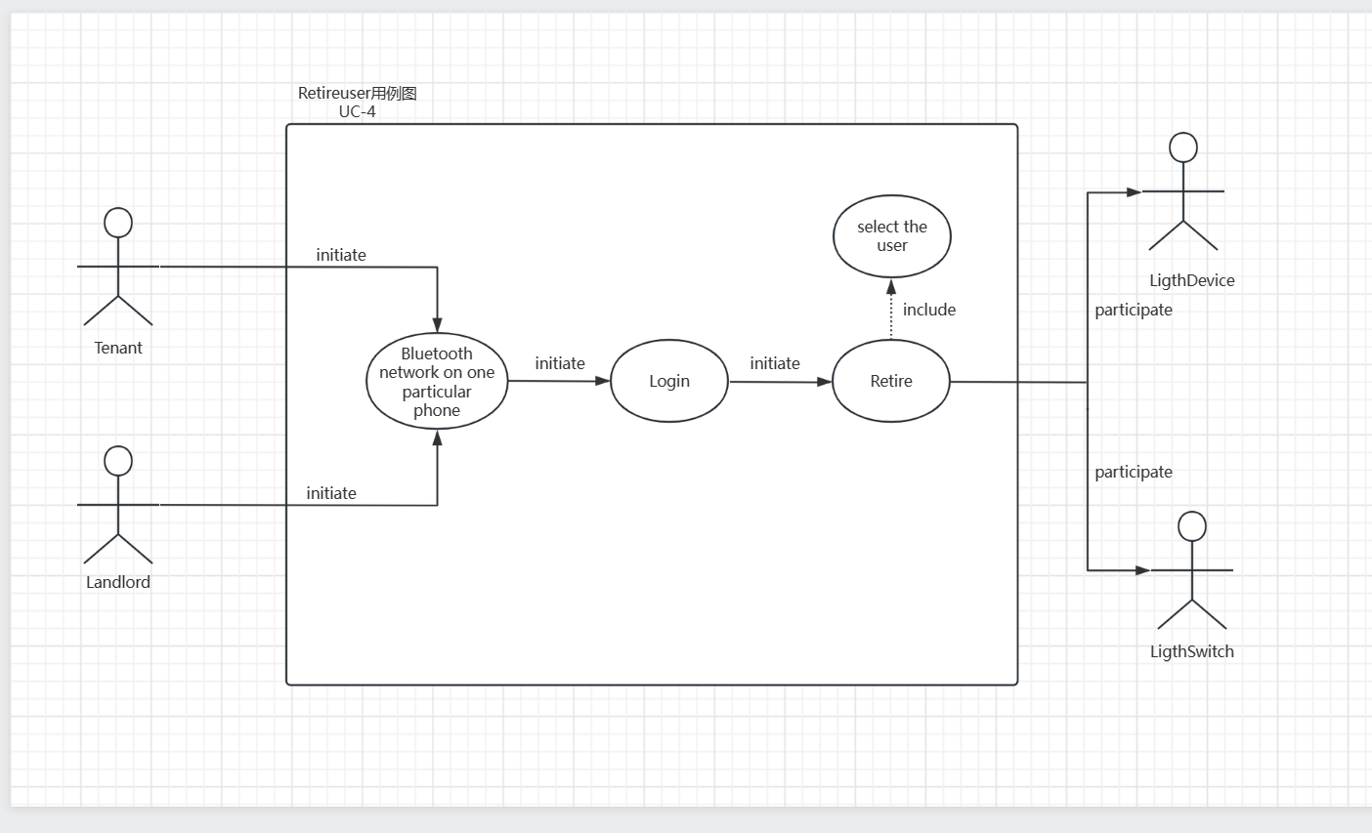

Slide 3
Use Case 1: Unlock
Use Case UC-1: |  |  | Unlock
Related Requirem’ts: |  |  | REQ1, REQ3, REQ4, and REQ5 stated in the table of REQs
Initiating Actor: |  |  | Any of: Tenant, Landlord
Actor’s Goal: |  |  | To disarm the lock and enter, and get space lighted up automatically.
Participating Actors: |  |  | LockDevice, LightSwitch, Timer
Preconditions: |  |  | • The set of valid Bluetooth of phone stored in the system database is non-empty. • The system displays the menu of available functions; at the phone screan the menu choices are “Lock” and “Unlock.”
Postconditions: |  |  | The auto-lock timer has started countdown from autoLockInterval.
Flow of Events for Main Success Scenario:
→ | 1. | Tenant/Landlord arrives at the door and use the bottom “Unlock” on phone
 | 2. | include::AuthenticateUser (UC-7),and decide to block or not
← | 3. | System (a) signals to the Tenant/Landlord the lock status on phone(or maybe on the screan on the door), e.g., “disarmed,” (b) signals to LockDevice to disarm the lock, and (c) signals to LightSwitch to turn the light on
← | 4. | System signals to the Timer to start the auto-lock timer countdown
→ | 5. | Tenant/Landlord opens the door, enters the home [and shuts the door and locks]

Slide 4
Use Case 4: RetireUser
Use Case UC-4: |  |  | RetireUser
Related Requirem’ts: |  |  | REQ7stated in the table of REQs
Initiating Actor: |  |  | Landlord
Actor’s Goal: |  |  | To Retire an existing user account and disable access.
Participating Actors: |  |  | Lock Database, Authority Management
Preconditions: |  |  | • The set of valid phone stored in the system database is non-empty. • The system displays the menu of available functions; at the phoe the menu choices are “RetireUser.”
Postconditions: |  |  | The auto-lock timer has started countdown from autoLockInterval.
Flow of Events for Main Success Scenario:
→ | 1. | Landlord select choice “RetireUser” on his/her phone
 | 2. | include::AuthenticateUser (UC-7)
← | 3. | System (a) signals to Authority Management (b) judge whether the order is valid, and (c) Retire the chosen user if valid
→ | 5. | Signal to Lock Database to delete the information

Slide 5
Acceptance Test Case for UC-1 Unlock
Test-case Identifier: | TC-1
Use Case Tested: | UC-1, main success scenario
Pass/fail Criteria: | The test passes if the user uses his/her phnoe that is contained in the database, with less than a maximum allowed number of unsuccessful attempts
Input Data: | valid phone (Bluetooth)
Test Procedure: |  | Expected Result:
Step 1. using the invalid phone device |  | System beeps to indicate failure; records unsuccessful attempt in the database; prompts the user to try again
Step 2. using the valid phone device |  | System flashes a green light to indicate success; records successful access in the database; disarms the lock device

Slide 6
Acceptance Test Case for UC-4 RetireUser
Test-case Identifier: | TC-2
Use Case Tested: | UC-4, main success scenario
Pass/fail Criteria: | The test passes if the user with the authorized phone to retire someone, with less than a maximum allowed number of unsuccessful attempts
Input Data: | Phone which send the signal , the user to be retired
Test Procedure: |  | Expected Result:
Step 1. using the unauthorized phone to retire |  | System beeps to indicate failure; attempt is blocked and send alarm to the authorized phone
Step 2. using the authorized phone to retire |  | Record the information of deletion and retire the user that is chosen

