Slide 1
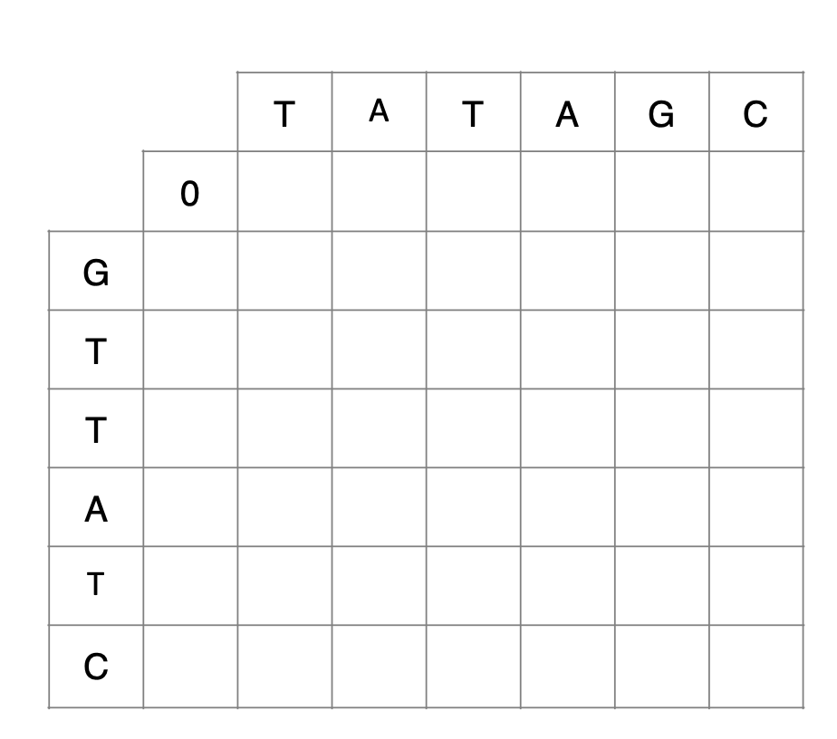
- | T | A | T | A | G | C
G | T | - | T | A | T | C
Score = 3
-2
-4
-6
-8
-10
-12
-2
-1
-3
-5
-7
-6
-8
-4
0
-2
-1
-3
-5
-7
-6
-2
-1
0
-2
-4
-6
-8
-4
0
-2
2
0
-2
-10
-6
-2
2
0
1
-1
-12
-8
-4
0
1
-1
3

