Slide 1
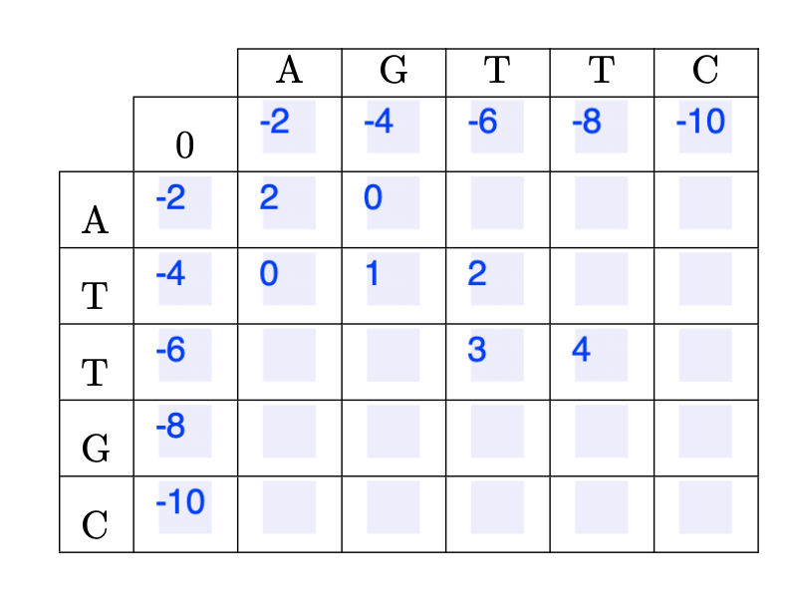
Q5
A | G | T | T | - | C
A | - | T | T | G | C
-2
-4
-6
0
-2
-2
-1
2
-4
0
1
2
3
-6
-2
-1
0
4

Slide 2
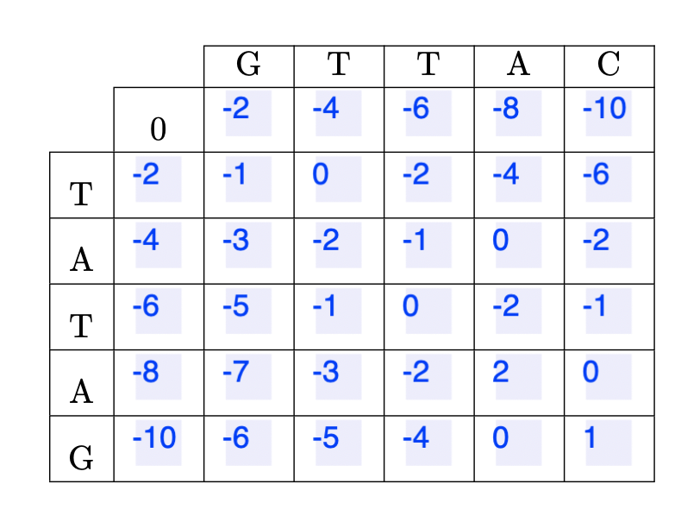
Q6

