Slide 1
Chapter 3
Stacks
Objectives
Upon completion you will be able to
Explain the design, use, and operation of a stack
Implement a stack using a linked list structure
Understand the operation of the stack ADT

Slide 2
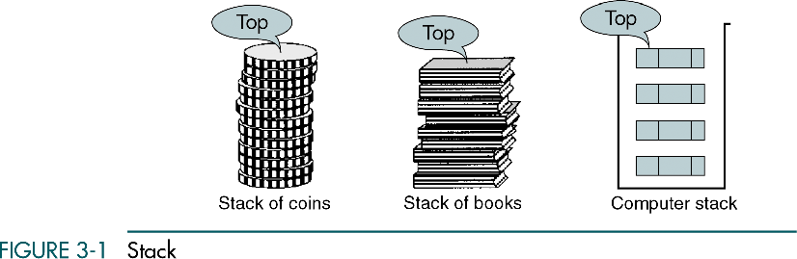

Slide 3
3.1 Basic Stack Operations
The stack concept is introduced and three basic stack operations are discussed.
3.2 Stack Linked List Implementation
In this section we present a linked-list design for a stack. After developing the data structures, we write pseudocode algorithms for the stack ADT.
3.3 C Language Implementations
This section presents a simple non-ADT implementation of a stack. We develop a simple program that inserts random characters into the stack and then prints them.
3.4 Stack ADT
Begins the discussion of the stack ADT with a discussion of the stack structure and its application interface. We then develop the required functions.

Slide 4
3.1 Basic Stack Operations
The stack concept is introduced and three basic stack operations are discussed.
3.2 Stack Linked List Implementation
In this section we present a linked-list design for a stack. After developing the data structures, we write pseudocode algorithms for the stack ADT.
3.3 C Language Implementations
This section presents a simple non-ADT implementation of a stack. We develop a simple program that inserts random characters into the stack and then prints them.
3.4 Stack ADT
We begin the discussion of the stack ADT with a discussion of the stack structure and its application interface. We then develop the required functions.
3.5 Stack Applications
Three basic application problems-parsing, postponement, and backtracking-are discussed and sample programs developed. In addition, several other stack applications are presented, including the classic Eight Queens problem.
3.6 How Recursion Works
This section discusses the concept of the stack frame and the use of stacks in writing recursive software
3-1 Basic Stack Operations
The stack concept is introduced and three basic stack operations are discussed.
Push
Pop
Stack Top

Slide 5
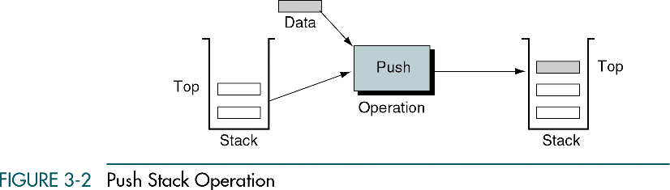

Slide 6
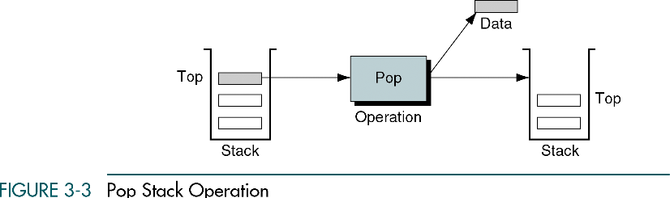

Slide 7
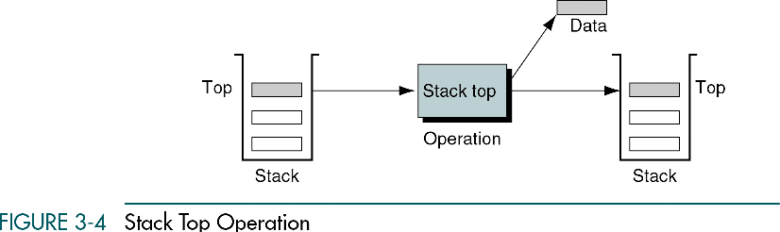

Slide 8
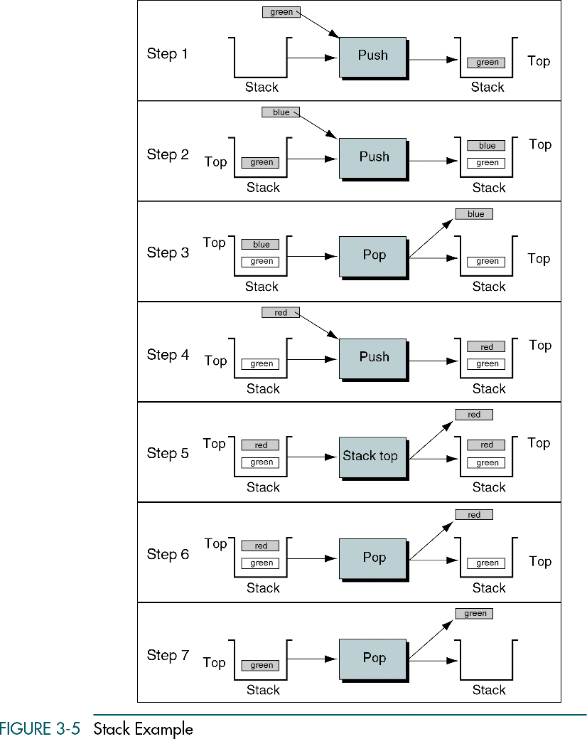

Slide 9
3-2 Stack Linked List Implementation
In this section we present a linked-list design for a stack. After developing the data structures, we write pseudocode algorithms for the stack ADT.
Data Structure
Algorithms

Slide 10
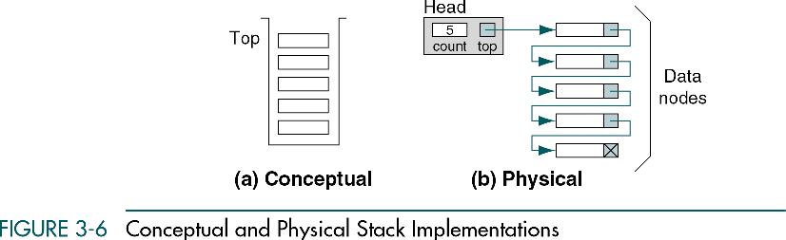

Slide 11
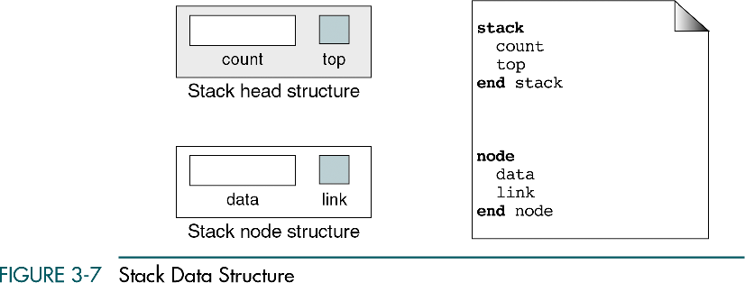

Slide 12
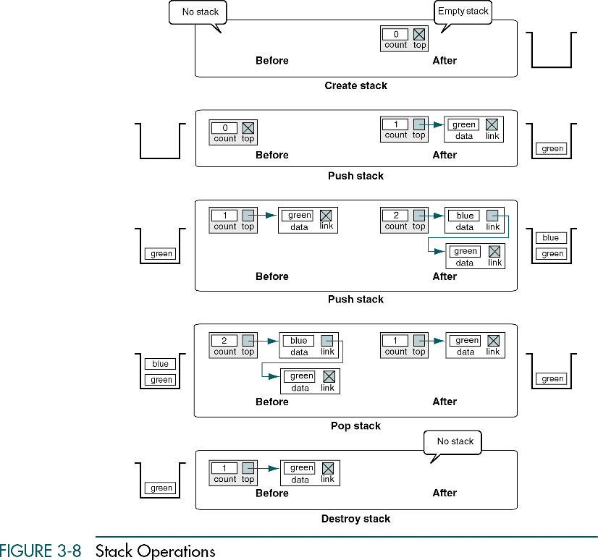

Slide 13
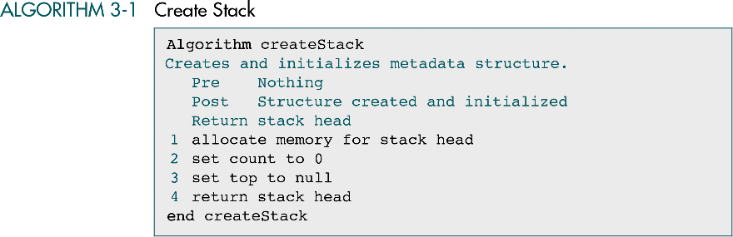

Slide 14
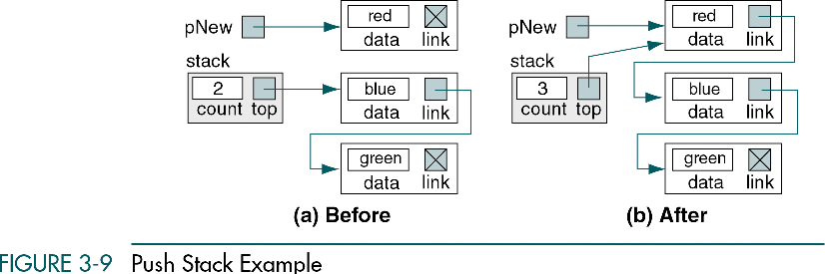

Slide 15
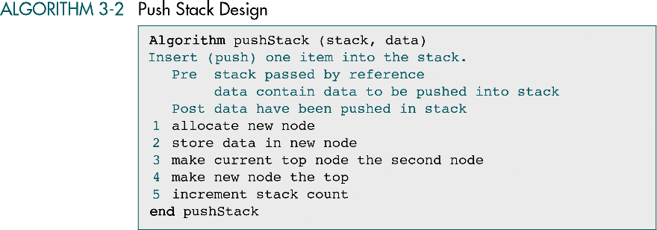

Slide 16
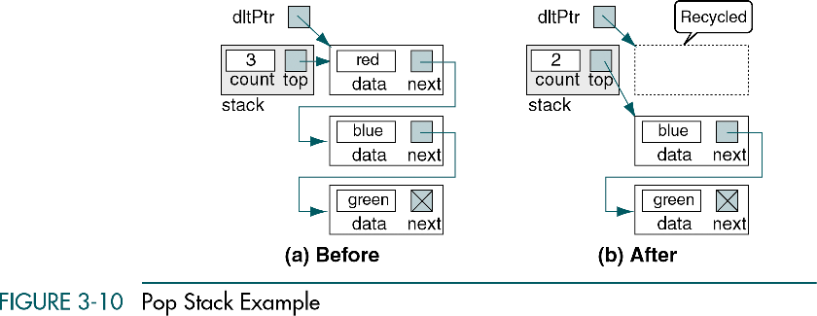

Slide 17
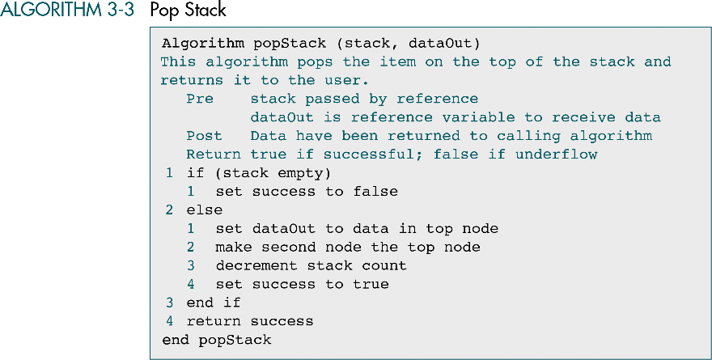

Slide 18
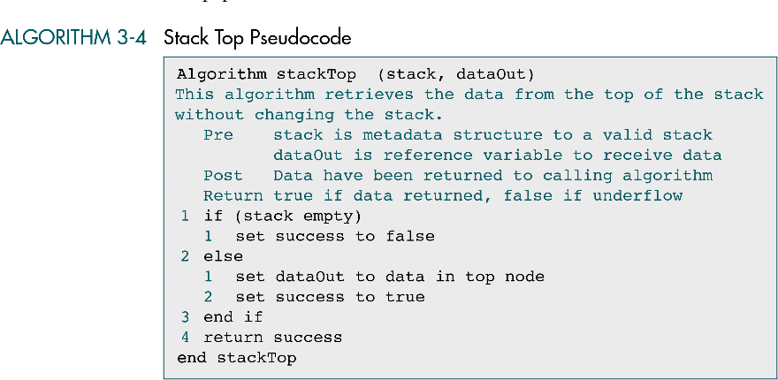

Slide 19
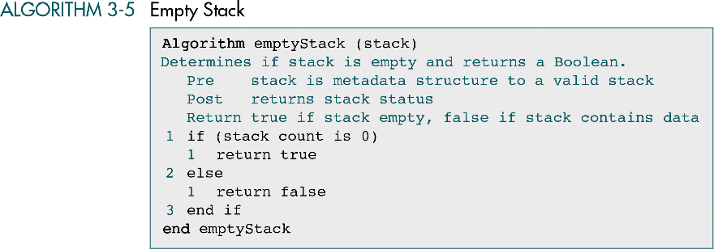

Slide 20
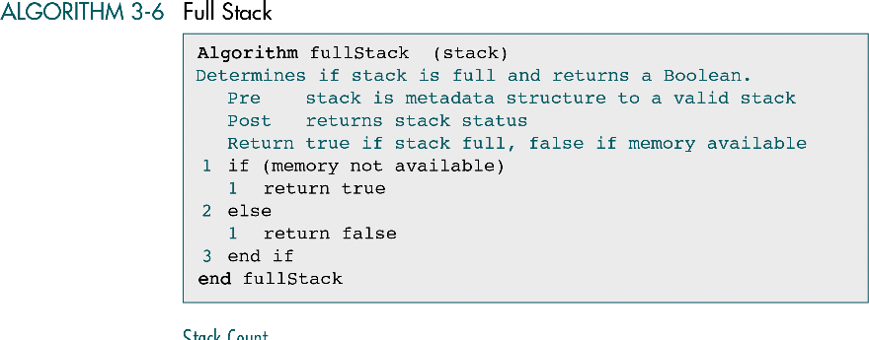

Slide 21
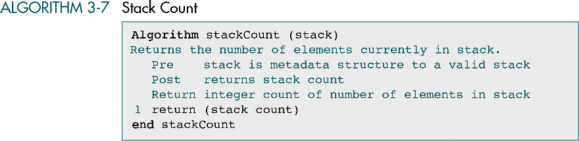

Slide 22
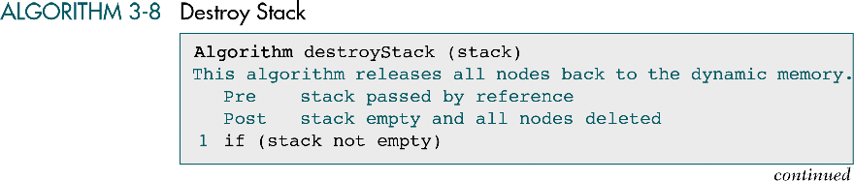

Slide 23
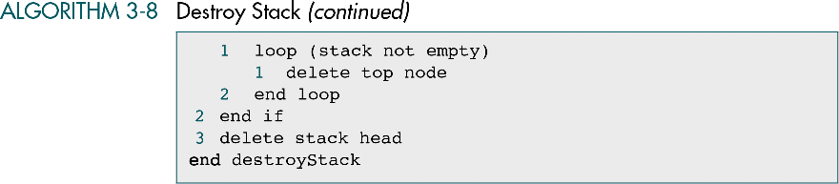

Slide 24
3-3 C Language Implementations
This section presents a simple non-ADT implementation of a stack. We develop a simple program that inserts random characters into the stack and then prints them.

Slide 25
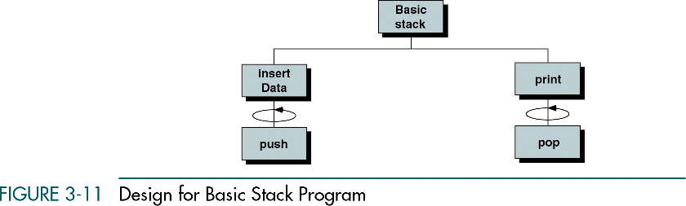

Slide 26
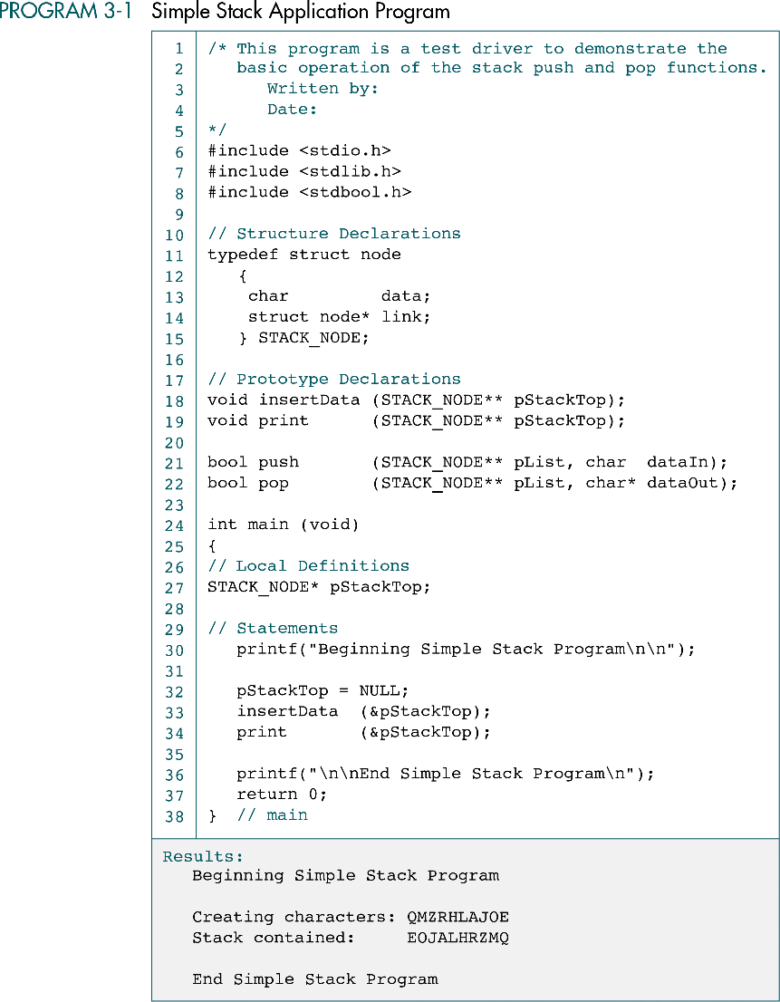

Slide 27
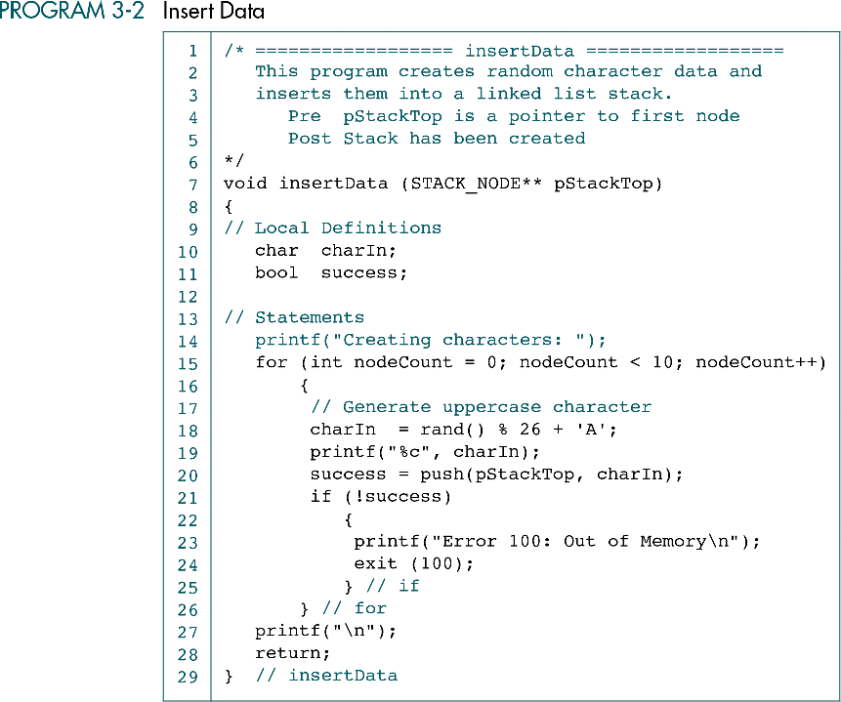

Slide 28
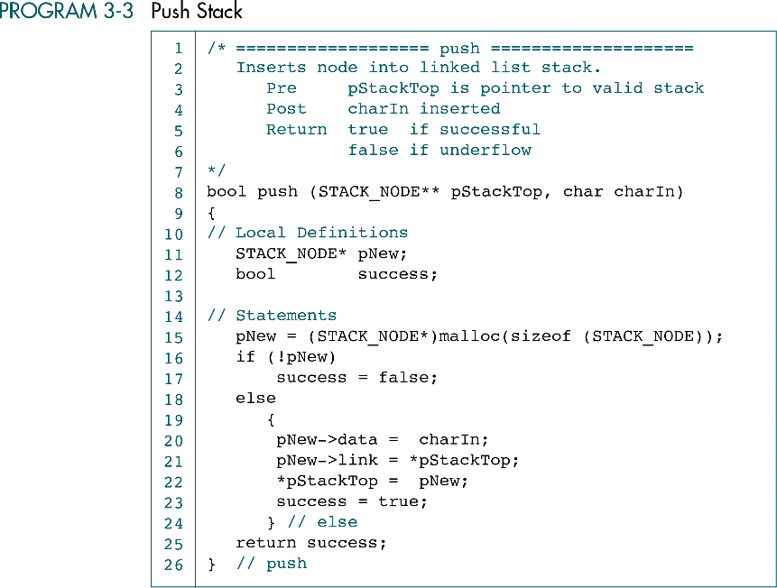

Slide 29
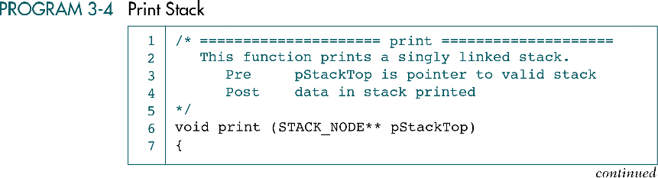
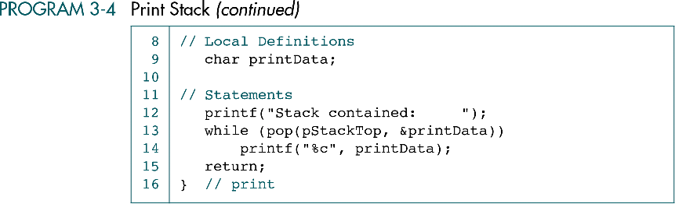

Slide 30
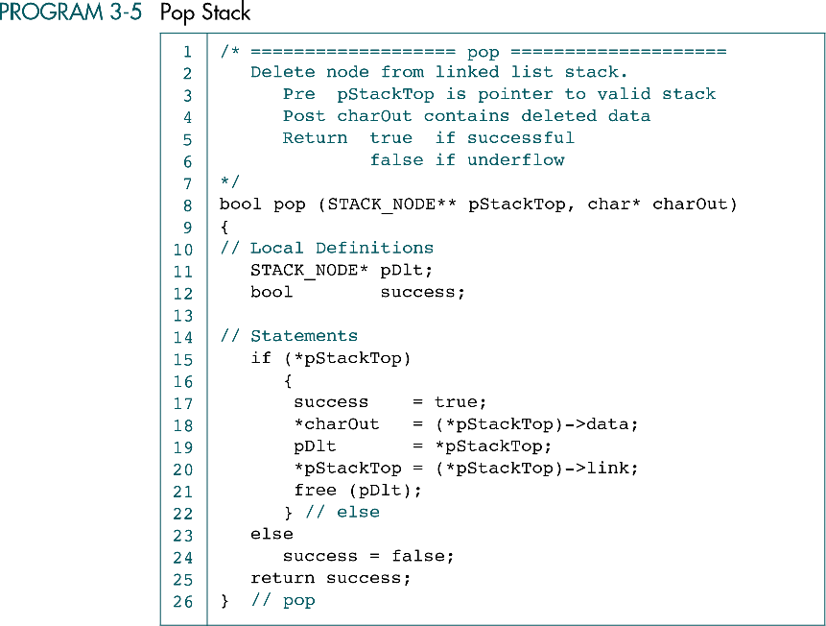

Slide 31
3-4 Stack ADT
We begin the discussion of the stack ADT with a discussion of the stack structure and its application interface. We then develop the required functions.
Data Structure
ADT Implemenation

Slide 32
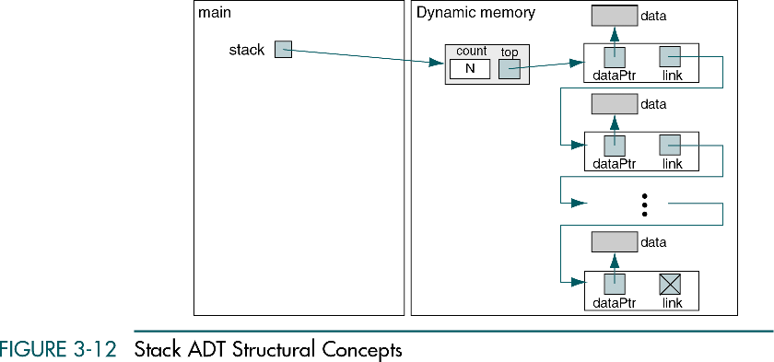

Slide 33
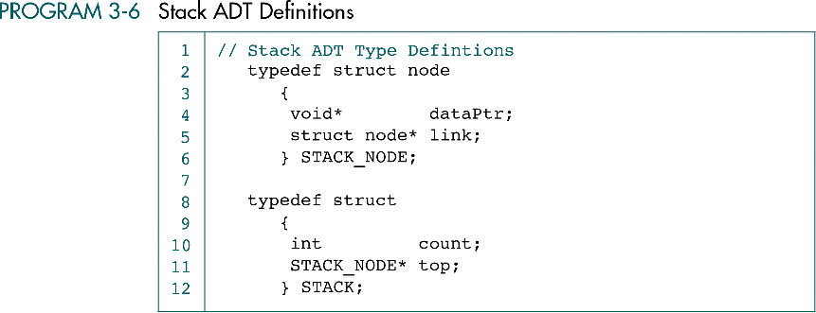

Slide 34
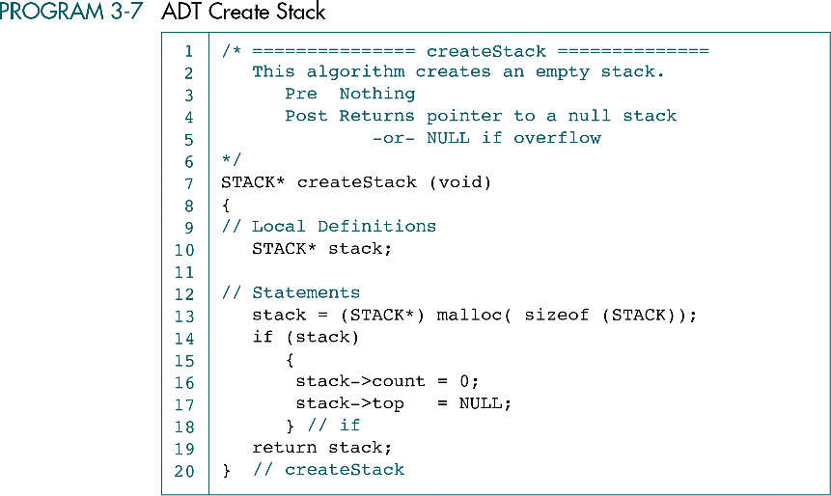

Slide 35
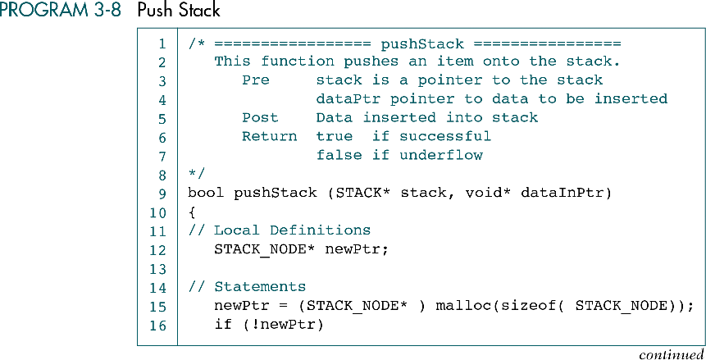
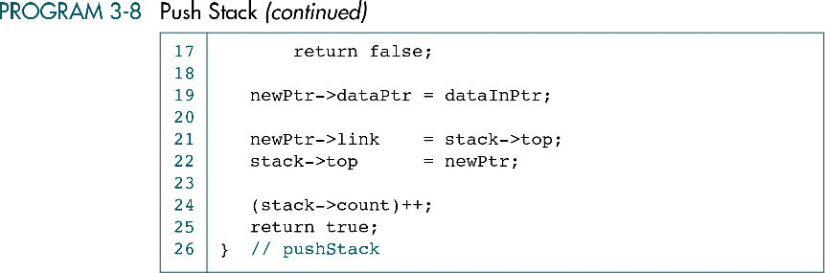

Slide 36
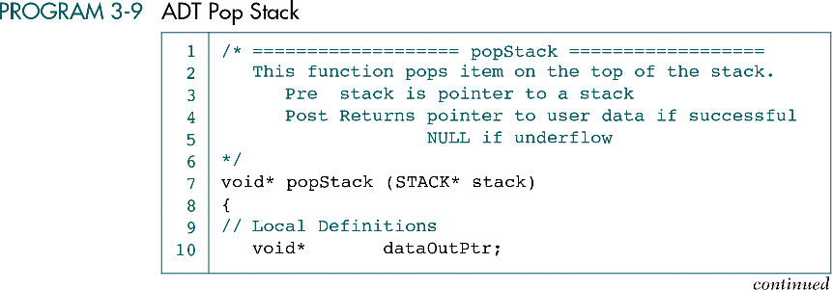

Slide 37
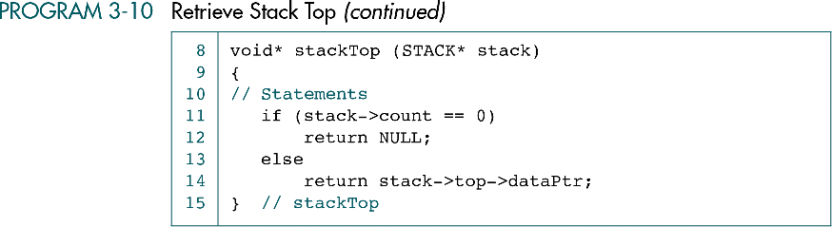

Slide 38
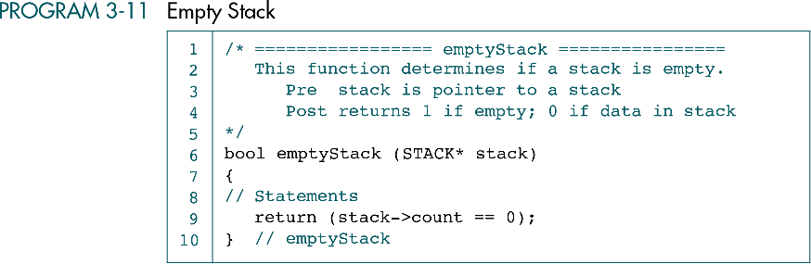

Slide 39
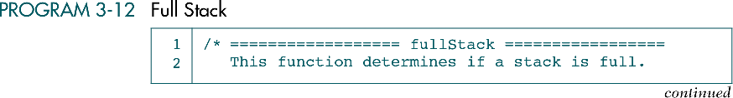
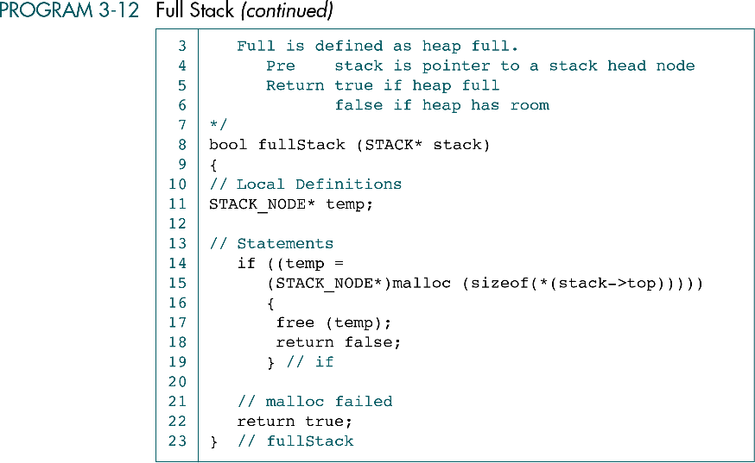

Slide 40
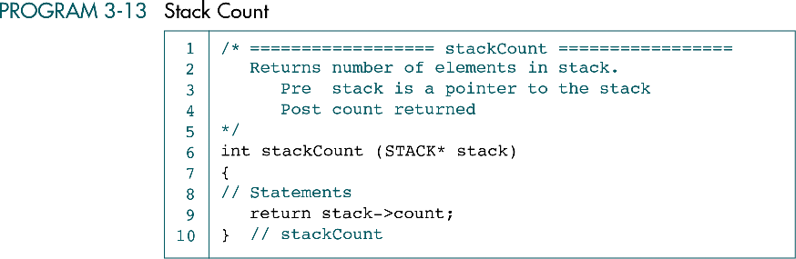

Slide 41
