Slide 1
Stacks

Slide 2
Applications of Stacks
Direct applications
  Delimiter matching
  Undo sequence in a text editor
  Chain of method calls in the Java Virtual Machine
Indirect applications
  Auxiliary data structure for algorithms
  Component of other data structures

Slide 3

The Stack ADT (§4.2)
The Stack ADT stores arbitrary objects
Insertions and deletions follow the last-in first-out scheme
Think of a spring-loaded plate dispenser
Main stack operations:
  push(object): inserts an element
  object pop(): removes and returns the last inserted element
Auxiliary stack operations:
  object top(): returns the last inserted element without removing it
  integer size(): returns the number of elements stored
  boolean isEmpty(): indicates whether no elements are stored

Slide 4
Stack Interface in Java
public interface Stack {
public int size();
public boolean isEmpty();
public Object top()
throws EmptyStackException;
public void push(Object o);
public Object pop()
throws EmptyStackException;
}
Java interface corresponding to our Stack ADT
Requires the definition of class EmptyStackException
Different from the built-in Java class java.util.Stack

Slide 5
Exceptions
Attempting the execution of an operation of ADT may sometimes cause an error condition, called an exception
Exceptions are said to be “thrown” by an operation that cannot be executed
In the Stack ADT, operations pop and top cannot be performed if the stack is empty
Attempting the execution of pop or top on an empty stack throws an EmptyStackException

Slide 6
Array-based Stack
A simple way of implementing the Stack ADT uses an array
We add elements from left to right
A variable keeps track of the index of the top element
Algorithm size()
return t + 1
Algorithm pop()
if isEmpty() then
throw EmptyStackException
else
t ← t − 1
return S[t + 1]
…
S
0
1
2
t

Slide 7

Array-based Stack (cont.)
The array storing the stack elements may become full
A push operation will then throw a FullStackException
  Limitation of the array-based implementation
  Not intrinsic to the Stack ADT
Algorithm push(o)
if t = S.length − 1 then
throw FullStackException
else
t ← t + 1
S[t] ← o
…
S
0
1
2
t

Slide 8




Stack using a Singly Linked List
We can implement a stack with a singly linked list
The top element is stored at the first node of the list
The space used is O(n) and each operation of the Stack ADT takes O(1) time
nodes
t
∅
elements

Slide 9
Parentheses Matching
Each “(”, “{”, or “[” must be paired with a matching “)”, “}”, or “[”
  correct: ( )(( )){([( )])}
  correct: ((( )(( )){([( )])}
  incorrect: )(( )){([( )])}
  incorrect: ({[ ])}
  incorrect: (

Slide 10
Parentheses Matching Algorithm
Algorithm ParenMatch(X,n):
Input: An array X of n tokens, each of which is either a grouping symbol, a
variable, an arithmetic operator, or a number
Output: true if and only if all the grouping symbols in X match
Let S be an empty stack
for i=0 to n-1 do
if X[i] is an opening grouping symbol then
S.push(X[i])
else if X[i] is a closing grouping symbol then
if S.isEmpty() then
return false {nothing to match with}
if S.pop() does not match the type of X[i] then
return false {wrong type}
if S.isEmpty() then
return true {every symbol matched}
else
return false {some symbols were never matched}

Slide 11
HTML Tag Matching
For fully-correct HTML, each <name> should pair with a matching </name>
<body>
<center>
<h1> The Little Boat </h1>
</center>
<p> The storm tossed the little
boat like a cheap sneaker in an
old washing machine. The three
drunken fishermen were used to
such treatment, of course, but
not the tree salesman, who even as
a stowaway now felt that he
had overpaid for the voyage. </p>
<ol>
<li> Will the salesman die? </li>
<li> What color is the boat? </li>
<li> And what about Naomi? </li>
</ol>
</body>
The Little Boat
The storm tossed the little boat
like a cheap sneaker in an old
washing machine. The three
drunken fishermen were used to
such treatment, of course, but not
the tree salesman, who even as
a stowaway now felt that he had
overpaid for the voyage.
1. Will the salesman die?
2. What color is the boat?
3. And what about Naomi?

Slide 12
Tag Matching Algorithm
Is similar to parentheses matching:
  import java.util.StringTokenizer;
  import datastructures.Stack;
  import datastructures.NodeStack;
  import java.io.*;
  /** Simpli.ed test of matching tags in an HTML document. */
  public class HTML { /** Nested class to store simple HTML tags */
    public static class Tag { String name; // The name of this tag
      boolean opening; // Is true i. this is an opening tag
      public Tag() { // Default constructor
        name = "";
        opening = false;
      }
      public Tag(String nm, boolean op) { // Preferred constructor
      name = nm;
      opening = op;
      }
      /** Is this an opening tag? */
      public boolean isOpening() { return opening; }
      /** Return the name of this tag */
      public String getName() {return name; }
    }
    /** Test if every opening tag has a matching closing tag. */
    public boolean isHTMLMatched(Tag[ ] tag) {
      Stack S = new NodeStack(); // Stack for matching tags
      for (int i=0; (i<tag.length) && (tag[i] != null); i++) {
        if (tag[i].isOpening())
        S.push(tag[i].getName()); // opening tag; push its name on the stack
        else {
        if (S.isEmpty()) // nothing to match
        return false;
        if (!((String) S.pop()).equals(tag[i].getName())) // wrong match
        return false;
        }
      }
      if (S.isEmpty())
      return true; // we matched everything
      return false; // we have some tags that never were matched
  }

Slide 13
Tag Matching Algorithm, cont.
public final static int CAPACITY = 1000; // Tag array size upper bound
/* Parse an HTML document into an array of html tags */
public Tag[ ] parseHTML(BufferedReader r) throws IOException {
String line; // a line of text
boolean inTag = false ; // true iff we are in a tag
Tag[ ] tag = new Tag[CAPACITY]; // our tag array (initially all null)
int count = 0 ; // tag counter
while ((line = r.readLine()) != null) {
  // Create a string tokenizer for HTML tags (use < and > as delimiters)
  StringTokenizer st = new StringTokenizer(line,"<> \t",true);
  while (st.hasMoreTokens()) {
    String token = (String) st.nextToken();
    if (token.equals("<")) // opening a new HTML tag
    inTag = true;
    else if (token.equals(">")) // ending an HTML tag
    inTag = false;
    else if (inTag) { // we have a opening or closing HTML tag
      if ( (token.length() == 0) | | (token.charAt(0) != ’/’) )
      tag[count++] = new Tag(token, true); // opening tag
      else // ending tag
      tag[count++] = new Tag(token.substring(1), false); // skip the
    } // Note: we ignore anything not in an HTML tag
  }
}
return tag; // our array of tags
}
/** Tester method */
public static void main(String[ ] args) throws IOException {
BufferedReader stdr; // Standard Input Reader
stdr = new BufferedReader(new InputStreamReader(System.in));
HTML tagChecker = new HTML();
if (tagChecker.isHTMLMatched(tagChecker.parseHTML(stdr)))
System.out.println("The input file is a matched HTML document.");
else
System.out.println("The input file is not a matched HTML document.");
}
}

Slide 14
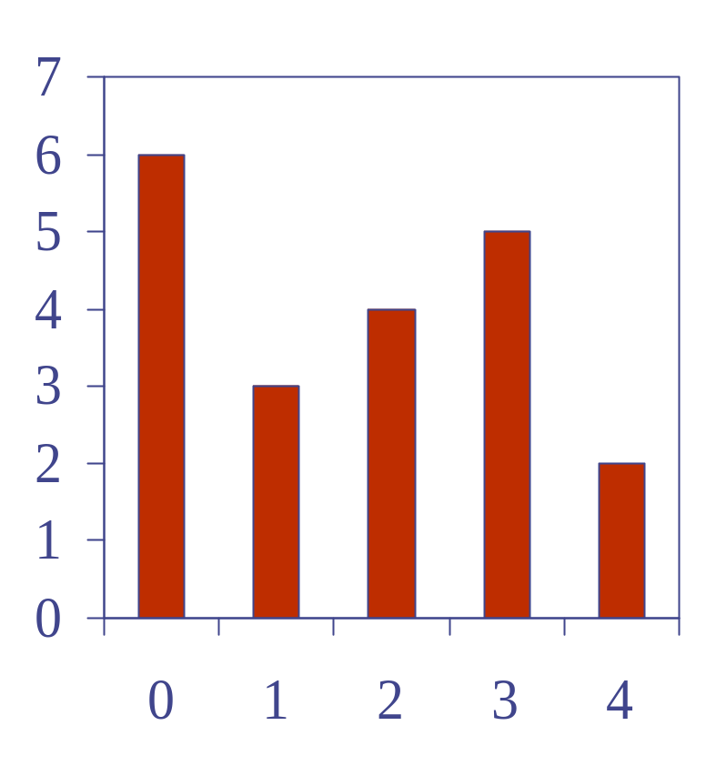
Computing Spans (not in book)
We show how to use a stack as an auxiliary data structure in an algorithm
Given an array X, the span S[i] of X[i] is the maximum number of consecutive elements X[j] immediately preceding X[i] and such that X[j] ≤ X[i]
Spans have applications to financial analysis
  E.g., stock at 52-week high
X
6 | 3 | 4 | 5 | 2
1 | 1 | 2 | 3 | 1
S

Slide 15
Quadratic Algorithm
Algorithm spans1(X, n)
Input array X of n integers
Output array S of spans of X #
S ← new array of n integers n
for i ← 0 to n − 1 do n
s ← 1 n
while s ≤ i ∧ X[i − s] ≤ X[i] 1 + 2 + …+ (n − 1)
s ← s + 1 1 + 2 + …+ (n − 1)
S[i] ← s n
return S 1
Algorithm spans1 runs in O(n²) time

Slide 16
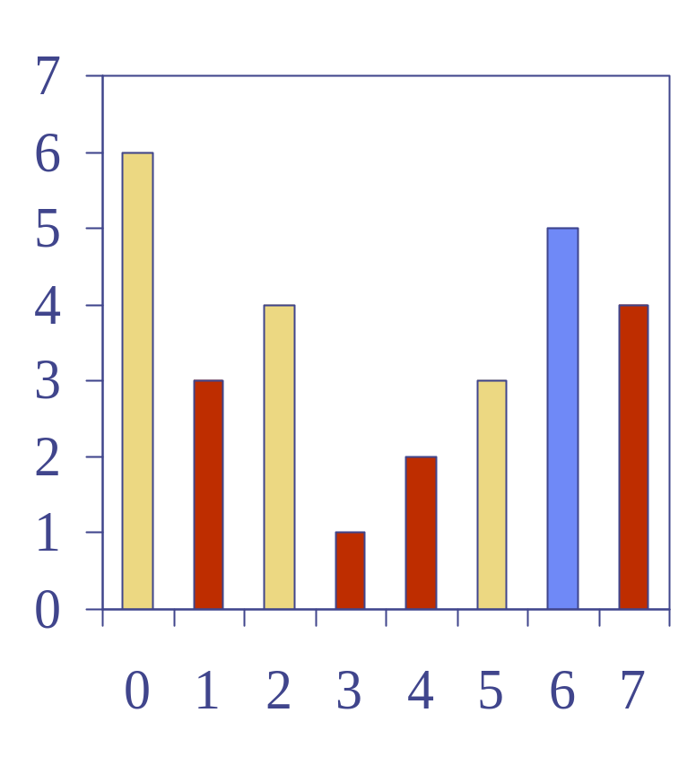
Computing Spans with a Stack
We keep in a stack the indices of the elements visible when “looking back”
We scan the array from left to right
  Let i be the current index
  We pop indices from the stack until we find index j such that X[i] < X[j]
  We set S[i] ← i − j
  We push x onto the stack

Slide 17
Linear Algorithm
Each index of the array
  Is pushed into the stack exactly one
  Is popped from the stack at most once
The statements in the while-loop are executed at most n times
Algorithm spans2 runs in O(n) time
Algorithm spans2(X, n) #
S ← new array of n integers n
A ← new empty stack 1
for i ← 0 to n − 1 do n
while (¬A.isEmpty() ∧
X[A.top()] ≤ X[i] ) do n
A.pop() n
if A.isEmpty() then n
S[i] ← i + 1 n
else
S[i] ← i − A.top() n
A.push(i) n
return S 1

