Slide 1
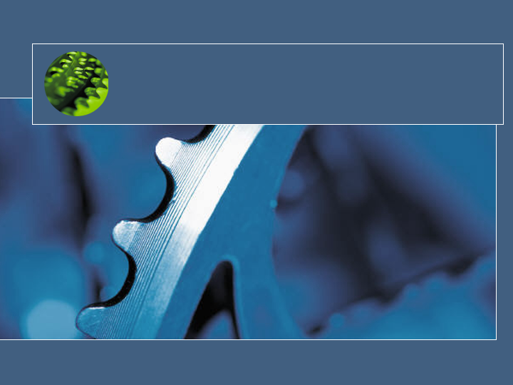
Stacks and Queues
CSC220 Data Structure
Winter 2004-5

Slide 2
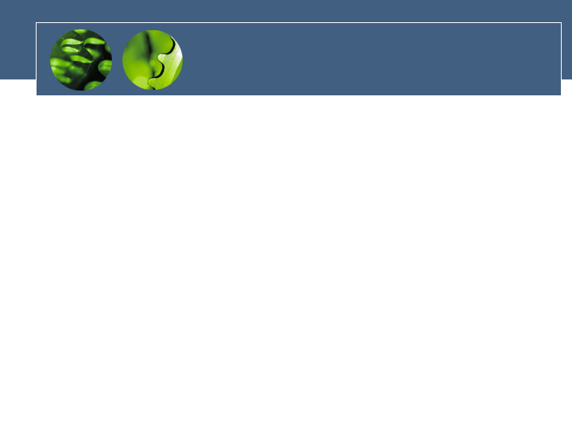
Abstract Data Type
Abstract Data Type as a design tool
Concerns only on the important concept or model
No concern on implementation details.
Stack & Queue is an example of ADT
An array is not ADT.

Slide 3
What is the difference?
Stack & Queue vs. Array
  Arrays are data storage structures while stacks and queues are specialized DS and used as programmer’s tools.
Stack – a container that allows push and pop
Queue - a container that allows enqueue and dequeue
No concern on implementation details.
In an array any item can be accessed, while in these data structures access is restricted.
They are more abstract than arrays.

Slide 4
Questions?
Array is not ADT
Is Linked list ADT?
Is Binary-tree ADT?
Is Hash table ADT?
What about graph?

Slide 5
Stacks
Allows access to only the last item inserted.
An item is inserted or removed from the stack from one end called the “top” of the stack.
This mechanism is called Last-In-First-Out (LIFO).
A Stack Applet example

Slide 6
Stack operations
Placing a data item on the top is called “pushing”, while removing an item from the top is called “popping” it.
push and pop are the primary stack operations.
Some of the applications are : microprocessors, some older calculators etc.

Slide 7
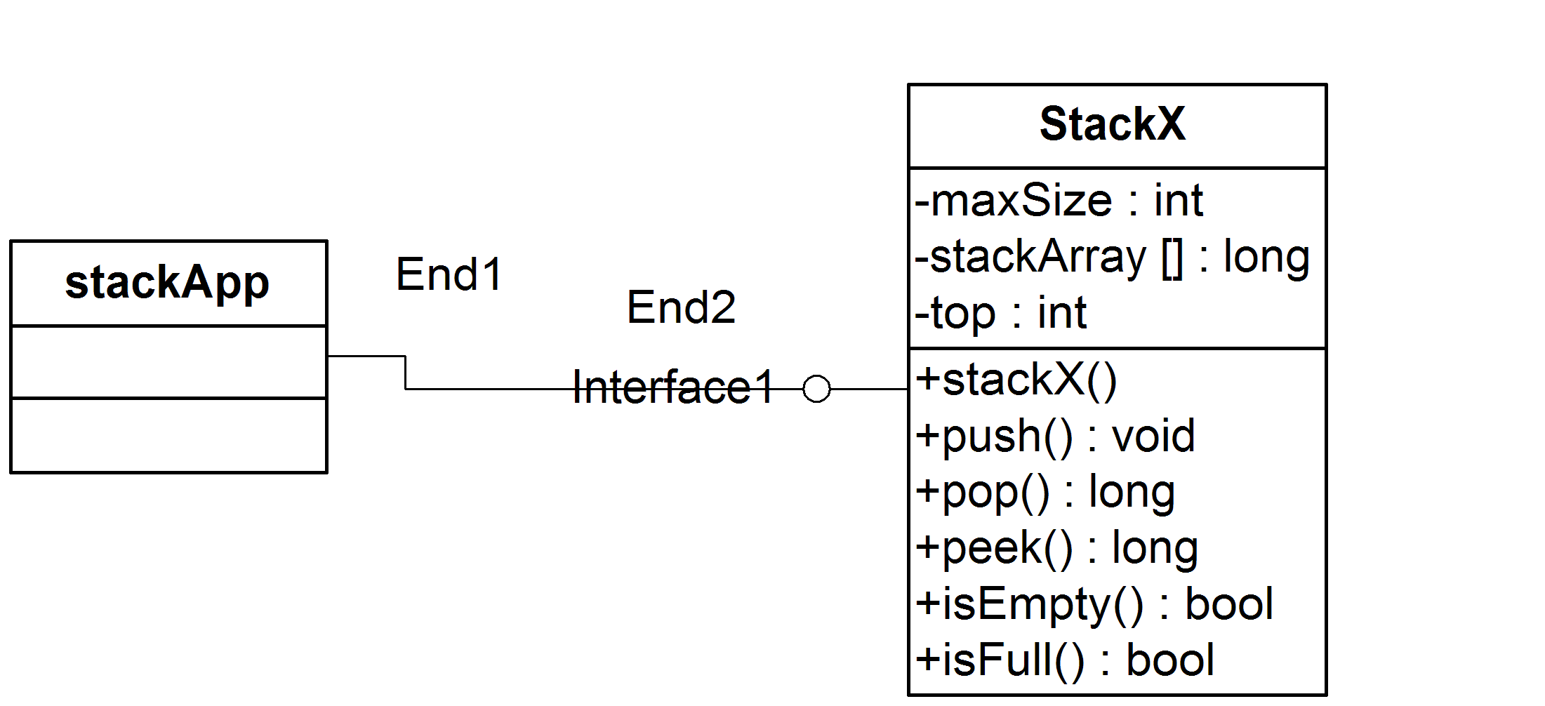
Example of Stack codes
First example stack ADT and implementation
C:\Documents and Settings\box\My Documents\CS\CSC\220\ReaderPrograms\ReaderFiles\Chap04\Stack\stack.java
push and pop operations are performed in O(1) time.

Slide 8
Example of Stack codes
Reversed word
What is it?
ABC -> CBA
  C:\Documents and Settings\box\My Documents\CS\CSC\220\ReaderPrograms\ReaderFiles\Chap04\Reverse\reverse.java

Slide 9
Example of Stack codes
BracketChecker (balancer)
A syntax checker (compiler) that understands a language containing any strings with balanced brackets ‘{‘ ‘[‘ ‘(‘ and ‘)’, ‘]’, ‘}’
  S -> Bl S1 Br
  S1 -> Bl string Br
  Bl -> ‘{‘ | ‘[‘ | ‘(‘
  Br -> ‘)’, | ‘]’, | ‘}’
  C:\Documents and Settings\box\My Documents\CS\CSC\220\ReaderPrograms\ReaderFiles\Chap04\Brackets\brackets.java

Slide 10
Queues
Queue is an ADT data structure similar to stack, except that the first item to be inserted is the first one to be removed.
This mechanism is called First-In-First-Out (FIFO).
Placing an item in a queue is called “insertion or enqueue”, which is done at the end of the queue called “rear”.
Removing an item from a queue is called “deletion or dequeue”, which is done at the other end of the queue called “front”.
Some of the applications are : printer queue, keystroke queue, etc.

Slide 11
Circular Queue
When a new item is inserted at the rear, the pointer to rear moves upwards.
Similarly, when an item is deleted from the queue the front arrow moves downwards.
After a few insert and delete operations the rear might reach the end of the queue and no more items can be inserted although the items from the front of the queue have been deleted and there is space in the queue.

Slide 12
Circular Queue
To solve this problem, queues implement wrapping around. Such queues are called Circular Queues.
Both the front and the rear pointers wrap around to the beginning of the array.
It is also called as “Ring buffer”.
Items can inserted and deleted from a queue in O(1) time.

Slide 13
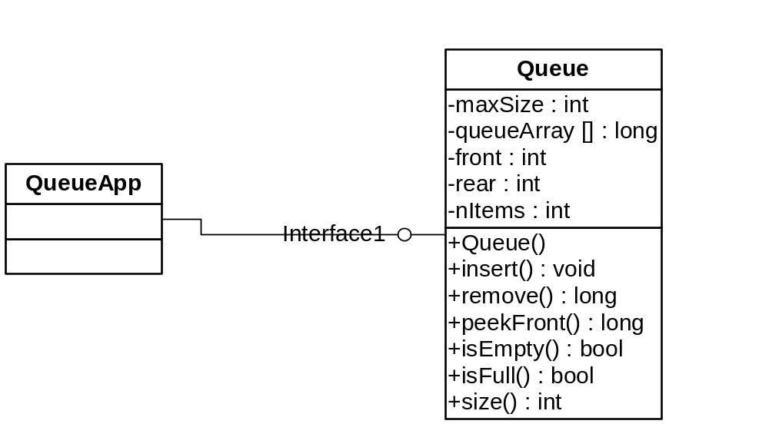
Queue Example

Slide 14
Queue sample code
C:\Documents and Settings\box\My Documents\CS\CSC\220\ReaderPrograms\ReaderFiles\Chap04\Queue\queue.java

Slide 15
Various Queues
Normal queue (FIFO)
Circular Queue (Normal Queue)
Double-ended Queue (Deque)
Priority Queue

Slide 16
Deque
It is a double-ended queue.
Items can be inserted and deleted from either ends.
More versatile data structure than stack or queue.
E.g. policy-based application (e.g. low priority go to the end, high go to the front)
In a case where you want to sort the queue once in a while, What sorting algorithm will you use?

Slide 17
Priority Queues
More specialized data structure.
Similar to Queue, having front and rear.
Items are removed from the front.
Items are ordered by key value so that the item with the lowest key (or highest) is always at the front.
Items are inserted in proper position to maintain the order.
Let’s discuss complexity

Slide 18
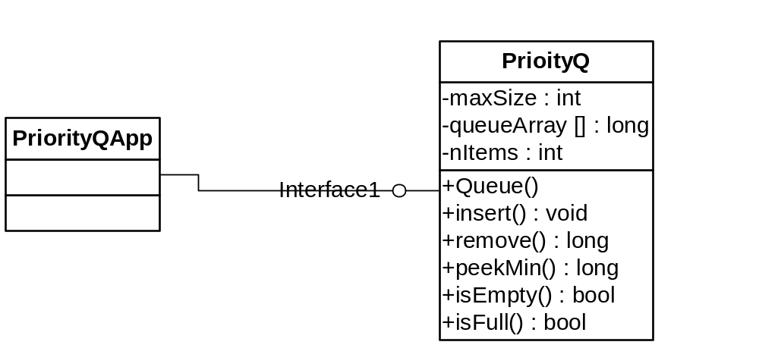
Priority Queue Example

Slide 19
Priority Queues
Used in multitasking operating system.
They are generally represented using “heap” data structure.
Insertion runs in O(n) time, deletion in O(1) time.
C:\Documents and Settings\box\My Documents\CS\CSC\220\ReaderPrograms\ReaderFiles\Chap04\PriorityQ\priorityQ.java

Slide 20
Parsing Arithmetic Expressions
2 + 3
2 + 4 * 5
((2 + 4) * 7) + 3* (9 – 5))
Infix vs postfix
Why do we want to do this transformation?
2 3 +
2 4 5 * +
2 4 + 7 * 3 9 5 - * +

Slide 21
Infix to postfix
Read ch from input until empty
  If ch is arg , output = output + arg
  If ch is “(“, push ‘(‘;
  If ch is op and higher than top push ch
  If ch is “)” or end of input,
    output = output + pop() until empty or top is “(“
  Read next input
C:\Documents and Settings\box\My Documents\CS\CSC\220\ReaderPrograms\ReaderFiles\Chap04\Postfix\postfix.java

Slide 22
Postfix eval
5 + 2 * 3 -> 5 2 3 * +
Algorithm
  While input is not empty
  If ch is number , push (ch)
  Else
    Pop (a)
    Pop(b)
    Eval (ch, a, b)
C:\Documents and Settings\box\My Documents\CS\CSC\220\ReaderPrograms\ReaderFiles\Chap04\Postfix\postfix.java

Slide 23
Quick XML Review
XML – Wave of the future

Slide 24
Another Real world example
<?xml version = "1.0"?>
<!-- An author -->
<author>
<name gender = "male">
<first> Art </first>
<last> Gittleman </last>
</name>
</author>

