Slide 1
Regression
Hung-yi Lee
李宏毅
Notes:
Regression 回归
Case Study 案例研究
Stock Market Forecast 股市预测
Dow Jones Industrial Average at tomorrow 明天的道琼斯工业平均指数
Self-driving Car
Recommendation
Estimating the Combat Power (CP) of a pokemon after evolution 评估宝可梦进化后的战斗力 (CP)
feature 特征
weight 权重
bias 偏差
Goodness of Function 函数优度
Training Data: 10 pokemons 训练数据：10 只 Pokemon
Estimated y based on input function 根据输入函数估计 y
Estimation error 估计误差
The color represents L(𝑤,𝑏). 颜色代表 L(𝑤,𝑏)。
Gradient Descent 梯度下降
Negative 负
Positive 正
Increase w 增加
Decrease w 减少
Local optimal 局部最优
not global optimal 不是全局最优
Worry 担心
Don’t worry. In linear regression, the loss function L is convex. 别担心。在线性回归中，损失函数 L 是凸函数。
Formulation of 𝜕𝐿∕𝜕𝑤 and 𝜕𝐿∕𝜕𝑏 𝜕𝐿∕𝜕𝑤 和 𝜕𝐿∕𝜕𝑏 的公式
Generalization 概括
What we really care about is the error on new data (testing data) 我们真正关心的是新数据（测试数据）上的错误
Better! Could it be even better? 更好！还能更好吗？
Slightly better. 稍微好一点。
How about more complex model? 更复杂的模型怎么样？
The results become worse ... 结果变得更糟......
A more complex model yields lower error on training data. 更复杂的模型在训练数据上产生的错误更少。
If we can truly find the best function 如果我们真的能找到最好的函数
A more complex model does not always lead to better performance on testing data. 更复杂的模型并不总是能在测试数据上带来更好的表现。
This is Overfitting. 这就是过度拟合。
Select suitable model 选择合适的模型
There is some hidden factors not considered in the previous model …… 其中存在一些先前模型未考虑到的隐藏因素……
Pidgey 波波
Eevee 伊布
Weedle 威德尔
Caterpie 卡特皮
Regularization 正则化
The functions with smaller 𝑤_𝑖 are better 𝑤_𝑖 越小的函数越好
Why smooth functions are preferred? 为什么更倾向于平滑函数？
If some noises corrupt input xi when testing 如果测试时某些噪声破坏了输入 xi
A smoother function has less influence. 更平滑的函数影响较小。
Training error: larger𝜆, considering the training error less 训练误差：𝜆越大，考虑到训练误差越小
We prefer smooth function, but don’t be too smooth. 我们更喜欢平滑的函数，但不要太平滑。
Pokemon: Original CP and species almost decide the CP after evolution (there are probably other hidden factors) 口袋妖怪：原始 CP 和物种几乎决定了进化后的 CP（可能还有其他隐藏因素）
Gradient descent 梯度下降
Following lectures: theory and tips 接下来的讲座：理论和技巧
Overfitting and Regularization 过度拟合和正则化
Following lectures: more theory behind these 接下来的讲座：这些背后的更多理论
We finally get average error = 11.1 on the testing data 我们最终在测试数据上得到平均误差 = 11.1
How about another set of new data? Underestimate? Overestimate? 另一组新数据怎么样？低估？高估？
Following lectures: validation 接下来的讲座：验证

Slide 2

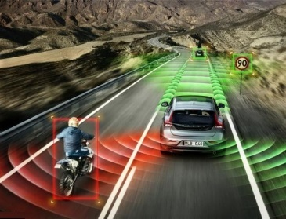


Regression: Output a scalar
Stock Market Forecast
Self-driving Car
Recommendation
Dow Jones Industrial Average at tomorrow
$$f\left( \right)=$$
$$f\left( \right)=$$
方向盤角度
$$f\left( \right)=$$
購買可能性
使用者 A
商品 B
Notes:
Regression 回归
Case Study 案例研究
Stock Market Forecast 股市预测
Dow Jones Industrial Average at tomorrow 明天的道琼斯工业平均指数
Self-driving Car
Recommendation
Estimating the Combat Power (CP) of a pokemon after evolution 评估宝可梦进化后的战斗力 (CP)
feature 特征
weight 权重
bias 偏差
Goodness of Function 函数优度
Training Data: 10 pokemons 训练数据：10 只 Pokemon
Estimated y based on input function 根据输入函数估计 y
Estimation error 估计误差
The color represents L(𝑤,𝑏). 颜色代表 L(𝑤,𝑏)。
Gradient Descent 梯度下降
Negative 负
Positive 正
Increase w 增加
Decrease w 减少
Local optimal 局部最优
not global optimal 不是全局最优
Worry 担心
Don’t worry. In linear regression, the loss function L is convex. 别担心。在线性回归中，损失函数 L 是凸函数。
Formulation of 𝜕𝐿∕𝜕𝑤 and 𝜕𝐿∕𝜕𝑏 𝜕𝐿∕𝜕𝑤 和 𝜕𝐿∕𝜕𝑏 的公式
Generalization 概括
What we really care about is the error on new data (testing data) 我们真正关心的是新数据（测试数据）上的错误
Better! Could it be even better? 更好！还能更好吗？
Slightly better. 稍微好一点。
How about more complex model? 更复杂的模型怎么样？
The results become worse ... 结果变得更糟......
A more complex model yields lower error on training data. 更复杂的模型在训练数据上产生的错误更少。
If we can truly find the best function 如果我们真的能找到最好的函数
A more complex model does not always lead to better performance on testing data. 更复杂的模型并不总是能在测试数据上带来更好的表现。
This is Overfitting. 这就是过度拟合。
Select suitable model 选择合适的模型
There is some hidden factors not considered in the previous model …… 其中存在一些先前模型未考虑到的隐藏因素……
Pidgey 波波
Eevee 伊布
Weedle 威德尔
Caterpie 卡特皮
Regularization 正则化
The functions with smaller 𝑤_𝑖 are better 𝑤_𝑖 越小的函数越好
Why smooth functions are preferred? 为什么更倾向于平滑函数？
If some noises corrupt input xi when testing 如果测试时某些噪声破坏了输入 xi
A smoother function has less influence. 更平滑的函数影响较小。
Training error: larger𝜆, considering the training error less 训练误差：𝜆越大，考虑到训练误差越小
We prefer smooth function, but don’t be too smooth. 我们更喜欢平滑的函数，但不要太平滑。
Pokemon: Original CP and species almost decide the CP after evolution (there are probably other hidden factors) 口袋妖怪：原始 CP 和物种几乎决定了进化后的 CP（可能还有其他隐藏因素）
Gradient descent 梯度下降
Following lectures: theory and tips 接下来的讲座：理论和技巧
Overfitting and Regularization 过度拟合和正则化
Following lectures: more theory behind these 接下来的讲座：这些背后的更多理论
We finally get average error = 11.1 on the testing data 我们最终在测试数据上得到平均误差 = 11.1
How about another set of new data? Underestimate? Overestimate? 另一组新数据怎么样？低估？高估？
Following lectures: validation 接下来的讲座：验证

Slide 3








Example Application
Estimating the Combat Power (CP) of a pokemon after evolution
$$x_{cp}$$
CP after evolution
$$f\left( \right)=$$
$$y$$
$$x_{s}$$
$$x$$
$$x_{hp}$$
$$x_{w}$$
$$x_{h}$$
Notes:
Regression 回归
Case Study 案例研究
Stock Market Forecast 股市预测
Dow Jones Industrial Average at tomorrow 明天的道琼斯工业平均指数
Self-driving Car
Recommendation
Estimating the Combat Power (CP) of a pokemon after evolution 评估宝可梦进化后的战斗力 (CP)
feature 特征
weight 权重
bias 偏差
Goodness of Function 函数优度
Training Data: 10 pokemons 训练数据：10 只 Pokemon
Estimated y based on input function 根据输入函数估计 y
Estimation error 估计误差
The color represents L(𝑤,𝑏). 颜色代表 L(𝑤,𝑏)。
Gradient Descent 梯度下降
Negative 负
Positive 正
Increase w 增加
Decrease w 减少
Local optimal 局部最优
not global optimal 不是全局最优
Worry 担心
Don’t worry. In linear regression, the loss function L is convex. 别担心。在线性回归中，损失函数 L 是凸函数。
Formulation of 𝜕𝐿∕𝜕𝑤 and 𝜕𝐿∕𝜕𝑏 𝜕𝐿∕𝜕𝑤 和 𝜕𝐿∕𝜕𝑏 的公式
Generalization 概括
What we really care about is the error on new data (testing data) 我们真正关心的是新数据（测试数据）上的错误
Better! Could it be even better? 更好！还能更好吗？
Slightly better. 稍微好一点。
How about more complex model? 更复杂的模型怎么样？
The results become worse ... 结果变得更糟......
A more complex model yields lower error on training data. 更复杂的模型在训练数据上产生的错误更少。
If we can truly find the best function 如果我们真的能找到最好的函数
A more complex model does not always lead to better performance on testing data. 更复杂的模型并不总是能在测试数据上带来更好的表现。
This is Overfitting. 这就是过度拟合。
Select suitable model 选择合适的模型
There is some hidden factors not considered in the previous model …… 其中存在一些先前模型未考虑到的隐藏因素……
Pidgey 波波
Eevee 伊布
Weedle 威德尔
Caterpie 卡特皮
Regularization 正则化
The functions with smaller 𝑤_𝑖 are better 𝑤_𝑖 越小的函数越好
Why smooth functions are preferred? 为什么更倾向于平滑函数？
If some noises corrupt input xi when testing 如果测试时某些噪声破坏了输入 xi
A smoother function has less influence. 更平滑的函数影响较小。
Training error: larger𝜆, considering the training error less 训练误差：𝜆越大，考虑到训练误差越小
We prefer smooth function, but don’t be too smooth. 我们更喜欢平滑的函数，但不要太平滑。
Pokemon: Original CP and species almost decide the CP after evolution (there are probably other hidden factors) 口袋妖怪：原始 CP 和物种几乎决定了进化后的 CP（可能还有其他隐藏因素）
Gradient descent 梯度下降
Following lectures: theory and tips 接下来的讲座：理论和技巧
Overfitting and Regularization 过度拟合和正则化
Following lectures: more theory behind these 接下来的讲座：这些背后的更多理论
We finally get average error = 11.1 on the testing data 我们最终在测试数据上得到平均误差 = 11.1
How about another set of new data? Underestimate? Overestimate? 另一组新数据怎么样？低估？高估？
Following lectures: validation 接下来的讲座：验证

Slide 4
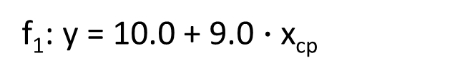

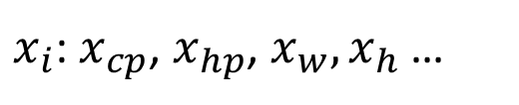
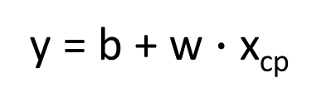

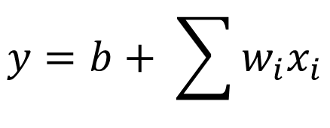
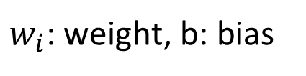
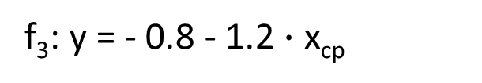
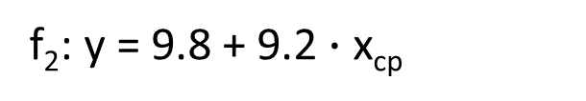

Step 1: Model
w and b are parameters (can be any value)
y = b + w $∙$ x_{cp}
f₁: y = 10.0 + 9.0 $∙$ x_{cp}
A set of function
Model
f₂: y = 9.8 + 9.2 $∙$ x_{cp}
f₃: y = - 0.8 - 1.2 $∙$ x_{cp}
…… infinite
CP after evolution
$$x$$
$$y$$
$$f\left( \right)=$$
$x_{i}$: $x_{cp}$, $x_{hp}$, $x_{w},x_{h}$ …
$$y=b+ \sum{w_{i}x_{i}}$$
Linear model:
feature
$w_{i}$: weight, b: bias
Notes:
Regression 回归
Case Study 案例研究
Stock Market Forecast 股市预测
Dow Jones Industrial Average at tomorrow 明天的道琼斯工业平均指数
Self-driving Car
Recommendation
Estimating the Combat Power (CP) of a pokemon after evolution 评估宝可梦进化后的战斗力 (CP)
feature 特征
weight 权重
bias 偏差
线性模型和多个特征值之前的关系：𝑦=𝑏+ ∑▒〖𝑤_𝑖 𝑥_𝑖 〗
Goodness of Function 函数优度
Training Data: 10 pokemons 训练数据：10 只 Pokemon
Estimated y based on input function 根据输入函数估计 y
Estimation error 估计误差
The color represents L(𝑤,𝑏). 颜色代表 L(𝑤,𝑏)。
Gradient Descent 梯度下降
Negative 负
Positive 正
Increase w 增加
Decrease w 减少
Local optimal 局部最优
not global optimal 不是全局最优
Worry 担心
Don’t worry. In linear regression, the loss function L is convex. 别担心。在线性回归中，损失函数 L 是凸函数。
Formulation of 𝜕𝐿∕𝜕𝑤 and 𝜕𝐿∕𝜕𝑏 𝜕𝐿∕𝜕𝑤 和 𝜕𝐿∕𝜕𝑏 的公式
Generalization 概括
What we really care about is the error on new data (testing data) 我们真正关心的是新数据（测试数据）上的错误
Better! Could it be even better? 更好！还能更好吗？
Slightly better. 稍微好一点。
How about more complex model? 更复杂的模型怎么样？
The results become worse ... 结果变得更糟......
A more complex model yields lower error on training data. 更复杂的模型在训练数据上产生的错误更少。
If we can truly find the best function 如果我们真的能找到最好的函数
A more complex model does not always lead to better performance on testing data. 更复杂的模型并不总是能在测试数据上带来更好的表现。
This is Overfitting. 这就是过度拟合。
Select suitable model 选择合适的模型
There is some hidden factors not considered in the previous model …… 其中存在一些先前模型未考虑到的隐藏因素……
Pidgey 波波
Eevee 伊布
Weedle 威德尔
Caterpie 卡特皮
Regularization 正则化
The functions with smaller 𝑤_𝑖 are better 𝑤_𝑖 越小的函数越好
Why smooth functions are preferred? 为什么更倾向于平滑函数？
If some noises corrupt input xi when testing 如果测试时某些噪声破坏了输入 xi
A smoother function has less influence. 更平滑的函数影响较小。
Training error: larger𝜆, considering the training error less 训练误差：𝜆越大，考虑到训练误差越小
We prefer smooth function, but don’t be too smooth. 我们更喜欢平滑的函数，但不要太平滑。
Pokemon: Original CP and species almost decide the CP after evolution (there are probably other hidden factors) 口袋妖怪：原始 CP 和物种几乎决定了进化后的 CP（可能还有其他隐藏因素）
Gradient descent 梯度下降
Following lectures: theory and tips 接下来的讲座：理论和技巧
Overfitting and Regularization 过度拟合和正则化
Following lectures: more theory behind these 接下来的讲座：这些背后的更多理论
We finally get average error = 11.1 on the testing data 我们最终在测试数据上得到平均误差 = 11.1
How about another set of new data? Underestimate? Overestimate? 另一组新数据怎么样？低估？高估？
Following lectures: validation 接下来的讲座：验证

Slide 5
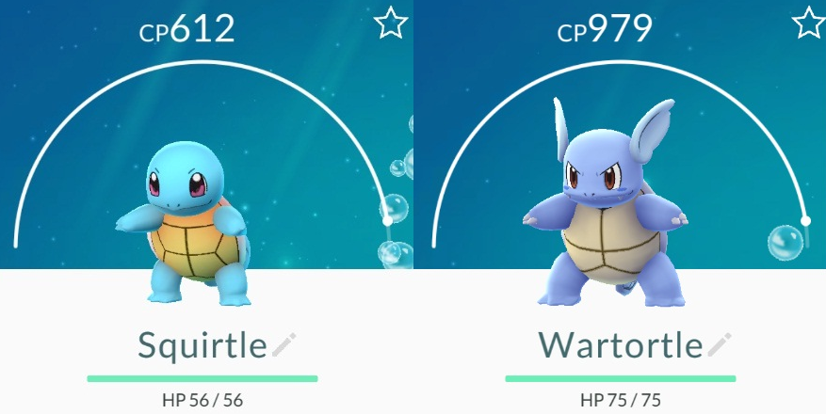
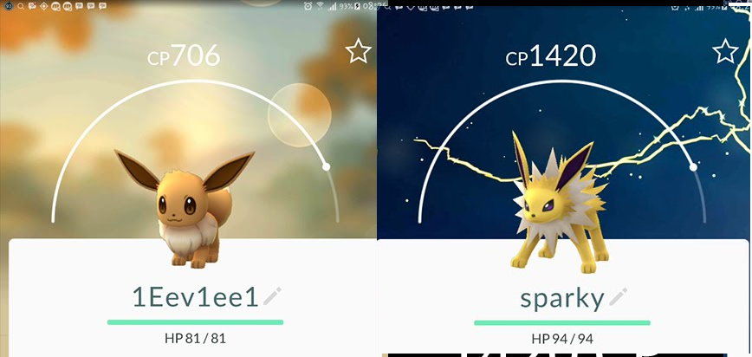




Step 2: Goodness of Function
y = b + w $∙$ x_{cp}
A set of function
Model
function
input:
function
Output (scalar):
$${\hat{y}}^{1}$$
$$x^{1}$$
$${\hat{y}}^{2}$$
$$x^{2}$$
Training
Data
Notes:
Regression 回归
Case Study 案例研究
Stock Market Forecast 股市预测
Dow Jones Industrial Average at tomorrow 明天的道琼斯工业平均指数
Self-driving Car
Recommendation
Estimating the Combat Power (CP) of a pokemon after evolution 评估宝可梦进化后的战斗力 (CP)
feature 特征
weight 权重
bias 偏差
线性模型和多个特征值之前的关系：𝑦=𝑏+ ∑▒〖𝑤_𝑖 𝑥_𝑖 〗
Goodness of Function 函数优度
Training Data: 10 pokemons 训练数据：10 只 Pokemon
Estimated y based on input function 根据输入函数估计 y
Estimation error 估计误差
The color represents L(𝑤,𝑏). 颜色代表 L(𝑤,𝑏)。
Gradient Descent 梯度下降
Negative 负
Positive 正
Increase w 增加
Decrease w 减少
Local optimal 局部最优
not global optimal 不是全局最优
Worry 担心
Don’t worry. In linear regression, the loss function L is convex. 别担心。在线性回归中，损失函数 L 是凸函数。
Formulation of 𝜕𝐿∕𝜕𝑤 and 𝜕𝐿∕𝜕𝑏 𝜕𝐿∕𝜕𝑤 和 𝜕𝐿∕𝜕𝑏 的公式
Generalization 概括
What we really care about is the error on new data (testing data) 我们真正关心的是新数据（测试数据）上的错误
Better! Could it be even better? 更好！还能更好吗？
Slightly better. 稍微好一点。
How about more complex model? 更复杂的模型怎么样？
The results become worse ... 结果变得更糟......
A more complex model yields lower error on training data. 更复杂的模型在训练数据上产生的错误更少。
If we can truly find the best function 如果我们真的能找到最好的函数
A more complex model does not always lead to better performance on testing data. 更复杂的模型并不总是能在测试数据上带来更好的表现。
This is Overfitting. 这就是过度拟合。
Select suitable model 选择合适的模型
There is some hidden factors not considered in the previous model …… 其中存在一些先前模型未考虑到的隐藏因素……
Pidgey 波波
Eevee 伊布
Weedle 威德尔
Caterpie 卡特皮
Regularization 正则化
The functions with smaller 𝑤_𝑖 are better 𝑤_𝑖 越小的函数越好
Why smooth functions are preferred? 为什么更倾向于平滑函数？
If some noises corrupt input xi when testing 如果测试时某些噪声破坏了输入 xi
A smoother function has less influence. 更平滑的函数影响较小。
Training error: larger𝜆, considering the training error less 训练误差：𝜆越大，考虑到训练误差越小
We prefer smooth function, but don’t be too smooth. 我们更喜欢平滑的函数，但不要太平滑。
Pokemon: Original CP and species almost decide the CP after evolution (there are probably other hidden factors) 口袋妖怪：原始 CP 和物种几乎决定了进化后的 CP（可能还有其他隐藏因素）
Gradient descent 梯度下降
Following lectures: theory and tips 接下来的讲座：理论和技巧
Overfitting and Regularization 过度拟合和正则化
Following lectures: more theory behind these 接下来的讲座：这些背后的更多理论
We finally get average error = 11.1 on the testing data 我们最终在测试数据上得到平均误差 = 11.1
How about another set of new data? Underestimate? Overestimate? 另一组新数据怎么样？低估？高估？
Following lectures: validation 接下来的讲座：验证

Slide 6
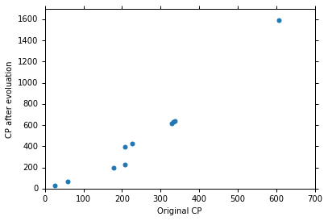







Step 2: Goodness of Function
Training Data: 10 pokemons
$$\left(x^{1},{\hat{y}}^{1}\right)$$
$$\left(x^{2},{\hat{y}}^{2}\right)$$
$$\left(x_{cp}^{n},{\hat{y}}^{n}\right)$$
$$……$$
$$\hat{y}$$
$$\left(x^{10},{\hat{y}}^{10}\right)$$
This is real data.
$$x_{cp}$$
Source: https://www.openintro.org/stat/data/?data=pokemon
Notes:
Regression 回归
Case Study 案例研究
Stock Market Forecast 股市预测
Dow Jones Industrial Average at tomorrow 明天的道琼斯工业平均指数
Self-driving Car
Recommendation
Estimating the Combat Power (CP) of a pokemon after evolution 评估宝可梦进化后的战斗力 (CP)
feature 特征
weight 权重
bias 偏差
线性模型和多个特征值之前的关系：𝑦=𝑏+ ∑▒〖𝑤_𝑖 𝑥_𝑖 〗
Goodness of Function 函数优度
Training Data: 10 pokemons 训练数据：10 只 Pokemon
Estimated y based on input function 根据输入函数估计 y
Estimation error 估计误差
The color represents L(𝑤,𝑏). 颜色代表 L(𝑤,𝑏)。
Gradient Descent 梯度下降
Negative 负
Positive 正
Increase w 增加
Decrease w 减少
Local optimal 局部最优
not global optimal 不是全局最优
Worry 担心
Don’t worry. In linear regression, the loss function L is convex. 别担心。在线性回归中，损失函数 L 是凸函数。
Formulation of 𝜕𝐿∕𝜕𝑤 and 𝜕𝐿∕𝜕𝑏 𝜕𝐿∕𝜕𝑤 和 𝜕𝐿∕𝜕𝑏 的公式
Generalization 概括
What we really care about is the error on new data (testing data) 我们真正关心的是新数据（测试数据）上的错误
Better! Could it be even better? 更好！还能更好吗？
Slightly better. 稍微好一点。
How about more complex model? 更复杂的模型怎么样？
The results become worse ... 结果变得更糟......
A more complex model yields lower error on training data. 更复杂的模型在训练数据上产生的错误更少。
If we can truly find the best function 如果我们真的能找到最好的函数
A more complex model does not always lead to better performance on testing data. 更复杂的模型并不总是能在测试数据上带来更好的表现。
This is Overfitting. 这就是过度拟合。
Select suitable model 选择合适的模型
There is some hidden factors not considered in the previous model …… 其中存在一些先前模型未考虑到的隐藏因素……
Pidgey 波波
Eevee 伊布
Weedle 威德尔
Caterpie 卡特皮
Regularization 正则化
The functions with smaller 𝑤_𝑖 are better 𝑤_𝑖 越小的函数越好
Why smooth functions are preferred? 为什么更倾向于平滑函数？
If some noises corrupt input xi when testing 如果测试时某些噪声破坏了输入 xi
A smoother function has less influence. 更平滑的函数影响较小。
Training error: larger𝜆, considering the training error less 训练误差：𝜆越大，考虑到训练误差越小
We prefer smooth function, but don’t be too smooth. 我们更喜欢平滑的函数，但不要太平滑。
Pokemon: Original CP and species almost decide the CP after evolution (there are probably other hidden factors) 口袋妖怪：原始 CP 和物种几乎决定了进化后的 CP（可能还有其他隐藏因素）
Gradient descent 梯度下降
Following lectures: theory and tips 接下来的讲座：理论和技巧
Overfitting and Regularization 过度拟合和正则化
Following lectures: more theory behind these 接下来的讲座：这些背后的更多理论
We finally get average error = 11.1 on the testing data 我们最终在测试数据上得到平均误差 = 11.1
How about another set of new data? Underestimate? Overestimate? 另一组新数据怎么样？低估？高估？
Following lectures: validation 接下来的讲座：验证

Slide 7

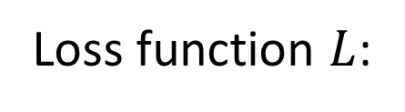

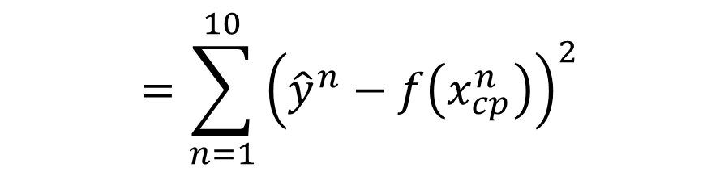
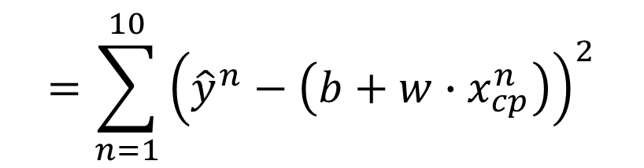
Step 2: Goodness of Function
y = b + w $∙$ x_{cp}
A set of function
Loss function $L$:
Model
Input: a function, output: how bad it is
Estimation error
$$=\sum_{n=1}^{10}{{\left({\hat{y}}^{n}−f\left(x_{cp}^{n}\right)\right)}^{2}}$$
Goodness of function f
$$L\left(f\right)$$
Estimated y based on input function
Sum over examples
Training
Data
$$L\left(w,b\right)$$
$$=\sum_{n=1}^{10}{{\left({\hat{y}}^{n}−\left(b+w∙x_{cp}^{n}\right)\right)}^{2}}$$
Notes:
Regression 回归
Case Study 案例研究
Stock Market Forecast 股市预测
Dow Jones Industrial Average at tomorrow 明天的道琼斯工业平均指数
Self-driving Car
Recommendation
Estimating the Combat Power (CP) of a pokemon after evolution 评估宝可梦进化后的战斗力 (CP)
feature 特征
weight 权重
bias 偏差
线性模型和多个特征值之前的关系：𝑦=𝑏+ ∑▒〖𝑤_𝑖 𝑥_𝑖 〗
Goodness of Function 函数优度
Training Data: 10 pokemons 训练数据：10 只 Pokemon
Estimated y based on input function 根据输入函数估计 y
Estimation error 估计误差
The color represents L(𝑤,𝑏). 颜色代表 L(𝑤,𝑏)。
Gradient Descent 梯度下降
Negative 负
Positive 正
Increase w 增加
Decrease w 减少
Local optimal 局部最优
not global optimal 不是全局最优
Worry 担心
Don’t worry. In linear regression, the loss function L is convex. 别担心。在线性回归中，损失函数 L 是凸函数。
Formulation of 𝜕𝐿∕𝜕𝑤 and 𝜕𝐿∕𝜕𝑏 𝜕𝐿∕𝜕𝑤 和 𝜕𝐿∕𝜕𝑏 的公式
Generalization 概括
What we really care about is the error on new data (testing data) 我们真正关心的是新数据（测试数据）上的错误
Better! Could it be even better? 更好！还能更好吗？
Slightly better. 稍微好一点。
How about more complex model? 更复杂的模型怎么样？
The results become worse ... 结果变得更糟......
A more complex model yields lower error on training data. 更复杂的模型在训练数据上产生的错误更少。
If we can truly find the best function 如果我们真的能找到最好的函数
A more complex model does not always lead to better performance on testing data. 更复杂的模型并不总是能在测试数据上带来更好的表现。
This is Overfitting. 这就是过度拟合。
Select suitable model 选择合适的模型
There is some hidden factors not considered in the previous model …… 其中存在一些先前模型未考虑到的隐藏因素……
Pidgey 波波
Eevee 伊布
Weedle 威德尔
Caterpie 卡特皮
Regularization 正则化
The functions with smaller 𝑤_𝑖 are better 𝑤_𝑖 越小的函数越好
Why smooth functions are preferred? 为什么更倾向于平滑函数？
If some noises corrupt input xi when testing 如果测试时某些噪声破坏了输入 xi
A smoother function has less influence. 更平滑的函数影响较小。
Training error: larger𝜆, considering the training error less 训练误差：𝜆越大，考虑到训练误差越小
We prefer smooth function, but don’t be too smooth. 我们更喜欢平滑的函数，但不要太平滑。
Pokemon: Original CP and species almost decide the CP after evolution (there are probably other hidden factors) 口袋妖怪：原始 CP 和物种几乎决定了进化后的 CP（可能还有其他隐藏因素）
Gradient descent 梯度下降
Following lectures: theory and tips 接下来的讲座：理论和技巧
Overfitting and Regularization 过度拟合和正则化
Following lectures: more theory behind these 接下来的讲座：这些背后的更多理论
We finally get average error = 11.1 on the testing data 我们最终在测试数据上得到平均误差 = 11.1
How about another set of new data? Underestimate? Overestimate? 另一组新数据怎么样？低估？高估？
Following lectures: validation 接下来的讲座：验证

Slide 8
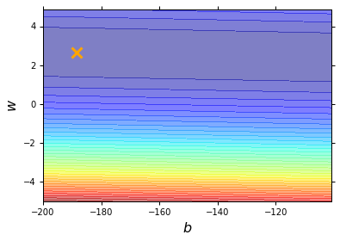
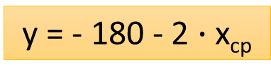
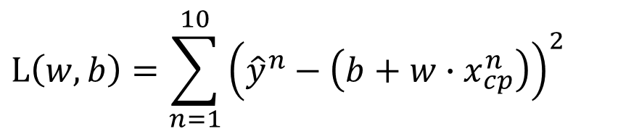
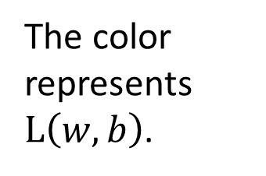
Step 2: Goodness of Function
$$L\left(w,b\right)=\sum_{n=1}^{10}{{\left({\hat{y}}^{n}−\left(b+w∙x_{cp}^{n}\right)\right)}^{2}}$$
Loss Function
Each point in the figure is a function
smallest
y = - 180 - 2 $∙$ x_{cp}
The color represents $L\left(w,b\right)$.
Very large
(true example)
Notes:
Regression 回归
Case Study 案例研究
Stock Market Forecast 股市预测
Dow Jones Industrial Average at tomorrow 明天的道琼斯工业平均指数
Self-driving Car
Recommendation
Estimating the Combat Power (CP) of a pokemon after evolution 评估宝可梦进化后的战斗力 (CP)
feature 特征
weight 权重
bias 偏差
线性模型和多个特征值之前的关系：𝑦=𝑏+ ∑▒〖𝑤_𝑖 𝑥_𝑖 〗
Goodness of Function 函数优度
Training Data: 10 pokemons 训练数据：10 只 Pokemon
Estimated y based on input function 根据输入函数估计 y
Estimation error 估计误差
The color represents L(𝑤,𝑏). 颜色代表 L(𝑤,𝑏)。
Gradient Descent 梯度下降
Negative 负
Positive 正
Increase w 增加
Decrease w 减少
Local optimal 局部最优
not global optimal 不是全局最优
Worry 担心
Don’t worry. In linear regression, the loss function L is convex. 别担心。在线性回归中，损失函数 L 是凸函数。
Formulation of 𝜕𝐿∕𝜕𝑤 and 𝜕𝐿∕𝜕𝑏 𝜕𝐿∕𝜕𝑤 和 𝜕𝐿∕𝜕𝑏 的公式
Generalization 概括
What we really care about is the error on new data (testing data) 我们真正关心的是新数据（测试数据）上的错误
Better! Could it be even better? 更好！还能更好吗？
Slightly better. 稍微好一点。
How about more complex model? 更复杂的模型怎么样？
The results become worse ... 结果变得更糟......
A more complex model yields lower error on training data. 更复杂的模型在训练数据上产生的错误更少。
If we can truly find the best function 如果我们真的能找到最好的函数
A more complex model does not always lead to better performance on testing data. 更复杂的模型并不总是能在测试数据上带来更好的表现。
This is Overfitting. 这就是过度拟合。
Select suitable model 选择合适的模型
There is some hidden factors not considered in the previous model …… 其中存在一些先前模型未考虑到的隐藏因素……
Pidgey 波波
Eevee 伊布
Weedle 威德尔
Caterpie 卡特皮
Regularization 正则化
The functions with smaller 𝑤_𝑖 are better 𝑤_𝑖 越小的函数越好
Why smooth functions are preferred? 为什么更倾向于平滑函数？
If some noises corrupt input xi when testing 如果测试时某些噪声破坏了输入 xi
A smoother function has less influence. 更平滑的函数影响较小。
Training error: larger𝜆, considering the training error less 训练误差：𝜆越大，考虑到训练误差越小
We prefer smooth function, but don’t be too smooth. 我们更喜欢平滑的函数，但不要太平滑。
Pokemon: Original CP and species almost decide the CP after evolution (there are probably other hidden factors) 口袋妖怪：原始 CP 和物种几乎决定了进化后的 CP（可能还有其他隐藏因素）
Gradient descent 梯度下降
Following lectures: theory and tips 接下来的讲座：理论和技巧
Overfitting and Regularization 过度拟合和正则化
Following lectures: more theory behind these 接下来的讲座：这些背后的更多理论
We finally get average error = 11.1 on the testing data 我们最终在测试数据上得到平均误差 = 11.1
How about another set of new data? Underestimate? Overestimate? 另一组新数据怎么样？低估？高估？
Following lectures: validation 接下来的讲座：验证

Slide 9
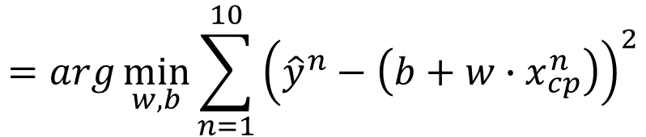

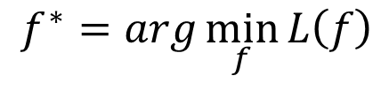

Step 3: Best Function
$$L\left(w,b\right)$$
$$=\sum_{n=1}^{10}{{\left({\hat{y}}^{n}−\left(b+w∙x_{cp}^{n}\right)\right)}^{2}}$$
A set of function
Model
Goodness of function f
Pick the “Best” Function
$$f^{∗}=\arg{\min_{f}{L\left(f\right)}}$$
Gradient Descent
Training
Data
$$w^{∗},b^{∗}=arg\min_{w,b}{L\left(w,b\right)}$$
$$=arg\min_{w,b}{\sum_{n=1}^{10}{{\left({\hat{y}}^{n}−\left(b+w∙x_{cp}^{n}\right)\right)}^{2}}}$$
Notes:
Regression 回归
Case Study 案例研究
Stock Market Forecast 股市预测
Dow Jones Industrial Average at tomorrow 明天的道琼斯工业平均指数
Self-driving Car
Recommendation
Estimating the Combat Power (CP) of a pokemon after evolution 评估宝可梦进化后的战斗力 (CP)
feature 特征
weight 权重
bias 偏差
线性模型和多个特征值之前的关系：𝑦=𝑏+ ∑▒〖𝑤_𝑖 𝑥_𝑖 〗
Goodness of Function 函数优度
Training Data: 10 pokemons 训练数据：10 只 Pokemon
Estimated y based on input function 根据输入函数估计 y
Estimation error 估计误差
The color represents L(𝑤,𝑏). 颜色代表 L(𝑤,𝑏)。
Gradient Descent 梯度下降
Negative 负
Positive 正
Increase w 增加
Decrease w 减少
Local optimal 局部最优
not global optimal 不是全局最优
Worry 担心
Don’t worry. In linear regression, the loss function L is convex. 别担心。在线性回归中，损失函数 L 是凸函数。
Formulation of 𝜕𝐿∕𝜕𝑤 and 𝜕𝐿∕𝜕𝑏 𝜕𝐿∕𝜕𝑤 和 𝜕𝐿∕𝜕𝑏 的公式
Generalization 概括
What we really care about is the error on new data (testing data) 我们真正关心的是新数据（测试数据）上的错误
Better! Could it be even better? 更好！还能更好吗？
Slightly better. 稍微好一点。
How about more complex model? 更复杂的模型怎么样？
The results become worse ... 结果变得更糟......
A more complex model yields lower error on training data. 更复杂的模型在训练数据上产生的错误更少。
If we can truly find the best function 如果我们真的能找到最好的函数
A more complex model does not always lead to better performance on testing data. 更复杂的模型并不总是能在测试数据上带来更好的表现。
This is Overfitting. 这就是过度拟合。
Select suitable model 选择合适的模型
There is some hidden factors not considered in the previous model …… 其中存在一些先前模型未考虑到的隐藏因素……
Pidgey 波波
Eevee 伊布
Weedle 威德尔
Caterpie 卡特皮
Regularization 正则化
The functions with smaller 𝑤_𝑖 are better 𝑤_𝑖 越小的函数越好
Why smooth functions are preferred? 为什么更倾向于平滑函数？
If some noises corrupt input xi when testing 如果测试时某些噪声破坏了输入 xi
A smoother function has less influence. 更平滑的函数影响较小。
Training error: larger𝜆, considering the training error less 训练误差：𝜆越大，考虑到训练误差越小
We prefer smooth function, but don’t be too smooth. 我们更喜欢平滑的函数，但不要太平滑。
Pokemon: Original CP and species almost decide the CP after evolution (there are probably other hidden factors) 口袋妖怪：原始 CP 和物种几乎决定了进化后的 CP（可能还有其他隐藏因素）
Gradient descent 梯度下降
Following lectures: theory and tips 接下来的讲座：理论和技巧
Overfitting and Regularization 过度拟合和正则化
Following lectures: more theory behind these 接下来的讲座：这些背后的更多理论
We finally get average error = 11.1 on the testing data 我们最终在测试数据上得到平均误差 = 11.1
How about another set of new data? Underestimate? Overestimate? 另一组新数据怎么样？低估？高估？
Following lectures: validation 接下来的讲座：验证

Slide 10
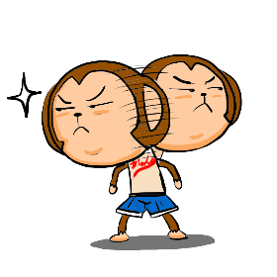
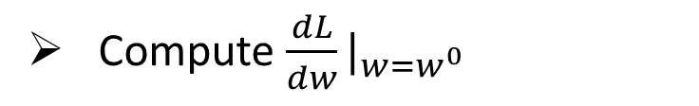

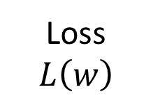
Step 3: Gradient Descent
http://chico386.pixnet.net/album/photo/171572850
$$w^{∗}=arg\min_{w}{L\left(w\right)}$$
Consider loss function 𝐿(𝑤) with one parameter w:
(Randomly) Pick an initial value w⁰
Compute $\frac{dL}{dw}|_{w=w^{0}}$
Loss
$$L\left(w\right)$$
Negative
Increase w
Positive
Decrease w
w⁰
Notes:
Regression 回归
Case Study 案例研究
Stock Market Forecast 股市预测
Dow Jones Industrial Average at tomorrow 明天的道琼斯工业平均指数
Self-driving Car
Recommendation
Estimating the Combat Power (CP) of a pokemon after evolution 评估宝可梦进化后的战斗力 (CP)
feature 特征
weight 权重
bias 偏差
线性模型和多个特征值之前的关系：𝑦=𝑏+ ∑▒〖𝑤_𝑖 𝑥_𝑖 〗
Goodness of Function 函数优度
Training Data: 10 pokemons 训练数据：10 只 Pokemon
Estimated y based on input function 根据输入函数估计 y
Estimation error 估计误差
The color represents L(𝑤,𝑏). 颜色代表 L(𝑤,𝑏)。
Gradient Descent 梯度下降
Negative 负
Positive 正
Increase w 增加
Decrease w 减少
Local optimal 局部最优
not global optimal 不是全局最优
Worry 担心
Don’t worry. In linear regression, the loss function L is convex. 别担心。在线性回归中，损失函数 L 是凸函数。
Formulation of 𝜕𝐿∕𝜕𝑤 and 𝜕𝐿∕𝜕𝑏 𝜕𝐿∕𝜕𝑤 和 𝜕𝐿∕𝜕𝑏 的公式
Generalization 概括
What we really care about is the error on new data (testing data) 我们真正关心的是新数据（测试数据）上的错误
Better! Could it be even better? 更好！还能更好吗？
Slightly better. 稍微好一点。
How about more complex model? 更复杂的模型怎么样？
The results become worse ... 结果变得更糟......
A more complex model yields lower error on training data. 更复杂的模型在训练数据上产生的错误更少。
If we can truly find the best function 如果我们真的能找到最好的函数
A more complex model does not always lead to better performance on testing data. 更复杂的模型并不总是能在测试数据上带来更好的表现。
This is Overfitting. 这就是过度拟合。
Select suitable model 选择合适的模型
There is some hidden factors not considered in the previous model …… 其中存在一些先前模型未考虑到的隐藏因素……
Pidgey 波波
Eevee 伊布
Weedle 威德尔
Caterpie 卡特皮
Regularization 正则化
The functions with smaller 𝑤_𝑖 are better 𝑤_𝑖 越小的函数越好
Why smooth functions are preferred? 为什么更倾向于平滑函数？
If some noises corrupt input xi when testing 如果测试时某些噪声破坏了输入 xi
A smoother function has less influence. 更平滑的函数影响较小。
Training error: larger𝜆, considering the training error less 训练误差：𝜆越大，考虑到训练误差越小
We prefer smooth function, but don’t be too smooth. 我们更喜欢平滑的函数，但不要太平滑。
Pokemon: Original CP and species almost decide the CP after evolution (there are probably other hidden factors) 口袋妖怪：原始 CP 和物种几乎决定了进化后的 CP（可能还有其他隐藏因素）
Gradient descent 梯度下降
Following lectures: theory and tips 接下来的讲座：理论和技巧
Overfitting and Regularization 过度拟合和正则化
Following lectures: more theory behind these 接下来的讲座：这些背后的更多理论
We finally get average error = 11.1 on the testing data 我们最终在测试数据上得到平均误差 = 11.1
How about another set of new data? Underestimate? Overestimate? 另一组新数据怎么样？低估？高估？
Following lectures: validation 接下来的讲座：验证

Slide 11
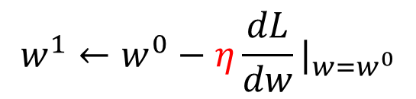

Step 3: Gradient Descent
http://chico386.pixnet.net/album/photo/171572850
$$w^{∗}=arg\min_{w}{L\left(w\right)}$$
Consider loss function 𝐿(𝑤) with one parameter w:
(Randomly) Pick an initial value w⁰
Compute $\frac{dL}{dw}|_{w=w^{0}}$
$$w^{1}←w^{0}−η\frac{dL}{dw}|_{w=w^{0}}$$
Loss
$$L\left(w\right)$$
η is called “learning rate”
w⁰
$$−η\frac{dL}{dw}|_{w=w^{0}}$$
Notes:
Regression 回归
Case Study 案例研究
Stock Market Forecast 股市预测
Dow Jones Industrial Average at tomorrow 明天的道琼斯工业平均指数
Self-driving Car
Recommendation
Estimating the Combat Power (CP) of a pokemon after evolution 评估宝可梦进化后的战斗力 (CP)
feature 特征
weight 权重
bias 偏差
线性模型和多个特征值之前的关系：𝑦=𝑏+ ∑▒〖𝑤_𝑖 𝑥_𝑖 〗
Goodness of Function 函数优度
Training Data: 10 pokemons 训练数据：10 只 Pokemon
Estimated y based on input function 根据输入函数估计 y
Estimation error 估计误差
The color represents L(𝑤,𝑏). 颜色代表 L(𝑤,𝑏)。
Gradient Descent 梯度下降
Negative 负
Positive 正
Increase w 增加
Decrease w 减少
η is called learning rate
Local optimal 局部最优
not global optimal 不是全局最优
Worry 担心
Don’t worry. In linear regression, the loss function L is convex. 别担心。在线性回归中，损失函数 L 是凸函数。
Formulation of 𝜕𝐿∕𝜕𝑤 and 𝜕𝐿∕𝜕𝑏 𝜕𝐿∕𝜕𝑤 和 𝜕𝐿∕𝜕𝑏 的公式
Generalization 概括
What we really care about is the error on new data (testing data) 我们真正关心的是新数据（测试数据）上的错误
Better! Could it be even better? 更好！还能更好吗？
Slightly better. 稍微好一点。
How about more complex model? 更复杂的模型怎么样？
The results become worse ... 结果变得更糟......
A more complex model yields lower error on training data. 更复杂的模型在训练数据上产生的错误更少。
If we can truly find the best function 如果我们真的能找到最好的函数
A more complex model does not always lead to better performance on testing data. 更复杂的模型并不总是能在测试数据上带来更好的表现。
This is Overfitting. 这就是过度拟合。
Select suitable model 选择合适的模型
There is some hidden factors not considered in the previous model …… 其中存在一些先前模型未考虑到的隐藏因素……
Pidgey 波波
Eevee 伊布
Weedle 威德尔
Caterpie 卡特皮
Regularization 正则化
The functions with smaller 𝑤_𝑖 are better 𝑤_𝑖 越小的函数越好
Why smooth functions are preferred? 为什么更倾向于平滑函数？
If some noises corrupt input xi when testing 如果测试时某些噪声破坏了输入 xi
A smoother function has less influence. 更平滑的函数影响较小。
Training error: larger𝜆, considering the training error less 训练误差：𝜆越大，考虑到训练误差越小
We prefer smooth function, but don’t be too smooth. 我们更喜欢平滑的函数，但不要太平滑。
Pokemon: Original CP and species almost decide the CP after evolution (there are probably other hidden factors) 口袋妖怪：原始 CP 和物种几乎决定了进化后的 CP（可能还有其他隐藏因素）
Gradient descent 梯度下降
Following lectures: theory and tips 接下来的讲座：理论和技巧
Overfitting and Regularization 过度拟合和正则化
Following lectures: more theory behind these 接下来的讲座：这些背后的更多理论
We finally get average error = 11.1 on the testing data 我们最终在测试数据上得到平均误差 = 11.1
How about another set of new data? Underestimate? Overestimate? 另一组新数据怎么样？低估？高估？
Following lectures: validation 接下来的讲座：验证

Slide 12


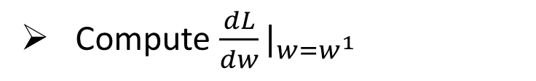
Step 3: Gradient Descent
$$w^{∗}=arg\min_{w}{L\left(w\right)}$$
Consider loss function 𝐿(𝑤) with one parameter w:
(Randomly) Pick an initial value w⁰
Compute $\frac{dL}{dw}|_{w=w^{0}}$
$$w^{1}←w^{0}−η\frac{dL}{dw}|_{w=w^{0}}$$
Loss
$$L\left(w\right)$$
Compute $\frac{dL}{dw}|_{w=w^{1}}$
$$w^{2}←w^{1}−η\frac{dL}{dw}|_{w=w^{1}}$$
…… Many iteration
Local minima
global minima
w⁰
w¹
w²
w^{T}
Notes:
Regression 回归
Case Study 案例研究
Stock Market Forecast 股市预测
Dow Jones Industrial Average at tomorrow 明天的道琼斯工业平均指数
Self-driving Car
Recommendation
Estimating the Combat Power (CP) of a pokemon after evolution 评估宝可梦进化后的战斗力 (CP)
feature 特征
weight 权重
bias 偏差
线性模型和多个特征值之前的关系：𝑦=𝑏+ ∑▒〖𝑤_𝑖 𝑥_𝑖 〗
Goodness of Function 函数优度
Training Data: 10 pokemons 训练数据：10 只 Pokemon
Estimated y based on input function 根据输入函数估计 y
Estimation error 估计误差
The color represents L(𝑤,𝑏). 颜色代表 L(𝑤,𝑏)。
Gradient Descent 梯度下降
Negative 负
Positive 正
Increase w 增加
Decrease w 减少
η is called learning rate
Local optimal 局部最优
not global optimal 不是全局最优
Worry 担心
Don’t worry. In linear regression, the loss function L is convex. 别担心。在线性回归中，损失函数 L 是凸函数。
Formulation of 𝜕𝐿∕𝜕𝑤 and 𝜕𝐿∕𝜕𝑏 𝜕𝐿∕𝜕𝑤 和 𝜕𝐿∕𝜕𝑏 的公式
Generalization 概括
What we really care about is the error on new data (testing data) 我们真正关心的是新数据（测试数据）上的错误
Better! Could it be even better? 更好！还能更好吗？
Slightly better. 稍微好一点。
How about more complex model? 更复杂的模型怎么样？
The results become worse ... 结果变得更糟......
A more complex model yields lower error on training data. 更复杂的模型在训练数据上产生的错误更少。
If we can truly find the best function 如果我们真的能找到最好的函数
A more complex model does not always lead to better performance on testing data. 更复杂的模型并不总是能在测试数据上带来更好的表现。
This is Overfitting. 这就是过度拟合。
Select suitable model 选择合适的模型
There is some hidden factors not considered in the previous model …… 其中存在一些先前模型未考虑到的隐藏因素……
Pidgey 波波
Eevee 伊布
Weedle 威德尔
Caterpie 卡特皮
Regularization 正则化
The functions with smaller 𝑤_𝑖 are better 𝑤_𝑖 越小的函数越好
Why smooth functions are preferred? 为什么更倾向于平滑函数？
If some noises corrupt input xi when testing 如果测试时某些噪声破坏了输入 xi
A smoother function has less influence. 更平滑的函数影响较小。
Training error: larger𝜆, considering the training error less 训练误差：𝜆越大，考虑到训练误差越小
We prefer smooth function, but don’t be too smooth. 我们更喜欢平滑的函数，但不要太平滑。
Pokemon: Original CP and species almost decide the CP after evolution (there are probably other hidden factors) 口袋妖怪：原始 CP 和物种几乎决定了进化后的 CP（可能还有其他隐藏因素）
Gradient descent 梯度下降
Following lectures: theory and tips 接下来的讲座：理论和技巧
Overfitting and Regularization 过度拟合和正则化
Following lectures: more theory behind these 接下来的讲座：这些背后的更多理论
We finally get average error = 11.1 on the testing data 我们最终在测试数据上得到平均误差 = 11.1
How about another set of new data? Underestimate? Overestimate? 另一组新数据怎么样？低估？高估？
Following lectures: validation 接下来的讲座：验证

Slide 13

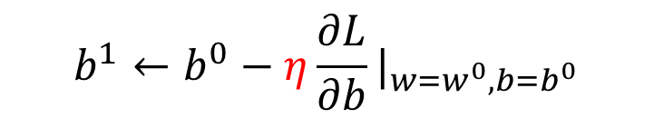

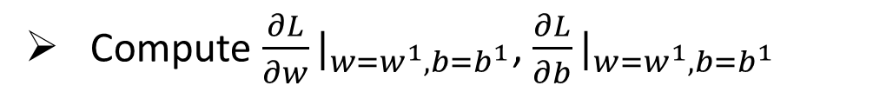
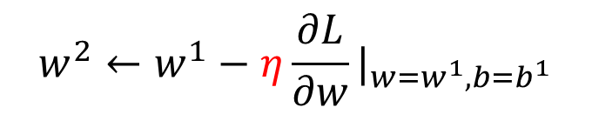



Step 3: Gradient Descent
$$\left[\begin{aligned}\frac{∂L}{∂w} \\ \frac{∂L}{∂b}\end{aligned}\right]$$
$$∇L=$$
gradient
How about two parameters?
$$w^{∗},b^{∗}=arg\min_{w,b}{L\left(w,b\right)}$$
(Randomly) Pick an initial value w⁰, b⁰
Compute $\frac{∂L}{∂w}|_{w=w^{0},b=b^{0}}$, $\frac{∂L}{∂b}|_{w=w^{0},b=b^{0}}$
$$w^{1}←w^{0}−η\frac{∂L}{∂w}|_{w=w^{0},b=b^{0}}$$
$$b^{1}←b^{0}−η\frac{∂L}{∂b}|_{w=w^{0},b=b^{0}}$$
Compute $\frac{∂L}{∂w}|_{w=w^{1},b=b^{1}}$, $\frac{∂L}{∂b}|_{w=w^{1},b=b^{1}}$
$$w^{2}←w^{1}−η\frac{∂L}{∂w}|_{w=w^{1},b=b^{1}}$$
$$b^{2}←b^{1}−η\frac{∂L}{∂b}|_{w=w^{1},b=b^{1}}$$
Notes:
Regression 回归
Case Study 案例研究
Stock Market Forecast 股市预测
Dow Jones Industrial Average at tomorrow 明天的道琼斯工业平均指数
Self-driving Car
Recommendation
Estimating the Combat Power (CP) of a pokemon after evolution 评估宝可梦进化后的战斗力 (CP)
feature 特征
weight 权重
bias 偏差
线性模型和多个特征值之前的关系：𝑦=𝑏+ ∑▒〖𝑤_𝑖 𝑥_𝑖 〗
Goodness of Function 函数优度
Training Data: 10 pokemons 训练数据：10 只 Pokemon
Estimated y based on input function 根据输入函数估计 y
Estimation error 估计误差
The color represents L(𝑤,𝑏). 颜色代表 L(𝑤,𝑏)。
Gradient Descent 梯度下降
Negative 负
Positive 正
Increase w 增加
Decrease w 减少
η is called learning rate
Local optimal 局部最优
not global optimal 不是全局最优
Worry 担心
Don’t worry. In linear regression, the loss function L is convex. 别担心。在线性回归中，损失函数 L 是凸函数。
Formulation of 𝜕𝐿∕𝜕𝑤 and 𝜕𝐿∕𝜕𝑏 𝜕𝐿∕𝜕𝑤 和 𝜕𝐿∕𝜕𝑏 的公式
Generalization 概括
What we really care about is the error on new data (testing data) 我们真正关心的是新数据（测试数据）上的错误
Better! Could it be even better? 更好！还能更好吗？
Slightly better. 稍微好一点。
How about more complex model? 更复杂的模型怎么样？
The results become worse ... 结果变得更糟......
A more complex model yields lower error on training data. 更复杂的模型在训练数据上产生的错误更少。
If we can truly find the best function 如果我们真的能找到最好的函数
A more complex model does not always lead to better performance on testing data. 更复杂的模型并不总是能在测试数据上带来更好的表现。
This is Overfitting. 这就是过度拟合。
Select suitable model 选择合适的模型
There is some hidden factors not considered in the previous model …… 其中存在一些先前模型未考虑到的隐藏因素……
Pidgey 波波
Eevee 伊布
Weedle 威德尔
Caterpie 卡特皮
Regularization 正则化
The functions with smaller 𝑤_𝑖 are better 𝑤_𝑖 越小的函数越好
Why smooth functions are preferred? 为什么更倾向于平滑函数？
If some noises corrupt input xi when testing 如果测试时某些噪声破坏了输入 xi
A smoother function has less influence. 更平滑的函数影响较小。
Training error: larger𝜆, considering the training error less 训练误差：𝜆越大，考虑到训练误差越小
We prefer smooth function, but don’t be too smooth. 我们更喜欢平滑的函数，但不要太平滑。
Pokemon: Original CP and species almost decide the CP after evolution (there are probably other hidden factors) 口袋妖怪：原始 CP 和物种几乎决定了进化后的 CP（可能还有其他隐藏因素）
Gradient descent 梯度下降
Following lectures: theory and tips 接下来的讲座：理论和技巧
Overfitting and Regularization 过度拟合和正则化
Following lectures: more theory behind these 接下来的讲座：这些背后的更多理论
We finally get average error = 11.1 on the testing data 我们最终在测试数据上得到平均误差 = 11.1
How about another set of new data? Underestimate? Overestimate? 另一组新数据怎么样？低估？高估？
Following lectures: validation 接下来的讲座：验证

Slide 14
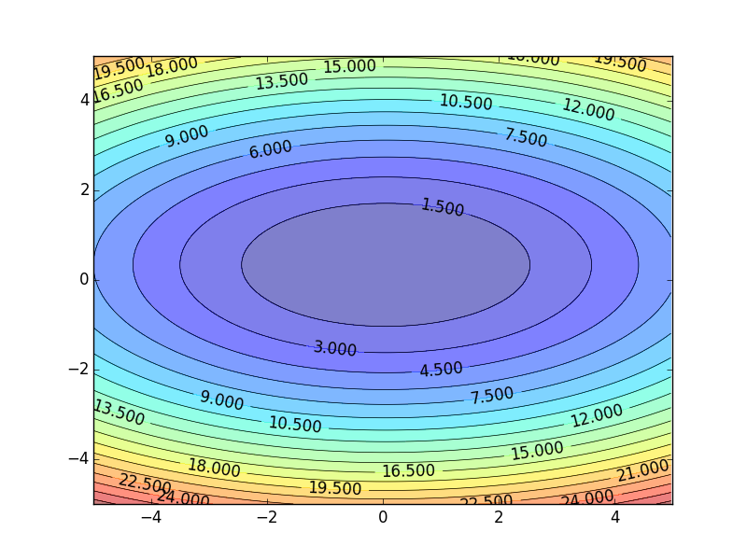
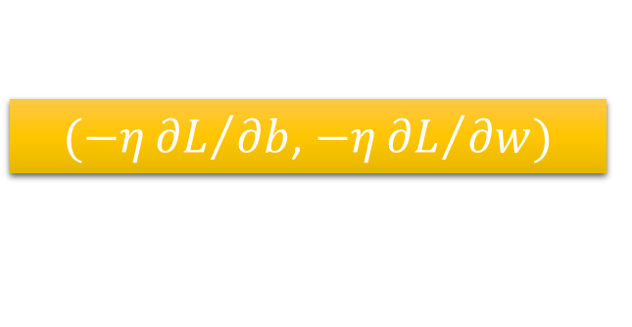
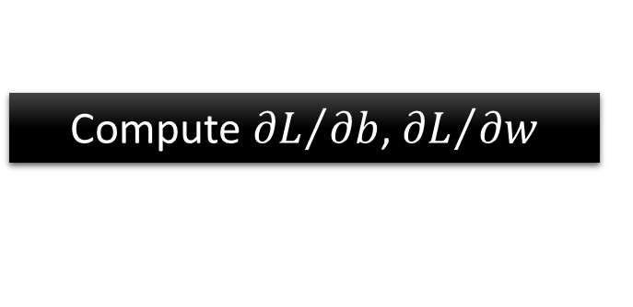


Step 3: Gradient Descent
Color: Value of Loss L(w,b)
$$w$$
$(−η{∂L}/{∂b}$, $−η{∂L}/{∂w})$
Compute ${∂L}/{∂b}$, ${∂L}/{∂w}$
$$b$$
Notes:
Regression 回归
Case Study 案例研究
Stock Market Forecast 股市预测
Dow Jones Industrial Average at tomorrow 明天的道琼斯工业平均指数
Self-driving Car
Recommendation
Estimating the Combat Power (CP) of a pokemon after evolution 评估宝可梦进化后的战斗力 (CP)
feature 特征
weight 权重
bias 偏差
线性模型和多个特征值之前的关系：𝑦=𝑏+ ∑▒〖𝑤_𝑖 𝑥_𝑖 〗
Goodness of Function 函数优度
Training Data: 10 pokemons 训练数据：10 只 Pokemon
Estimated y based on input function 根据输入函数估计 y
Estimation error 估计误差
The color represents L(𝑤,𝑏). 颜色代表 L(𝑤,𝑏)。
Gradient Descent 梯度下降
Negative 负
Positive 正
Increase w 增加
Decrease w 减少
η is called learning rate
Local optimal 局部最优
not global optimal 不是全局最优
Worry 担心
Don’t worry. In linear regression, the loss function L is convex. 别担心。在线性回归中，损失函数 L 是凸函数。
Formulation of 𝜕𝐿∕𝜕𝑤 and 𝜕𝐿∕𝜕𝑏 𝜕𝐿∕𝜕𝑤 和 𝜕𝐿∕𝜕𝑏 的公式
Generalization 概括
What we really care about is the error on new data (testing data) 我们真正关心的是新数据（测试数据）上的错误
Better! Could it be even better? 更好！还能更好吗？
Slightly better. 稍微好一点。
How about more complex model? 更复杂的模型怎么样？
The results become worse ... 结果变得更糟......
A more complex model yields lower error on training data. 更复杂的模型在训练数据上产生的错误更少。
If we can truly find the best function 如果我们真的能找到最好的函数
A more complex model does not always lead to better performance on testing data. 更复杂的模型并不总是能在测试数据上带来更好的表现。
This is Overfitting. 这就是过度拟合。
Select suitable model 选择合适的模型
There is some hidden factors not considered in the previous model …… 其中存在一些先前模型未考虑到的隐藏因素……
Pidgey 波波
Eevee 伊布
Weedle 威德尔
Caterpie 卡特皮
Regularization 正则化
The functions with smaller 𝑤_𝑖 are better 𝑤_𝑖 越小的函数越好
Why smooth functions are preferred? 为什么更倾向于平滑函数？
If some noises corrupt input xi when testing 如果测试时某些噪声破坏了输入 xi
A smoother function has less influence. 更平滑的函数影响较小。
Training error: larger𝜆, considering the training error less 训练误差：𝜆越大，考虑到训练误差越小
We prefer smooth function, but don’t be too smooth. 我们更喜欢平滑的函数，但不要太平滑。
Pokemon: Original CP and species almost decide the CP after evolution (there are probably other hidden factors) 口袋妖怪：原始 CP 和物种几乎决定了进化后的 CP（可能还有其他隐藏因素）
Gradient descent 梯度下降
Following lectures: theory and tips 接下来的讲座：理论和技巧
Overfitting and Regularization 过度拟合和正则化
Following lectures: more theory behind these 接下来的讲座：这些背后的更多理论
We finally get average error = 11.1 on the testing data 我们最终在测试数据上得到平均误差 = 11.1
How about another set of new data? Underestimate? Overestimate? 另一组新数据怎么样？低估？高估？
Following lectures: validation 接下来的讲座：验证

Slide 15

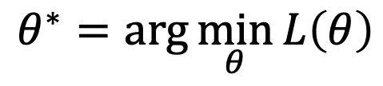
Step 3: Gradient Descent
When solving:
Each time we update the parameters, we obtain $θ$ that makes $L\left(θ\right)$ smaller.
$$θ^{∗}=arg\min_{θ}{L\left(θ\right)}$$
by gradient descent
$$L\left(θ^{0}\right)>L\left(θ^{1}\right)>L\left(θ^{2}\right)>…$$
Is this statement correct?
Notes:
Regression 回归
Case Study 案例研究
Stock Market Forecast 股市预测
Dow Jones Industrial Average at tomorrow 明天的道琼斯工业平均指数
Self-driving Car
Recommendation
Estimating the Combat Power (CP) of a pokemon after evolution 评估宝可梦进化后的战斗力 (CP)
feature 特征
weight 权重
bias 偏差
线性模型和多个特征值之前的关系：𝑦=𝑏+ ∑▒〖𝑤_𝑖 𝑥_𝑖 〗
Goodness of Function 函数优度
Training Data: 10 pokemons 训练数据：10 只 Pokemon
Estimated y based on input function 根据输入函数估计 y
Estimation error 估计误差
The color represents L(𝑤,𝑏). 颜色代表 L(𝑤,𝑏)。
Gradient Descent 梯度下降
Negative 负
Positive 正
Increase w 增加
Decrease w 减少
η is called learning rate
Local optimal 局部最优
not global optimal 不是全局最优
Is this statement correct? 这种说法正确吗？
Worry 担心
Don’t worry. In linear regression, the loss function L is convex. 别担心。在线性回归中，损失函数 L 是凸函数。
Formulation of 𝜕𝐿∕𝜕𝑤 and 𝜕𝐿∕𝜕𝑏 𝜕𝐿∕𝜕𝑤 和 𝜕𝐿∕𝜕𝑏 的公式
Generalization 概括
What we really care about is the error on new data (testing data) 我们真正关心的是新数据（测试数据）上的错误
Better! Could it be even better? 更好！还能更好吗？
Slightly better. 稍微好一点。
How about more complex model? 更复杂的模型怎么样？
The results become worse ... 结果变得更糟......
A more complex model yields lower error on training data. 更复杂的模型在训练数据上产生的错误更少。
If we can truly find the best function 如果我们真的能找到最好的函数
A more complex model does not always lead to better performance on testing data. 更复杂的模型并不总是能在测试数据上带来更好的表现。
This is Overfitting. 这就是过度拟合。
Select suitable model 选择合适的模型
There is some hidden factors not considered in the previous model …… 其中存在一些先前模型未考虑到的隐藏因素……
Pidgey 波波
Eevee 伊布
Weedle 威德尔
Caterpie 卡特皮
Regularization 正则化
The functions with smaller 𝑤_𝑖 are better 𝑤_𝑖 越小的函数越好
Why smooth functions are preferred? 为什么更倾向于平滑函数？
If some noises corrupt input xi when testing 如果测试时某些噪声破坏了输入 xi
A smoother function has less influence. 更平滑的函数影响较小。
Training error: larger𝜆, considering the training error less 训练误差：𝜆越大，考虑到训练误差越小
We prefer smooth function, but don’t be too smooth. 我们更喜欢平滑的函数，但不要太平滑。
Pokemon: Original CP and species almost decide the CP after evolution (there are probably other hidden factors) 口袋妖怪：原始 CP 和物种几乎决定了进化后的 CP（可能还有其他隐藏因素）
Gradient descent 梯度下降
Following lectures: theory and tips 接下来的讲座：理论和技巧
Overfitting and Regularization 过度拟合和正则化
Following lectures: more theory behind these 接下来的讲座：这些背后的更多理论
We finally get average error = 11.1 on the testing data 我们最终在测试数据上得到平均误差 = 11.1
How about another set of new data? Underestimate? Overestimate? 另一组新数据怎么样？低估？高估？
Following lectures: validation 接下来的讲座：验证

Slide 16
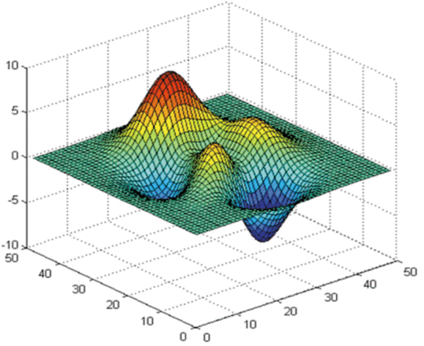






Step 3: Gradient Descent
Loss
Very slow at the plateau
$$L$$
Stuck at saddle point
$$w_{1}$$
$$w_{2}$$
Stuck at local minima
$$∂L∕∂w$$
$$≈0$$
$$∂L∕∂w$$
$$=0$$
$$∂L∕∂w$$
$$=0$$
The value of the parameter w
Notes:
Regression 回归
Case Study 案例研究
Stock Market Forecast 股市预测
Dow Jones Industrial Average at tomorrow 明天的道琼斯工业平均指数
Self-driving Car
Recommendation
Estimating the Combat Power (CP) of a pokemon after evolution 评估宝可梦进化后的战斗力 (CP)
feature 特征
weight 权重
bias 偏差
线性模型和多个特征值之前的关系：𝑦=𝑏+ ∑▒〖𝑤_𝑖 𝑥_𝑖 〗
Goodness of Function 函数优度
Training Data: 10 pokemons 训练数据：10 只 Pokemon
Estimated y based on input function 根据输入函数估计 y
Estimation error 估计误差
The color represents L(𝑤,𝑏). 颜色代表 L(𝑤,𝑏)。
Gradient Descent 梯度下降
Negative 负
Positive 正
Increase w 增加
Decrease w 减少
η is called learning rate
Local optimal 局部最优
not global optimal 不是全局最优
Is this statement correct? 这种说法正确吗？
Stuck at local minima 卡在局部极小值
Stuck at saddle point 卡在鞍点
Very slow at the plateau 在高原上非常缓慢
Worry 担心
Don’t worry. In linear regression, the loss function L is convex. 别担心。在线性回归中，损失函数 L 是凸函数。
Formulation of 𝜕𝐿∕𝜕𝑤 and 𝜕𝐿∕𝜕𝑏 𝜕𝐿∕𝜕𝑤 和 𝜕𝐿∕𝜕𝑏 的公式
Generalization 概括
What we really care about is the error on new data (testing data) 我们真正关心的是新数据（测试数据）上的错误
Better! Could it be even better? 更好！还能更好吗？
Slightly better. 稍微好一点。
How about more complex model? 更复杂的模型怎么样？
The results become worse ... 结果变得更糟......
A more complex model yields lower error on training data. 更复杂的模型在训练数据上产生的错误更少。
If we can truly find the best function 如果我们真的能找到最好的函数
A more complex model does not always lead to better performance on testing data. 更复杂的模型并不总是能在测试数据上带来更好的表现。
This is Overfitting. 这就是过度拟合。
Select suitable model 选择合适的模型
There is some hidden factors not considered in the previous model …… 其中存在一些先前模型未考虑到的隐藏因素……
Pidgey 波波
Eevee 伊布
Weedle 威德尔
Caterpie 卡特皮
Regularization 正则化
The functions with smaller 𝑤_𝑖 are better 𝑤_𝑖 越小的函数越好
Why smooth functions are preferred? 为什么更倾向于平滑函数？
If some noises corrupt input xi when testing 如果测试时某些噪声破坏了输入 xi
A smoother function has less influence. 更平滑的函数影响较小。
Training error: larger𝜆, considering the training error less 训练误差：𝜆越大，考虑到训练误差越小
We prefer smooth function, but don’t be too smooth. 我们更喜欢平滑的函数，但不要太平滑。
Pokemon: Original CP and species almost decide the CP after evolution (there are probably other hidden factors) 口袋妖怪：原始 CP 和物种几乎决定了进化后的 CP（可能还有其他隐藏因素）
Gradient descent 梯度下降
Following lectures: theory and tips 接下来的讲座：理论和技巧
Overfitting and Regularization 过度拟合和正则化
Following lectures: more theory behind these 接下来的讲座：这些背后的更多理论
We finally get average error = 11.1 on the testing data 我们最终在测试数据上得到平均误差 = 11.1
How about another set of new data? Underestimate? Overestimate? 另一组新数据怎么样？低估？高估？
Following lectures: validation 接下来的讲座：验证

Slide 17

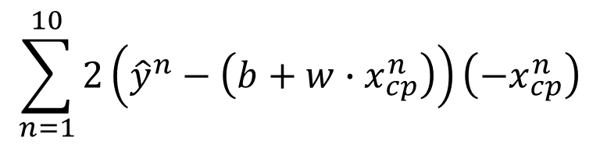


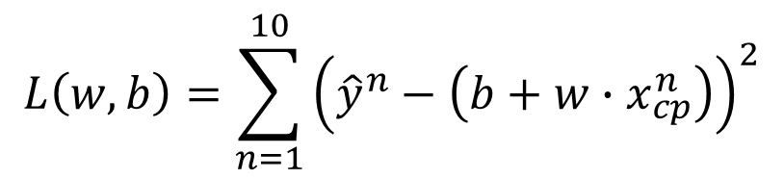
Step 3: Gradient Descent
Formulation of ${∂L}/{∂w}$ and ${∂L}/{∂b}$
$$L\left(w,b\right)=\sum_{n=1}^{10}{{\left({\hat{y}}^{n}−\left(b+w∙x_{cp}^{n}\right)\right)}^{2}}$$
$$\sum_{n=1}^{10}{2\left({\hat{y}}^{n}−\left(b+w∙x_{cp}^{n}\right)\right)\left(−x_{cp}^{n}\right)}$$
$$\frac{∂L}{∂w}=?$$
$$\frac{∂L}{∂b}=?$$
Notes:
Regression 回归
Case Study 案例研究
Stock Market Forecast 股市预测
Dow Jones Industrial Average at tomorrow 明天的道琼斯工业平均指数
Self-driving Car
Recommendation
Estimating the Combat Power (CP) of a pokemon after evolution 评估宝可梦进化后的战斗力 (CP)
feature 特征
weight 权重
bias 偏差
线性模型和多个特征值之前的关系：𝑦=𝑏+ ∑▒〖𝑤_𝑖 𝑥_𝑖 〗
Goodness of Function 函数优度
Training Data: 10 pokemons 训练数据：10 只 Pokemon
Estimated y based on input function 根据输入函数估计 y
Estimation error 估计误差
The color represents L(𝑤,𝑏). 颜色代表 L(𝑤,𝑏)。
Gradient Descent 梯度下降
Negative 负
Positive 正
Increase w 增加
Decrease w 减少
η is called learning rate
Local optimal 局部最优
not global optimal 不是全局最优
Is this statement correct? 这种说法正确吗？
Stuck at local minima 卡在局部极小值
Stuck at saddle point 卡在鞍点
Very slow at the plateau 在高原上非常缓慢
Worry 担心
Don’t worry. In linear regression, the loss function L is convex. 别担心。在线性回归中，损失函数 L 是凸函数。
Formulation of 𝜕𝐿∕𝜕𝑤 and 𝜕𝐿∕𝜕𝑏 𝜕𝐿∕𝜕𝑤 和 𝜕𝐿∕𝜕𝑏 的公式
Generalization 概括
What we really care about is the error on new data (testing data) 我们真正关心的是新数据（测试数据）上的错误
Better! Could it be even better? 更好！还能更好吗？
Slightly better. 稍微好一点。
How about more complex model? 更复杂的模型怎么样？
The results become worse ... 结果变得更糟......
A more complex model yields lower error on training data. 更复杂的模型在训练数据上产生的错误更少。
If we can truly find the best function 如果我们真的能找到最好的函数
A more complex model does not always lead to better performance on testing data. 更复杂的模型并不总是能在测试数据上带来更好的表现。
This is Overfitting. 这就是过度拟合。
Select suitable model 选择合适的模型
There is some hidden factors not considered in the previous model …… 其中存在一些先前模型未考虑到的隐藏因素……
Pidgey 波波
Eevee 伊布
Weedle 威德尔
Caterpie 卡特皮
Regularization 正则化
The functions with smaller 𝑤_𝑖 are better 𝑤_𝑖 越小的函数越好
Why smooth functions are preferred? 为什么更倾向于平滑函数？
If some noises corrupt input xi when testing 如果测试时某些噪声破坏了输入 xi
A smoother function has less influence. 更平滑的函数影响较小。
Training error: larger𝜆, considering the training error less 训练误差：𝜆越大，考虑到训练误差越小
We prefer smooth function, but don’t be too smooth. 我们更喜欢平滑的函数，但不要太平滑。
Pokemon: Original CP and species almost decide the CP after evolution (there are probably other hidden factors) 口袋妖怪：原始 CP 和物种几乎决定了进化后的 CP（可能还有其他隐藏因素）
Gradient descent 梯度下降
Following lectures: theory and tips 接下来的讲座：理论和技巧
Overfitting and Regularization 过度拟合和正则化
Following lectures: more theory behind these 接下来的讲座：这些背后的更多理论
We finally get average error = 11.1 on the testing data 我们最终在测试数据上得到平均误差 = 11.1
How about another set of new data? Underestimate? Overestimate? 另一组新数据怎么样？低估？高估？
Following lectures: validation 接下来的讲座：验证

Slide 18
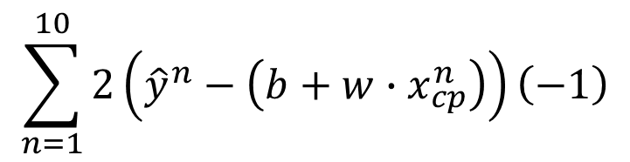
Step 3: Gradient Descent
Formulation of ${∂L}/{∂w}$ and ${∂L}/{∂b}$
$$L\left(w,b\right)=\sum_{n=1}^{10}{{\left({\hat{y}}^{n}−\left(b+w∙x_{cp}^{n}\right)\right)}^{2}}$$
$$\sum_{n=1}^{10}{2\left({\hat{y}}^{n}−\left(b+w∙x_{cp}^{n}\right)\right)\left(−x_{cp}^{n}\right)}$$
$$\frac{∂L}{∂w}=?$$
$$\frac{∂L}{∂b}=?$$
$$\sum_{n=1}^{10}{2\left({\hat{y}}^{n}−\left(b+w∙x_{cp}^{n}\right)\right)\left(−1\right)}$$
Notes:
Regression 回归
Case Study 案例研究
Stock Market Forecast 股市预测
Dow Jones Industrial Average at tomorrow 明天的道琼斯工业平均指数
Self-driving Car
Recommendation
Estimating the Combat Power (CP) of a pokemon after evolution 评估宝可梦进化后的战斗力 (CP)
feature 特征
weight 权重
bias 偏差
线性模型和多个特征值之前的关系：𝑦=𝑏+ ∑▒〖𝑤_𝑖 𝑥_𝑖 〗
Goodness of Function 函数优度
Training Data: 10 pokemons 训练数据：10 只 Pokemon
Estimated y based on input function 根据输入函数估计 y
Estimation error 估计误差
The color represents L(𝑤,𝑏). 颜色代表 L(𝑤,𝑏)。
Gradient Descent 梯度下降
Negative 负
Positive 正
Increase w 增加
Decrease w 减少
η is called learning rate
Local optimal 局部最优
not global optimal 不是全局最优
Is this statement correct? 这种说法正确吗？
Stuck at local minima 卡在局部极小值
Stuck at saddle point 卡在鞍点
Very slow at the plateau 在高原上非常缓慢
Worry 担心
Don’t worry. In linear regression, the loss function L is convex. 别担心。在线性回归中，损失函数 L 是凸函数。
Formulation of 𝜕𝐿∕𝜕𝑤 and 𝜕𝐿∕𝜕𝑏 𝜕𝐿∕𝜕𝑤 和 𝜕𝐿∕𝜕𝑏 的公式
Generalization 概括
What we really care about is the error on new data (testing data) 我们真正关心的是新数据（测试数据）上的错误
Better! Could it be even better? 更好！还能更好吗？
Slightly better. 稍微好一点。
How about more complex model? 更复杂的模型怎么样？
The results become worse ... 结果变得更糟......
A more complex model yields lower error on training data. 更复杂的模型在训练数据上产生的错误更少。
If we can truly find the best function 如果我们真的能找到最好的函数
A more complex model does not always lead to better performance on testing data. 更复杂的模型并不总是能在测试数据上带来更好的表现。
This is Overfitting. 这就是过度拟合。
Select suitable model 选择合适的模型
There is some hidden factors not considered in the previous model …… 其中存在一些先前模型未考虑到的隐藏因素……
Pidgey 波波
Eevee 伊布
Weedle 威德尔
Caterpie 卡特皮
Regularization 正则化
The functions with smaller 𝑤_𝑖 are better 𝑤_𝑖 越小的函数越好
Why smooth functions are preferred? 为什么更倾向于平滑函数？
If some noises corrupt input xi when testing 如果测试时某些噪声破坏了输入 xi
A smoother function has less influence. 更平滑的函数影响较小。
Training error: larger𝜆, considering the training error less 训练误差：𝜆越大，考虑到训练误差越小
We prefer smooth function, but don’t be too smooth. 我们更喜欢平滑的函数，但不要太平滑。
Pokemon: Original CP and species almost decide the CP after evolution (there are probably other hidden factors) 口袋妖怪：原始 CP 和物种几乎决定了进化后的 CP（可能还有其他隐藏因素）
Gradient descent 梯度下降
Following lectures: theory and tips 接下来的讲座：理论和技巧
Overfitting and Regularization 过度拟合和正则化
Following lectures: more theory behind these 接下来的讲座：这些背后的更多理论
We finally get average error = 11.1 on the testing data 我们最终在测试数据上得到平均误差 = 11.1
How about another set of new data? Underestimate? Overestimate? 另一组新数据怎么样？低估？高估？
Following lectures: validation 接下来的讲座：验证

Slide 19
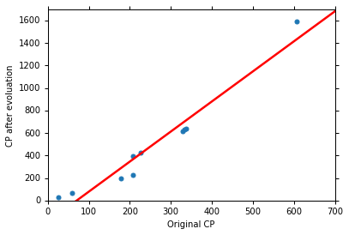
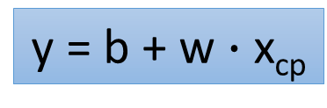
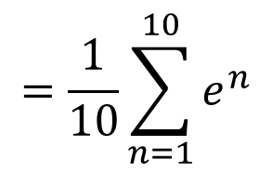


How’s the results?
Training Data
y = b + w $∙$ x_{cp}
b = -188.4
$$e^{1}$$
w = 2.7
Average Error on Training Data
$$e^{2}$$
$$=\frac{1}{10}\sum_{n=1}^{10}{e^{n}}$$
= 31.9
Notes:
Regression 回归
Case Study 案例研究
Stock Market Forecast 股市预测
Dow Jones Industrial Average at tomorrow 明天的道琼斯工业平均指数
Self-driving Car
Recommendation
Estimating the Combat Power (CP) of a pokemon after evolution 评估宝可梦进化后的战斗力 (CP)
feature 特征
weight 权重
bias 偏差
线性模型和多个特征值之前的关系：𝑦=𝑏+ ∑▒〖𝑤_𝑖 𝑥_𝑖 〗
Goodness of Function 函数优度
Training Data: 10 pokemons 训练数据：10 只 Pokemon
Estimated y based on input function 根据输入函数估计 y
Estimation error 估计误差
The color represents L(𝑤,𝑏). 颜色代表 L(𝑤,𝑏)。
Gradient Descent 梯度下降
Negative 负
Positive 正
Increase w 增加
Decrease w 减少
η is called learning rate
Local optimal 局部最优
not global optimal 不是全局最优
Is this statement correct? 这种说法正确吗？
Stuck at local minima 卡在局部极小值
Stuck at saddle point 卡在鞍点
Very slow at the plateau 在高原上非常缓慢
Worry 担心
Don’t worry. In linear regression, the loss function L is convex. 别担心。在线性回归中，损失函数 L 是凸函数。
Formulation of 𝜕𝐿∕𝜕𝑤 and 𝜕𝐿∕𝜕𝑏 𝜕𝐿∕𝜕𝑤 和 𝜕𝐿∕𝜕𝑏 的公式
Generalization 概括
What we really care about is the error on new data (testing data) 我们真正关心的是新数据（测试数据）上的错误
Better! Could it be even better? 更好！还能更好吗？
Slightly better. 稍微好一点。
How about more complex model? 更复杂的模型怎么样？
The results become worse ... 结果变得更糟......
A more complex model yields lower error on training data. 更复杂的模型在训练数据上产生的错误更少。
If we can truly find the best function 如果我们真的能找到最好的函数
A more complex model does not always lead to better performance on testing data. 更复杂的模型并不总是能在测试数据上带来更好的表现。
This is Overfitting. 这就是过度拟合。
Select suitable model 选择合适的模型
There is some hidden factors not considered in the previous model …… 其中存在一些先前模型未考虑到的隐藏因素……
Pidgey 波波
Eevee 伊布
Weedle 威德尔
Caterpie 卡特皮
Regularization 正则化
The functions with smaller 𝑤_𝑖 are better 𝑤_𝑖 越小的函数越好
Why smooth functions are preferred? 为什么更倾向于平滑函数？
If some noises corrupt input xi when testing 如果测试时某些噪声破坏了输入 xi
A smoother function has less influence. 更平滑的函数影响较小。
Training error: larger𝜆, considering the training error less 训练误差：𝜆越大，考虑到训练误差越小
We prefer smooth function, but don’t be too smooth. 我们更喜欢平滑的函数，但不要太平滑。
Pokemon: Original CP and species almost decide the CP after evolution (there are probably other hidden factors) 口袋妖怪：原始 CP 和物种几乎决定了进化后的 CP（可能还有其他隐藏因素）
Gradient descent 梯度下降
Following lectures: theory and tips 接下来的讲座：理论和技巧
Overfitting and Regularization 过度拟合和正则化
Following lectures: more theory behind these 接下来的讲座：这些背后的更多理论
We finally get average error = 11.1 on the testing data 我们最终在测试数据上得到平均误差 = 11.1
How about another set of new data? Underestimate? Overestimate? 另一组新数据怎么样？低估？高估？
Following lectures: validation 接下来的讲座：验证

Slide 20
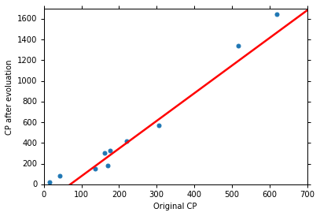
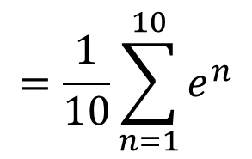
How’s the results? - Generalization
What we really care about is the error on new data (testing data)
Another 10 pokemons as testing data
y = b + w $∙$ x_{cp}
b = -188.4
How can we do better?
w = 2.7
Average Error on Testing Data
$$=\frac{1}{10}\sum_{n=1}^{10}{e^{n}}$$
= 35.0
> Average Error on Training Data (31.9)
Notes:
Regression 回归
Case Study 案例研究
Stock Market Forecast 股市预测
Dow Jones Industrial Average at tomorrow 明天的道琼斯工业平均指数
Self-driving Car
Recommendation
Estimating the Combat Power (CP) of a pokemon after evolution 评估宝可梦进化后的战斗力 (CP)
feature 特征
weight 权重
bias 偏差
线性模型和多个特征值之前的关系：𝑦=𝑏+ ∑▒〖𝑤_𝑖 𝑥_𝑖 〗
Goodness of Function 函数优度
Training Data: 10 pokemons 训练数据：10 只 Pokemon
Estimated y based on input function 根据输入函数估计 y
Estimation error 估计误差
The color represents L(𝑤,𝑏). 颜色代表 L(𝑤,𝑏)。
Gradient Descent 梯度下降
Negative 负
Positive 正
Increase w 增加
Decrease w 减少
η is called learning rate
Local optimal 局部最优
not global optimal 不是全局最优
Is this statement correct? 这种说法正确吗？
Stuck at local minima 卡在局部极小值
Stuck at saddle point 卡在鞍点
Very slow at the plateau 在高原上非常缓慢
Worry 担心
Don’t worry. In linear regression, the loss function L is convex. 别担心。在线性回归中，损失函数 L 是凸函数。
Formulation of 𝜕𝐿∕𝜕𝑤 and 𝜕𝐿∕𝜕𝑏 𝜕𝐿∕𝜕𝑤 和 𝜕𝐿∕𝜕𝑏 的公式
Generalization 概括
What we really care about is the error on new data (testing data) 我们真正关心的是新数据（测试数据）上的错误
Better! Could it be even better? 更好！还能更好吗？
Slightly better. 稍微好一点。
How about more complex model? 更复杂的模型怎么样？
The results become worse ... 结果变得更糟......
A more complex model yields lower error on training data. 更复杂的模型在训练数据上产生的错误更少。
If we can truly find the best function 如果我们真的能找到最好的函数
A more complex model does not always lead to better performance on testing data. 更复杂的模型并不总是能在测试数据上带来更好的表现。
This is Overfitting. 这就是过度拟合。
Select suitable model 选择合适的模型
There is some hidden factors not considered in the previous model …… 其中存在一些先前模型未考虑到的隐藏因素……
Pidgey 波波
Eevee 伊布
Weedle 威德尔
Caterpie 卡特皮
Regularization 正则化
The functions with smaller 𝑤_𝑖 are better 𝑤_𝑖 越小的函数越好
Why smooth functions are preferred? 为什么更倾向于平滑函数？
If some noises corrupt input xi when testing 如果测试时某些噪声破坏了输入 xi
A smoother function has less influence. 更平滑的函数影响较小。
Training error: larger𝜆, considering the training error less 训练误差：𝜆越大，考虑到训练误差越小
We prefer smooth function, but don’t be too smooth. 我们更喜欢平滑的函数，但不要太平滑。
Pokemon: Original CP and species almost decide the CP after evolution (there are probably other hidden factors) 口袋妖怪：原始 CP 和物种几乎决定了进化后的 CP（可能还有其他隐藏因素）
Gradient descent 梯度下降
Following lectures: theory and tips 接下来的讲座：理论和技巧
Overfitting and Regularization 过度拟合和正则化
Following lectures: more theory behind these 接下来的讲座：这些背后的更多理论
We finally get average error = 11.1 on the testing data 我们最终在测试数据上得到平均误差 = 11.1
How about another set of new data? Underestimate? Overestimate? 另一组新数据怎么样？低估？高估？
Following lectures: validation 接下来的讲座：验证

Slide 21



Selecting another Model
y = b + w₁ $∙$ x_{cp} + w₂ $∙$ (x_{cp})²
Best Function
b = -10.3
w₁ = 1.0, w₂ = 2.7 x 10⁻³
Average Error = 15.4
Testing:
Average Error = 18.4
Better! Could it be even better?
Notes:
Regression 回归
Case Study 案例研究
Stock Market Forecast 股市预测
Dow Jones Industrial Average at tomorrow 明天的道琼斯工业平均指数
Self-driving Car
Recommendation
Estimating the Combat Power (CP) of a pokemon after evolution 评估宝可梦进化后的战斗力 (CP)
feature 特征
weight 权重
bias 偏差
线性模型和多个特征值之前的关系：𝑦=𝑏+ ∑▒〖𝑤_𝑖 𝑥_𝑖 〗
Goodness of Function 函数优度
Training Data: 10 pokemons 训练数据：10 只 Pokemon
Estimated y based on input function 根据输入函数估计 y
Estimation error 估计误差
The color represents L(𝑤,𝑏). 颜色代表 L(𝑤,𝑏)。
Gradient Descent 梯度下降
Negative 负
Positive 正
Increase w 增加
Decrease w 减少
η is called learning rate
Local optimal 局部最优
not global optimal 不是全局最优
Is this statement correct? 这种说法正确吗？
Stuck at local minima 卡在局部极小值
Stuck at saddle point 卡在鞍点
Very slow at the plateau 在高原上非常缓慢
Worry 担心
Don’t worry. In linear regression, the loss function L is convex. 别担心。在线性回归中，损失函数 L 是凸函数。
Formulation of 𝜕𝐿∕𝜕𝑤 and 𝜕𝐿∕𝜕𝑏 𝜕𝐿∕𝜕𝑤 和 𝜕𝐿∕𝜕𝑏 的公式
Generalization 概括
What we really care about is the error on new data (testing data) 我们真正关心的是新数据（测试数据）上的错误
Better! Could it be even better? 更好！还能更好吗？
Slightly better. 稍微好一点。
How about more complex model? 更复杂的模型怎么样？
The results become worse ... 结果变得更糟......
A more complex model yields lower error on training data. 更复杂的模型在训练数据上产生的错误更少。
If we can truly find the best function 如果我们真的能找到最好的函数
A more complex model does not always lead to better performance on testing data. 更复杂的模型并不总是能在测试数据上带来更好的表现。
This is Overfitting. 这就是过度拟合。
Select suitable model 选择合适的模型
There is some hidden factors not considered in the previous model …… 其中存在一些先前模型未考虑到的隐藏因素……
Pidgey 波波
Eevee 伊布
Weedle 威德尔
Caterpie 卡特皮
Regularization 正则化
The functions with smaller 𝑤_𝑖 are better 𝑤_𝑖 越小的函数越好
Why smooth functions are preferred? 为什么更倾向于平滑函数？
If some noises corrupt input xi when testing 如果测试时某些噪声破坏了输入 xi
A smoother function has less influence. 更平滑的函数影响较小。
Training error: larger𝜆, considering the training error less 训练误差：𝜆越大，考虑到训练误差越小
We prefer smooth function, but don’t be too smooth. 我们更喜欢平滑的函数，但不要太平滑。
Pokemon: Original CP and species almost decide the CP after evolution (there are probably other hidden factors) 口袋妖怪：原始 CP 和物种几乎决定了进化后的 CP（可能还有其他隐藏因素）
Gradient descent 梯度下降
Following lectures: theory and tips 接下来的讲座：理论和技巧
Overfitting and Regularization 过度拟合和正则化
Following lectures: more theory behind these 接下来的讲座：这些背后的更多理论
We finally get average error = 11.1 on the testing data 我们最终在测试数据上得到平均误差 = 11.1
How about another set of new data? Underestimate? Overestimate? 另一组新数据怎么样？低估？高估？
Following lectures: validation 接下来的讲座：验证

Slide 22



Selecting another Model
y = b + w₁ $∙$ x_{cp} + w₂ $∙$ (x_{cp})²
+ w₃ $∙$ (x_{cp})³
Best Function
b = 6.4, w₁ = 0.66
w₂ = 4.3 x 10⁻³
w₃ = -1.8 x 10⁻⁶
Average Error = 15.3
Testing:
Average Error = 18.1
Slightly better.
How about more complex model?
Notes:
Regression 回归
Case Study 案例研究
Stock Market Forecast 股市预测
Dow Jones Industrial Average at tomorrow 明天的道琼斯工业平均指数
Self-driving Car
Recommendation
Estimating the Combat Power (CP) of a pokemon after evolution 评估宝可梦进化后的战斗力 (CP)
feature 特征
weight 权重
bias 偏差
线性模型和多个特征值之前的关系：𝑦=𝑏+ ∑▒〖𝑤_𝑖 𝑥_𝑖 〗
Goodness of Function 函数优度
Training Data: 10 pokemons 训练数据：10 只 Pokemon
Estimated y based on input function 根据输入函数估计 y
Estimation error 估计误差
The color represents L(𝑤,𝑏). 颜色代表 L(𝑤,𝑏)。
Gradient Descent 梯度下降
Negative 负
Positive 正
Increase w 增加
Decrease w 减少
η is called learning rate
Local optimal 局部最优
not global optimal 不是全局最优
Is this statement correct? 这种说法正确吗？
Stuck at local minima 卡在局部极小值
Stuck at saddle point 卡在鞍点
Very slow at the plateau 在高原上非常缓慢
Worry 担心
Don’t worry. In linear regression, the loss function L is convex. 别担心。在线性回归中，损失函数 L 是凸函数。
Formulation of 𝜕𝐿∕𝜕𝑤 and 𝜕𝐿∕𝜕𝑏 𝜕𝐿∕𝜕𝑤 和 𝜕𝐿∕𝜕𝑏 的公式
Generalization 概括
What we really care about is the error on new data (testing data) 我们真正关心的是新数据（测试数据）上的错误
Better! Could it be even better? 更好！还能更好吗？
Slightly better. 稍微好一点。
How about more complex model? 更复杂的模型怎么样？
The results become worse ... 结果变得更糟......
A more complex model yields lower error on training data. 更复杂的模型在训练数据上产生的错误更少。
If we can truly find the best function 如果我们真的能找到最好的函数
A more complex model does not always lead to better performance on testing data. 更复杂的模型并不总是能在测试数据上带来更好的表现。
This is Overfitting. 这就是过度拟合。
Select suitable model 选择合适的模型
There is some hidden factors not considered in the previous model …… 其中存在一些先前模型未考虑到的隐藏因素……
Pidgey 波波
Eevee 伊布
Weedle 威德尔
Caterpie 卡特皮
Regularization 正则化
The functions with smaller 𝑤_𝑖 are better 𝑤_𝑖 越小的函数越好
Why smooth functions are preferred? 为什么更倾向于平滑函数？
If some noises corrupt input xi when testing 如果测试时某些噪声破坏了输入 xi
A smoother function has less influence. 更平滑的函数影响较小。
Training error: larger𝜆, considering the training error less 训练误差：𝜆越大，考虑到训练误差越小
We prefer smooth function, but don’t be too smooth. 我们更喜欢平滑的函数，但不要太平滑。
Pokemon: Original CP and species almost decide the CP after evolution (there are probably other hidden factors) 口袋妖怪：原始 CP 和物种几乎决定了进化后的 CP（可能还有其他隐藏因素）
Gradient descent 梯度下降
Following lectures: theory and tips 接下来的讲座：理论和技巧
Overfitting and Regularization 过度拟合和正则化
Following lectures: more theory behind these 接下来的讲座：这些背后的更多理论
We finally get average error = 11.1 on the testing data 我们最终在测试数据上得到平均误差 = 11.1
How about another set of new data? Underestimate? Overestimate? 另一组新数据怎么样？低估？高估？
Following lectures: validation 接下来的讲座：验证

Slide 23



Selecting another Model
y = b + w₁ $∙$ x_{cp} + w₂ $∙$ (x_{cp})²
+ w₃ $∙$ (x_{cp})³ + w₄ $∙$ (x_{cp})⁴
Best Function
Average Error = 14.9
Testing:
Average Error = 28.8
The results become worse ...
Notes:
Regression 回归
Case Study 案例研究
Stock Market Forecast 股市预测
Dow Jones Industrial Average at tomorrow 明天的道琼斯工业平均指数
Self-driving Car
Recommendation
Estimating the Combat Power (CP) of a pokemon after evolution 评估宝可梦进化后的战斗力 (CP)
feature 特征
weight 权重
bias 偏差
线性模型和多个特征值之前的关系：𝑦=𝑏+ ∑▒〖𝑤_𝑖 𝑥_𝑖 〗
Goodness of Function 函数优度
Training Data: 10 pokemons 训练数据：10 只 Pokemon
Estimated y based on input function 根据输入函数估计 y
Estimation error 估计误差
The color represents L(𝑤,𝑏). 颜色代表 L(𝑤,𝑏)。
Gradient Descent 梯度下降
Negative 负
Positive 正
Increase w 增加
Decrease w 减少
η is called learning rate
Local optimal 局部最优
not global optimal 不是全局最优
Is this statement correct? 这种说法正确吗？
Stuck at local minima 卡在局部极小值
Stuck at saddle point 卡在鞍点
Very slow at the plateau 在高原上非常缓慢
Worry 担心
Don’t worry. In linear regression, the loss function L is convex. 别担心。在线性回归中，损失函数 L 是凸函数。
Formulation of 𝜕𝐿∕𝜕𝑤 and 𝜕𝐿∕𝜕𝑏 𝜕𝐿∕𝜕𝑤 和 𝜕𝐿∕𝜕𝑏 的公式
Generalization 概括
What we really care about is the error on new data (testing data) 我们真正关心的是新数据（测试数据）上的错误
Better! Could it be even better? 更好！还能更好吗？
Slightly better. 稍微好一点。
How about more complex model? 更复杂的模型怎么样？
The results become worse ... 结果变得更糟......
A more complex model yields lower error on training data. 更复杂的模型在训练数据上产生的错误更少。
If we can truly find the best function 如果我们真的能找到最好的函数
A more complex model does not always lead to better performance on testing data. 更复杂的模型并不总是能在测试数据上带来更好的表现。
This is Overfitting. 这就是过度拟合。
Select suitable model 选择合适的模型
There is some hidden factors not considered in the previous model …… 其中存在一些先前模型未考虑到的隐藏因素……
Pidgey 波波
Eevee 伊布
Weedle 威德尔
Caterpie 卡特皮
Regularization 正则化
The functions with smaller 𝑤_𝑖 are better 𝑤_𝑖 越小的函数越好
Why smooth functions are preferred? 为什么更倾向于平滑函数？
If some noises corrupt input xi when testing 如果测试时某些噪声破坏了输入 xi
A smoother function has less influence. 更平滑的函数影响较小。
Training error: larger𝜆, considering the training error less 训练误差：𝜆越大，考虑到训练误差越小
We prefer smooth function, but don’t be too smooth. 我们更喜欢平滑的函数，但不要太平滑。
Pokemon: Original CP and species almost decide the CP after evolution (there are probably other hidden factors) 口袋妖怪：原始 CP 和物种几乎决定了进化后的 CP（可能还有其他隐藏因素）
Gradient descent 梯度下降
Following lectures: theory and tips 接下来的讲座：理论和技巧
Overfitting and Regularization 过度拟合和正则化
Following lectures: more theory behind these 接下来的讲座：这些背后的更多理论
We finally get average error = 11.1 on the testing data 我们最终在测试数据上得到平均误差 = 11.1
How about another set of new data? Underestimate? Overestimate? 另一组新数据怎么样？低估？高估？
Following lectures: validation 接下来的讲座：验证

Slide 24



Selecting another Model
y = b + w₁ $∙$ x_{cp} + w₂ $∙$ (x_{cp})²
+ w₃ $∙$ (x_{cp})³ + w₄ $∙$ (x_{cp})⁴
+ w₅ $∙$ (x_{cp})⁵
Best Function
Average Error = 12.8
Testing:
Average Error = 232.1
The results are so bad.
Notes:
Regression 回归
Case Study 案例研究
Stock Market Forecast 股市预测
Dow Jones Industrial Average at tomorrow 明天的道琼斯工业平均指数
Self-driving Car
Recommendation
Estimating the Combat Power (CP) of a pokemon after evolution 评估宝可梦进化后的战斗力 (CP)
feature 特征
weight 权重
bias 偏差
线性模型和多个特征值之前的关系：𝑦=𝑏+ ∑▒〖𝑤_𝑖 𝑥_𝑖 〗
Goodness of Function 函数优度
Training Data: 10 pokemons 训练数据：10 只 Pokemon
Estimated y based on input function 根据输入函数估计 y
Estimation error 估计误差
The color represents L(𝑤,𝑏). 颜色代表 L(𝑤,𝑏)。
Gradient Descent 梯度下降
Negative 负
Positive 正
Increase w 增加
Decrease w 减少
η is called learning rate
Local optimal 局部最优
not global optimal 不是全局最优
Is this statement correct? 这种说法正确吗？
Stuck at local minima 卡在局部极小值
Stuck at saddle point 卡在鞍点
Very slow at the plateau 在高原上非常缓慢
Worry 担心
Don’t worry. In linear regression, the loss function L is convex. 别担心。在线性回归中，损失函数 L 是凸函数。
Formulation of 𝜕𝐿∕𝜕𝑤 and 𝜕𝐿∕𝜕𝑏 𝜕𝐿∕𝜕𝑤 和 𝜕𝐿∕𝜕𝑏 的公式
Generalization 概括
What we really care about is the error on new data (testing data) 我们真正关心的是新数据（测试数据）上的错误
Better! Could it be even better? 更好！还能更好吗？
Slightly better. 稍微好一点。
How about more complex model? 更复杂的模型怎么样？
The results become worse ... 结果变得更糟......
A more complex model yields lower error on training data. 更复杂的模型在训练数据上产生的错误更少。
If we can truly find the best function 如果我们真的能找到最好的函数
A more complex model does not always lead to better performance on testing data. 更复杂的模型并不总是能在测试数据上带来更好的表现。
This is Overfitting. 这就是过度拟合。
Select suitable model 选择合适的模型
There is some hidden factors not considered in the previous model …… 其中存在一些先前模型未考虑到的隐藏因素……
Pidgey 波波
Eevee 伊布
Weedle 威德尔
Caterpie 卡特皮
Regularization 正则化
The functions with smaller 𝑤_𝑖 are better 𝑤_𝑖 越小的函数越好
Why smooth functions are preferred? 为什么更倾向于平滑函数？
If some noises corrupt input xi when testing 如果测试时某些噪声破坏了输入 xi
A smoother function has less influence. 更平滑的函数影响较小。
Training error: larger𝜆, considering the training error less 训练误差：𝜆越大，考虑到训练误差越小
We prefer smooth function, but don’t be too smooth. 我们更喜欢平滑的函数，但不要太平滑。
Pokemon: Original CP and species almost decide the CP after evolution (there are probably other hidden factors) 口袋妖怪：原始 CP 和物种几乎决定了进化后的 CP（可能还有其他隐藏因素）
Gradient descent 梯度下降
Following lectures: theory and tips 接下来的讲座：理论和技巧
Overfitting and Regularization 过度拟合和正则化
Following lectures: more theory behind these 接下来的讲座：这些背后的更多理论
We finally get average error = 11.1 on the testing data 我们最终在测试数据上得到平均误差 = 11.1
How about another set of new data? Underestimate? Overestimate? 另一组新数据怎么样？低估？高估？
Following lectures: validation 接下来的讲座：验证

Slide 25






Model Selection
Training Data
1.
y = b + w $∙$ x_{cp}
2.
y = b + w₁ $∙$ x_{cp} + w₂ $∙$ (x_{cp})²
y = b + w₁ $∙$ x_{cp} + w₂ $∙$ (x_{cp})²
+ w₃ $∙$ (x_{cp})³
3.
y = b + w₁ $∙$ x_{cp} + w₂ $∙$ (x_{cp})²
+ w₃ $∙$ (x_{cp})³ + w₄ $∙$ (x_{cp})⁴
4.
y = b + w₁ $∙$ x_{cp} + w₂ $∙$ (x_{cp})²
+ w₃ $∙$ (x_{cp})³ + w₄ $∙$ (x_{cp})⁴
+ w₅ $∙$ (x_{cp})⁵
A more complex model yields lower error on training data.
5.
If we can truly find the best function
Notes:
Regression 回归
Case Study 案例研究
Stock Market Forecast 股市预测
Dow Jones Industrial Average at tomorrow 明天的道琼斯工业平均指数
Self-driving Car
Recommendation
Estimating the Combat Power (CP) of a pokemon after evolution 评估宝可梦进化后的战斗力 (CP)
feature 特征
weight 权重
bias 偏差
线性模型和多个特征值之前的关系：𝑦=𝑏+ ∑▒〖𝑤_𝑖 𝑥_𝑖 〗
Goodness of Function 函数优度
Training Data: 10 pokemons 训练数据：10 只 Pokemon
Estimated y based on input function 根据输入函数估计 y
Estimation error 估计误差
The color represents L(𝑤,𝑏). 颜色代表 L(𝑤,𝑏)。
Gradient Descent 梯度下降
Negative 负
Positive 正
Increase w 增加
Decrease w 减少
η is called learning rate
Local optimal 局部最优
not global optimal 不是全局最优
Is this statement correct? 这种说法正确吗？
Stuck at local minima 卡在局部极小值
Stuck at saddle point 卡在鞍点
Very slow at the plateau 在高原上非常缓慢
Worry 担心
Don’t worry. In linear regression, the loss function L is convex. 别担心。在线性回归中，损失函数 L 是凸函数。
Formulation of 𝜕𝐿∕𝜕𝑤 and 𝜕𝐿∕𝜕𝑏 𝜕𝐿∕𝜕𝑤 和 𝜕𝐿∕𝜕𝑏 的公式
Generalization 概括
What we really care about is the error on new data (testing data) 我们真正关心的是新数据（测试数据）上的错误
Better! Could it be even better? 更好！还能更好吗？
Slightly better. 稍微好一点。
How about more complex model? 更复杂的模型怎么样？
The results become worse ... 结果变得更糟......
A more complex model yields lower error on training data. 更复杂的模型在训练数据上产生的错误更少。
If we can truly find the best function 如果我们真的能找到最好的函数
A more complex model does not always lead to better performance on testing data. 更复杂的模型并不总是能在测试数据上带来更好的表现。
This is Overfitting. 这就是过度拟合。
Select suitable model 选择合适的模型
There is some hidden factors not considered in the previous model …… 其中存在一些先前模型未考虑到的隐藏因素……
Pidgey 波波
Eevee 伊布
Weedle 威德尔
Caterpie 卡特皮
Regularization 正则化
The functions with smaller 𝑤_𝑖 are better 𝑤_𝑖 越小的函数越好
Why smooth functions are preferred? 为什么更倾向于平滑函数？
If some noises corrupt input xi when testing 如果测试时某些噪声破坏了输入 xi
A smoother function has less influence. 更平滑的函数影响较小。
Training error: larger𝜆, considering the training error less 训练误差：𝜆越大，考虑到训练误差越小
We prefer smooth function, but don’t be too smooth. 我们更喜欢平滑的函数，但不要太平滑。
Pokemon: Original CP and species almost decide the CP after evolution (there are probably other hidden factors) 口袋妖怪：原始 CP 和物种几乎决定了进化后的 CP（可能还有其他隐藏因素）
Gradient descent 梯度下降
Following lectures: theory and tips 接下来的讲座：理论和技巧
Overfitting and Regularization 过度拟合和正则化
Following lectures: more theory behind these 接下来的讲座：这些背后的更多理论
We finally get average error = 11.1 on the testing data 我们最终在测试数据上得到平均误差 = 11.1
How about another set of new data? Underestimate? Overestimate? 另一组新数据怎么样？低估？高估？
Following lectures: validation 接下来的讲座：验证

Slide 26

Model Selection
 | Training | Testing
1 | 31.9 | 35.0
2 | 15.4 | 18.4
3 | 15.3 | 18.1
4 | 14.9 | 28.2
5 | 12.8 | 232.1
Overfitting
A more complex model does not always lead to better performance on testing data.
This is Overfitting.
Select suitable model
Notes:
Regression 回归
Case Study 案例研究
Stock Market Forecast 股市预测
Dow Jones Industrial Average at tomorrow 明天的道琼斯工业平均指数
Self-driving Car
Recommendation
Estimating the Combat Power (CP) of a pokemon after evolution 评估宝可梦进化后的战斗力 (CP)
feature 特征
weight 权重
bias 偏差
线性模型和多个特征值之前的关系：𝑦=𝑏+ ∑▒〖𝑤_𝑖 𝑥_𝑖 〗
Goodness of Function 函数优度
Training Data: 10 pokemons 训练数据：10 只 Pokemon
Estimated y based on input function 根据输入函数估计 y
Estimation error 估计误差
The color represents L(𝑤,𝑏). 颜色代表 L(𝑤,𝑏)。
Gradient Descent 梯度下降
Negative 负
Positive 正
Increase w 增加
Decrease w 减少
η is called learning rate
Local optimal 局部最优
not global optimal 不是全局最优
Is this statement correct? 这种说法正确吗？
Stuck at local minima 卡在局部极小值
Stuck at saddle point 卡在鞍点
Very slow at the plateau 在高原上非常缓慢
Worry 担心
Don’t worry. In linear regression, the loss function L is convex. 别担心。在线性回归中，损失函数 L 是凸函数。
Formulation of 𝜕𝐿∕𝜕𝑤 and 𝜕𝐿∕𝜕𝑏 𝜕𝐿∕𝜕𝑤 和 𝜕𝐿∕𝜕𝑏 的公式
Generalization 概括
What we really care about is the error on new data (testing data) 我们真正关心的是新数据（测试数据）上的错误
Better! Could it be even better? 更好！还能更好吗？
Slightly better. 稍微好一点。
How about more complex model? 更复杂的模型怎么样？
The results become worse ... 结果变得更糟......
A more complex model yields lower error on training data. 更复杂的模型在训练数据上产生的错误更少。
If we can truly find the best function 如果我们真的能找到最好的函数
A more complex model does not always lead to better performance on testing data. 更复杂的模型并不总是能在测试数据上带来更好的表现。
This is Overfitting. 这就是过度拟合。
Select suitable model 选择合适的模型
There is some hidden factors not considered in the previous model …… 其中存在一些先前模型未考虑到的隐藏因素……
Pidgey 波波
Eevee 伊布
Weedle 威德尔
Caterpie 卡特皮
Regularization 正则化
The functions with smaller 𝑤_𝑖 are better 𝑤_𝑖 越小的函数越好
Why smooth functions are preferred? 为什么更倾向于平滑函数？
If some noises corrupt input xi when testing 如果测试时某些噪声破坏了输入 xi
A smoother function has less influence. 更平滑的函数影响较小。
Training error: larger𝜆, considering the training error less 训练误差：𝜆越大，考虑到训练误差越小
We prefer smooth function, but don’t be too smooth. 我们更喜欢平滑的函数，但不要太平滑。
Pokemon: Original CP and species almost decide the CP after evolution (there are probably other hidden factors) 口袋妖怪：原始 CP 和物种几乎决定了进化后的 CP（可能还有其他隐藏因素）
Gradient descent 梯度下降
Following lectures: theory and tips 接下来的讲座：理论和技巧
Overfitting and Regularization 过度拟合和正则化
Following lectures: more theory behind these 接下来的讲座：这些背后的更多理论
We finally get average error = 11.1 on the testing data 我们最终在测试数据上得到平均误差 = 11.1
How about another set of new data? Underestimate? Overestimate? 另一组新数据怎么样？低估？高估？
Following lectures: validation 接下来的讲座：验证

Slide 27

Let’s collect more data
There is some hidden factors not considered in the previous model ……
Notes:
Regression 回归
Case Study 案例研究
Stock Market Forecast 股市预测
Dow Jones Industrial Average at tomorrow 明天的道琼斯工业平均指数
Self-driving Car
Recommendation
Estimating the Combat Power (CP) of a pokemon after evolution 评估宝可梦进化后的战斗力 (CP)
feature 特征
weight 权重
bias 偏差
线性模型和多个特征值之前的关系：𝑦=𝑏+ ∑▒〖𝑤_𝑖 𝑥_𝑖 〗
Goodness of Function 函数优度
Training Data: 10 pokemons 训练数据：10 只 Pokemon
Estimated y based on input function 根据输入函数估计 y
Estimation error 估计误差
The color represents L(𝑤,𝑏). 颜色代表 L(𝑤,𝑏)。
Gradient Descent 梯度下降
Negative 负
Positive 正
Increase w 增加
Decrease w 减少
η is called learning rate
Local optimal 局部最优
not global optimal 不是全局最优
Is this statement correct? 这种说法正确吗？
Stuck at local minima 卡在局部极小值
Stuck at saddle point 卡在鞍点
Very slow at the plateau 在高原上非常缓慢
Worry 担心
Don’t worry. In linear regression, the loss function L is convex. 别担心。在线性回归中，损失函数 L 是凸函数。
Formulation of 𝜕𝐿∕𝜕𝑤 and 𝜕𝐿∕𝜕𝑏 𝜕𝐿∕𝜕𝑤 和 𝜕𝐿∕𝜕𝑏 的公式
Generalization 概括
What we really care about is the error on new data (testing data) 我们真正关心的是新数据（测试数据）上的错误
Better! Could it be even better? 更好！还能更好吗？
Slightly better. 稍微好一点。
How about more complex model? 更复杂的模型怎么样？
The results become worse ... 结果变得更糟......
A more complex model yields lower error on training data. 更复杂的模型在训练数据上产生的错误更少。
If we can truly find the best function 如果我们真的能找到最好的函数
A more complex model does not always lead to better performance on testing data. 更复杂的模型并不总是能在测试数据上带来更好的表现。
This is Overfitting. 这就是过度拟合。
Select suitable model 选择合适的模型
There is some hidden factors not considered in the previous model …… 其中存在一些先前模型未考虑到的隐藏因素……
Pidgey 波波
Eevee 伊布
Weedle 威德尔
Caterpie 卡特皮
Regularization 正则化
The functions with smaller 𝑤_𝑖 are better 𝑤_𝑖 越小的函数越好
Why smooth functions are preferred? 为什么更倾向于平滑函数？
If some noises corrupt input xi when testing 如果测试时某些噪声破坏了输入 xi
A smoother function has less influence. 更平滑的函数影响较小。
Training error: larger𝜆, considering the training error less 训练误差：𝜆越大，考虑到训练误差越小
We prefer smooth function, but don’t be too smooth. 我们更喜欢平滑的函数，但不要太平滑。
Pokemon: Original CP and species almost decide the CP after evolution (there are probably other hidden factors) 口袋妖怪：原始 CP 和物种几乎决定了进化后的 CP（可能还有其他隐藏因素）
Gradient descent 梯度下降
Following lectures: theory and tips 接下来的讲座：理论和技巧
Overfitting and Regularization 过度拟合和正则化
Following lectures: more theory behind these 接下来的讲座：这些背后的更多理论
We finally get average error = 11.1 on the testing data 我们最终在测试数据上得到平均误差 = 11.1
How about another set of new data? Underestimate? Overestimate? 另一组新数据怎么样？低估？高估？
Following lectures: validation 接下来的讲座：验证

Slide 28





What are the hidden factors?
Eevee
Pidgey
Weedle
Caterpie
Notes:
Regression 回归
Case Study 案例研究
Stock Market Forecast 股市预测
Dow Jones Industrial Average at tomorrow 明天的道琼斯工业平均指数
Self-driving Car
Recommendation
Estimating the Combat Power (CP) of a pokemon after evolution 评估宝可梦进化后的战斗力 (CP)
feature 特征
weight 权重
bias 偏差
线性模型和多个特征值之前的关系：𝑦=𝑏+ ∑▒〖𝑤_𝑖 𝑥_𝑖 〗
Goodness of Function 函数优度
Training Data: 10 pokemons 训练数据：10 只 Pokemon
Estimated y based on input function 根据输入函数估计 y
Estimation error 估计误差
The color represents L(𝑤,𝑏). 颜色代表 L(𝑤,𝑏)。
Gradient Descent 梯度下降
Negative 负
Positive 正
Increase w 增加
Decrease w 减少
η is called learning rate
Local optimal 局部最优
not global optimal 不是全局最优
Is this statement correct? 这种说法正确吗？
Stuck at local minima 卡在局部极小值
Stuck at saddle point 卡在鞍点
Very slow at the plateau 在高原上非常缓慢
Worry 担心
Don’t worry. In linear regression, the loss function L is convex. 别担心。在线性回归中，损失函数 L 是凸函数。
Formulation of 𝜕𝐿∕𝜕𝑤 and 𝜕𝐿∕𝜕𝑏 𝜕𝐿∕𝜕𝑤 和 𝜕𝐿∕𝜕𝑏 的公式
Generalization 概括
What we really care about is the error on new data (testing data) 我们真正关心的是新数据（测试数据）上的错误
Better! Could it be even better? 更好！还能更好吗？
Slightly better. 稍微好一点。
How about more complex model? 更复杂的模型怎么样？
The results become worse ... 结果变得更糟......
A more complex model yields lower error on training data. 更复杂的模型在训练数据上产生的错误更少。
If we can truly find the best function 如果我们真的能找到最好的函数
A more complex model does not always lead to better performance on testing data. 更复杂的模型并不总是能在测试数据上带来更好的表现。
This is Overfitting. 这就是过度拟合。
Select suitable model 选择合适的模型
There is some hidden factors not considered in the previous model …… 其中存在一些先前模型未考虑到的隐藏因素……
Pidgey 波波
Eevee 伊布
Weedle 威德尔
Caterpie 卡特皮
Regularization 正则化
The functions with smaller 𝑤_𝑖 are better 𝑤_𝑖 越小的函数越好
Why smooth functions are preferred? 为什么更倾向于平滑函数？
If some noises corrupt input xi when testing 如果测试时某些噪声破坏了输入 xi
A smoother function has less influence. 更平滑的函数影响较小。
Training error: larger𝜆, considering the training error less 训练误差：𝜆越大，考虑到训练误差越小
We prefer smooth function, but don’t be too smooth. 我们更喜欢平滑的函数，但不要太平滑。
Pokemon: Original CP and species almost decide the CP after evolution (there are probably other hidden factors) 口袋妖怪：原始 CP 和物种几乎决定了进化后的 CP（可能还有其他隐藏因素）
Gradient descent 梯度下降
Following lectures: theory and tips 接下来的讲座：理论和技巧
Overfitting and Regularization 过度拟合和正则化
Following lectures: more theory behind these 接下来的讲座：这些背后的更多理论
We finally get average error = 11.1 on the testing data 我们最终在测试数据上得到平均误差 = 11.1
How about another set of new data? Underestimate? Overestimate? 另一组新数据怎么样？低估？高估？
Following lectures: validation 接下来的讲座：验证

Slide 29










Back to step 1: Redesign the Model
$$y=b+ \sum{w_{i}x_{i}}$$
Linear model?
x
$x_{s}=\text{species}$ of x
If $x_{s}=\text{Pidgey}$:
$$y=b_{1}+w_{1}∙x_{cp}$$
If $x_{s}=\text{Weedle}$:
$$y=b_{2}+w_{2}∙x_{cp}$$
If $x_{s}=\text{Caterpie}$:
$$y=b_{3}+w_{3}∙x_{cp}$$
If $x_{s}=\text{Eevee}$:
$$y=b_{4}+w_{4}∙x_{cp}$$
y
Notes:
Regression 回归
Case Study 案例研究
Stock Market Forecast 股市预测
Dow Jones Industrial Average at tomorrow 明天的道琼斯工业平均指数
Self-driving Car
Recommendation
Estimating the Combat Power (CP) of a pokemon after evolution 评估宝可梦进化后的战斗力 (CP)
feature 特征
weight 权重
bias 偏差
线性模型和多个特征值之前的关系：𝑦=𝑏+ ∑▒〖𝑤_𝑖 𝑥_𝑖 〗
Goodness of Function 函数优度
Training Data: 10 pokemons 训练数据：10 只 Pokemon
Estimated y based on input function 根据输入函数估计 y
Estimation error 估计误差
The color represents L(𝑤,𝑏). 颜色代表 L(𝑤,𝑏)。
Gradient Descent 梯度下降
Negative 负
Positive 正
Increase w 增加
Decrease w 减少
η is called learning rate
Local optimal 局部最优
not global optimal 不是全局最优
Is this statement correct? 这种说法正确吗？
Stuck at local minima 卡在局部极小值
Stuck at saddle point 卡在鞍点
Very slow at the plateau 在高原上非常缓慢
Worry 担心
Don’t worry. In linear regression, the loss function L is convex. 别担心。在线性回归中，损失函数 L 是凸函数。
Formulation of 𝜕𝐿∕𝜕𝑤 and 𝜕𝐿∕𝜕𝑏 𝜕𝐿∕𝜕𝑤 和 𝜕𝐿∕𝜕𝑏 的公式
Generalization 概括
What we really care about is the error on new data (testing data) 我们真正关心的是新数据（测试数据）上的错误
Better! Could it be even better? 更好！还能更好吗？
Slightly better. 稍微好一点。
How about more complex model? 更复杂的模型怎么样？
The results become worse ... 结果变得更糟......
A more complex model yields lower error on training data. 更复杂的模型在训练数据上产生的错误更少。
If we can truly find the best function 如果我们真的能找到最好的函数
A more complex model does not always lead to better performance on testing data. 更复杂的模型并不总是能在测试数据上带来更好的表现。
This is Overfitting. 这就是过度拟合。
Select suitable model 选择合适的模型
There is some hidden factors not considered in the previous model …… 其中存在一些先前模型未考虑到的隐藏因素……
Pidgey 波波
Eevee 伊布
Weedle 威德尔
Caterpie 卡特皮
Regularization 正则化
The functions with smaller 𝑤_𝑖 are better 𝑤_𝑖 越小的函数越好
Why smooth functions are preferred? 为什么更倾向于平滑函数？
If some noises corrupt input xi when testing 如果测试时某些噪声破坏了输入 xi
A smoother function has less influence. 更平滑的函数影响较小。
Training error: larger𝜆, considering the training error less 训练误差：𝜆越大，考虑到训练误差越小
We prefer smooth function, but don’t be too smooth. 我们更喜欢平滑的函数，但不要太平滑。
Pokemon: Original CP and species almost decide the CP after evolution (there are probably other hidden factors) 口袋妖怪：原始 CP 和物种几乎决定了进化后的 CP（可能还有其他隐藏因素）
Gradient descent 梯度下降
Following lectures: theory and tips 接下来的讲座：理论和技巧
Overfitting and Regularization 过度拟合和正则化
Following lectures: more theory behind these 接下来的讲座：这些背后的更多理论
We finally get average error = 11.1 on the testing data 我们最终在测试数据上得到平均误差 = 11.1
How about another set of new data? Underestimate? Overestimate? 另一组新数据怎么样？低估？高估？
Following lectures: validation 接下来的讲座：验证

Slide 30













Back to step 1: Redesign the Model
$$y=b+ \sum{w_{i}x_{i}}$$
Linear model?
$$y=b_{1}∙δ\left(x_{s}=\text{Pidgey}\right)$$
1
1
$$x_{cp}$$
$$+w_{1}∙δ\left(x_{s}=\text{Pidgey}\right)x_{cp}$$
$$δ\left(x_{s}=\text{Pidgey}\right)$$
0
$$+b_{2}∙δ\left(x_{s}=\text{Weedle}\right)$$
=1
If $x_{s}=\text{Pidgey}$
$$+w_{2}∙δ\left(x_{s}=\text{Weedle}\right)x_{cp}$$
0
=0
otherwise
$$+b_{3}∙δ\left(x_{s}=\text{Caterpie}\right)$$
0
$$+w_{3}∙δ\left(x_{s}=\text{Caterpie}\right)x_{cp}$$
0
If $x_{s}=\text{Pidgey}$
$$+b_{4}∙δ\left(x_{s}=\text{Eevee}\right)$$
0
$$y=b_{1}+w_{1}∙x_{cp}$$
$$+w_{4}∙δ\left(x_{s}=\text{Eevee}\right)x_{cp}$$
0
Notes:
Regression 回归
Case Study 案例研究
Stock Market Forecast 股市预测
Dow Jones Industrial Average at tomorrow 明天的道琼斯工业平均指数
Self-driving Car
Recommendation
Estimating the Combat Power (CP) of a pokemon after evolution 评估宝可梦进化后的战斗力 (CP)
feature 特征
weight 权重
bias 偏差
线性模型和多个特征值之前的关系：𝑦=𝑏+ ∑▒〖𝑤_𝑖 𝑥_𝑖 〗
Goodness of Function 函数优度
Training Data: 10 pokemons 训练数据：10 只 Pokemon
Estimated y based on input function 根据输入函数估计 y
Estimation error 估计误差
The color represents L(𝑤,𝑏). 颜色代表 L(𝑤,𝑏)。
Gradient Descent 梯度下降
Negative 负
Positive 正
Increase w 增加
Decrease w 减少
η is called learning rate
Local optimal 局部最优
not global optimal 不是全局最优
Is this statement correct? 这种说法正确吗？
Stuck at local minima 卡在局部极小值
Stuck at saddle point 卡在鞍点
Very slow at the plateau 在高原上非常缓慢
Worry 担心
Don’t worry. In linear regression, the loss function L is convex. 别担心。在线性回归中，损失函数 L 是凸函数。
Formulation of 𝜕𝐿∕𝜕𝑤 and 𝜕𝐿∕𝜕𝑏 𝜕𝐿∕𝜕𝑤 和 𝜕𝐿∕𝜕𝑏 的公式
Generalization 概括
What we really care about is the error on new data (testing data) 我们真正关心的是新数据（测试数据）上的错误
Better! Could it be even better? 更好！还能更好吗？
Slightly better. 稍微好一点。
How about more complex model? 更复杂的模型怎么样？
The results become worse ... 结果变得更糟......
A more complex model yields lower error on training data. 更复杂的模型在训练数据上产生的错误更少。
If we can truly find the best function 如果我们真的能找到最好的函数
A more complex model does not always lead to better performance on testing data. 更复杂的模型并不总是能在测试数据上带来更好的表现。
This is Overfitting. 这就是过度拟合。
Select suitable model 选择合适的模型
There is some hidden factors not considered in the previous model …… 其中存在一些先前模型未考虑到的隐藏因素……
Pidgey 波波
Eevee 伊布
Weedle 威德尔
Caterpie 卡特皮
Regularization 正则化
The functions with smaller 𝑤_𝑖 are better 𝑤_𝑖 越小的函数越好
Why smooth functions are preferred? 为什么更倾向于平滑函数？
If some noises corrupt input xi when testing 如果测试时某些噪声破坏了输入 xi
A smoother function has less influence. 更平滑的函数影响较小。
Training error: larger𝜆, considering the training error less 训练误差：𝜆越大，考虑到训练误差越小
We prefer smooth function, but don’t be too smooth. 我们更喜欢平滑的函数，但不要太平滑。
Pokemon: Original CP and species almost decide the CP after evolution (there are probably other hidden factors) 口袋妖怪：原始 CP 和物种几乎决定了进化后的 CP（可能还有其他隐藏因素）
Gradient descent 梯度下降
Following lectures: theory and tips 接下来的讲座：理论和技巧
Overfitting and Regularization 过度拟合和正则化
Following lectures: more theory behind these 接下来的讲座：这些背后的更多理论
We finally get average error = 11.1 on the testing data 我们最终在测试数据上得到平均误差 = 11.1
How about another set of new data? Underestimate? Overestimate? 另一组新数据怎么样？低估？高估？
Following lectures: validation 接下来的讲座：验证

Slide 31


Training Data
Average error = 3.8
Testing
Data
Average error = 14.3
Notes:
Regression 回归
Case Study 案例研究
Stock Market Forecast 股市预测
Dow Jones Industrial Average at tomorrow 明天的道琼斯工业平均指数
Self-driving Car
Recommendation
Estimating the Combat Power (CP) of a pokemon after evolution 评估宝可梦进化后的战斗力 (CP)
feature 特征
weight 权重
bias 偏差
线性模型和多个特征值之前的关系：𝑦=𝑏+ ∑▒〖𝑤_𝑖 𝑥_𝑖 〗
Goodness of Function 函数优度
Training Data: 10 pokemons 训练数据：10 只 Pokemon
Estimated y based on input function 根据输入函数估计 y
Estimation error 估计误差
The color represents L(𝑤,𝑏). 颜色代表 L(𝑤,𝑏)。
Gradient Descent 梯度下降
Negative 负
Positive 正
Increase w 增加
Decrease w 减少
η is called learning rate
Local optimal 局部最优
not global optimal 不是全局最优
Is this statement correct? 这种说法正确吗？
Stuck at local minima 卡在局部极小值
Stuck at saddle point 卡在鞍点
Very slow at the plateau 在高原上非常缓慢
Worry 担心
Don’t worry. In linear regression, the loss function L is convex. 别担心。在线性回归中，损失函数 L 是凸函数。
Formulation of 𝜕𝐿∕𝜕𝑤 and 𝜕𝐿∕𝜕𝑏 𝜕𝐿∕𝜕𝑤 和 𝜕𝐿∕𝜕𝑏 的公式
Generalization 概括
What we really care about is the error on new data (testing data) 我们真正关心的是新数据（测试数据）上的错误
Better! Could it be even better? 更好！还能更好吗？
Slightly better. 稍微好一点。
How about more complex model? 更复杂的模型怎么样？
The results become worse ... 结果变得更糟......
A more complex model yields lower error on training data. 更复杂的模型在训练数据上产生的错误更少。
If we can truly find the best function 如果我们真的能找到最好的函数
A more complex model does not always lead to better performance on testing data. 更复杂的模型并不总是能在测试数据上带来更好的表现。
This is Overfitting. 这就是过度拟合。
Select suitable model 选择合适的模型
There is some hidden factors not considered in the previous model …… 其中存在一些先前模型未考虑到的隐藏因素……
Pidgey 波波
Eevee 伊布
Weedle 威德尔
Caterpie 卡特皮
Regularization 正则化
The functions with smaller 𝑤_𝑖 are better 𝑤_𝑖 越小的函数越好
Why smooth functions are preferred? 为什么更倾向于平滑函数？
If some noises corrupt input xi when testing 如果测试时某些噪声破坏了输入 xi
A smoother function has less influence. 更平滑的函数影响较小。
Training error: larger𝜆, considering the training error less 训练误差：𝜆越大，考虑到训练误差越小
We prefer smooth function, but don’t be too smooth. 我们更喜欢平滑的函数，但不要太平滑。
Pokemon: Original CP and species almost decide the CP after evolution (there are probably other hidden factors) 口袋妖怪：原始 CP 和物种几乎决定了进化后的 CP（可能还有其他隐藏因素）
Gradient descent 梯度下降
Following lectures: theory and tips 接下来的讲座：理论和技巧
Overfitting and Regularization 过度拟合和正则化
Following lectures: more theory behind these 接下来的讲座：这些背后的更多理论
We finally get average error = 11.1 on the testing data 我们最终在测试数据上得到平均误差 = 11.1
How about another set of new data? Underestimate? Overestimate? 另一组新数据怎么样？低估？高估？
Following lectures: validation 接下来的讲座：验证

Slide 32



Are there any other hidden factors?
CP after evolution
weight
CP after evolution
CP after evolution
Height
HP
Notes:
Regression 回归
Case Study 案例研究
Stock Market Forecast 股市预测
Dow Jones Industrial Average at tomorrow 明天的道琼斯工业平均指数
Self-driving Car
Recommendation
Estimating the Combat Power (CP) of a pokemon after evolution 评估宝可梦进化后的战斗力 (CP)
feature 特征
weight 权重
bias 偏差
线性模型和多个特征值之前的关系：𝑦=𝑏+ ∑▒〖𝑤_𝑖 𝑥_𝑖 〗
Goodness of Function 函数优度
Training Data: 10 pokemons 训练数据：10 只 Pokemon
Estimated y based on input function 根据输入函数估计 y
Estimation error 估计误差
The color represents L(𝑤,𝑏). 颜色代表 L(𝑤,𝑏)。
Gradient Descent 梯度下降
Negative 负
Positive 正
Increase w 增加
Decrease w 减少
η is called learning rate
Local optimal 局部最优
not global optimal 不是全局最优
Is this statement correct? 这种说法正确吗？
Stuck at local minima 卡在局部极小值
Stuck at saddle point 卡在鞍点
Very slow at the plateau 在高原上非常缓慢
Worry 担心
Don’t worry. In linear regression, the loss function L is convex. 别担心。在线性回归中，损失函数 L 是凸函数。
Formulation of 𝜕𝐿∕𝜕𝑤 and 𝜕𝐿∕𝜕𝑏 𝜕𝐿∕𝜕𝑤 和 𝜕𝐿∕𝜕𝑏 的公式
Generalization 概括
What we really care about is the error on new data (testing data) 我们真正关心的是新数据（测试数据）上的错误
Better! Could it be even better? 更好！还能更好吗？
Slightly better. 稍微好一点。
How about more complex model? 更复杂的模型怎么样？
The results become worse ... 结果变得更糟......
A more complex model yields lower error on training data. 更复杂的模型在训练数据上产生的错误更少。
If we can truly find the best function 如果我们真的能找到最好的函数
A more complex model does not always lead to better performance on testing data. 更复杂的模型并不总是能在测试数据上带来更好的表现。
This is Overfitting. 这就是过度拟合。
Select suitable model 选择合适的模型
There is some hidden factors not considered in the previous model …… 其中存在一些先前模型未考虑到的隐藏因素……
Pidgey 波波
Eevee 伊布
Weedle 威德尔
Caterpie 卡特皮
Regularization 正则化
The functions with smaller 𝑤_𝑖 are better 𝑤_𝑖 越小的函数越好
Why smooth functions are preferred? 为什么更倾向于平滑函数？
If some noises corrupt input xi when testing 如果测试时某些噪声破坏了输入 xi
A smoother function has less influence. 更平滑的函数影响较小。
Training error: larger𝜆, considering the training error less 训练误差：𝜆越大，考虑到训练误差越小
We prefer smooth function, but don’t be too smooth. 我们更喜欢平滑的函数，但不要太平滑。
Pokemon: Original CP and species almost decide the CP after evolution (there are probably other hidden factors) 口袋妖怪：原始 CP 和物种几乎决定了进化后的 CP（可能还有其他隐藏因素）
Gradient descent 梯度下降
Following lectures: theory and tips 接下来的讲座：理论和技巧
Overfitting and Regularization 过度拟合和正则化
Following lectures: more theory behind these 接下来的讲座：这些背后的更多理论
We finally get average error = 11.1 on the testing data 我们最终在测试数据上得到平均误差 = 11.1
How about another set of new data? Underestimate? Overestimate? 另一组新数据怎么样？低估？高估？
Following lectures: validation 接下来的讲座：验证

Slide 33









Back to step 1: Redesign the Model Again
x
If $x_{s}=\text{Pidgey}$:
$$y′=b_{1}+w_{1}∙x_{cp}+w_{5}∙{\left(x_{cp}\right)}^{2}$$
If $x_{s}=\text{Weedle}$:
$$y′=b_{2}+w_{2}∙x_{cp}+w_{6}∙{\left(x_{cp}\right)}^{2}$$
Training Error
= 1.9
If $x_{s}=\text{Caterpie}$:
$$y′=b_{3}+w_{3}∙x_{cp}+w_{7}∙{\left(x_{cp}\right)}^{2}$$
$$y′=b_{4}+w_{4}∙x_{cp}+w_{8}∙{\left(x_{cp}\right)}^{2}$$
Testing Error
= 102.3
If $x_{s}=\text{Eevee}$:
$$y=y′+w_{9}∙x_{hp}+w_{10}∙{\left(x_{hp}\right)}^{2}$$
Overfitting!
$$+w_{11}∙x_{h}+w_{12}∙{\left(x_{h}\right)}^{2}+w_{13}∙x_{w}+w_{14}∙{\left(x_{w}\right)}^{2}$$
y
Notes:
Regression 回归
Case Study 案例研究
Stock Market Forecast 股市预测
Dow Jones Industrial Average at tomorrow 明天的道琼斯工业平均指数
Self-driving Car
Recommendation
Estimating the Combat Power (CP) of a pokemon after evolution 评估宝可梦进化后的战斗力 (CP)
feature 特征
weight 权重
bias 偏差
线性模型和多个特征值之前的关系：𝑦=𝑏+ ∑▒〖𝑤_𝑖 𝑥_𝑖 〗
Goodness of Function 函数优度
Training Data: 10 pokemons 训练数据：10 只 Pokemon
Estimated y based on input function 根据输入函数估计 y
Estimation error 估计误差
The color represents L(𝑤,𝑏). 颜色代表 L(𝑤,𝑏)。
Gradient Descent 梯度下降
Negative 负
Positive 正
Increase w 增加
Decrease w 减少
η is called learning rate
Local optimal 局部最优
not global optimal 不是全局最优
Is this statement correct? 这种说法正确吗？
Stuck at local minima 卡在局部极小值
Stuck at saddle point 卡在鞍点
Very slow at the plateau 在高原上非常缓慢
Worry 担心
Don’t worry. In linear regression, the loss function L is convex. 别担心。在线性回归中，损失函数 L 是凸函数。
Formulation of 𝜕𝐿∕𝜕𝑤 and 𝜕𝐿∕𝜕𝑏 𝜕𝐿∕𝜕𝑤 和 𝜕𝐿∕𝜕𝑏 的公式
Generalization 概括
What we really care about is the error on new data (testing data) 我们真正关心的是新数据（测试数据）上的错误
Better! Could it be even better? 更好！还能更好吗？
Slightly better. 稍微好一点。
How about more complex model? 更复杂的模型怎么样？
The results become worse ... 结果变得更糟......
A more complex model yields lower error on training data. 更复杂的模型在训练数据上产生的错误更少。
If we can truly find the best function 如果我们真的能找到最好的函数
A more complex model does not always lead to better performance on testing data. 更复杂的模型并不总是能在测试数据上带来更好的表现。
This is Overfitting. 这就是过度拟合。
Select suitable model 选择合适的模型
There is some hidden factors not considered in the previous model …… 其中存在一些先前模型未考虑到的隐藏因素……
Pidgey 波波
Eevee 伊布
Weedle 威德尔
Caterpie 卡特皮
Regularization 正则化
The functions with smaller 𝑤_𝑖 are better 𝑤_𝑖 越小的函数越好
Why smooth functions are preferred? 为什么更倾向于平滑函数？
If some noises corrupt input xi when testing 如果测试时某些噪声破坏了输入 xi
A smoother function has less influence. 更平滑的函数影响较小。
Training error: larger𝜆, considering the training error less 训练误差：𝜆越大，考虑到训练误差越小
We prefer smooth function, but don’t be too smooth. 我们更喜欢平滑的函数，但不要太平滑。
Pokemon: Original CP and species almost decide the CP after evolution (there are probably other hidden factors) 口袋妖怪：原始 CP 和物种几乎决定了进化后的 CP（可能还有其他隐藏因素）
Gradient descent 梯度下降
Following lectures: theory and tips 接下来的讲座：理论和技巧
Overfitting and Regularization 过度拟合和正则化
Following lectures: more theory behind these 接下来的讲座：这些背后的更多理论
We finally get average error = 11.1 on the testing data 我们最终在测试数据上得到平均误差 = 11.1
How about another set of new data? Underestimate? Overestimate? 另一组新数据怎么样？低估？高估？
Following lectures: validation 接下来的讲座：验证

Slide 34








Back to step 2: Regularization
$$y=b+ \sum{w_{i}x_{i}}$$
The functions with smaller $w_{i}$ are better
$$L=\sum_{n}{{\left({\hat{y}}^{n}−\left(b+ \sum{w_{i}x_{i}}\right)\right)}^{2}}$$
$$+λ\sum{{\left(w_{i}\right)}^{2}}$$
Smaller $w_{i}$ means …
smoother
$$y=b+ \sum{w_{i}x_{i}}$$
$$y+\sum{w_{i}Δx_{i}}$$
$$=b+ \sum{w_{i}{(x}_{i}\text{+}\text{Δ}\text{x}\text{i} )}$$
We believe smoother function is more likely to be correct
Do you have to apply regularization on bias?
Notes:
Regression 回归
Case Study 案例研究
Stock Market Forecast 股市预测
Dow Jones Industrial Average at tomorrow 明天的道琼斯工业平均指数
Self-driving Car
Recommendation
Estimating the Combat Power (CP) of a pokemon after evolution 评估宝可梦进化后的战斗力 (CP)
feature 特征
weight 权重
bias 偏差
线性模型和多个特征值之前的关系：𝑦=𝑏+ ∑▒〖𝑤_𝑖 𝑥_𝑖 〗
Goodness of Function 函数优度
Training Data: 10 pokemons 训练数据：10 只 Pokemon
Estimated y based on input function 根据输入函数估计 y
Estimation error 估计误差
The color represents L(𝑤,𝑏). 颜色代表 L(𝑤,𝑏)。
Gradient Descent 梯度下降
Negative 负
Positive 正
Increase w 增加
Decrease w 减少
η is called learning rate
Local optimal 局部最优
not global optimal 不是全局最优
Is this statement correct? 这种说法正确吗？
Stuck at local minima 卡在局部极小值
Stuck at saddle point 卡在鞍点
Very slow at the plateau 在高原上非常缓慢
Worry 担心
Don’t worry. In linear regression, the loss function L is convex. 别担心。在线性回归中，损失函数 L 是凸函数。
Formulation of 𝜕𝐿∕𝜕𝑤 and 𝜕𝐿∕𝜕𝑏 𝜕𝐿∕𝜕𝑤 和 𝜕𝐿∕𝜕𝑏 的公式
Generalization 概括
What we really care about is the error on new data (testing data) 我们真正关心的是新数据（测试数据）上的错误
Better! Could it be even better? 更好！还能更好吗？
Slightly better. 稍微好一点。
How about more complex model? 更复杂的模型怎么样？
The results become worse ... 结果变得更糟......
A more complex model yields lower error on training data. 更复杂的模型在训练数据上产生的错误更少。
If we can truly find the best function 如果我们真的能找到最好的函数
A more complex model does not always lead to better performance on testing data. 更复杂的模型并不总是能在测试数据上带来更好的表现。
This is Overfitting. 这就是过度拟合。
Select suitable model 选择合适的模型
There is some hidden factors not considered in the previous model …… 其中存在一些先前模型未考虑到的隐藏因素……
Pidgey 波波
Eevee 伊布
Weedle 威德尔
Caterpie 卡特皮
Regularization 正则化
The functions with smaller 𝑤_𝑖 are better 𝑤_𝑖 越小的函数越好
We believe smoother function is more likely to be correct 我们相信平滑的函数更可能是正确的
smoother 平滑
Why smooth functions are preferred? 为什么更倾向于平滑函数？
If some noises corrupt input xi when testing 如果测试时某些噪声破坏了输入 xi
A smoother function has less influence. 更平滑的函数影响较小。
Training error: larger𝜆, considering the training error less 训练误差：𝜆越大，考虑到训练误差越小
We prefer smooth function, but don’t be too smooth. 我们更喜欢平滑的函数，但不要太平滑。
Pokemon: Original CP and species almost decide the CP after evolution (there are probably other hidden factors) 口袋妖怪：原始 CP 和物种几乎决定了进化后的 CP（可能还有其他隐藏因素）
Gradient descent 梯度下降
Following lectures: theory and tips 接下来的讲座：理论和技巧
Overfitting and Regularization 过度拟合和正则化
Following lectures: more theory behind these 接下来的讲座：这些背后的更多理论
We finally get average error = 11.1 on the testing data 我们最终在测试数据上得到平均误差 = 11.1
How about another set of new data? Underestimate? Overestimate? 另一组新数据怎么样？低估？高估？
Following lectures: validation 接下来的讲座：验证

Slide 35



Regularization
$$λ$$ | Training | Testing
0 | 1.9 | 102.3
1 | 2.3 | 68.7
10 | 3.5 | 25.7
100 | 4.1 | 11.1
1000 | 5.6 | 12.8
10000 | 6.3 | 18.7
100000 | 8.5 | 26.8
smoother
How smooth?
Select $λ$ obtaining the best model
Training error: larger$λ$, considering the training error less
We prefer smooth function, but don’t be too smooth.
Notes:
Regression 回归
Case Study 案例研究
Stock Market Forecast 股市预测
Dow Jones Industrial Average at tomorrow 明天的道琼斯工业平均指数
Self-driving Car
Recommendation
Estimating the Combat Power (CP) of a pokemon after evolution 评估宝可梦进化后的战斗力 (CP)
feature 特征
weight 权重
bias 偏差
线性模型和多个特征值之前的关系：𝑦=𝑏+ ∑▒〖𝑤_𝑖 𝑥_𝑖 〗
Goodness of Function 函数优度
Training Data: 10 pokemons 训练数据：10 只 Pokemon
Estimated y based on input function 根据输入函数估计 y
Estimation error 估计误差
The color represents L(𝑤,𝑏). 颜色代表 L(𝑤,𝑏)。
Gradient Descent 梯度下降
Negative 负
Positive 正
Increase w 增加
Decrease w 减少
η is called learning rate
Local optimal 局部最优
not global optimal 不是全局最优
Is this statement correct? 这种说法正确吗？
Stuck at local minima 卡在局部极小值
Stuck at saddle point 卡在鞍点
Very slow at the plateau 在高原上非常缓慢
Worry 担心
Don’t worry. In linear regression, the loss function L is convex. 别担心。在线性回归中，损失函数 L 是凸函数。
Formulation of 𝜕𝐿∕𝜕𝑤 and 𝜕𝐿∕𝜕𝑏 𝜕𝐿∕𝜕𝑤 和 𝜕𝐿∕𝜕𝑏 的公式
Generalization 概括
What we really care about is the error on new data (testing data) 我们真正关心的是新数据（测试数据）上的错误
Better! Could it be even better? 更好！还能更好吗？
Slightly better. 稍微好一点。
How about more complex model? 更复杂的模型怎么样？
The results become worse ... 结果变得更糟......
A more complex model yields lower error on training data. 更复杂的模型在训练数据上产生的错误更少。
If we can truly find the best function 如果我们真的能找到最好的函数
A more complex model does not always lead to better performance on testing data. 更复杂的模型并不总是能在测试数据上带来更好的表现。
This is Overfitting. 这就是过度拟合。
Select suitable model 选择合适的模型
There is some hidden factors not considered in the previous model …… 其中存在一些先前模型未考虑到的隐藏因素……
Pidgey 波波
Eevee 伊布
Weedle 威德尔
Caterpie 卡特皮
Regularization 正则化
The functions with smaller 𝑤_𝑖 are better 𝑤_𝑖 越小的函数越好
We believe smoother function is more likely to be correct 我们相信平滑的函数更可能是正确的
smoother 平滑
Why smooth functions are preferred? 为什么更倾向于平滑函数？
If some noises corrupt input xi when testing 如果测试时某些噪声破坏了输入 xi
A smoother function has less influence. 更平滑的函数影响较小。
Training error: larger𝜆, considering the training error less 训练误差：𝜆越大，考虑到训练误差越小
We prefer smooth function, but don’t be too smooth. 我们更喜欢平滑的函数，但不要太平滑。
Pokemon: Original CP and species almost decide the CP after evolution (there are probably other hidden factors) 口袋妖怪：原始 CP 和物种几乎决定了进化后的 CP（可能还有其他隐藏因素）
Gradient descent 梯度下降
Following lectures: theory and tips 接下来的讲座：理论和技巧
Overfitting and Regularization 过度拟合和正则化
Following lectures: more theory behind these 接下来的讲座：这些背后的更多理论
We finally get average error = 11.1 on the testing data 我们最终在测试数据上得到平均误差 = 11.1
How about another set of new data? Underestimate? Overestimate? 另一组新数据怎么样？低估？高估？
Following lectures: validation 接下来的讲座：验证

Slide 36
Conclusion
Pokémon: Original CP and species almost decide the CP after evolution
There are probably other hidden factors
Gradient descent
More theory and tips in the following lectures
We finally get average error = 11.1 on the testing data
How about new data? Larger error? Lower error?
Next lecture: Where does the error come from?
More theory about overfitting and regularization
The concept of validation
Notes:
Regression 回归
Case Study 案例研究
Stock Market Forecast 股市预测
Dow Jones Industrial Average at tomorrow 明天的道琼斯工业平均指数
Self-driving Car
Recommendation
Estimating the Combat Power (CP) of a pokemon after evolution 评估宝可梦进化后的战斗力 (CP)
feature 特征
weight 权重
bias 偏差
线性模型和多个特征值之前的关系：𝑦=𝑏+ ∑▒〖𝑤_𝑖 𝑥_𝑖 〗
Goodness of Function 函数优度
Training Data: 10 pokemons 训练数据：10 只 Pokemon
Estimated y based on input function 根据输入函数估计 y
Estimation error 估计误差
The color represents L(𝑤,𝑏). 颜色代表 L(𝑤,𝑏)。
Gradient Descent 梯度下降
Negative 负
Positive 正
Increase w 增加
Decrease w 减少
η is called learning rate
Local optimal 局部最优
not global optimal 不是全局最优
Is this statement correct? 这种说法正确吗？
Stuck at local minima 卡在局部极小值
Stuck at saddle point 卡在鞍点
Very slow at the plateau 在高原上非常缓慢
Worry 担心
Don’t worry. In linear regression, the loss function L is convex. 别担心。在线性回归中，损失函数 L 是凸函数。
Formulation of 𝜕𝐿∕𝜕𝑤 and 𝜕𝐿∕𝜕𝑏 𝜕𝐿∕𝜕𝑤 和 𝜕𝐿∕𝜕𝑏 的公式
Generalization 概括
What we really care about is the error on new data (testing data) 我们真正关心的是新数据（测试数据）上的错误
Better! Could it be even better? 更好！还能更好吗？
Slightly better. 稍微好一点。
How about more complex model? 更复杂的模型怎么样？
The results become worse ... 结果变得更糟......
A more complex model yields lower error on training data. 更复杂的模型在训练数据上产生的错误更少。
If we can truly find the best function 如果我们真的能找到最好的函数
A more complex model does not always lead to better performance on testing data. 更复杂的模型并不总是能在测试数据上带来更好的表现。
This is Overfitting. 这就是过度拟合。
Select suitable model 选择合适的模型
There is some hidden factors not considered in the previous model …… 其中存在一些先前模型未考虑到的隐藏因素……
Pidgey 波波
Eevee 伊布
Weedle 威德尔
Caterpie 卡特皮
Regularization 正则化
The functions with smaller 𝑤_𝑖 are better 𝑤_𝑖 越小的函数越好
We believe smoother function is more likely to be correct 我们相信平滑的函数更可能是正确的
smoother 平滑
Why smooth functions are preferred? 为什么更倾向于平滑函数？
If some noises corrupt input xi when testing 如果测试时某些噪声破坏了输入 xi
A smoother function has less influence. 更平滑的函数影响较小。
Training error: larger𝜆, considering the training error less 训练误差：𝜆越大，考虑到训练误差越小
We prefer smooth function, but don’t be too smooth. 我们更喜欢平滑的函数，但不要太平滑。
Pokemon: Original CP and species almost decide the CP after evolution (there are probably other hidden factors) 口袋妖怪：原始 CP 和物种几乎决定了进化后的 CP（可能还有其他隐藏因素）
Gradient descent 梯度下降
Following lectures: theory and tips 接下来的讲座：理论和技巧
Overfitting and Regularization 过度拟合和正则化
Following lectures: more theory behind these 接下来的讲座：这些背后的更多理论
We finally get average error = 11.1 on the testing data 我们最终在测试数据上得到平均误差 = 11.1
How about another set of new data? Underestimate? Overestimate? 另一组新数据怎么样？低估？高估？
Following lectures: validation 接下来的讲座：验证

Slide 37
Reference
Bishop: Chapter 1.1

Slide 38
Acknowledgment
感謝 鄭凱文 同學發現投影片上的符號錯誤
感謝 童寬 同學發現投影片上的符號錯誤
感謝 黃振綸 同學發現課程網頁上影片連結錯誤的符號錯誤

