Slide 1
Matrix Factorization

Slide 2
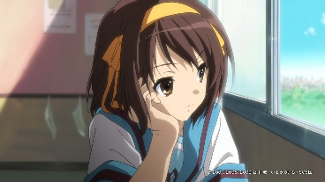
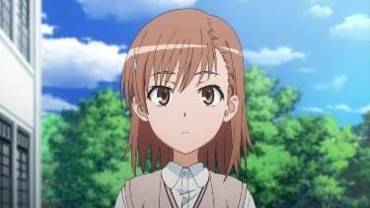
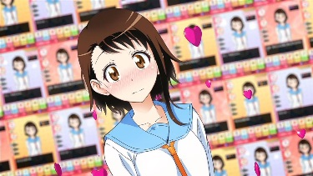
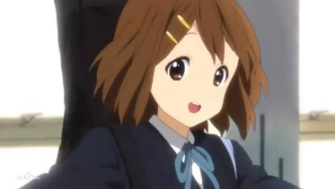
Otakus v.s. No. of Figures
A | 5 | 3 | 0 | 1
B | 4 | 3 | 0 | 1
C | 1 | 1 | 0 | 5
D | 1 | 0 | 4 | 4
E | 0 | 1 | 5 | 4
There are some common factors behind otakus and characters.
http://www.quuxlabs.com/blog/2010/09/matrix-factorization-a-simple-tutorial-and-implementation-in-python/
Notes:
平澤唯
Figure
We can do dimension reduction on otakus and characters individually.

Slide 3
Otakus v.s. No. of Figures
The factors are latent.
No one cares ……
Not directly observable
呆
呆
match
A
傲
傲
呆
呆
B
傲
呆
傲
呆
C
傲
呆
傲
傲

Slide 4


















呆
$$r^{1}$$
$$r^{2}$$
$$r^{3}$$
$$r^{4}$$
傲
A | 5 | 3 | 0 | 1
B | 4 | 3 | 0 | 1
C | 1 | 1 | 0 | 5
D | 1 | 0 | 4 | 4
E | 0 | 1 | 5 | 4
$$r^{A}$$
$$r^{B}$$
$$r^{C}$$
Matrix X
$$r^{D}$$
$$r^{E}$$
No. of Otakus = M
No. of characters = N
No. of latent factor = K
N
K
N
$$r^{A}∙r^{1}≈5$$
$$n_{A1}$$
$$n_{A2}$$
r^{A}
r¹
r²
$$r^{B}∙r^{1}≈4$$
$$×$$
K
M
$$n_{B1}$$
$$n_{B2}$$
$$≈$$
N
r^{B}
$$r^{C}∙r^{1}≈1$$
Matrix X
Minimize Error
Singular value decomposition (SVD)
……

Slide 5




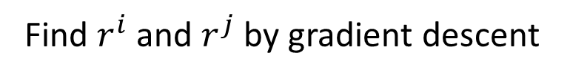

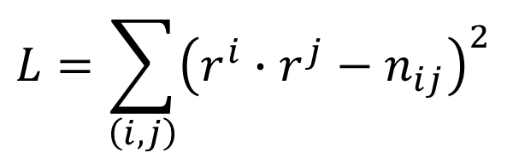

$$r^{j}$$
$$r^{1}$$
$$r^{2}$$
$$r^{3}$$
$$r^{4}$$
$$r^{i}$$
A | 5 | 3 | ? | 1
B | 4 | 3 | ? | 1
C | 1 | 1 | ? | 5
D | 1 | ? | 4 | 4
E | ? | 1 | 5 | 4
$$r^{A}$$
$$n_{A1}$$
$$r^{B}$$
$$r^{C}$$
$$r^{D}$$
$$r^{E}$$
Only considering the defined value
$$r^{A}∙r^{1}≈5$$
Minimizing
$$r^{B}∙r^{1}≈4$$
$$L=\sum_{\left(i,j\right)}{{\left(r^{i}∙r^{j}−n_{ij}\right)}^{2}}$$
$$r^{C}∙r^{1}≈1$$
……
Find $r^{i}$ and $r^{j}$ by gradient descent

Slide 6
$$r^{1}$$
$$r^{2}$$
$$r^{3}$$
$$r^{4}$$
A | 5 | 3 | ? | 1
B | 4 | 3 | ? | 1
C | 1 | 1 | ? | 5
D | 1 | ? | 4 | 4
E | ? | 1 | 5 | 4
$$r^{A}$$
-0.4
$$r^{B}$$
-0.3
$$r^{C}$$
2.2
$$r^{D}$$
0.6
$$r^{E}$$
0.1
Assume the dimensions of r are all 2 (there are two factors)
A | 0.2 | 2.1
B | 0.2 | 1.8
C | 1.3 | 0.7
D | 1.9 | 0.2
E | 2.2 | 0.0
1 (春日) | 0.0 | 2.2
2 (炮姐) | 0.1 | 1.5
3 (姐寺) | 1.9 | -0.3
4 (小唯) | 2.2 | 0.5

Slide 7


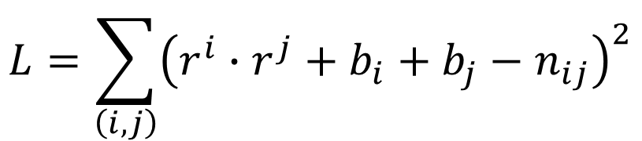

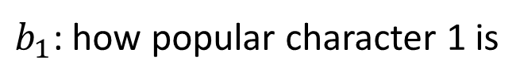
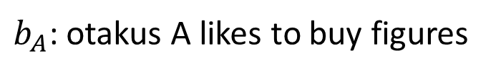
More about Matrix Factorization
Considering the induvial characteristics
Ref: Matrix Factorization Techniques For Recommender Systems
$$r^{A}∙r^{1}≈5$$
$$r^{A}∙r^{1}+b_{A}+b_{1}≈5$$
$b_{A}$: otakus A likes to buy figures
$b_{1}$: how popular character 1 is
$$L=\sum_{\left(i,j\right)}{{\left(r^{i}∙r^{j}+b_{i}+b_{j}−n_{ij}\right)}^{2}}$$
Minimizing
Find $r^{i}$, $r^{j}$, $b_{i}$, $b_{j}$ by gradient descent
(can add regularization)

Slide 8
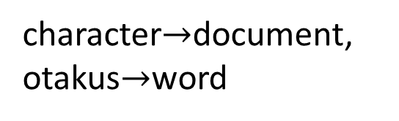
Matrix Factorization for Topic analysis
character$→$document, otakus$→$word
Latent semantic analysis (LSA)
Probability latent semantic analysis (PLSA)
Thomas Hofmann, Probabilistic Latent Semantic Indexing, SIGIR, 1999
latent Dirichlet allocation (LDA)
David M. Blei, Andrew Y. Ng, Michael I. Jordan, Latent Dirichlet Allocation, Journal of Machine Learning Research, 2003
Number in Table:
 | Doc 1 | Doc 2 | Doc 3 | Doc 4
投資 | 5 | 3 | 0 | 1
股票 | 4 | 0 | 0 | 1
總統 | 1 | 1 | 0 | 5
選舉 | 1 | 0 | 0 | 4
立委 | 0 | 1 | 5 | 4
Term frequency
(weighted by inverse document frequency)
Latent factors are topics (財經、政治 …… )

