Slide 1
More about Validation Set
I used a validation set,
but my model still overfitted?

Slide 2
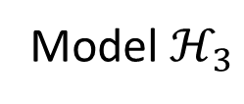

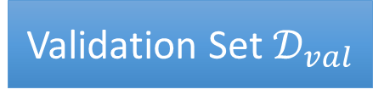
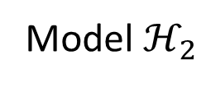


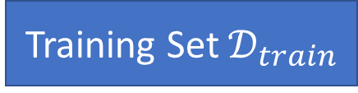

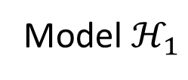

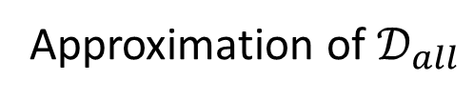





Validation Set
Training Set $𝒟_{train}$
Validation Set $𝒟_{val}$
Model $ℋ_{1}$
$$h_{1}^{∗}=arg\min_{h∈ℋ_{1}}{L\left(h,𝒟_{train}\right)}$$
$$L\left(h_{1}^{∗},𝒟_{val}\right)$$
$$=0.9$$
Model $ℋ_{2}$
$$h_{2}^{∗}=arg\min_{h∈ℋ_{2}}{L\left(h,𝒟_{train}\right)}$$
$$L\left(h_{2}^{∗},𝒟_{val}\right)$$
$$=0.7$$
Model $ℋ_{3}$
$$h_{3}^{∗}=arg\min_{h∈ℋ_{3}}{L\left(h,𝒟_{train}\right)}$$
$$L\left(h_{3}^{∗},𝒟_{val}\right)$$
$$=0.5$$
Testing Set $𝒟_{test}$
Approximation of $𝒟_{all}$

Slide 3


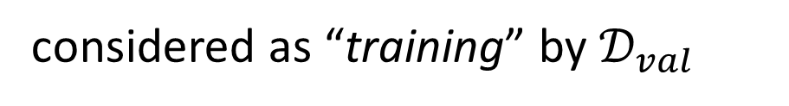



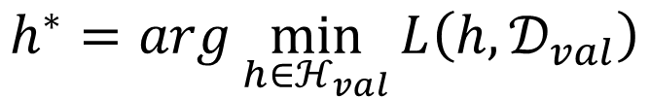
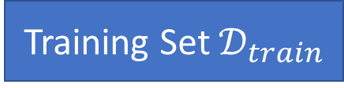

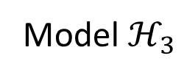

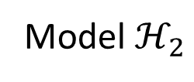



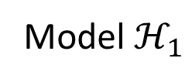


Training Set $𝒟_{train}$
Validation Set $𝒟_{val}$
Model $ℋ_{1}$
$$h_{1}^{∗}=arg\min_{h∈ℋ_{1}}{L\left(h,𝒟_{train}\right)}$$
$$L\left(h_{1}^{∗},𝒟_{val}\right)$$
$$=0.9$$
Model $ℋ_{2}$
$$h_{2}^{∗}=arg\min_{h∈ℋ_{2}}{L\left(h,𝒟_{train}\right)}$$
$$L\left(h_{2}^{∗},𝒟_{val}\right)$$
$$=0.7$$
Model $ℋ_{3}$
$$h_{3}^{∗}=arg\min_{h∈ℋ_{3}}{L\left(h,𝒟_{train}\right)}$$
$$L\left(h_{3}^{∗},𝒟_{val}\right)$$
$$=0.5$$
$$ℋ_{val}=\left\{h_{1}^{∗},h_{2}^{∗},h_{3}^{∗}\right\}$$
$$h^{∗}=arg\min_{h∈ℋ_{val}}{L\left(h,𝒟_{val}\right)}$$
Using validation set to select model =
considered as “training” by $𝒟_{val}$
Your model is
$$ℋ_{val}=\left\{h_{1}^{∗},h_{2}^{∗},h_{3}^{∗}\right\}$$

Slide 4


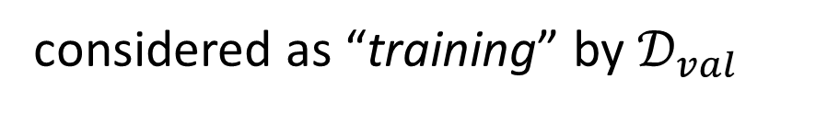

Using validation set to select model =
considered as “training” by $𝒟_{val}$
Your model is
$$ℋ_{val}=\left\{h_{1}^{∗},h_{2}^{∗},h_{3}^{∗}\right\}$$
$$L\left(h^{train},𝒟_{all}\right)−L\left(h^{all},𝒟_{all}\right)≤δ$$
$$P\left(𝒟_{train} is bad\right)≤\left|ℋ\right|∙2exp\left(−2Nε^{2}\right)$$
$$L\left(h^{val},𝒟_{all}\right)−L\left(h^{all},𝒟_{all}\right)≤δ$$
$$P\left(𝒟_{val} is bad\right)≤\left|ℋ_{val}\right|∙2exp\left(−2N_{val}ε^{2}\right)$$
It is small.
Hopefully …… ☺

