Slide 1
Graphical Model & Gibbs Sampling
Hung-yi Lee
Notes:
Can be add:
How about conditional random field
To understand:
Gibbs random field, MRF, Hammersley–Clifford theorem
Outline:
1st part: (which example should I use???)
decomposed into random variable
factor graph
some examples: Ising, HW2, the hidden CRF one?, social network????
define the factor
factors can be combined
MRF They are all linear, how to train and probabilityies
More examples with hidden variables:
- image segmentation
- sequence
- tree
2nd part:
gibbs sampling

Slide 2

Structured Learning
We also know how to involve hidden information.
Problem 1: Evaluation
Problem 2: Inference
Problem 3: Training
What does F(x,y) look like?
Given training data, how to find F(x,y)
How to solve the “arg max” problem
$$F\left(x,y\right)=w∙φ\left(x,y\right)$$
Structured SVM, etc.
Notes:
can not use it casually?

Slide 3
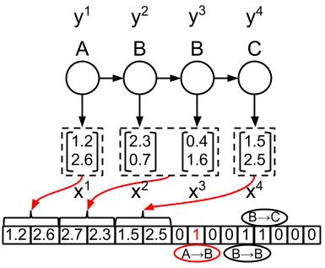


Difficulties
Difficulty 1. Evaluation
Graphical Model
$F\left(x,y\right)=w∙φ\left(x,y\right)$
$φ\left(x,y\right)$
Hard to figure out? Hard to interpret the meaning?
Difficulty 2. Inference
Gibbs Sampling
We can use Viterbi algorithm to deal with sequence labeling. How about other cases?

Slide 4
Graphical Model
A language which describes the evaluation function
Notes:
MRF <> Hammersley–Clifford theorem
Graphical model
Provide an intuitive way to define $F\left(x,y\right)$
Make the meaning of a defined $F\left(x,y\right)$ easy to be interpreted
For structured learning like structured perceptron, know how to inference solve the problem
Inference for everyone when using MRF
Outline:
1. decomposed
2. factor
3. factor to MRF
4. how to train it

Slide 5

Graphical Model
Define and describe your evaluation function F(x,y) by a graph
There are three kinds of graphical model.
Factor graph, Markov Random Field (MRF) and Bayesian Network (BN)
Only factor graph and MRF will be briefly mentioned today.
$$F\left(x,y\right)$$
Graph
Notes:
Define easily and Understand others’ evaluation function F(x,y) easily

Slide 6
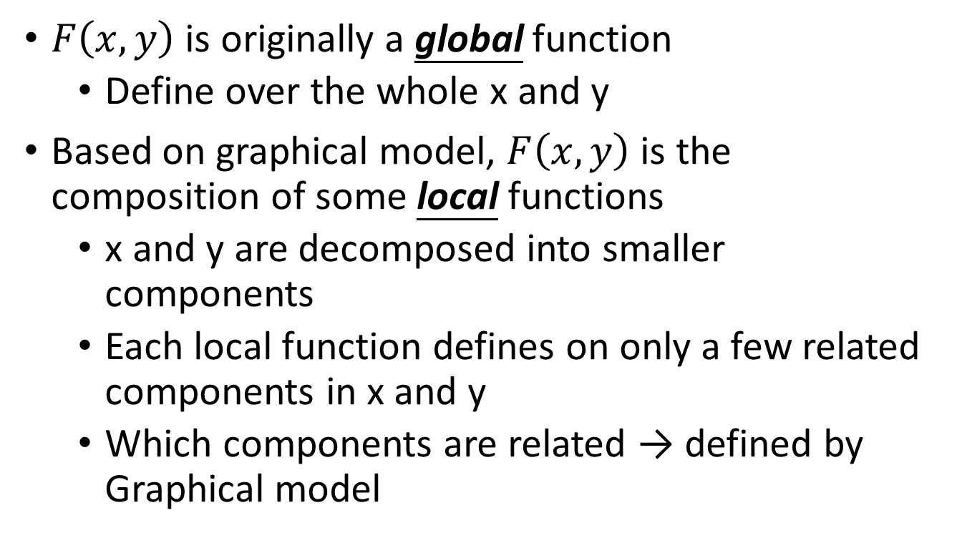
Decompose F(x,y)
$F\left(x,y\right)$ is originally a global function
Define over the whole x and y
Based on graphical model, $F\left(x,y\right)$ is the composition of some local functions
x and y are decomposed into smaller components
Each local function defines on only a few related components in x and y
Which components are related → defined by Graphical model
Notes:
represent a factor

Slide 7
Decomposable x and y
x and y are decomposed into smaller components
POS Tagging
{word}
x₁
x₂
x₃
x₄
x:
John saw the saw.
x:
x₁
x₂
x₃
x₄
y₁
y₂
y₃
y₄
y₁
y₂
y₃
y₄
y:
PN V D N
y:
{tags}
Notes:
樣本空間

Slide 8



Factor Graph
Each factor influences some components.
Each factor corresponds to a local function.
X
Y
x₁
x₂
y₁
y₂
factor a
factor b
factor c
$$f_{a}\left(x_{1},y_{1}\right)$$
$$f_{b}\left(x_{2},y_{1},y_{2}\right)$$
$$f_{d}\left(y_{2}\right)$$
Larger value means more compatible.
$$F\left(x,y\right)=f_{a}\left(x_{1},y_{1}\right)+f_{b}\left(x_{2},y_{1},y_{2}\right)+f_{c}\left(y_{2}\right)$$
You only have to define the factors.
The local functions of the factors are learned from data.
Notes:
This is factor graph.
Factor defined first

Slide 9
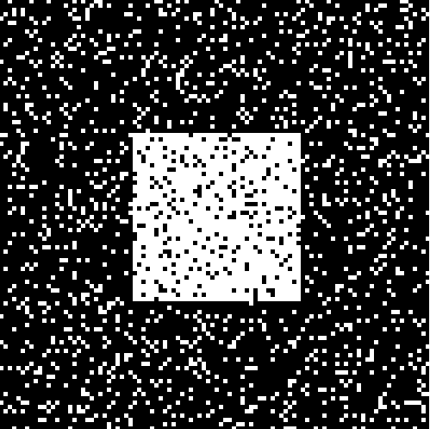

Factor Graph - Example
Image De-noising
Each pixel is one component
…
…
…
Noisy image x
{-1,1}
x₇
x₈
x₉
……
x₄
x₅
x₆
……
x₁
x₂
x₃
……
…
…
…
Clean image y
{-1,1}
y₇
y₈
y₉
……
y₄
y₅
y₆
……
y₁
y₂
y₃
……
http://cs.stanford.edu/people/karpathy/visml/ising_example.html
Notes:
If you think democe is not cool, …..
http://www.mathworks.com/help/images/ref/imnoise.html

Slide 10
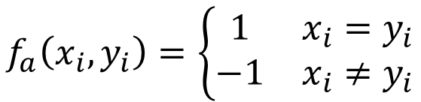
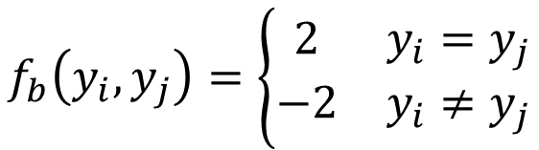
Factor Graph - Example
Noisy and clean images are related
a: the values of x_{i} and y_{i}
Factor:
The colors in the clean image is smooth.
b: the values of the neighboring y_{i}
x₃
x₄
$$f_{a}\left(x_{i},y_{i}\right)=\left\{\begin{matrix}1 & x_{i}=y_{i} \\ −1 & x_{i}≠y_{i}\end{matrix}\right.$$
noisy image
x₁
x₂
a
a
$$f_{b}\left(y_{i},y_{j}\right)=\left\{\begin{matrix}2 & y_{i}=y_{j} \\ −2 & y_{i}≠y_{j}\end{matrix}\right.$$
a
a
y₃
y₄
b
cleaned image
y₁
b
y₂
The weights can be learned from data.
b
b
Notes:
It is still bipartite
How about x
Should it be zero-one

Slide 11
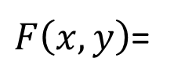
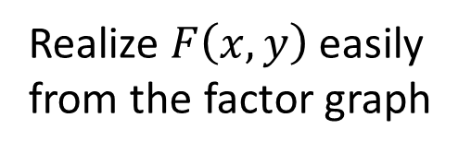
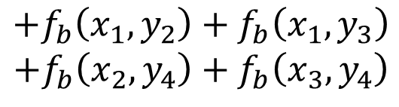
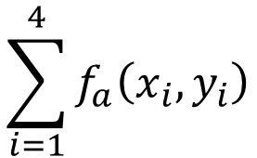
Factor Graph - Example
Noisy and clean images are related
a: the values of x_{i} and y_{i}
Factor:
The colors in the clean image is smooth.
b: the values of the neighboring y_{i}
x₃
x₄
Realize $F\left(x,y\right)$ easily from the factor graph
noisy image
x₁
x₂
a
a
$$\sum_{i=1}^{4}{f_{a}\left(x_{i},y_{i}\right)}$$
$F\left(x,y\right)$=
a
a
y₃
y₄
b
$$+f_{b}\left(x_{1},y_{2}\right)+f_{b}\left(x_{1},y_{3}\right)$$
$$+f_{b}\left(x_{2},y_{4}\right)+f_{b}\left(x_{3},y_{4}\right)$$
cleaned image
y₁
b
y₂
b
b
Notes:
It is still bipartite
How about x
Should it be zero-one

Slide 12



Factor Graph - Example
Factor:
c: the values of x_{i} and the values of the neighboring y_{i}
d: the values of the neighboring x_{i} and the values of y_{i}
x_{i-1}
x_{i}
d
$$f_{c}\left(x_{i},y_{i},y_{i−1}\right)$$
d
e
e
$$f_{d}\left(x_{i},x_{i−1},y_{i}\right)$$
c
……
c
……
y_{i-1}
y_{i}
$$f_{e}\left(x_{i},x_{i−1},y_{i},y_{i−1}\right)$$
……
……
……
……
Notes:
How about x
Should it be zero-one

Slide 13
Markov Random Field (MRF)
Clique: a set of components connecting to each other
Maximum Clique: a clique that is not included by other cliques
B
D
A
C

Slide 14



MRF
Each maximum clique on the graph corresponds to a factor
MRF
Factor Graph
A
B
A
B
$$f\left(A,B\right)$$
B
A
B
C
A
C
$$f\left(A,B,C\right)$$
B
D
A
B
C
D
A
C
$$f\left(A,B,C,D\right)$$
Notes:
What if we have duplicate …..

Slide 15
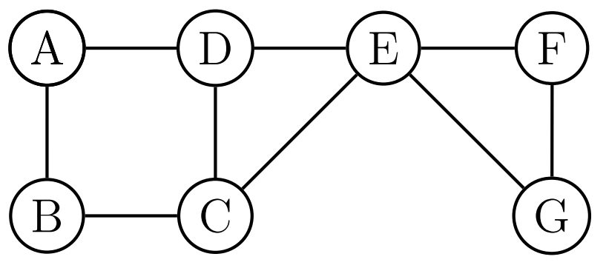
MRF
MRF
Factor Graph
b
a
d
e
c
Evaluation Function
$$f_{a}\left(A,B\right){+f}_{b}\left(A,D\right)+f_{c}\left(B,C\right)+f_{d}\left(C,D,E\right)+f_{e}\left(E,F,G\right)$$

Slide 16

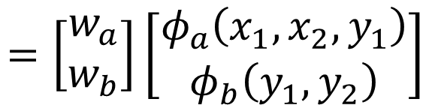


Training
x₁
x₂
a
y₂
b
y₁
$$F\left(x,y\right)=f_{a}\left(x_{1},x_{2},y_{1}\right)+f_{b}\left(y_{1},y_{2}\right)$$
$$=w_{a}∙φ_{a}\left(x_{1},x_{2},y_{1}\right)$$
$$+w_{b}∙φ_{b}\left(y_{1},y_{2}\right)$$
$$=\left[\begin{aligned}w_{a} \\ w_{b}\end{aligned}\right]\left[\begin{aligned}φ_{a}\left(x_{1},x_{2},y_{1}\right) \\ φ_{b}\left(y_{1},y_{2}\right)\end{aligned}\right]$$
Simply training by structured perceptron or structured SVM
$$=w∙φ\left(x,y\right)$$
Max-Margin Markov Networks (M3N)

Slide 17
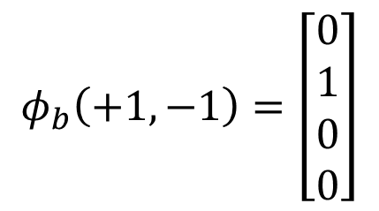
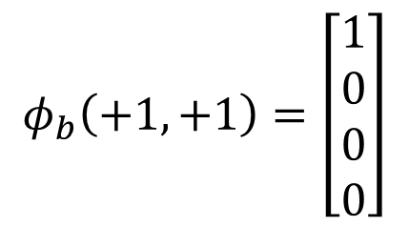

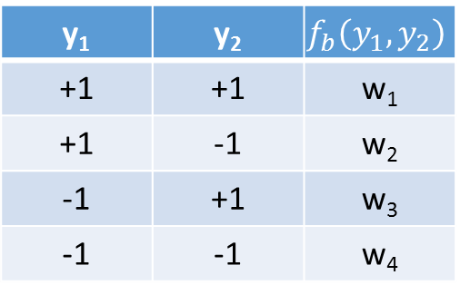
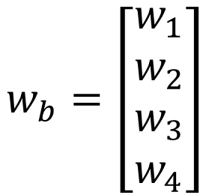
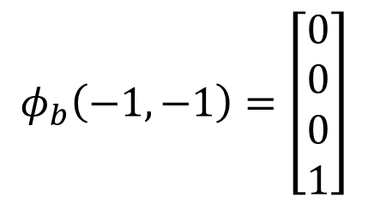
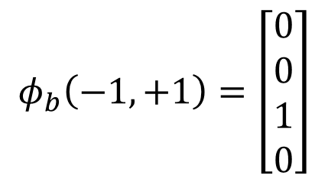
Training
x₁
x₂
$$φ_{b}\left(+1,+1\right)=\left[\begin{aligned}1 \\ 0 \\ 0 \\ 0\end{aligned}\right]$$
a
y₂
b
y₁
$$φ_{b}\left(+1,−1\right)=\left[\begin{aligned}0 \\ 1 \\ 0 \\ 0\end{aligned}\right]$$
$$F\left(x,y\right)=f_{a}\left(x_{1},x_{2},y_{1}\right)+f_{b}\left(y_{1},y_{2}\right)$$
$$=w_{a}∙φ_{a}\left(x_{1},x_{2},y_{1}\right)$$
$$+w_{b}∙φ_{b}\left(y_{1},y_{2}\right)$$
$$φ_{b}\left(−1,+1\right)=\left[\begin{aligned}0 \\ 0 \\ 1 \\ 0\end{aligned}\right]$$
$$y_{1},y_{2}ε\left\{+1,−1\right\}$$
y₁ | y₂ | $$f_{b}\left(y_{1},y_{2}\right)$$
+1 | +1 | w₁
+1 | -1 | w₂
-1 | +1 | w₃
-1 | -1 | w₄
$$w_{b}=\left[\begin{aligned}w_{1} \\ w_{2} \\ w_{3} \\ w_{4}\end{aligned}\right]$$
$$φ_{b}\left(−1,−1\right)=\left[\begin{aligned}0 \\ 0 \\ 0 \\ 1\end{aligned}\right]$$

Slide 18

Now can you interpret this?
$φ\left(x,y\right)$

Slide 19




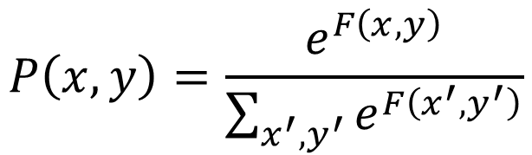


Probability Point of View
$F\left(x,y\right)$ can be any real number
If you like probability
Between 0 and 1
To be positive
$$P\left(x,y\right)=\frac{e^{F\left(x,y\right)}}{\sum_{x^{′},y^{′}}{e^{F\left(x^{′},y^{′}\right)}}}$$
normalization
$$=\frac{P\left(x,y\right)}{P\left(x\right)}$$
$$P\left(y|x\right)$$
$$=\frac{\frac{e^{F\left(x,y\right)}}{\sum_{x^{′},y^{′}}{e^{F\left(x^{′},y^{′}\right)}}}}{\sum_{y^{′′}}{\frac{e^{F\left(x,y^{′′}\right)}}{\sum_{x^{′},y^{′}}{e^{F\left(x^{′},y^{′}\right)}}}}}$$
$$=\frac{P\left(x,y\right)}{\sum_{y^{′′}}{P\left(x,y^{′′}\right)}}$$
$$=\frac{e^{F\left(x,y\right)}}{\sum_{y^{′′}}{e^{F\left(x,y^{′′}\right)}}}$$
Notes:
Maybe I have to mention some more examples in the next pages

Slide 20
Gibbs Sampling
Inference for the dumb
Notes:
For structured learning like structured perceptron, know how to inference solve the problem
Inference for everyone when using MRF
Outline:
idea of sampling
Gibbs
Gibbs on MRF
Example

Slide 21

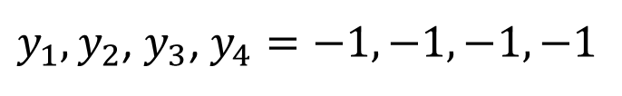
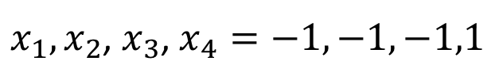
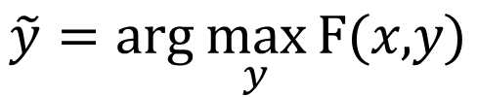

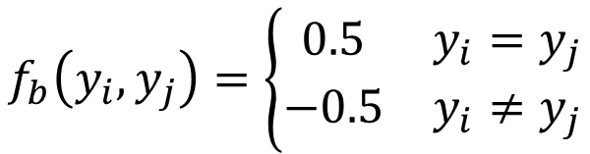
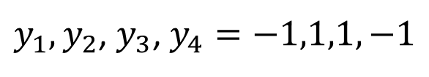
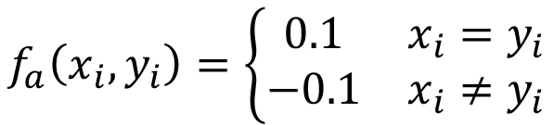

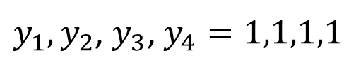
$$f_{a}\left(x_{i},y_{i}\right)=\left\{\begin{matrix}0.1 & x_{i}=y_{i} \\ −0.1 & x_{i}≠y_{i}\end{matrix}\right.$$
Inference:
$$\tilde{y}=arg\max_{y}{\text{F}\text{(}\text{x}\text{,}\text{y}\text{)}}$$
$$f_{b}\left(y_{i},y_{j}\right)=\left\{\begin{matrix}0.5 & y_{i}=y_{j} \\ −0.5 & y_{i}≠y_{j}\end{matrix}\right.$$
$y_{1},y_{2}$, $y_{3}$, $y_{4}=−1,−1,−1,−1$
Given input noisy image x
$$F\left(x,y\right)=2.2$$
max
$x_{1},x_{2}$, $x_{3}$, $x_{4}=−1,−1,−1,1$
$y_{1},y_{2}$, $y_{3}$, $y_{4}=1,1,1,1$
x₃
x₄
$$F\left(x,y\right)=1.8$$
x₃
x₄
0.1
$y_{1},y_{2}$, $y_{3}$, $y_{4}=−1,1,1,−1$
x₁
x₂
-0.1
x₁
x₂
a
a
$$F\left(x,y\right)=−2.2$$
0.1
0.1
…
a
a
0.5
y₃
y₃
y₄
y₄
Enumerate all possible y
0.5
b
y₁
b
Design an efficient algorithm to do that is not always easy.
y₁
y₂
y₂
b
0.5
0.5
b

Slide 22
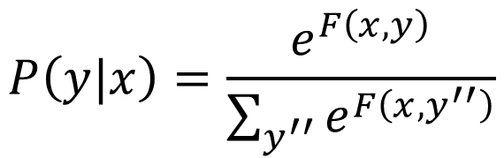

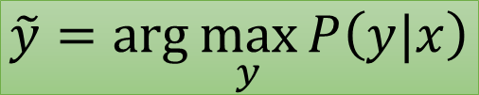
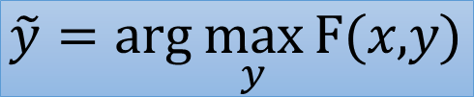
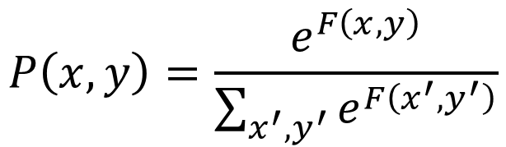
Sampling?
Probability point of view:
$$P\left(x,y\right)=\frac{e^{F\left(x,y\right)}}{\sum_{x^{′},y^{′}}{e^{F\left(x^{′},y^{′}\right)}}}$$
$$P\left(y|x\right)=\frac{e^{F\left(x,y\right)}}{\sum_{y^{′′}}{e^{F\left(x,y^{′′}\right)}}}$$
Independent of y
$$∝F\left(x,y\right)$$
$$\tilde{y}=arg\max_{y}{\text{F}\text{(}\text{x}\text{,}\text{y}\text{)}}$$
=
$$\tilde{y}=arg\max_{y}{P\left(y|x\right)}$$
Notes:
Different x, different distribution

Slide 23
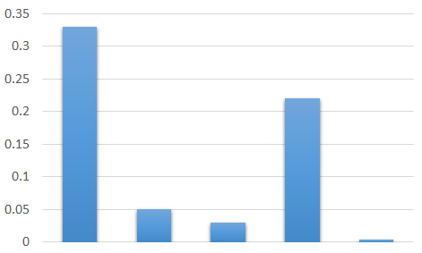


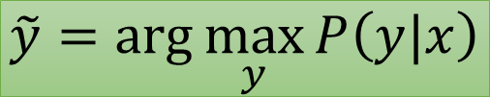
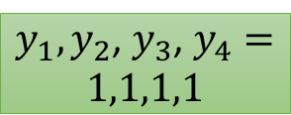


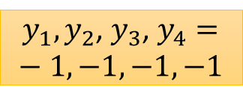

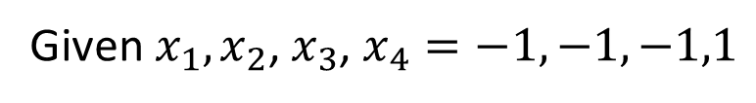



Sampling?
$$\tilde{y}=arg\max_{y}{P\left(y|x\right)}$$
Sample from the distribution ……
$P\left(y|x\right)$ is a distribution
Given $x_{1},x_{2}$, $x_{3}$, $x_{4}=−1,−1,−1,1$
$$−1,−1,−1,−1$$
$y_{1},y_{2}$, $y_{3}$, $y_{4}=−1,−1,−1,−1$
$$1,1,1,1$$
$$−1,−1,−1,1$$
$y_{1},y_{2}$, $y_{3}$, $y_{4}=1,1,1,1$
$$−1,−1,−1,−1$$
Probability P(y|x)
$$1,1,1,1$$
$$−1,−1,−1,−1$$
……
$$−1,−1,−1,−1$$
Max probability
Inference result

Slide 24
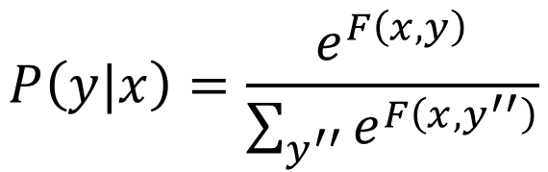
Sampling?
$$P\left(y|x\right)=\frac{e^{F\left(x,y\right)}}{\sum_{y^{′′}}{e^{F\left(x,y^{′′}\right)}}}$$
Sample from the distribution ……
$P\left(y|x\right)$ is a distribution
Given $x_{1},x_{2}$, $x_{3}$, $x_{4}=−1,−1,−1,1$
$$−1,−1,−1,−1$$
$y_{1},y_{2}$, $y_{3}$, $y_{4}=−1,−1,−1,−1$
$$1,1,1,1$$
$$−1,−1,−1,1$$
$y_{1},y_{2}$, $y_{3}$, $y_{4}=1,1,1,1$
$$−1,−1,−1,−1$$
Probability P(y|x)
$$1,1,1,1$$
$$−1,−1,−1,−1$$
……
It is hard to know the distribution.
$$−1,−1,−1,−1$$
If we know the distribution, why bother with the sampling?
Max probability
Inference result

Slide 25
Gibbs Sampling
There is a probability distribution P(y|x)
y = {y₁, y₂, …, y_{N}}
We want to sample from P(y|x), but it is too complex to do that
However, P(y_{i}|y₁, y₂, …, y_{i-1}, y_{i+1}, …, y_{N},x) can be computed
We can sample from P(y|x) by Gibbs sampling
Notes:
z is a set of random variables

Slide 26

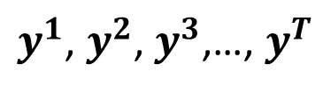

Gibbs Sampling
$$y^{0}=\left\{y_{1}^{0},y_{2}^{0},⋯,y_{N}^{0}\right\}$$
Initialization
For t = 1 to T:
T samples
$$y_{1}^{t}\sim P\left(y_{1}|y_{2}=y_{2}^{t−1},y_{3}=y_{3}^{t−1},y_{4}=y_{4}^{t−1},⋯,y_{N}=y_{N}^{t−1},x\right)$$
$$y_{2}^{t}\sim P\left(y_{2}|y_{1}=y_{1}^{t},y_{3}=y_{3}^{t−1},y_{4}=y_{4}^{t−1},⋯,y_{N}=y_{N}^{t−1},x\right)$$
$$y_{3}^{t}\sim P\left(y_{3}|y_{1}=y_{1}^{t},y_{2}=y_{2}^{t},y_{4}=y_{4}^{t−1},⋯,y_{N}=y_{N}^{t−1},x\right)$$
…
$$y_{N}^{t}\sim P\left(y_{N}|y_{1}=y_{1}^{t},y_{2}=y_{2}^{t},y_{3}=y_{3}^{t},⋯,y_{N−1}=y_{N−1}^{t},x\right)$$
Get a sample: $y^{t}=\left\{y_{1}^{t},y_{2}^{t},⋯,y_{N}^{t}\right\}$
As sampling from P(y|x)
$y^{1}$, $y^{2}$, $y^{3}$,…, $y^{T}$
Notes:
Superscript, donw script
Markov Chain: a stochastic process in which future states are independent of past states given the present state

Slide 27
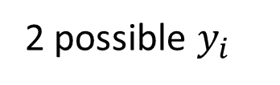
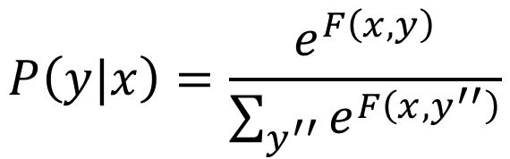


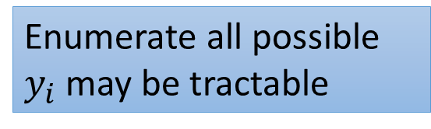

Gibbs Sampling
Is P(y_{i}|y₁, y₂, …, y_{i-1}, y_{i+1}, …, y_{N},x) easy to be computed?
$$y_{i}ε\left\{+1,−1\right\}$$
2^{N} possible y
$$P\left(y|x\right)=\frac{e^{F\left(x,y\right)}}{\sum_{y^{′′}}{e^{F\left(x,y^{′′}\right)}}}$$
Enumerate all possible y may not be tractable
$$P\left(y_{i}|y_{1},y_{2},⋯,y_{i−1},y_{i+1},⋯,y_{N},x\right)$$
$$=\frac{e^{F\left(x,y_{−i},y_{i}\right)}}{\sum_{y_{i}^{′}}{e^{F\left(x,y_{−i},y_{i}^{′}\right)}}}$$
$$y_{i}ε\left\{+1,−1\right\}$$
2 possible $y_{i}$
Enumerate all possible $y_{i}$ may be tractable

Slide 28
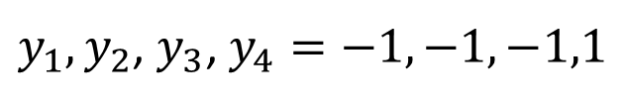
Initialization
$y_{1},y_{2}$, $y_{3}$, $y_{4}=−1,−1,−1,1$
x₃
x₄
x₁
x₂
y₃
y₃
y₄
y₄
Sample from P(y|x) by Gibbs sampling
y₁
y₁
y₂
y₂

Slide 29

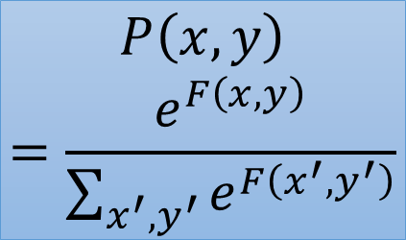

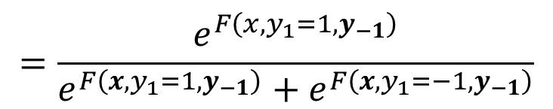
Sample y₁ given all the other variables
$y_{1}\sim P\left(y_{1}|y_{−1},x\right)$
$$y_{−1}=\left\{y_{2},y_{3},y_{4}\right\}$$
x₃
x₄
0.1
0.1
x₁
x₂
$$P\left(x,y\right)$$
$$=\frac{e^{F\left(x,y\right)}}{\sum_{x^{′},y^{′}}{e^{F\left(x^{′},y^{′}\right)}}}$$
-0.1
0.1
y₃
y₃
y₄
y₄
-0.5
-0.5
y₁
-0.5
y₁
y₁
y₂
?
y₁
y₂
-0.5
Compute $P\left(y_{1}=1|y_{−1},x\right)$ and $P\left(y_{1}=−1|y_{−1},x\right)$
$$P\left(y_{1}=1|y_{−1},x\right)=\frac{P\left(x,y_{1}=1,y_{−1}\right)}{P\left(x,y_{1}=1,y_{−1}\right)+P\left(x,y_{1}=−1,y_{−1}\right)}$$
$$=\frac{e^{F\left(x,y_{1}=1,y_{−1}\right)}}{e^{F\left(x,y_{1}=1,y_{−1}\right)}+e^{F\left(x,y_{1}=−1,y_{−1}\right)}}$$
= -1.8
= -1.8

Slide 30


Sample y₁ given all the other variables
$y_{1}\sim P\left(y_{1}|y_{−1},x\right)$
$$y_{−1}=\left\{y_{2},y_{3},y_{4}\right\}$$
x₃
x₄
0.1
0.1
x₁
x₂
0.1
0.1
y₃
y₃
y₄
y₄
0.5
-0.5
0.5
-0.5
y₁
y₁
y₁
y₂
?
y₁
y₂
Compute $P\left(y_{1}=1|y_{−1},x\right)$ and $P\left(y_{1}=−1|y_{−1},x\right)$
$$P\left(y_{1}=1|y_{−1},x\right)=\frac{P\left(x,y_{1}=1,y_{−1}\right)}{P\left(x,y_{1}=1,y_{−1}\right)+P\left(x,y_{1}=−1,y_{−1}\right)}$$
$$=\frac{e^{F\left(x,y_{1}=1,y_{−1}\right)}}{e^{F\left(x,y_{1}=1,y_{−1}\right)}+e^{F\left(x,y_{1}=−1,y_{−1}\right)}}$$
= -1.8
$$=0.10$$
$$y_{1}=−1$$
Random sample
= -1.8
=0.4

Slide 31
Sample y₁ given all the other variables
$y_{1}\sim P\left(y_{1}|y_{−1},x\right)$
$$y_{−1}=\left\{y_{2},y_{3},y_{4}\right\}$$
x₃
x₄
x₁
x₂
y₃
y₃
y₄
y₄
y₁
y₁
y₁
y₂
?
y₁
y₂
Compute $P\left(y_{1}=1|y_{−1},x\right)$ and $P\left(y_{1}=−1|y_{−1},x\right)$
$$P\left(y_{1}=1|y_{−1},x\right)=\frac{P\left(x,y_{1}=1,y_{−1}\right)}{P\left(x,y_{1}=1,y_{−1}\right)+P\left(x,y_{1}=−1,y_{−1}\right)}$$
$$=\frac{e^{F\left(x,y_{1}=1,y_{−1}\right)}}{e^{F\left(x,y_{1}=1,y_{−1}\right)}+e^{F\left(x,y_{1}=−1,y_{−1}\right)}}$$
= -1.8
$$=0.10$$
$$y_{1}=−1$$
Random sample
= -1.8
=0.4

Slide 32
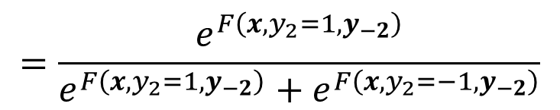

Sample y₂ given all the other variables
$y_{2}\sim P\left(y_{2}|y_{−2},x\right)$
x₃
x₄
0.1
0.1
x₁
x₂
0.1
-0.1
y₃
y₃
y₄
y₄
0.5
-0.5
y₁
-0.5
0.5
y₁
y₁
y₂
y₁
y₂
?
$$P\left(y_{2}=1|y_{−2},x\right)=\frac{P\left(x,y_{2}=1,y_{−2}\right)}{P\left(x,y_{2}=1,y_{−2}\right)+P\left(x,y_{2}=−1,y_{−2}\right)}$$
=0.2
$$=\frac{e^{F\left(x,y_{2}=1,y_{−2}\right)}}{e^{F\left(x,y_{2}=1,y_{−2}\right)}+e^{F\left(x,y_{2}=−1,y_{−2}\right)}}$$
=0.2

Slide 33
Sample y₂ given all the other variables
$y_{2}\sim P\left(y_{2}|y_{−2},x\right)$
x₃
x₄
0.1
0.1
x₁
x₂
0.1
0.1
y₃
y₃
y₄
y₄
0.5
-0.5
y₁
0.5
-0.5
y₁
y₁
y₂
y₁
y₂
y₂
?
$$P\left(y_{2}=1|y_{−2},x\right)=\frac{P\left(x,y_{2}=1,y_{−2}\right)}{P\left(x,y_{2}=1,y_{−2}\right)+P\left(x,y_{2}=−1,y_{−2}\right)}$$
=0.2
$$=\frac{e^{F\left(x,y_{2}=1,y_{−2}\right)}}{e^{F\left(x,y_{2}=1,y_{−2}\right)}+e^{F\left(x,y_{2}=−1,y_{−2}\right)}}$$
=0.2
=0.4

Slide 34


Sample y₂ given all the other variables
$y_{2}\sim P\left(y_{2}|y_{−2},x\right)$
x₃
x₄
x₁
x₂
y₃
y₃
y₄
y₄
y₁
y₂
y₁
y₁
y₂
y₁
?
$$P\left(y_{2}=1|y_{−2},x\right)=\frac{P\left(x,y_{2}=1,y_{−2}\right)}{P\left(x,y_{2}=1,y_{−2}\right)+P\left(x,y_{2}=−1,y_{−2}\right)}$$
=0.2
$$=\frac{e^{F\left(x,y_{2}=1,y_{−2}\right)}}{e^{F\left(x,y_{2}=1,y_{−2}\right)}+e^{F\left(x,y_{2}=−1,y_{−2}\right)}}$$
$$=0.45$$
$$y_{2}=1$$
Random sample
=0.2
=0.4

Slide 35




Sample y₃ given all the other variables
$y_{3}\sim P\left(y_{3}|y_{−3},x\right)$
x₃
x₄
x₁
x₂
?
y₃
y₄
y₃
y₄
y₁
y₂
y₁
y₁
y₂
y₁
$$P\left(y_{3}=1|y_{−3},x\right)=?$$
$$0.45$$
$$y_{3}=−1$$
Random sample

Slide 36

Sample y₄ given all the other variables
$y_{4}\sim P\left(y_{4}|y_{−4},x\right)$
x₃
x₄
x₁
x₂
?
y₃
y₄
y₄
y₄
y₃
y₄
y₁
y₂
y₁
y₁
y₂
y₁
Get 1-st sample y₁=-1, y₂=1, y₃=-1, y₄=-1

Slide 37
x₃
x₄
x₁
x₂
y₄
y₄
y₃
y₄
y₄
?
y₃
y₄
y₃
y₄
y₃
?
y₂
y₂
y₁
y₂
y₁
y₂
y₁
?
y₁
?
Get 1-st sample y₁=-1, y₂=1, y₃=-1, y₄=-1
Get 2-nd sample y₁=-1, y₂=-1, y₃=-1, y₄=-1

Slide 38
Get 1-st sample y₁=-1, y₂=1, y₃=-1, y₄=-1
Get 2-nd sample y₁=-1, y₂=-1, y₃=-1, y₄=-1
Get 3-rd sample y₁=1, y₂=1, y₃=-1, y₄=1
Get 4-th sample y₁=-1, y₂=1, y₃=-1, y₄=1
Get 5-th sample y₁=1, y₂=1, y₃=1, y₄=1
……
Until you want to stop
Notes:
-1 1 -1 -1
-1 -1 -1 -1
1 1 -1 1
-1 1 -1 1
1 1 1 1
1 1 1 1
-1 -1 -1 -1
-1 1 1 1
1 1 1 1
1 1 -1 -1

Slide 39



P(y^{A}|x)≈0.33
P(y^{B}|x)≈0.22
P(y^{C}|x)≈0.004
y^{A}
y^{B}
y^{C}
No. of samples | y^{A} | y^{B} | y^{C}
10 | 2 | 3 | 0
100 | 23 | 37 | 0
1000 | 315 | 230 | 8
10000 | 3307 | 2225 | 40
100000 | 32637 | 22129 | 422
P(y^{A}|x) ≈0.33
P(y^{B}|x) ≈0.22
P(y^{C}|x) ≈0.004
From sampling:
y^{A} would be the results of inference.
Notes:
Very Close to True probability distribution
0.46799579911834
0.172166033050238
0.0233001388465779

Slide 40
How about starting from different initialization?
Not really change the final results.
No. of samples | A | B | C
10 | 3 | 1 | 0
100 | 40 | 11 | 1
1000 | 331 | 237 | 2
10000 | 3251 | 2176 | 31
100000 | 32911 | 21845 | 385
Starting from …
No. of samples | A | B | C
10 | 0 | 3 | 0
100 | 28 | 31 | 0
1000 | 318 | 226 | 2
10000 | 3277 | 2169 | 46
100000 | 32319 | 21751 | 393
Starting from …
Notes:
Different from start, but be the same finally

Slide 41

All rivers run into the sea.
http://www.juergenwiki.de/work/wiki/doku.php?id=public:mcmc
Notes:
殊途同歸

Slide 42

Practical Suggestion
“burn-in”
“burn-in” period: The first few of samples would be influenced by the initialization
Discard the samples in the “burn-in” period
Modify the sampling distribution
c > 1
X c
$$=\frac{e^{F\left(x,y_{−i},y_{i}\right)}}{\sum_{y_{i}^{′}}{e^{F\left(x,y_{−i},y_{i}^{′}\right)}}}$$
$$P\left(y_{i}|y_{1},y_{2},⋯,y_{i−1},y_{i+1},⋯,y_{N},x\right)$$
X c
X c
Increase c after each interaction

Slide 43
Gibbs Sampling
A little bit of theory
Notes:
Outline:
-What is Markov chain
- -When will it be stationary? Properties ….
-Gibbs is a Markov chain
-P(z) is the stationary
For structured learning like structured perceptron, know how to inference solve the problem
Inference for everyone when using MRF
Question
- Ergoic: true considition. What is not?
- Slice sampling (not sure to mention or not)

Slide 44



Gibbs Sampling
Gibbs sampling from a distribution P(z) ( z = {z₁,…,z_{N}} )
$$z^{0}=\left\{z_{1}^{0},z_{2}^{0},⋯,z_{N}^{0}\right\}$$
For t = 1 to T:
$$z_{1}^{t}\sim P\left(z_{1}|z_{2}=z_{2}^{t−1},z_{3}=z_{3}^{t−1},z_{4}=z_{4}^{t−1},⋯,z_{N}=z_{N}^{t−1}\right)$$
$$z_{2}^{t}\sim P\left(z_{2}|z_{1}=z_{1}^{t},z_{3}=z_{3}^{t−1},z_{4}=z_{4}^{t−1},⋯,z_{N}=z_{N}^{t−1}\right)$$
$$z_{3}^{t}\sim P\left(z_{3}|z_{1}=z_{1}^{t},z_{2}=z_{2}^{t},z_{4}=z_{4}^{t−1},⋯,z_{N}=z_{N}^{t−1}\right)$$
…
$$z_{N}^{t}\sim P\left(z_{N}|z_{1}=z_{1}^{t},z_{2}=z_{2}^{t},z_{3}=z_{3}^{t},⋯,z_{N−1}=z_{N−1}^{t}\right)$$
Output: $z^{t}=\left\{z_{1}^{t},z_{2}^{t},⋯,z_{N}^{t}\right\}$
As sampling from P(z)
$z^{1}$, $z^{2}$, $z^{3}$,…, $z^{T}$
Why?
Notes:
Markov Chain: a stochastic process in which future states are independent of past states given the present state

Slide 45


Markov Chain
0
Three cities A, B and C
C
1/6
1/2
1/2
1/2
A
1/6
B
2/3
1/2
0
The traveler recorded the cities he visited each day.
A
B
C
A
A
……
This is a Markov chain
state
Notes:
Each day he decided which city he would visit with the probability distribution depending on which city he was in
Random Walk
Web pages ? Use on webpages, page rank

Slide 46




Markov Chain
With sufficient samples ……
A : B : C = 0.6 : 0.2 : 0.2
(independent of the starting city)
10000 days
10000 days
10000 days
Notes:
5915
2025
2060
6016
2002
1982
5946
2016
2038
0.6
0.2
0.2

Slide 47
Markov Chain
0
0.2
C
P(A)=0.6
P(B)=0.2
1/6
1/2
1/2
1/2
P(C)=0.2
0.6
0.2
A
1/6
B
Stationary
Distribution
2/3
1/2
0
2/3
0.6
1/2
0.2
1/2
0.2
0.6
$$P_{T}\left(A | A\right)P\left(A\right)+P_{T}\left(A | B\right)P\left(B\right)+P_{T}\left(A | C\right)P\left(C\right)=P\left(A\right)$$
$$P_{T}\left(B | A\right)P\left(A\right)+P_{T}\left(B | B\right)P\left(B\right)+P_{T}\left(B | C\right)P\left(C\right)=P\left(B\right)$$
$$P_{T}\left(C | A\right)P\left(A\right)+P_{T}\left(C | B\right)P\left(B\right)+P_{T}\left(C | C\right)P\left(C\right)=P\left(C\right)$$
The distribution will not change.
Notes:
Web pages ? Use on webpages, page rank

Slide 48
Markov Chain
A Markov Chain can have multiple stationary distributions.
1
C
Reaching which stationary distribution depends on starting state
B
A
1
1
The Markov Chain fulfill some conditions will have unique stationary distribution.
P_{T}(s’|s) for any states s and s’ is not zero
Unique stationary distribution
(sufficient but not necessary condition)
Notes:
Web pages ? Use on webpages, page rank
Irreducible, appreriodic

Slide 49


Markov Chain from Gibbs Sampling
Gibbs sampling from a distribution P(z) ( z = {z₁,…,z_{N}} )
$$z^{0}=\left\{z_{1}^{0},z_{2}^{0},⋯,z_{N}^{0}\right\}$$
For t = 1 to T:
$$z_{1}^{t}\sim P\left(z_{1}|z_{2}=z_{2}^{t−1},z_{3}=z_{3}^{t−1},z_{4}=z_{4}^{t−1},⋯,z_{N}=z_{N}^{t−1}\right)$$
$$z_{2}^{t}\sim P\left(z_{2}|z_{1}=z_{1}^{t},z_{3}=z_{3}^{t−1},z_{4}=z_{4}^{t−1},⋯,z_{N}=z_{N}^{t−1}\right)$$
$$z_{3}^{t}\sim P\left(z_{3}|z_{1}=z_{1}^{t},z_{2}=z_{2}^{t},z_{4}=z_{4}^{t−1},⋯,z_{N}=z_{N}^{t−1}\right)$$
…
$$z_{N}^{t}\sim P\left(z_{N}|z_{1}=z_{1}^{t},z_{2}=z_{2}^{t},z_{3}=z_{3}^{t},⋯,z_{N−1}=z_{N−1}^{t}\right)$$
Output: $z^{t}=\left\{z_{1}^{t},z_{2}^{t},⋯,z_{N}^{t}\right\}$
This is a Markov Chain
$z^{1}$, $z^{2}$, $z^{3}$,…, $z^{T}$
z^{t} only depend on z^{t-1}
state
Notes:
Markov Chain: a stochastic process in which future states are independent of past states given the present state

Slide 50
Markov Chain from Gibbs Sampling
Gibbs sampling from a distribution P(z) ( z = {z₁,…,z_{N}} )
$$z^{0}=\left\{z_{1}^{0},z_{2}^{0},⋯,z_{N}^{0}\right\}$$
For t = 1 to T:
$$z_{1}^{t}\sim P\left(z_{1}|z_{2}=z_{2}^{t−1},z_{3}=z_{3}^{t−1},z_{4}=z_{4}^{t−1},⋯,z_{N}=z_{N}^{t−1}\right)$$
$$z_{2}^{t}\sim P\left(z_{2}|z_{1}=z_{1}^{t},z_{3}=z_{3}^{t−1},z_{4}=z_{4}^{t−1},⋯,z_{N}=z_{N}^{t−1}\right)$$
$$z_{3}^{t}\sim P\left(z_{3}|z_{1}=z_{1}^{t},z_{2}=z_{2}^{t},z_{4}=z_{4}^{t−1},⋯,z_{N}=z_{N}^{t−1}\right)$$
…
$$z_{N}^{t}\sim P\left(z_{N}|z_{1}=z_{1}^{t},z_{2}=z_{2}^{t},z_{3}=z_{3}^{t},⋯,z_{N−1}=z_{N−1}^{t}\right)$$
Output: $z^{t}=\left\{z_{1}^{t},z_{2}^{t},⋯,z_{N}^{t}\right\}$
Proof that the Markov chain has unique stationary distribution which is P(z).
$z^{1}$, $z^{2}$, $z^{3}$,…, $z^{T}$
Notes:
Markov Chain: a stochastic process in which future states are independent of past states given the present state

Slide 51

Markov Chain from Gibbs Sampling
Markov chain from Gibbs sampling has unique stationary distribution?
$P_{T}\left(z^{′}|z\right)>0$, for any z and z’
Yes
$$z_{1}^{t}\sim P\left(z_{1}|z_{2}=z_{2}^{t−1},z_{3}=z_{3}^{t−1}, ⋯,z_{N}=z_{N}^{t−1}\right)$$
None of the conditional probability is zero
$$z_{2}^{t}\sim P\left(z_{2}|z_{1}=z_{1}^{t},z_{3}=z_{3}^{t−1}, ⋯,z_{N}=z_{N}^{t−1}\right)$$
$$z_{3}^{t}\sim P\left(z_{3}|z_{1}=z_{1}^{t},z_{2}=z_{2}^{t}, ⋯,z_{N}=z_{N}^{t−1}\right)$$
…
$$z_{N}^{t}\sim P\left(z_{N}|z_{1}=z_{1}^{t},z_{2}=z_{2}^{t}, ⋯,z_{N−1}=z_{N−1}^{t}\right)$$
can be any z^{t}

Slide 52






Markov Chain from Gibbs Sampling
Show that P(z) is a stationary distribution
$$\sum_{z}{P_{T}\left(z^{′}|z\right) P\left(z\right)}$$
$$=P\left(z^{′}\right)$$
$$P_{T}\left(z^{′}|z\right)$$
$$=P\left(z_{1}^{′}|z_{2},z_{3},z_{4},⋯,z_{N}\right)$$
$$×P\left(z_{2}^{′}|z_{1}^{′},z_{3},z_{4},⋯,z_{N}\right)$$
$$×P\left(z_{3}^{′}|z_{1}^{′},z_{2}^{′},z_{4},⋯,z_{N}\right)$$
…
$$×P\left(z_{N}^{′}|z_{1}^{′},z_{2}^{′},z_{3}^{′},⋯,z_{N−1}^{′}\right)$$
There is only one stationary distribution for Gibbs sampling, so we are done.
Notes:
Can be proofed,
Random systematic sweep
http://web.maths.unsw.edu.au/~peterdel-moral/teaching-notes-levers-johansen.pdf

Slide 53
Thank you for your attention!

