Slide 1
MLDS
Caffe Tutorial
2015-12-18 simpdanny

Slide 2

Outline
BVLC: Berkeley Vision and Learning Center
Caffe: Convolutional Architecture for Fast Feature Embedding
What can Caffe do?
Installation
Tutorial
Conclusion

Slide 3
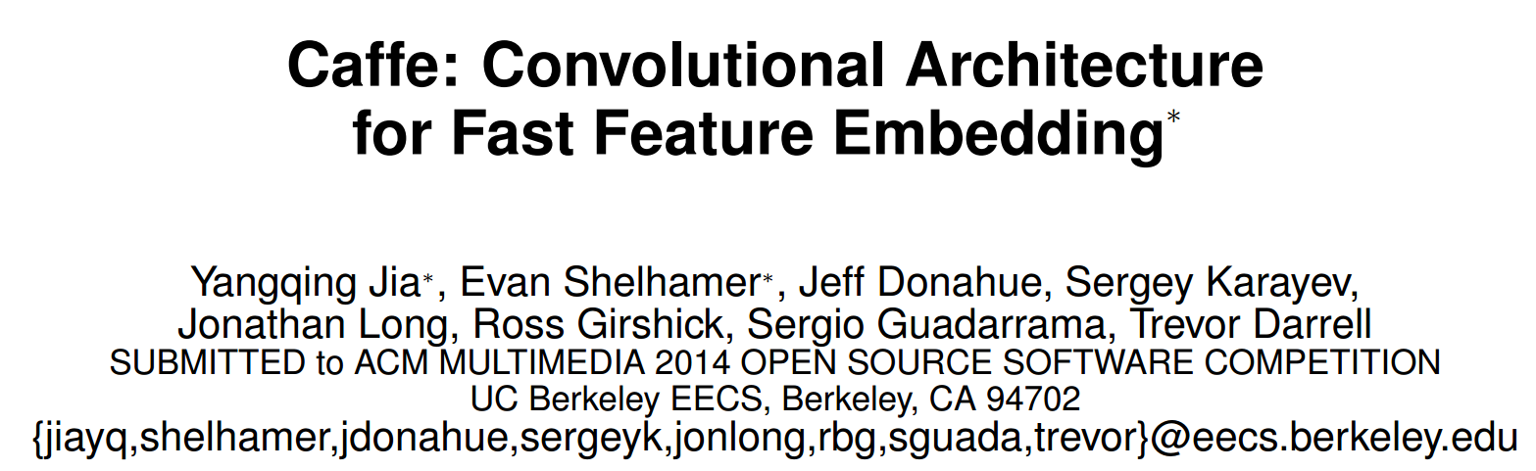
Caffe
Convolutional Architecture for Fast Feature Embedding
http://caffe.berkeleyvision.org/

Slide 4
Notes
CNN/DNN
Different training objective function
Different optimization algorithm
Program control
Model Zoo
C++ Framework
NO LSTM/RNN

Slide 5
CNN/DNN modules
Vision Layer
Convolution/ Pooling/ Local Response Normalization
Common Layer
InnerProduct( = DNN fully-connected weights)
batch normalization
element-wise summation/product/BNLL
dropout layer
Activation Layer(Non-linearity)
Sigmoid/Tanh/ReLU/PReLU
Utility Layer
Dimension slicing/concatenation/flattening/reshaping

Slide 6
Training Loss Layer
CrossEntropyLoss
L1, L2 Loss, pair-wise contrasive loss
Multitask Learning with loss weights
Accuracy Layer: for evaluation only.

Slide 7
Optimization Algorithms
SGD, RMSProp, ADAM, ADADELTA, ADGRAD…
Momentum
Learning Rate Adjustment Policies
decay, step-decay, exp-decay
Regularization
weight-decay, L1 decay

Slide 8
Program Control
Snapshot (solverstate)
Phase:
Convention: Train/Validation/Test
Caffe: Train/Test/Deploy
You could assign different action w.r.t different phase.
Caffe Program Interface
You can provide meta data without actually implement the deep learning algorithms.
You can extend the module and implement your own ideas.

Slide 9
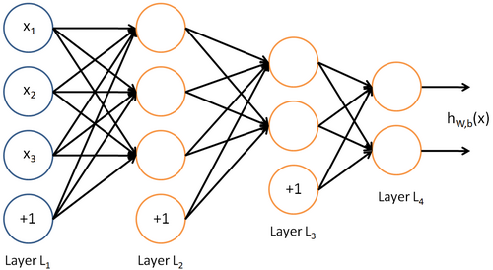
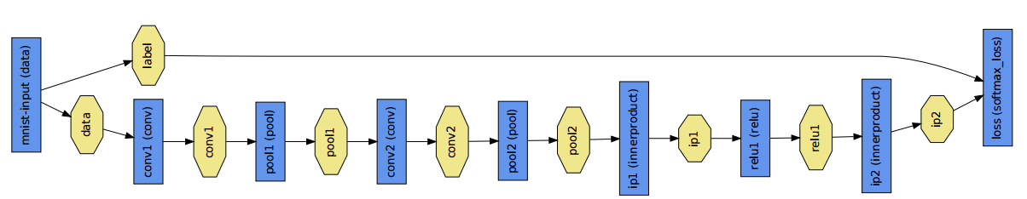
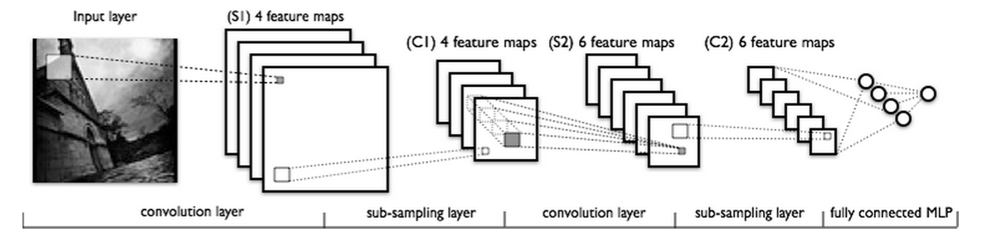

Slide 10
What can Caffe do?
Multitask learning
Multi-target, Multi-loss
Parameters share training
Siamese Neural Network
Easy to integrated into online system.
With known distributed database, protocol…
C++, Python and Matlab binding.

Slide 11
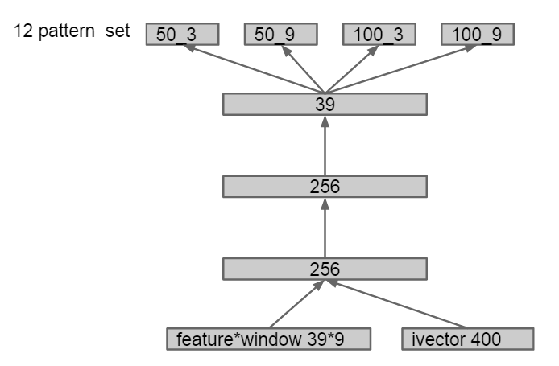
Multitask Learning

Slide 12
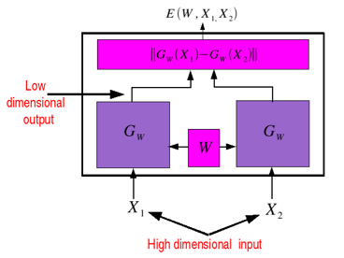
Siamese Neural Network

Slide 13
Introduction
The goal of Caffe is to find the effective representations(feature embedding) for various inputs, such as images and sounds, with help of deep learning and GPU acceleration.
There does exist cross-domain feature embedding among different tasks.
Utilize CUDA(cuDNN) to achieve acceptable training time.

Slide 14
Introduction
Caffe is designed for images and based on state-of-the-art CNN. However, the concept of feature embedding shares among other works(e.g. speech recognition).
Yes, Caffe supports non-image tasks with a bit more efforts.

Slide 15
Introduction
Caffe provided well-known and well-trained models, offering state-of-the-art researching and off-the-shelf deployment.
ImageNet: classify images into 22000 categories.
GoogleNet: classify images into 1000 categories.
R-CNN: object detection (20 or 200 types)

Slide 16
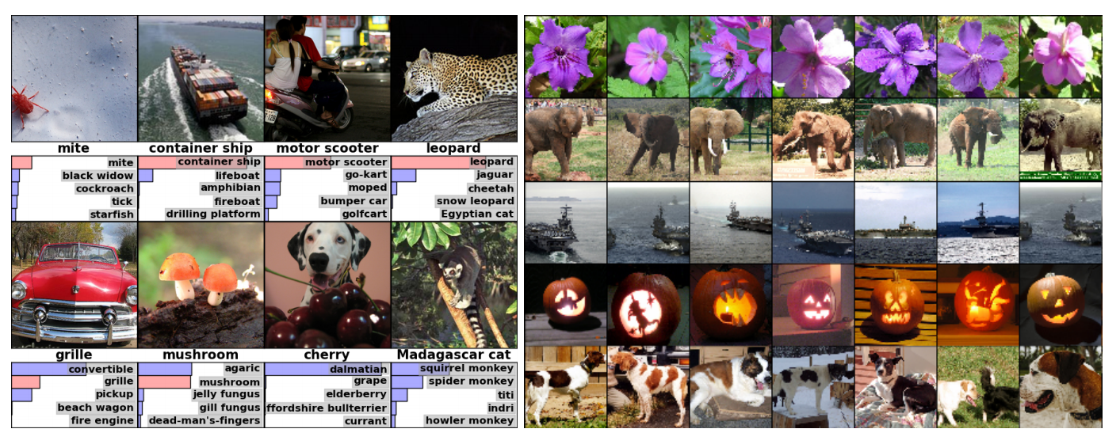
ImageNet

Slide 17
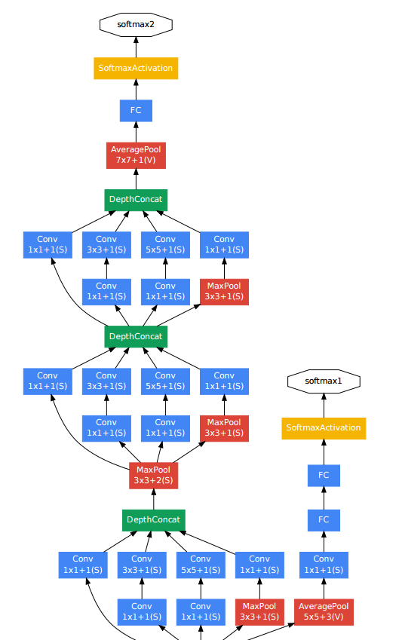
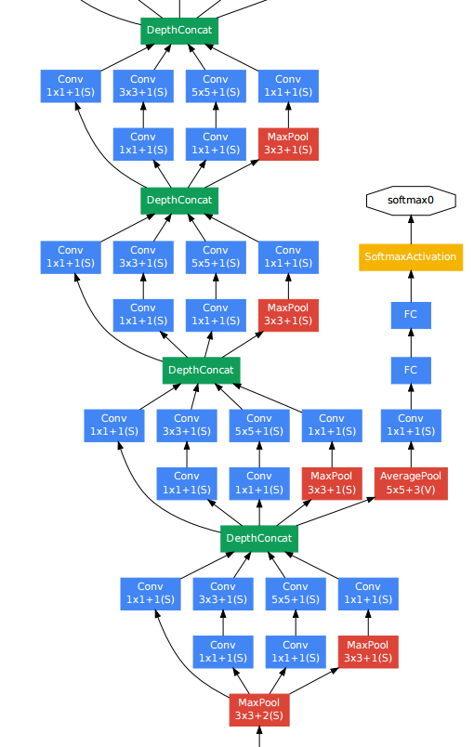
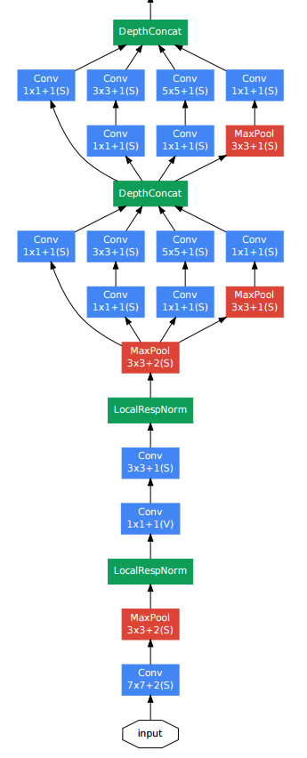
GoogleNet

Slide 18
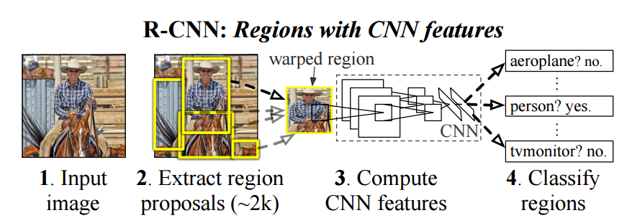
R-CNN

Slide 19
Highlights
Complete toolkit for training, testing, fine-tuning and deploying.
Modularity
Extensible
Forward, backward, CPU/GPU version.
Good coding style and huge community
Only well-test idea would be merged into Caffe
Distributed developed with many coders.
Clearly logging, documentation, robust, bullet proof, easy-understanding message...

Slide 20
Highlights
Python/Matlab binding
Online deploying interface
Online training is not intuitively integrated but able to.
Pre-trained models

Slide 21
Architecture
C++ implementation
Well-known efficiency.
Saving models in GPBL.
Google Protocol Buffer Language
Human-readable, efficient serialization and implemented in multiple interface.
Online training
Memory data.
Offline training
LevelDB database for image data
HDF5 database for general purpose.

Slide 22
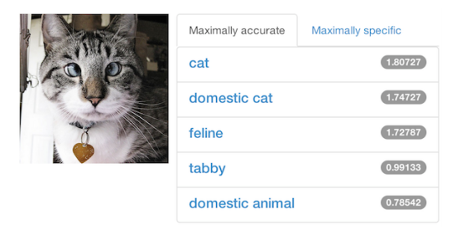
Application
Object Classification/Detection
ImageNet
Demo

Slide 23
Application
Learning Feature Embedding
ImageNet
Using pre-trained models as feature extractor

Slide 24
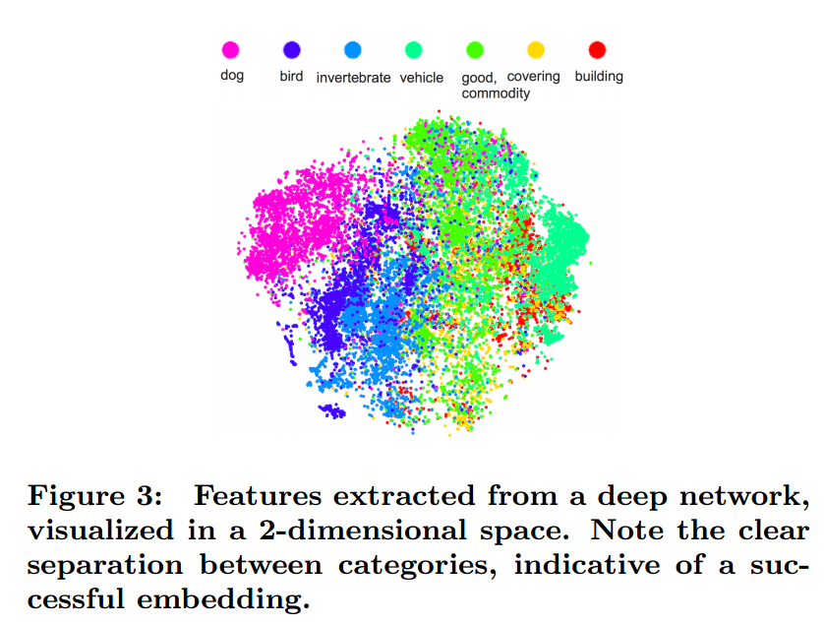

Slide 25
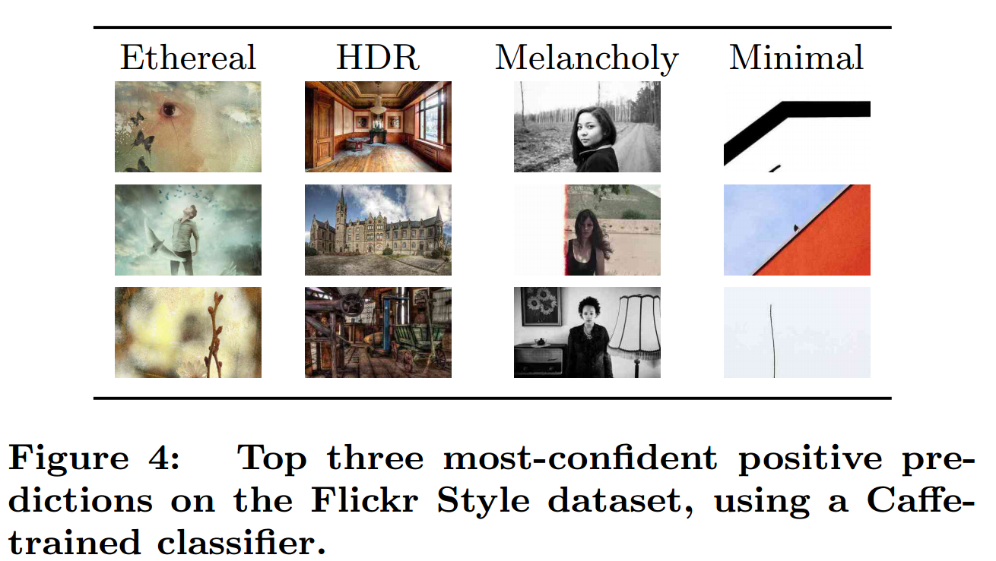

Slide 26
Tutorial
Installation
Prerequisite/Core/Wrappers
Data Preprocessing
LevelDB/HDF5
Models
description, model weights, protobuf
Solver
description, solver state
Training/Testing/Fine-tuning/Deploying

Slide 27
Warning
Caffe is not officially supporting Windows OS. Ubuntu/CentOS is recommended.
Caffe is not officially supporting Windows OS. Ubuntu/CentOS is recommended.
Caffe is not officially supporting Windows OS. Ubuntu/CentOS is recommended.
不要問我windows怎麼灌。

Slide 28
Installation
Install Prerequisite
CUDA and cuDNN
BLAS via OpenBLAS, MKL, or ATLAS
sudo apt-get install Boost/OpenCV/protobuf/glog/gflags/hdf5/leveldb/snappy/lmdb
Install Caffe
prepare Makefile.config from Makefile.config.example
make all && make test && make runtest
Install Python wrapper(optional but recommended)
for req in $(cat requirements.txt); do pip install $req; done
export PYTHONPATH=/path/to/caffe/python:$PYTHONPATH

Slide 29
Data Preprocessing
Input data must be 4D array:
Image: ( number, channel, height, width)
Non-image: ( number, dimension , 1 , 1 )
Training target is usually 2D array:
Label: ( number, dimension )
Online Memory
(C++) MemoryDataLayer::Reset()
(python) Net.set_input_arrays()
Offline database
prepare a directory contain all the images
prepare lmdb(python) or leveldb(c++) for images
prepare hdf5(python) for general purposes
prepare train.list/test.list comprising the path

Slide 30
Models
Description
DAG layered structure written in json format.
Data Layers: read from data, only out-degree
Activation/Neuron Layers: perform forward/backward pass.
Loss Layers: nn output, only in-degree
Common Layers: for utility
Each type of layers contain its own parameters
Different layer parameter could share!

Slide 31
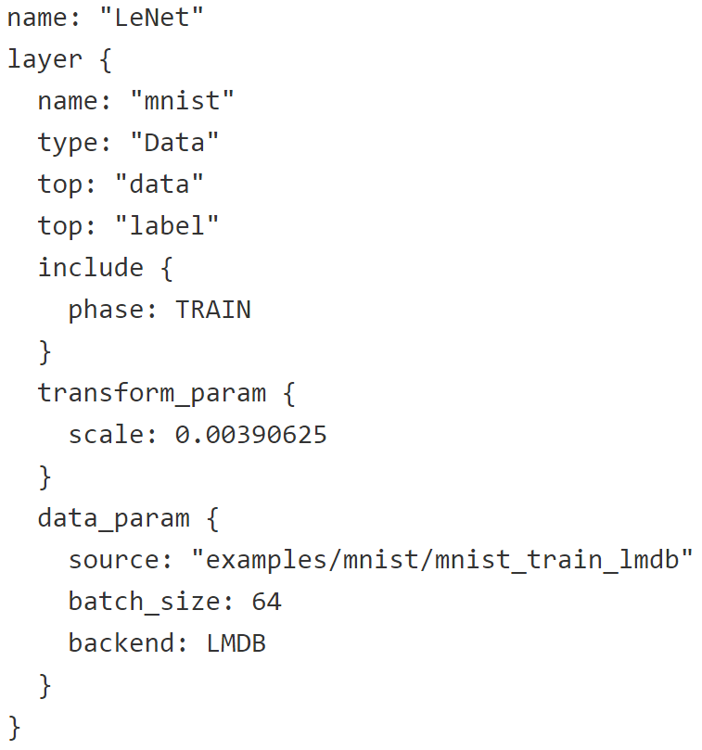
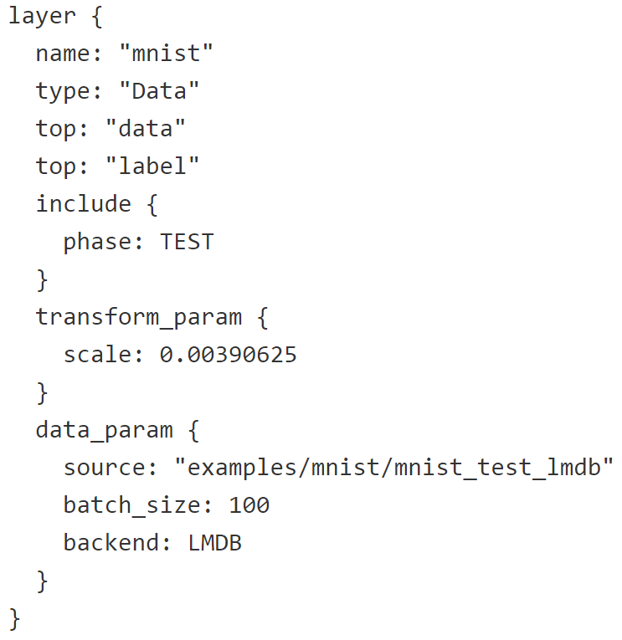
Models

Slide 32
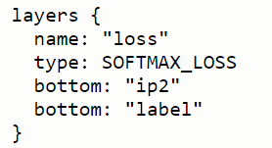
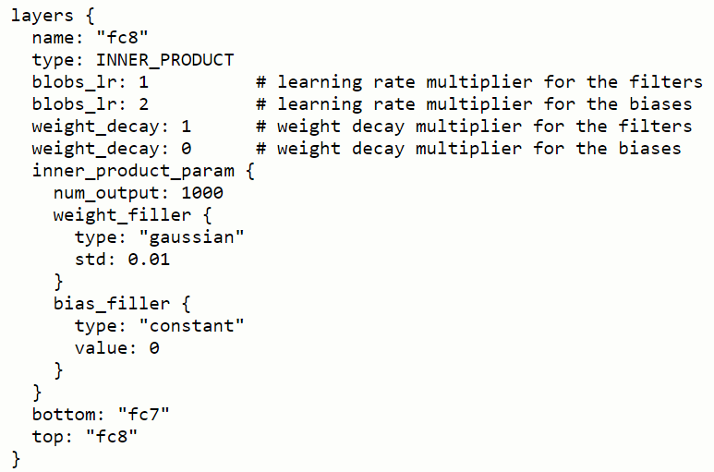
Models

Slide 33
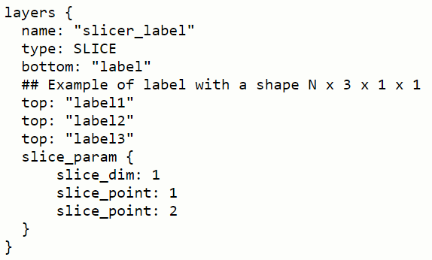
Models

Slide 34
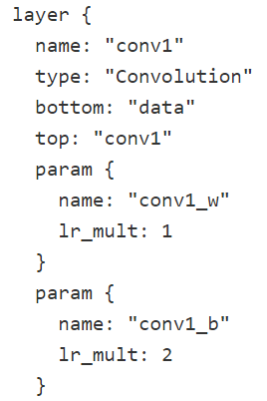
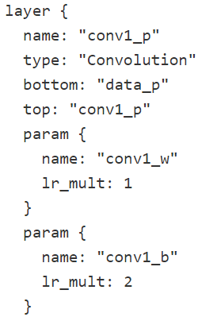
Models

Slide 35
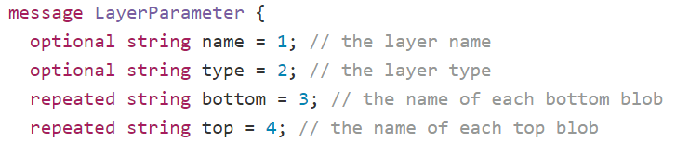
Models
Model Weights
x.caffemodel
store in GPBL format
prototype

Slide 36
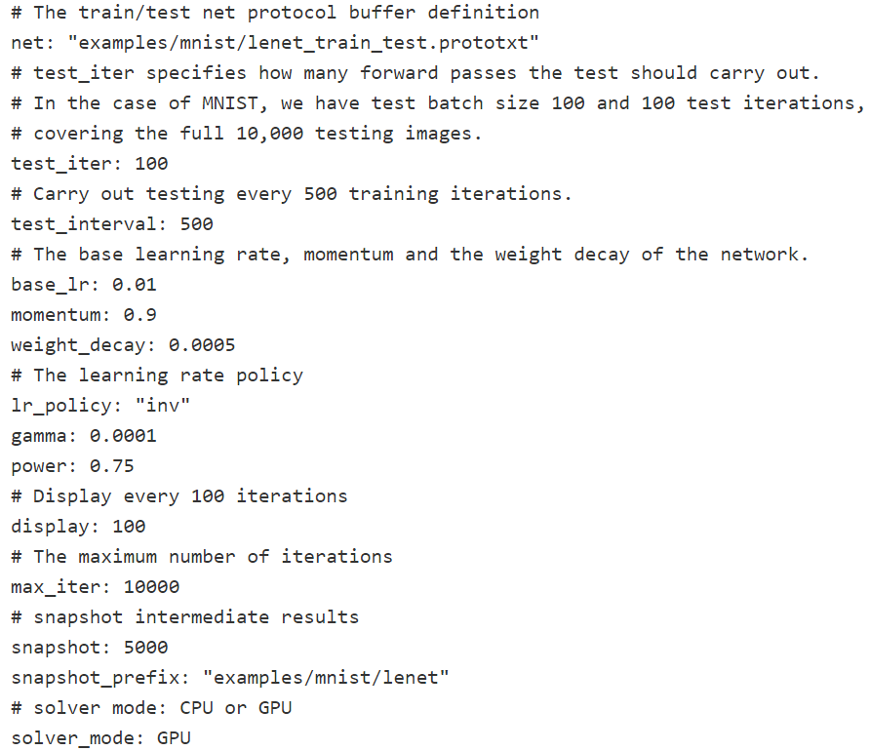
Solver

Slide 37
Training and Testing
Preparation:
data
model description(nnet.prototxt)
solver description(solver.prototxt)
You can specify two phase
training -> calculate loss, gradients, backward pass and update
testing -> calculate accuracy/loss
run:
caffe train --solver=solver.prototxt

Slide 38
Fine-tuning
Preparation:
data
model description(nnet.prototxt)
solver description(solver.prototxt)
pre-trained models(pretrain.caffemodel)
run:
caffe train --solver=solver.prototxt --weights=pretrain.caffe

Slide 39
Deploying
Preparation:
data
model description(deploy.prototxt)
well-train model(well_train.caffemodel)
pycaffe if you use python
your own code(python, c++ or matlab)
deploy.prototxt is slightly different

Slide 40
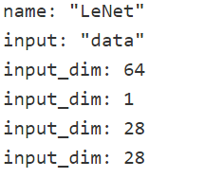
Deploying(python example)
Add data description in deploy.prototxt
remove any DATA_LAYER
In python, import caffe
net = caffe.Classifier(MODEL_FILE, PRETRAINED)
use numpy array to prepare your input data
net.blobs['data'].reshape(input_shape)
out = net.forward( data=input )
use out['label'] to get any output you want.

Slide 41
Final Recommendation
Caffe is easy and flexible to use, but not that efficient. 甚至可以不用寫程式XD
For complicated structure with multi-loss layer, weight sharing and advanced optimization, caffe is good.
However, you should prepare data in the specified format
HDF5, LMDB, LEVELDB…
offline training/testing is easy and preferred
For online procedure, you must write your own code to deploy.

