Slide 1
NTM

Slide 2
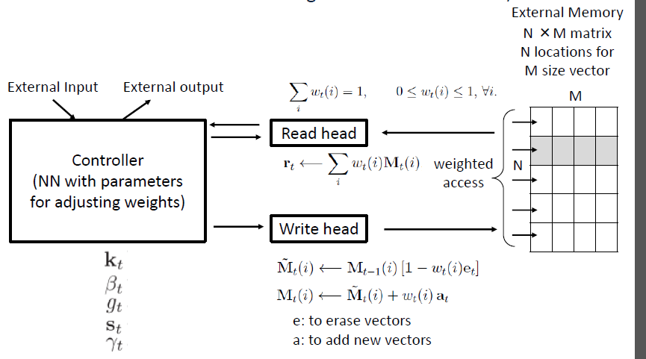
output
DNN
Head t-1
Memory
Head t
input
Weight for erase and write are the same, why not learn it???

Slide 3
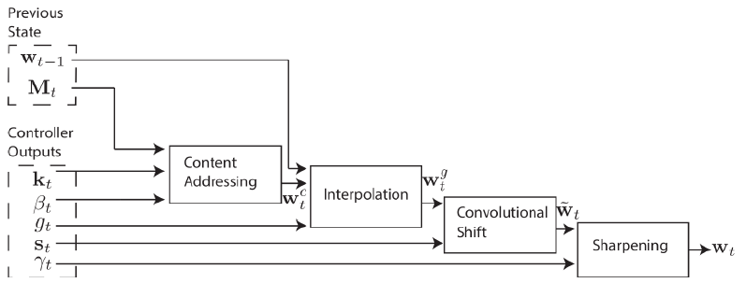
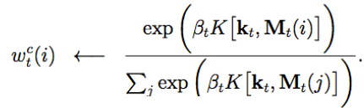

Slide 4
Way 1
Segment into segment, each segment has a proxy
How to segment
1-1: segment
1-2: find the break point

Slide 5
Way 1
MFCC
End signal
Just 1 (for count)
Different, long enough
Init with ang
Just features
How long it should be

Slide 6
Just a parameter to be learned
Key is the same
To the right should be initialized larger
Just a parameter to be learned
Control by the last value of read (can be a scalar)
Just a parameter to be learned

Slide 7
Control by the last value of read (can be a scalar)
Just input

Slide 8
What happen after the output signal

Slide 9
Way 2
Poly normial
Or something like Furies transform

