Slide 1
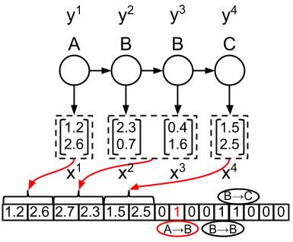






In HMM, if you know emission probability (P(x₁|A), P(x₁|B), P(x₁|C) … ) and transition probability ( P(A|A), P(B|A), …. ), you can run Viterbi.
In Structured SVM ……
Replace P(x₁|A) with
$$e^{w_{A}∙x_{1}}$$
Replace P(x₁|B) with
$$e^{w_{B}∙x_{1}}$$
$$φ\left(x,y\right)$$
Replace P(A|A) with
$$e^{w_{AA}}$$
Replace P(B|A) with
$$w:$$
w_{A}
w_{B}
w_{C}
w_{AA}
w_{AB}
……
$$e^{w_{AB}}$$

