Slide 1
Machine Learning and having it deep and structured
Final Presentation

Slide 2
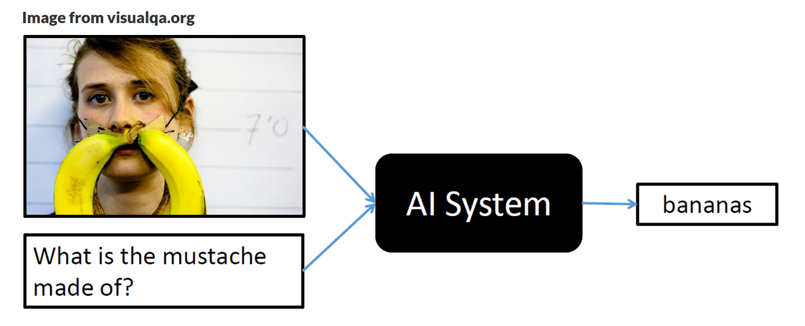
Visual Question Answering
Task description

Slide 3
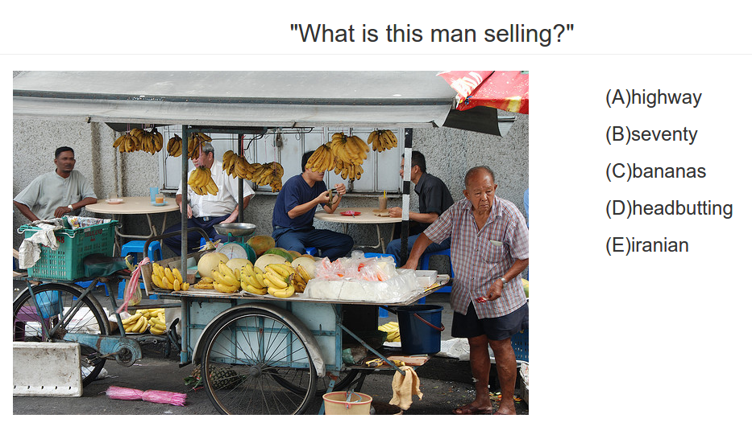
Visual Question Answering
Simplified Version
選擇題

Slide 4
Data
Training Data
Image Set : 82,783 pictures
Question Set : 146,962 questions
Multiple Choices : 5 choices for each question
Correct Answers
Additional Information (e.g. Question Type)
Testing Data
Image Set : 40,504 pictures
Question Set : 72,802 questions
Multiple Choices : 5 choices for each question

Slide 5
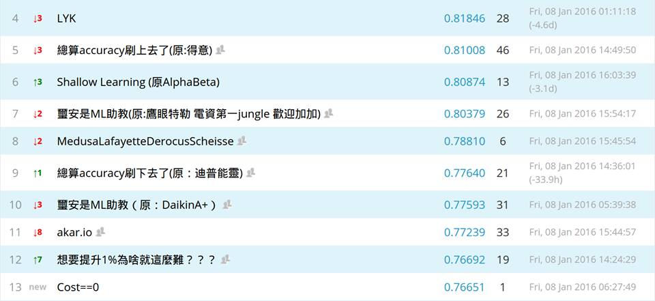
At 2015/01/08 23:59
Top 10

Slide 6
Presentation
報告順序已隨機決定
每組 12 分鐘
10 分鐘按鈴第一次
12 分鐘按鈴第二次 (請立刻結束)
報告結束後，由在座同學票選人氣前三名

Slide 7
Final Presentation
正式開始

Slide 8
Thank you!

Slide 9
