Slide 1
Machine Learning HW1
TA Hours
MLTAs
ntumlta2019@gmail.com

Slide 2
Outline
Simple linear regression using gradient descent (with adagrad)
Extract features
Implement linear regression
Adagrad
Predict pm2.5

Slide 3
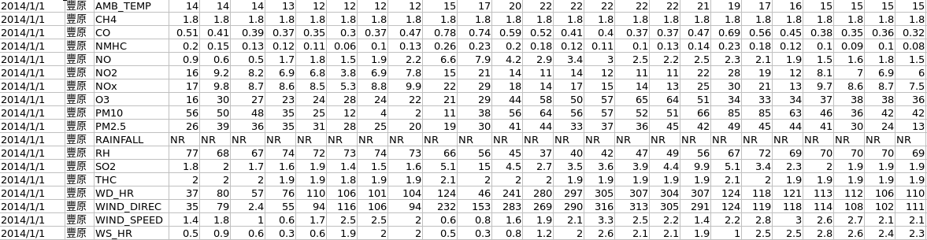
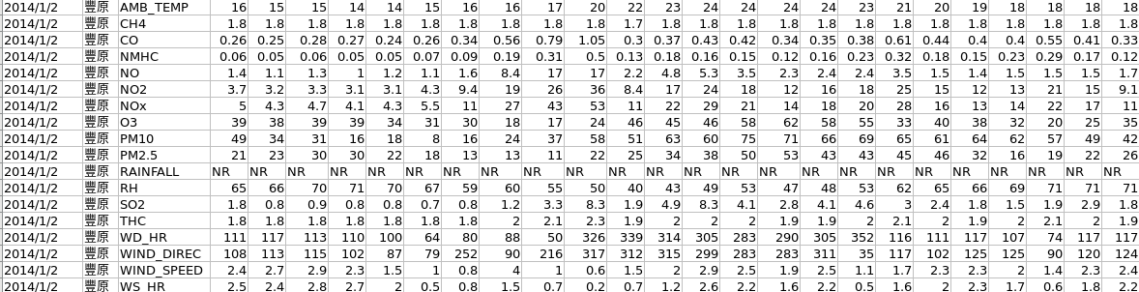
Extract Features
24
18
2014/1/1
...
18
2014/1/2
18
2014/1/3
...

Slide 4
Extract Features
Pseudo code 1 | Declare a 18-dim vector (Data) 2 | for i_th row in training data : 3 | Data[i_th row%18].append(every element in i_th row)
Data will become a vector like
2014/1/1
2014/1/2
2014/1/3
...

Slide 5
Extract Features
480
480
480
18
一月份data
二月份data
三月份data
…...
每10小時為一筆資料
18
…...

Slide 6
Extract Features
Pseudo code 1 | Declare train_x for previous 9-hr data, and train_y for 10th-hr pm2.5 2 | for i in all the given data: 3 | sample every10 hrs： 4 | train_x.append(previous 9-hr data) 5 | train_y.append(the value of 10th-hr pm2.5) 6 | add a bias term to every data in train_x

Slide 7

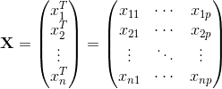
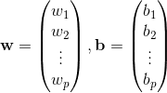
Implement linear regression
Pseudo code 1 | Declare weight vector, initial lr ,and # of iteration 2 | for i_th iteration : 3 | y’ = the product of train_x and weight vector 4 | Loss = y’ - train_y 5 | gradient = 2*np.dot((train_x)’, L ) 6 | weight vector -= learning rate * gradient

Slide 8
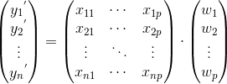
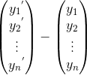
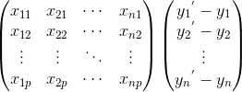
Implement linear regression
3.
Pseudo code 1 | Declare weight vector, initial lr ,and # of iteration 2 | for i_th iteration : 3 | y’ = the inner product of train_x and weight vector 4 | Loss = y’ - train_y 5 | gradient = 2*np.dot((train_x)’, L ) 6 | weight vector -= learning rate * gradient
4.
L =
5.
gradient = 2 x
p-dim vector

Slide 9
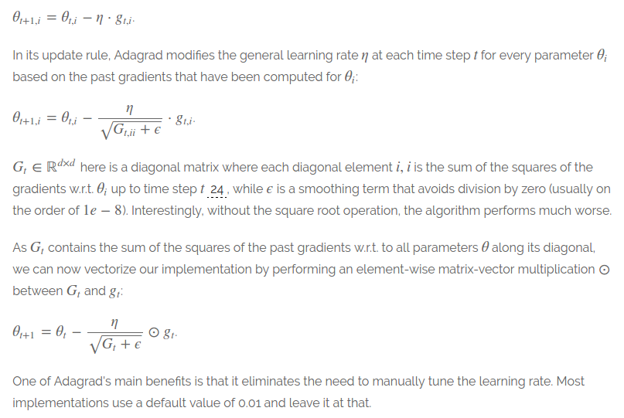
Adagrad

Slide 10
Adagrad
Pseudo code 1 | Declare weight vector, initial lr ,and # of iteration
Declare prev_gra storing gradients in every previous iterations 2 | for i_th iteration : 3 | y’ = the inner product of train_x and weight vector 4 | Loss = y’ - train_y 5 | gradient = 2*np.dot((train_x)’, L )
prev_gra += gra**2 ada = np.sqrt(prev_gra) 6 | weight vector -= learning rate * gradient / ada

Slide 11
Predict PM2.5
Pseudo code 1 | read test_x.csv file 2 | for every 18 rows : 3 | test_x.append([1]) 4 | test_x.append(9-hr data) 5 | test_y = np.dot(weight vector, test_x)

Slide 12
Reference
Adagrad : https://youtu.be/yKKNr-QKz2Q?list=PLJV_el3uVTsPy9oCRY30oBPNLCo89yu49&t=705
RMSprop
https://www.youtube.com/watch?v=5Yt-obwvMHI
Adam
https://www.youtube.com/watch?v=JXQT_vxqwIs

