Slide 1

Self-attention
Hung-yi Lee
李宏毅

Slide 2
Sophisticated Input
Input is a vector
Input is a set of vectors
Model
Scalar or Class
Model
Scalars or Classes
(may change length)
Notes:
Self-attention 要解决的问题
Sophisticated Input 复杂的输入

Slide 3
Vector Set as Input
this is a cat
One-hot Encoding
Word Embedding
apple = [ 1 0 0 0 0 …… ]
dog
bag = [ 0 1 0 0 0 …… ]
rabbit
run
cat = [ 0 0 1 0 0 …… ]
jump
cat
dog = [ 0 0 0 1 0 …… ]
tree
flower
elephant = [ 0 0 0 0 1 …… ]
To learn more: https://youtu.be/X7PH3NuYW0Q (in Mandarin)
Notes:
有哪些例子说明输入是 Vector Set
One-hot Encoding 最严重的问题是假设了所有的词汇之间都是没有关系的，而实际上词汇与词汇之间是有关系的
也就是这个向量中没有语义的信息
Word Embedding 中有语义的信息
Word Embedding 要怎么得到，请参考 https://youtu.be/X7PH3NuYW0Q (in Mandarin)

Slide 4
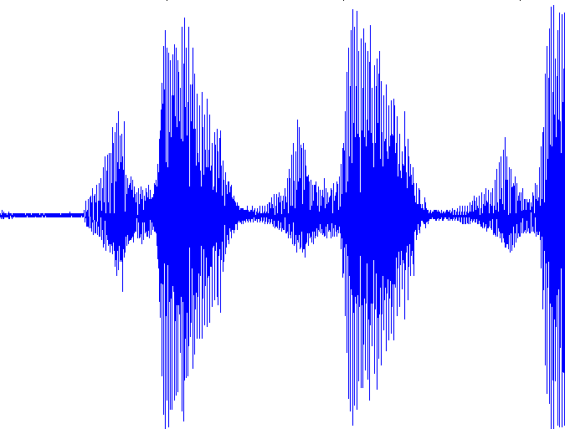
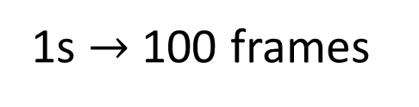
Vector Set as Input
10ms
1s $→$ 100 frames
25ms
400 sample points (16KHz)
39-dim MFCC
80-dim filter bank output
frame
Notes:
數位語音處理 第七章
Speech Signal and Front-end Processing
http://ocw.aca.ntu.edu.tw/ntu-ocw/ocw/cou/104S204/7

Slide 5

Vector Set as Input
https://medium.com/analytics-vidhya/social-network-analytics-f082f4e21b16
Graph is also a set of vectors (consider each node as a vector)
Each profile is a vector
Notes:
http://speech.ee.ntu.edu.tw/~tlkagk/courses/ML2020/GNN.pdf

Slide 6
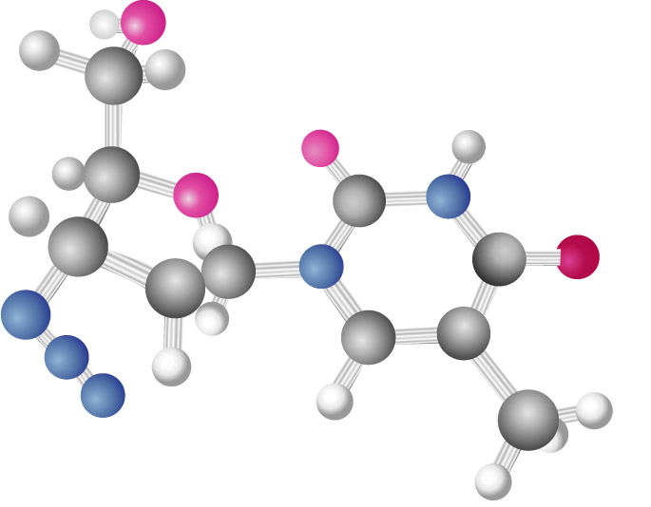
Vector Set as Input
http://www.twword.com/wiki/%E5%88%86%E5%AD%90
Graph is also a set of vectors (consider each node as a vector)
H = [ 1 0 0 0 0 …… ]
C = [ 0 1 0 0 0 …… ]
O = [ 0 0 1 0 0 …… ]
……
One-hot vector
Notes:
http://speech.ee.ntu.edu.tw/~tlkagk/courses/ML2020/GNN.pdf

Slide 7

What is the output?
Each vector has a label.
Model
N
N
Example Applications
not
I saw a saw
N
V
DET
N
a
a
b
b
POS tagging
HW2
buy
buy
Notes:
可能得输出，有三种可能性
Each vector has a label.
这个 label 可能是 Scalar or Class
POS tagging 词性标注

Slide 8
What is the output?
Each vector has a label.
Model
N
N
The whole sequence has a label.
Model
Example Applications
this is good
Sentiment analysis
HW4
positive
speaker
hydrophilicity

Slide 9
What is the output?
Each vector has a label.
focus of this lecture
Model
N
N
The whole sequence has a label.
Model
seq2seq
Model decides the number of labels itself.
Model
N
Translation (HW5)
N’

Slide 10
Sequence Labeling
Is it possible to consider the context?
Fully-connected
FC can consider the neighbor
FC
How to consider the whole sequence?
a window covers the whole sequence?
FC
FC
FC
FC
window
I
saw
a
saw
Notes:
Each vector has a label. 就是 Sequence Labeling 问题
Sequence Labeling 问题的直观解决方法是 Fully-connected
Fully-connected 最主要的问题是忽略了词汇上下文
已词性标注任务为例，词汇在不同的上下文中有不同的词性
neighbor 邻居

Slide 11

Self-attention
FC
FC
FC
FC
with context
Self-attention
Notes:
How to consider the whole sequence?
使用 Self-attention 机制考虑整个句子
Self-attention 是以整个句子作为输入的

Slide 12

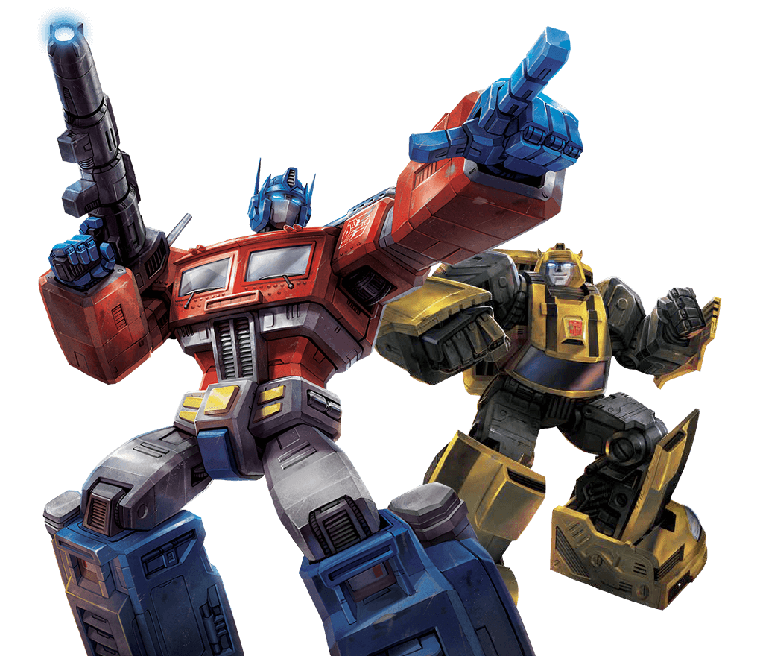
FC
FC
FC
FC
Self-attention
FC
FC
FC
FC
Self-attention
Attention is all you need.
https://arxiv.org/abs/1706.03762
Notes:
Self-attention 可以使用多次
Attention is all you need. 最主要的作用就是告诉大家只需要 Self-attention 机制，不需要将 attention 机制和 RNN 等结合起来
只使用 Self-attention 机制即可

Slide 13








Self-attention
$$b^{1}$$
$$b^{2}$$
$$b^{3}$$
$$b^{4}$$
$$a^{1}$$
$$a^{2}$$
$$a^{3}$$
$$a^{4}$$
Can be either input or a hidden layer

Slide 14

Self-attention
$$b^{1}$$
$$α$$
relevant?
$$a^{1}$$
$$a^{2}$$
$$a^{3}$$
$$a^{4}$$
Find the relevant vectors in a sequence
Notes:
怎么产生 b^1 这个向量
b^2 和 b^3 ... 都是类似的
Find the relevant vectors in a sequence 找出序列中的相关向量

Slide 15












Self-attention
$$α$$
Additive
$$W$$
Dot-product
$$α$$
$$=q∙k$$
$$tanh$$
$$q$$
$$k$$
$$+$$
$$W^{q}$$
$$W^{k}$$
$$W^{q}$$
$$W^{k}$$
Notes:
计算 𝛼 的两种方法

Slide 16














Self-attention
$$α_{1,2}=q^{1}∙k^{2}$$
$$α_{1,3}=q^{1}∙k^{3}$$
$$α_{1,4}=q^{1}∙k^{4}$$
attention score
$$α_{1,2}$$
$$α_{1,3}$$
$$α_{1,4}$$
$$q^{1}$$
query
$$k^{2}$$
key
$$k^{3}$$
$$k^{4}$$
$$a^{1}$$
$$a^{2}$$
$$a^{3}$$
$$a^{4}$$
$$q^{1}=W^{q}a^{1}$$
$$k^{2}=W^{k}a^{2}$$
$$k^{3}=W^{k}a^{3}$$
$$k^{4}=W^{k}a^{4}$$

Slide 17


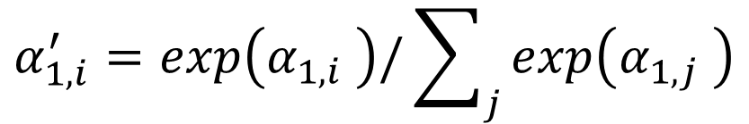





Self-attention
$$α_{1,i}^{′}=exp\left(α_{1,i} \right)/\sum_{j}{exp\left(α_{1,j} \right)}$$
$$α_{1,1}^{′}$$
$$α_{1,2}^{′}$$
$$α_{1,3}^{′}$$
$$α_{1,4}^{′}$$
Soft-max
$$α_{1,1}$$
$$α_{1,2}$$
$$α_{1,3}$$
$$α_{1,4}$$
$$q^{1}$$
$$k^{1}$$
$$k^{2}$$
$$k^{3}$$
$$k^{4}$$
$$a^{1}$$
$$a^{2}$$
$$a^{3}$$
$$a^{4}$$
$$q^{1}=W^{q}a^{1}$$
$$k^{2}=W^{k}a^{2}$$
$$k^{3}=W^{k}a^{3}$$
$$k^{4}=W^{k}a^{4}$$
$$k^{1}=W^{k}a^{1}$$
Notes:
为什么需要 Soft-max

Slide 18
















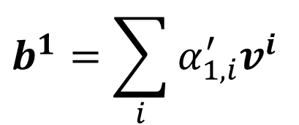
Self-attention
Extract information based on attention scores
$$b^{1}=\sum_{i}{α_{1,i}^{′}v^{i} }$$
$$b^{1}$$
$$α_{1,1}^{′}$$
$$α_{1,2}^{′}$$
$$α_{1,3}^{′}$$
$$α_{1,4}^{′}$$
$$q^{1}$$
$$k^{1}$$
$$v^{1}$$
$$k^{2}$$
$$v^{2}$$
$$k^{3}$$
$$v^{3}$$
$$k^{4}$$
$$v^{4}$$
$$a^{1}$$
$$a^{2}$$
$$a^{3}$$
$$a^{4}$$
$$v^{1}=W^{v}a^{1}$$
$$v^{2}=W^{v}a^{2}$$
$$v^{3}=W^{v}a^{3}$$
$$v^{4}=W^{v}a^{4}$$
Notes:
Extract information based on attention scores 根据注意力得分提取信息

Slide 19
Self-attention
parallel
$$b^{1}$$
$$b^{2}$$
$$b^{3}$$
$$b^{4}$$
$$a^{1}$$
$$a^{2}$$
$$a^{3}$$
$$a^{4}$$
Can be either input or a hidden layer

Slide 20




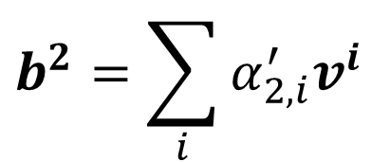




Self-attention
$$b^{2}=\sum_{i}{α_{2,i}^{′}v^{i} }$$
$$b^{2}$$
$$α_{2,1}^{′}$$
$$α_{2,2}^{′}$$
$$α_{2,3}^{′}$$
$$α_{2,4}^{′}$$
$$q^{1}$$
$$k^{1}$$
$$v^{1}$$
$$q^{2}$$
$$k^{2}$$
$$v^{2}$$
$$q^{3}$$
$$k^{3}$$
$$v^{3}$$
$$q^{4}$$
$$k^{4}$$
$$v^{4}$$
$$a^{1}$$
$$a^{2}$$
$$a^{3}$$
$$a^{4}$$
Notes:
Relation between attention and CNN
Global receptive field (compared to convolutional architectures)

Slide 21




































Self-attention
$$q^{1}$$
$$q^{2}$$
$$q^{3}$$
$$q^{4}$$
$$a^{1}$$
$$a^{2}$$
=
$$a^{3}$$
$$q^{i}=W^{q}a^{i}$$
$$W^{q}$$
$$a^{4}$$
$$Q$$
$$I$$
$$a^{1}$$
$$a^{2}$$
$$k^{1}$$
$$a^{3}$$
$$k^{2}$$
$$a^{4}$$
$$k^{3}$$
$$k^{i}=W^{k}a^{i}$$
$$k^{4}$$
=
$$W^{k}$$
$$K$$
$$I$$
$$a^{1}$$
$$a^{2}$$
$$a^{3}$$
$$v^{1}$$
$$a^{4}$$
$$v^{2}$$
$$v^{3}$$
$$v^{i}=W^{v}a^{i}$$
$$v^{4}$$
=
$$W^{v}$$
$$V$$
$$I$$
$$q^{1}$$
$$k^{1}$$
$$v^{1}$$
$$q^{2}$$
$$k^{2}$$
$$v^{2}$$
$$q^{3}$$
$$k^{3}$$
$$v^{3}$$
$$q^{4}$$
$$k^{4}$$
$$v^{4}$$
$$a^{1}$$
$$a^{2}$$
$$a^{3}$$
$$a^{4}$$

Slide 22






















Self-attention
$$α_{1,1}$$
$$k^{1}$$
$$α_{1,1}=$$
$$k^{1}$$
$$q^{1}$$
$$α_{1,2}=$$
$$k^{2}$$
$$q^{1}$$
$$α_{1,2}$$
$$k^{2}$$
$$=$$
$$q^{1}$$
$$α_{1,3}$$
$$k^{3}$$
$$α_{1,3}=$$
$$k^{3}$$
$$q^{1}$$
$$α_{1,4}=$$
$$k^{4}$$
$$q^{1}$$
$$α_{1,4}$$
$$k^{4}$$
$$α_{1,1}$$
$$α_{1,2}$$
$$α_{1,3}$$
$$α_{1,4}$$
$$q^{1}$$
$$k^{1}$$
$$v^{1}$$
$$q^{2}$$
$$k^{2}$$
$$v^{2}$$
$$q^{3}$$
$$k^{3}$$
$$v^{3}$$
$$q^{4}$$
$$k^{4}$$
$$v^{4}$$
Notes:
Relation between attention and CNN
Global receptive field (compared to convolutional architectures)
(ignore $\sqrt{d}$ for simplicity)

Slide 23

















































Self-attention
$$α_{1,1}$$
$$k^{1}$$
$$α_{1,1}=$$
$$k^{1}$$
$$q^{1}$$
$$α_{1,2}=$$
$$k^{2}$$
$$q^{1}$$
$$α_{1,2}$$
$$k^{2}$$
$$=$$
$$q^{1}$$
$$α_{1,3}$$
$$k^{3}$$
$$α_{1,3}=$$
$$k^{3}$$
$$q^{1}$$
$$α_{1,4}=$$
$$k^{4}$$
$$q^{1}$$
$$α_{1,4}$$
$$k^{4}$$
$$α_{2,1}$$
$$α_{2,2}$$
$$α_{2,3}$$
$$α_{2,4}$$
$$q^{1}$$
$$k^{1}$$
$$v^{1}$$
$$q^{2}$$
$$k^{2}$$
$$v^{2}$$
$$q^{3}$$
$$k^{3}$$
$$v^{3}$$
$$q^{4}$$
$$k^{4}$$
$$v^{4}$$
$$α_{1,1}^{′}$$
$$α_{2,1}^{′}$$
$$α_{3,1}^{′}$$
$$α_{4,1}^{′}$$
$$α_{1,1}$$
$$α_{2,1}$$
$$α_{3,1}$$
$$α_{4,1}$$
$$k^{1}$$
$$α_{1,2}^{′}$$
$$α_{2,2}^{′}$$
$$α_{3,2}^{′}$$
$$α_{4,2}^{′}$$
$$α_{1,2}$$
$$α_{2,2}$$
$$α_{3,2}$$
$$α_{4,2}$$
$$k^{2}$$
$$α_{1,3}^{′}$$
$$α_{2,3}^{′}$$
$$α_{3,3}^{′}$$
$$=$$
$$q^{1}$$
$$q^{2}$$
$$q^{3}$$
$$q^{4}$$
$$α_{4,3}^{′}$$
$$α_{1,3}$$
$$α_{2,3}$$
$$α_{3,3}$$
$$α_{4,3}$$
$$k^{3}$$
$$α_{1,4}^{′}$$
$$α_{2,4}^{′}$$
$$α_{3,4}^{′}$$
$$α_{4,4}^{′}$$
$$α_{1,4}$$
$$α_{2,4}$$
$$α_{3,4}$$
$$α_{4,4}$$
$$k^{4}$$
$$Q$$
$$A′$$
softmax
$$A$$
$$K^{T}$$
Notes:
Relation between attention and CNN
Global receptive field (compared to convolutional architectures)

Slide 24







































Self-attention
$$b^{1}$$
$$α_{1,1}^{′}$$
$$α_{1,2}^{′}$$
$$α_{1,3}^{′}$$
$$α_{1,4}^{′}$$
$$q^{1}$$
$$k^{1}$$
$$v^{1}$$
$$q^{2}$$
$$k^{2}$$
$$v^{2}$$
$$q^{3}$$
$$k^{3}$$
$$v^{3}$$
$$q^{4}$$
$$k^{4}$$
$$v^{4}$$
$$α_{1,1}^{′}$$
$$α_{2,1}^{′}$$
$$α_{3,1}^{′}$$
$$α_{4,1}^{′}$$
$$α_{1,2}^{′}$$
$$α_{2,2}^{′}$$
$$α_{3,2}^{′}$$
$$α_{4,2}^{′}$$
$$b^{1}$$
=
$$b^{2}$$
$$b^{3}$$
$$b^{4}$$
$$v^{1}$$
$$v^{2}$$
$$v^{3}$$
$$v^{4}$$
$$α_{1,3}^{′}$$
$$α_{2,3}^{′}$$
$$α_{3,3}^{′}$$
$$α_{4,3}^{′}$$
$$O$$
$$V$$
$$α_{1,4}^{′}$$
$$α_{3,4}^{′}$$
$$α_{2,4}^{′}$$
$$α_{4,4}^{′}$$
$$A′$$
Notes:
Relation between attention and CNN
Global receptive field (compared to convolutional architectures)

Slide 25
















Self-attention
$$Q$$
=
$$I$$
$$W^{q}$$
$$K$$
=
$$I$$
$$W^{k}$$
$$V$$
=
$$I$$
$$W^{v}$$
Parameters to be learned
$$A′$$
$$A$$
=
$$Q$$
$$K^{T}$$
Attention Matrix
$$A′$$
$$O$$
=
$$V$$
Notes:
反正就是一堆矩陣乘法，用 GPU 可以加速

Slide 26
























Multi-head Self-attention
Different types of relevance
$$q^{i,1}=W^{q,1}q^{i}$$
$$b^{i,1}$$
$$q^{i,2}=W^{q,2}q^{i}$$
$$q^{i,1}$$
$$q^{i,2}$$
$$k^{i,1}$$
$$k^{i,2}$$
$$v^{i,1}$$
$$v^{i,2}$$
$$q^{j,1}$$
$$q^{j,2}$$
$$k^{j,1}$$
$$k^{j,2}$$
$$v^{j,1}$$
$$v^{j,2}$$
$$q^{i}$$
$$k^{i}$$
$$v^{i}$$
$$q^{j}$$
$$k^{j}$$
$$v^{j}$$
$$q^{i}=W^{q}a^{i}$$
$$a^{i}$$
(2 heads as example)
$$a^{j}$$

Slide 27

Multi-head Self-attention
Different types of relevance
$$q^{i,1}=W^{q,1}q^{i}$$
$$b^{i,1}$$
$$q^{i,2}=W^{q,2}q^{i}$$
$$b^{i,2}$$
$$q^{i,1}$$
$$q^{i,2}$$
$$k^{i,1}$$
$$k^{i,2}$$
$$v^{i,1}$$
$$v^{i,2}$$
$$q^{j,1}$$
$$q^{j,2}$$
$$k^{j,1}$$
$$k^{j,2}$$
$$v^{j,1}$$
$$v^{j,2}$$
$$q^{i}$$
$$k^{i}$$
$$v^{i}$$
$$q^{j}$$
$$k^{j}$$
$$v^{j}$$
$$q^{i}=W^{q}a^{i}$$
$$a^{i}$$
(2 heads as example)
$$a^{j}$$

Slide 28
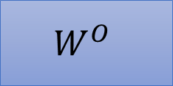

Multi-head Self-attention
Different types of relevance
$$b^{i,1}$$
$$b^{i}$$
=
$$W^{O}$$
$$b^{i,2}$$
$$q^{i,1}$$
$$q^{i,2}$$
$$k^{i,1}$$
$$k^{i,2}$$
$$v^{i,1}$$
$$v^{i,2}$$
$$q^{j,1}$$
$$q^{j,2}$$
$$k^{j,1}$$
$$k^{j,2}$$
$$v^{j,1}$$
$$v^{j,2}$$
$$q^{i}$$
$$k^{i}$$
$$v^{i}$$
$$q^{j}$$
$$k^{j}$$
$$v^{j}$$
$$q^{i}=W^{q}a^{i}$$
$$a^{i}$$
(2 heads as example)
$$a^{j}$$

Slide 29
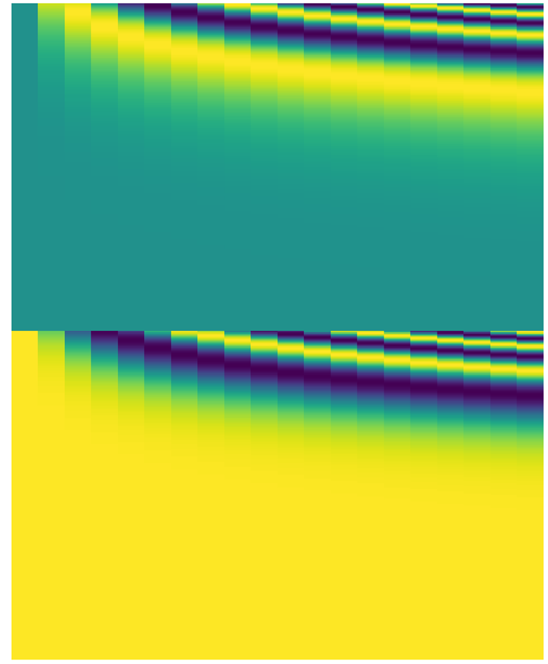

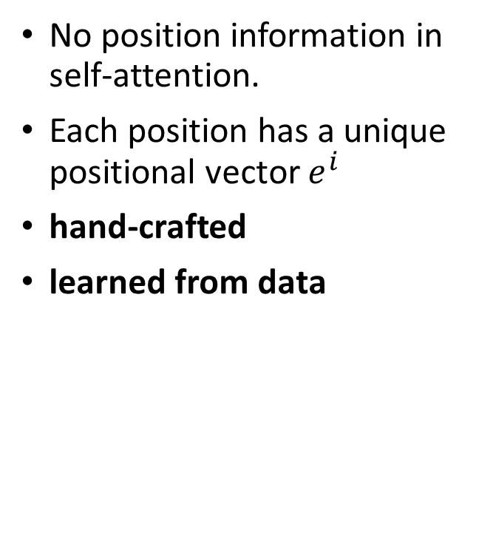




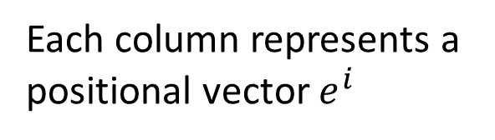
Positional Encoding
Each column represents a positional vector $e^{i}$
No position information in self-attention.
Each position has a unique positional vector $e^{i}$
hand-crafted
learned from data
$$q^{i}$$
$$k^{i}$$
$$v^{i}$$
$$e^{i}$$
+
$$a^{i}$$
-1
1
Notes:
No position information in self-attention.
没有位置信息的含义是根据前面展示的计算过程，如果互换 a^1 和 a^2 的位置，最后得到的结果是一样的
也就是序列 a^1 a^2 a^3 a^4 和序列 a^2 a^1 a^3 a^4 得到的 b^1 b^2 b^3 b^4 都是一样的，只不过顺序不一样而已
实际上位置信息又是也是有用的，例如在词性分析的任务中，按照经验动词一般不会出现在句首，所以句首是动词的可能性就比较低，
使用位置信息就可以得到句首是动词的概率是比较低的
加上位置信息的办法就是 Positional Encoding

Slide 30
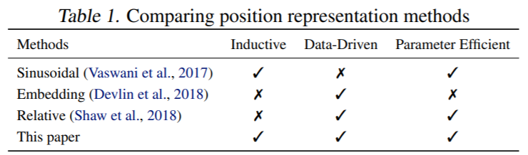
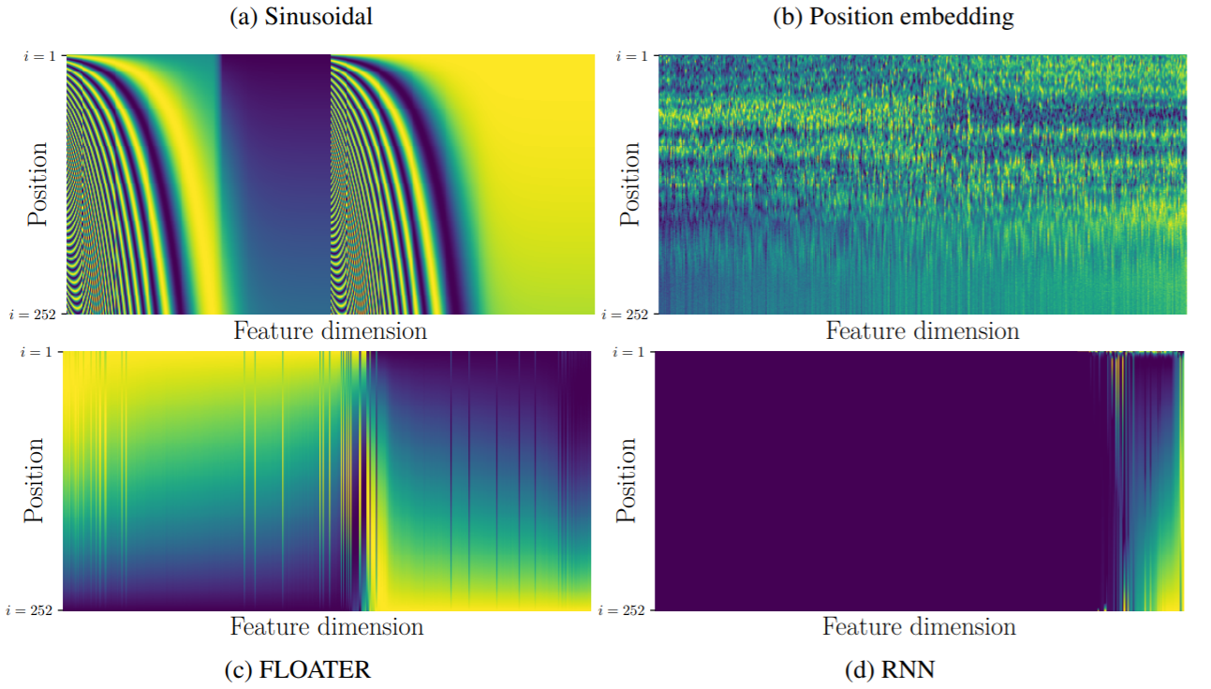
https://arxiv.org/abs/2003.09229
Notes:
各种实现 Positional Encoding 的方法

Slide 31
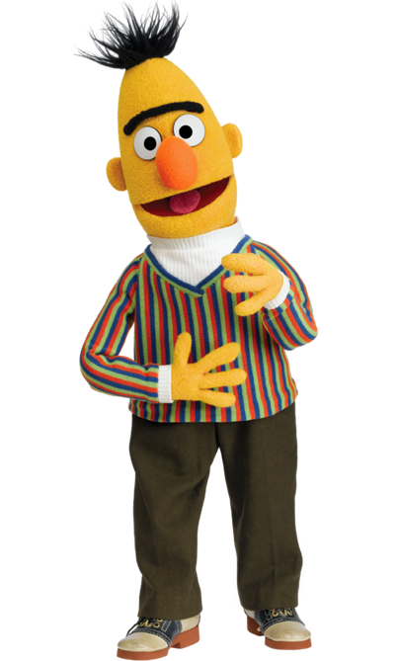
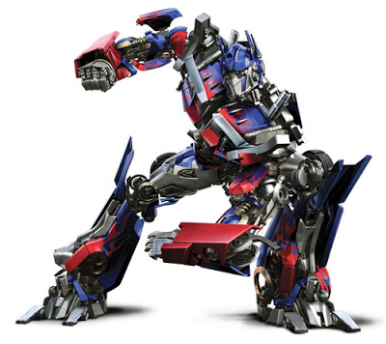
Many applications …
Transformer
BERT
https://arxiv.org/abs/1706.03762
https://arxiv.org/abs/1810.04805
Widely used in Natural Langue Processing (NLP)!

Slide 32











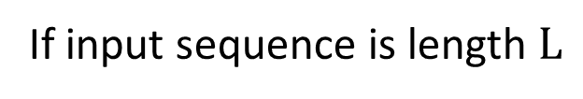
Self-attention for Speech
https://arxiv.org/abs/1910.12977
Attention in a range
Speech is a very long vector sequence.
$$b^{1}$$
$$b^{2}$$
$$b^{3}$$
$$b^{4}$$
10ms
If input sequence is length $L$
$$A′$$
$$L$$
$$a^{1}$$
$$a^{2}$$
$$a^{3}$$
$$a^{4}$$
Attention Matrix
$$L$$
Truncated Self-attention
Notes:
Self-attention 应用于 Speech 语音是的改进
Truncated Self-attention
Truncated Self-attention 不是看这个语音产生的 vector，只是看一部分 vector

Slide 33
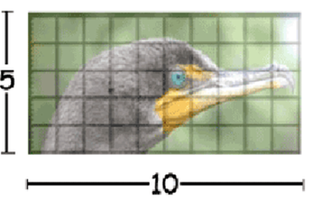
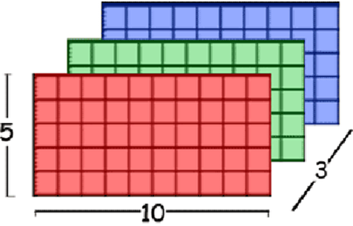
Self-attention for Image
An image can also be considered as a vector set.
This is a vector.
Source of image: https://www.researchgate.net/figure/Color-image-representation-and-RGB-matrix_fig15_282798184

Slide 34
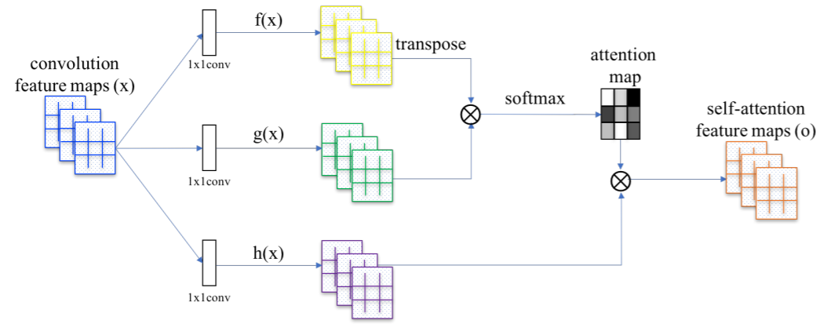
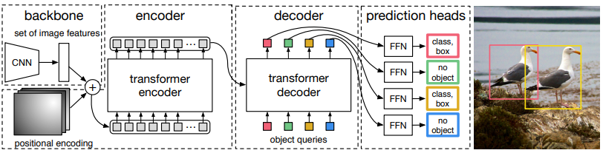
Self-Attention GAN
https://arxiv.org/abs/1805.08318
DEtection Transformer (DETR)
https://arxiv.org/abs/2005.12872
Notes:
https://github.com/facebookresearch/detr
https://arxiv.org/abs/2005.12872
https://analyticsindiamag.com/object-detection-with-transformers/

Slide 35
Self-attention v.s. CNN
1 | 0 | 0 | 0 | 0 | 1
0 | 1 | 0 | 0 | 1 | 0
0 | 0 | 1 | 1 | 0 | 0
1 | 0 | 0 | 0 | 1 | 0
0 | 1 | 0 | 0 | 1 | 0
0 | 0 | 1 | 0 | 1 | 0
CNN: self-attention that can only attends in a receptive field
1 | 0 | 0 | 0 | 0 | 1
0 | 1 | 0 | 0 | 1 | 0
0 | 0 | 1 | 1 | 0 | 0
1 | 0 | 0 | 0 | 1 | 0
0 | 1 | 0 | 0 | 1 | 0
0 | 0 | 1 | 0 | 1 | 0
1 | 0 | 0 | 0 | 0 | 1
0 | 1 | 0 | 0 | 1 | 0
0 | 0 | 1 | 1 | 0 | 0
1 | 0 | 0 | 0 | 1 | 0
0 | 1 | 0 | 0 | 1 | 0
0 | 0 | 1 | 0 | 1 | 0
CNN is simplified self-attention.
Self-attention: CNN with learnable receptive field
Self-attention is the complex version of CNN.

Slide 36
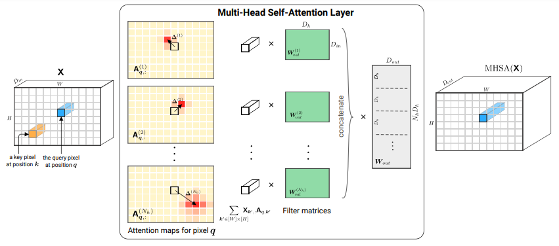
Self-attention v.s. CNN
Self-attention
CNN
On the Relationship between Self-Attention and Convolutional Layers
https://arxiv.org/abs/1911.03584
Notes:
Shall I explain this more …?
ICLR 2020

Slide 37
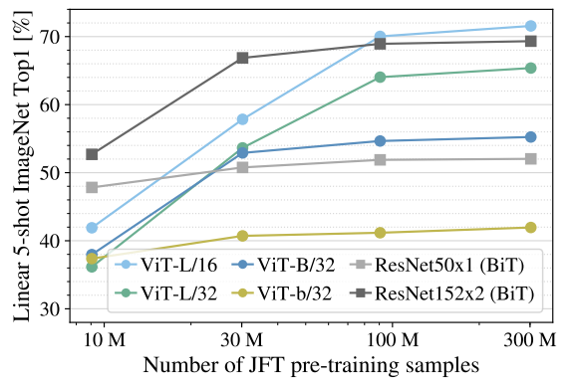
Self-attention v.s. CNN
Good for more data
Self-attention
Good for less data
CNN
An Image is Worth 16x16 Words: Transformers for Image Recognition at Scale
https://arxiv.org/pdf/2010.11929.pdf
Notes:
Self needs more data to work
Vision Transformer (ViT)
ViT-L/16 means the “Large” variant with 16×16 input patch size.

Slide 38

Self-attention v.s. RNN
Recurrent Neural Network (RNN)
FC
FC
FC
FC
memory
RNN
RNN
RNN
RNN
hard to consider
nonparallel
parallel
Self-attention
easy to consider
Transformers are RNNs: Fast Autoregressive Transformers with Linear Attention
https://arxiv.org/abs/2006.16236
Notes:
RNN + attention https://arxiv.org/abs/1611.08656
Self-attention 考虑个整个输入
RNN 只考虑了左边的输入，但这个不同点可以使用双向 RNN 解决
RNN 与 Self-attention 最大的不同是 RNN 最后的输出如果想包含第一个 vector 的信息，那么就一定要保证 memory 里面一定要有第一个 vector 的信息，而一定要有第一个 vector 的信息是不容易办到的
而 Self-attention 可以轻易办到

Slide 39


To learn more about RNN ……
https://youtu.be/xCGidAeyS4M
https://youtu.be/Jjy6ER0bHv8
(in Mandarin)
(in English)

Slide 40
Self-attention for Graph
Attention Matrix
1
2
1
2
3
4
5
6
7
8
1
8
3
2
3
4
7
4
5
6
5
6
7
Consider edge: only attention to connected nodes
8
0
This is one type of Graph Neural Network (GNN).
Notes:
Graph Attention Networks

Slide 41


Self-attention for Graph
To learn more about GNN …
https://youtu.be/eybCCtNKwzA
https://youtu.be/M9ht8vsVEw8
(in Mandarin)
(in Mandarin)

Slide 42
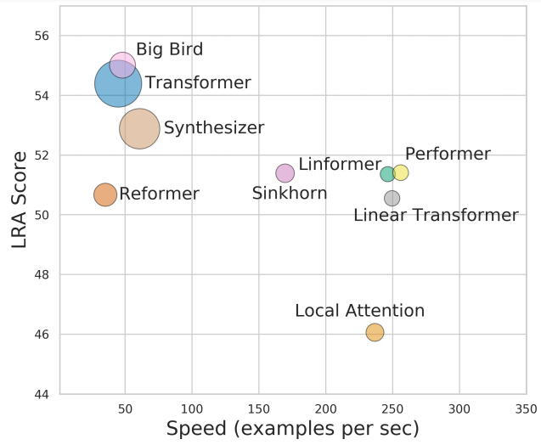
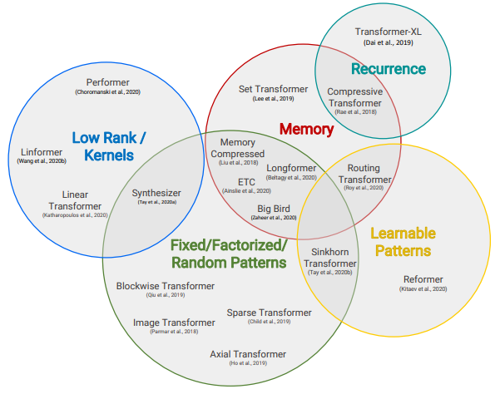
To Learn More …
Long Range Arena: A Benchmark for Efficient Transformers
https://arxiv.org/abs/2011.04006
Efficient Transformers: A Survey
https://arxiv.org/abs/2009.06732
Notes:
各种 Self-attention 的变形

Slide 43


