Slide 1
Attention-based Model

Slide 2
External Memory
Input
DNN/RNN
output
Reading Head Controller
Reading Head
……
……
Machine’s Memory
Ref: http://speech.ee.ntu.edu.tw/~tlkagk/courses/MLDS_2015_2/Lecture/Attain%20(v3).ecm.mp4/index.html
Notes:
Need an example …… ok, in the future

Slide 3

Reading Comprehension
Query
DNN/RNN
answer
Reading Head Controller
Semantic Analysis
……
……
Each sentence becomes a vector.
Notes:
Reading Comprehension 阅读理解
Semantic Analysis 语义分析

Slide 4









Memory Network
Answer
$$=\sum_{n=1}^{N}{α_{n}x^{n}}$$
DNN
Sentence to vector can be jointly trained.
Extracted Information
$$α_{1}$$
$$α_{2}$$
$$α_{3}$$
$$α_{N}$$
Document
……
$$x^{N}$$
$$x^{1}$$
$$x^{2}$$
$$x^{3}$$
vector
Match
q
Query
Sainbayar Sukhbaatar, Arthur Szlam, Jason Weston, Rob Fergus, “End-To-End Memory Networks”, NIPS, 2015
Notes:
Conventional reading comprehension
Find support sentences
Answering
Find the suppor sentence by attentione-based model
All questions is QA
VQA is the same, not describe here

Slide 5









Memory
Network
Answer
$$=\sum_{n=1}^{N}{α_{n}h^{n}}$$
Extracted Information
DNN
Jointly learned
$$h^{1}$$
$$h^{2}$$
$$h^{3}$$
……
$$h^{N}$$
Hopping
$$α_{1}$$
$$α_{2}$$
$$α_{3}$$
$$α_{N}$$
Document
……
$$x^{N}$$
$$x^{1}$$
$$x^{2}$$
$$x^{3}$$
Match
q
Query
Notes:
Conventional reading comprehension
Find support sentences
Answering
Find the suppor sentence by attentione-based model
All questions is QA
VQA is the same, not describe here

Slide 6

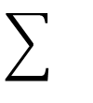
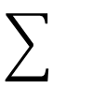
Memory
Network
DNN
a
Extract information
……
……
Compute attention
Extract information
……
……
Compute attention
q

Slide 7
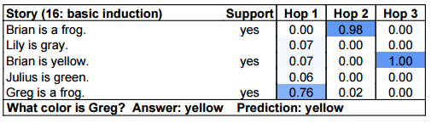
Multiple-hop
End-To-End Memory Networks. S. Sukhbaatar, A. Szlam, J. Weston, R. Fergus. NIPS, 2015.
The position of reading head:
Keras has example: https://github.com/fchollet/keras/blob/master/examples/babi_memnn.py

Slide 8
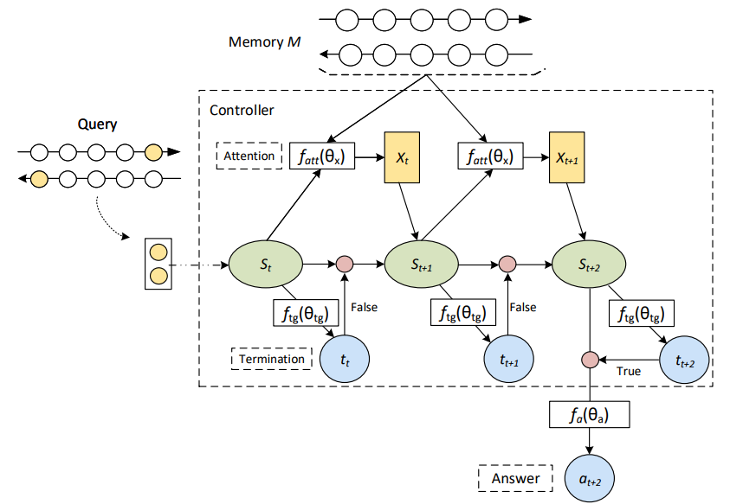
Multiple-hop
ReasoNet
https://arxiv.org/abs/1609.05284

Slide 9
Rnet
R-Net
Notes:
Match-LSTM with Ans-Ptr (Boundary) (ensemble)Singapore Management University
https://arxiv.org/abs/1608.07905

Slide 10
Bi-directional Attention Flow

Slide 11
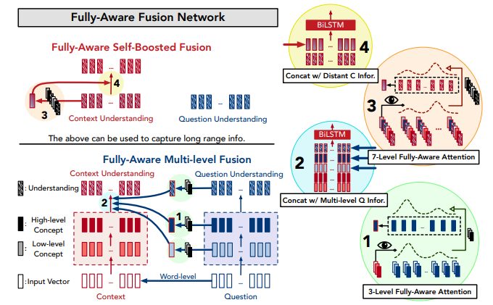

Slide 12
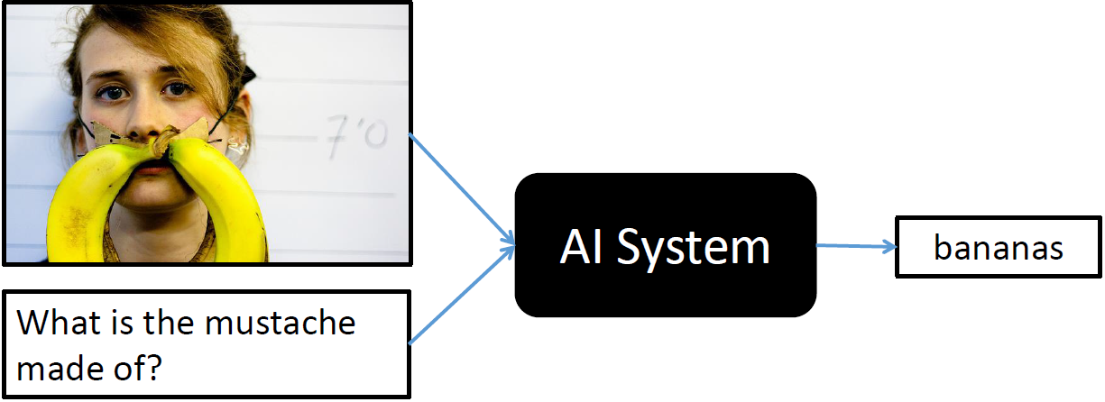
Visual Question Answering
source: http://visualqa.org/
Notes:
太陽花梗

Slide 13
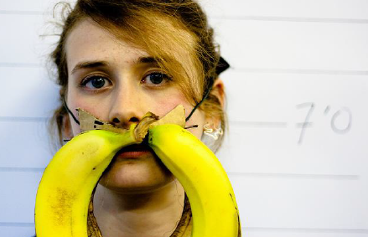
Visual Question Answering
Query
DNN/RNN
answer
Reading Head Controller
CNN
A vector for each region

Slide 14
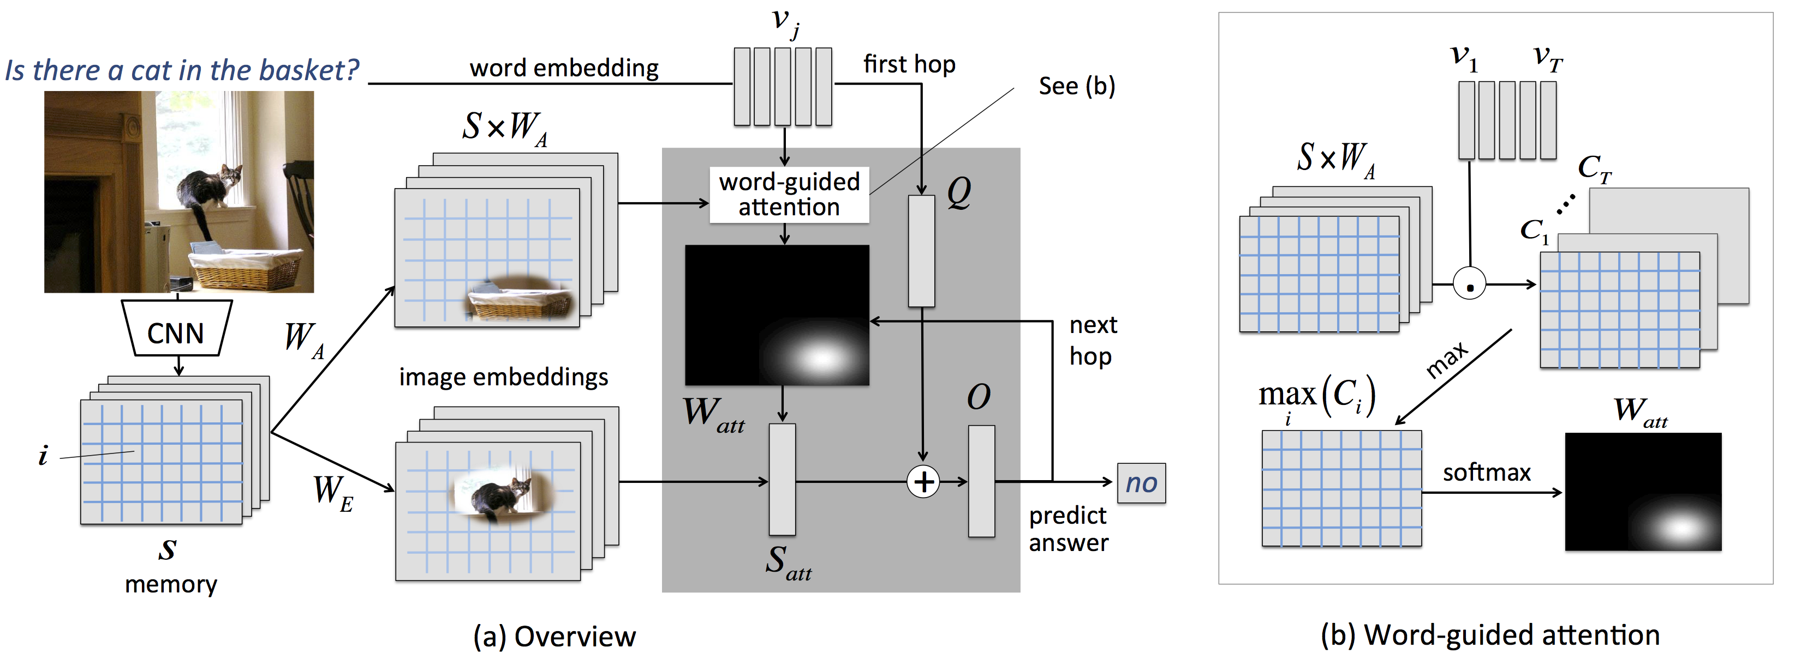
Visual Question Answering
Huijuan Xu, Kate Saenko. Ask, Attend and Answer: Exploring Question-Guided Spatial Attention for Visual Question Answering. arXiv Pre-Print, 2015

Slide 15
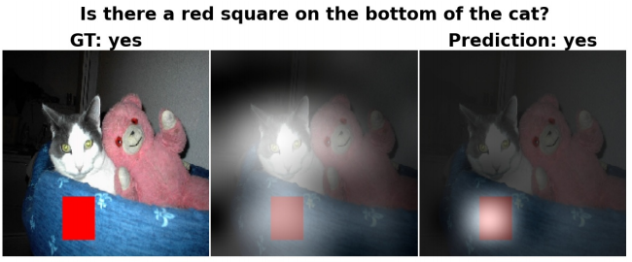
Visual Question Answering
Huijuan Xu, Kate Saenko. Ask, Attend and Answer: Exploring Question-Guided Spatial Attention for Visual Question Answering. arXiv Pre-Print, 2015
Notes:
UMass Lowell, USA

Slide 16
External Memory v2
Input
DNN/RNN
output
Reading Head Controller
Writing Head Controller
Writing Head
Reading Head
……
……
Machine’s Memory
Neural Turing Machine
Notes:
Need an example …… ok, in the future

Slide 17




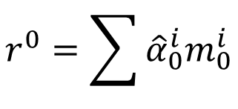




Neural Turing Machine
y¹
h⁰
f
$$r^{0}=\sum{{\hat{α}}_{0}^{i}m_{0}^{i}}$$
x¹
r⁰
Retrieval process
$${\hat{α}}_{0}^{1}$$
$${\hat{α}}_{0}^{2}$$
$${\hat{α}}_{0}^{3}$$
$${\hat{α}}_{0}^{4}$$
$$m_{0}^{1}$$
$$m_{0}^{2}$$
$$m_{0}^{3}$$
$$m_{0}^{4}$$
Notes:
What is the different

Slide 18












Neural Turing Machine
y¹
h⁰
f
$$r^{0}=\sum{{\hat{α}}_{0}^{i}m_{0}^{i}}$$
x¹
r⁰
$$k_{}^{1}$$
$$e_{}^{1}$$
$$a_{}^{1}$$
$${\hat{α}}_{0}^{1}$$
$${\hat{α}}_{0}^{2}$$
$${\hat{α}}_{0}^{3}$$
$${\hat{α}}_{0}^{4}$$
$${\hat{α}}_{1}^{1}$$
$${\hat{α}}_{1}^{2}$$
$${\hat{α}}_{1}^{3}$$
$${\hat{α}}_{1}^{4}$$
softmax
$$m_{0}^{1}$$
$$m_{0}^{2}$$
$$m_{0}^{3}$$
$$m_{0}^{4}$$
$$α_{1}^{1}$$
$$α_{1}^{2}$$
$$α_{1}^{3}$$
$$α_{1}^{4}$$
$$α_{1}^{i}=cos\left(m_{0}^{i},k^{1}\right)$$
Notes:
What is the different

Slide 19













Neural Turing Machine
$$m_{1}^{i}$$
$$=$$
$$m_{0}^{i}$$
$${−\hat{α}}_{1}^{i}$$
$$e_{}^{1}$$
$$⨀$$
$$m_{0}^{i}$$
$${+\hat{α}}_{1}^{i}$$
$$a_{}^{1}$$
(element-wise)
$$k_{}^{1}$$
$$e_{}^{1}$$
$$a_{}^{1}$$
0 ~ 1
$${\hat{α}}_{0}^{1}$$
$${\hat{α}}_{0}^{2}$$
$${\hat{α}}_{0}^{3}$$
$${\hat{α}}_{0}^{4}$$
$${\hat{α}}_{1}^{1}$$
$${\hat{α}}_{1}^{2}$$
$${\hat{α}}_{1}^{3}$$
$${\hat{α}}_{1}^{4}$$
$$m_{0}^{1}$$
$$m_{0}^{2}$$
$$m_{0}^{3}$$
$$m_{0}^{4}$$
$$m_{1}^{1}$$
$$m_{1}^{2}$$
$$m_{1}^{3}$$
$$m_{1}^{4}$$
Notes:
What is the different

Slide 20








Neural Turing Machine
y¹
y²
h⁰
f
h¹
f
x¹
r⁰
x²
r¹
$${\hat{α}}_{0}^{1}$$
$${\hat{α}}_{0}^{2}$$
$${\hat{α}}_{0}^{3}$$
$${\hat{α}}_{0}^{4}$$
$${\hat{α}}_{1}^{1}$$
$${\hat{α}}_{1}^{2}$$
$${\hat{α}}_{1}^{3}$$
$${\hat{α}}_{1}^{4}$$
$${\hat{α}}_{2}^{1}$$
$${\hat{α}}_{2}^{2}$$
$${\hat{α}}_{2}^{3}$$
$${\hat{α}}_{2}^{4}$$
$$m_{0}^{1}$$
$$m_{0}^{2}$$
$$m_{0}^{3}$$
$$m_{0}^{4}$$
$$m_{1}^{1}$$
$$m_{1}^{2}$$
$$m_{1}^{3}$$
$$m_{1}^{4}$$
$$m_{2}^{1}$$
$$m_{2}^{2}$$
$$m_{2}^{3}$$
$$m_{2}^{4}$$
Notes:
What is the different!!!!!!!!!!!!!!!!!!???????????????????????

Slide 21
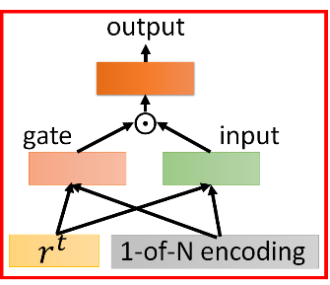
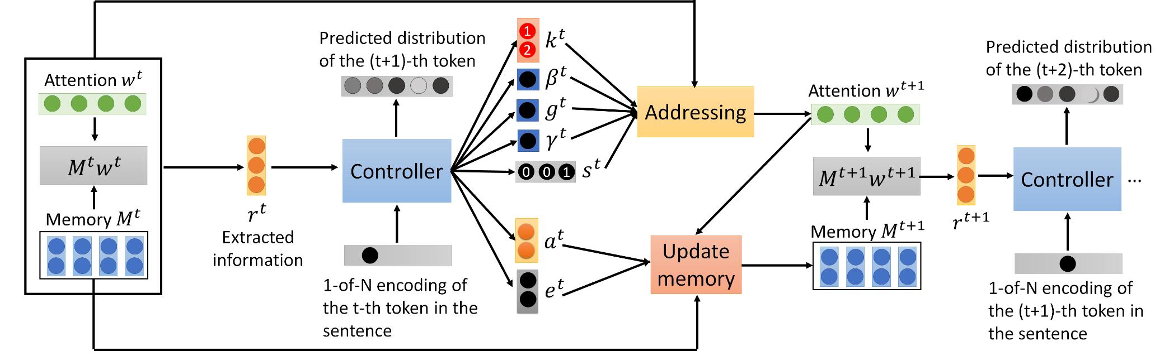
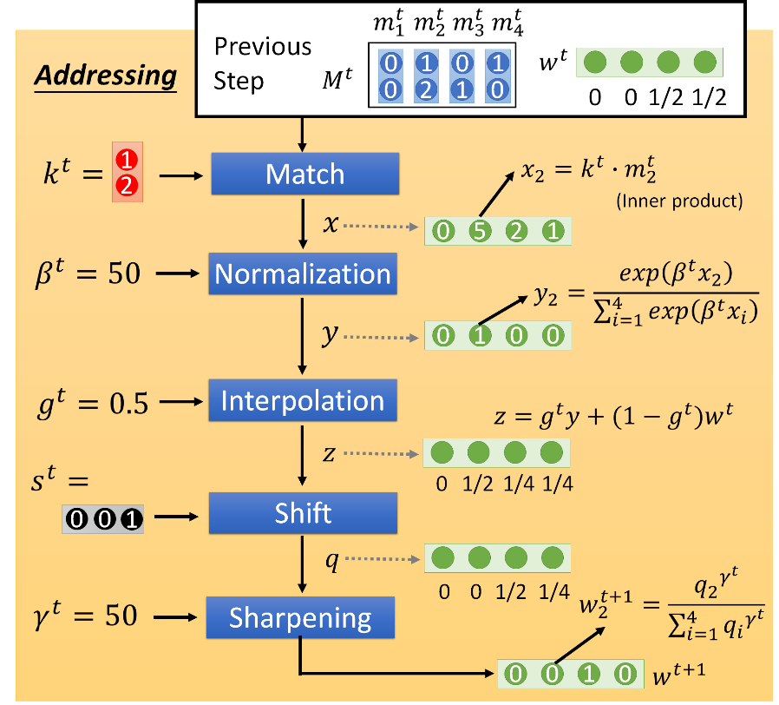
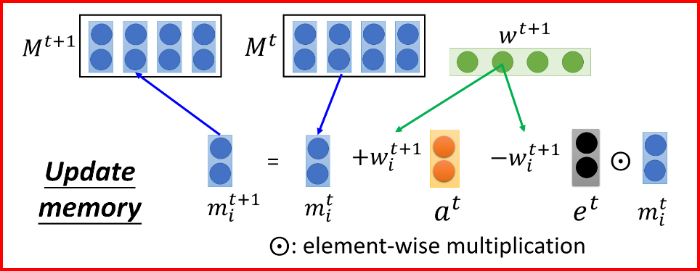
Neural Turing Machine for LM
Wei-Jen Ko, Bo-Hsiang Tseng, Hung-yi Lee, “Recurrent Neural Network based Language Modeling with Controllable External Memory”, ICASSP, 2017

Slide 22
Stack RNN
Armand Joulin, Tomas Mikolov, Inferring Algorithmic Patterns with Stack-Augmented Recurrent Nets, arXiv Pre-Print, 2015
y^{t}
Push
Pop
Nothing
f
+
+
Information to store
……
Push, Pop, Nothing
0.7
0.2
0.1
…
…
…
X0.7
X0.2
X0.1
stack
x^{t}

