Slide 1
Tips for Training Deep Network

Slide 2
Output
Training Strategy: Batch Normalization
Activation Function: SELU
Network Structure: Highway Network

Slide 3
Batch Normalization

Slide 4
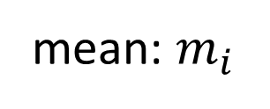







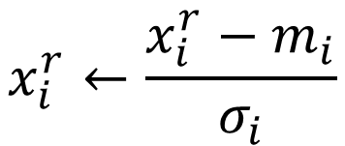

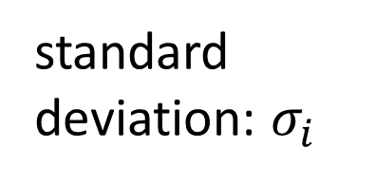

Feature Scaling
$$x^{1}$$
$$x^{2}$$
$$x^{3}$$
$$x^{r}$$
$$x^{R}$$
For each dimension i:
$$x_{1}^{1}$$
$$x_{1}^{2}$$
$$x_{2}^{1}$$
$$x_{2}^{2}$$
……
……
mean: $m_{i}$
……
……
……
……
……
standard deviation: $σ_{i}$
$$x_{i}^{r}←\frac{x_{i}^{r}−m_{i}}{σ_{i}}$$
The means of all dimensions are 0, and the variances are all 1
In general, gradient descent converges much faster with feature scaling than without it.
Notes:
Can we demo this???????????????
https://standardfrancis.wordpress.com/2015/04/16/batch-normalization/

Slide 5






How about Hidden Layer?
Feature Scaling
Feature Scaling ?
Feature Scaling ?
$$x^{1}$$
Layer 1
$$a^{1}$$
$$\text{Layer} \text{2}$$
$$a^{2}$$
……
Difficulty: their statistics change during the training …
Batch normalization
Smaller learning rate can be helpful, but the training would be slower.
Internal Covariate Shift
Notes:
Normalizes layer inputs to zero mean and unit variance. whitening.
Naive method: Train on a batch. Update model parameters. Then normalize. Doesn't work: Leads to exploding biases while distribution parameters (mean, variance) don't change.
If we do it this way gradient always ignores the effect that the normalization for the next batch would have
i.e. : “The issue with the above approach is that the gradient descent optimization does not take into account the fact that the normalization takes place”

Slide 6


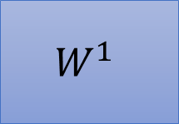




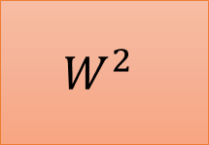














Batch
$$x^{1}$$
$$W^{1}$$
$$z^{1}$$
Sigmoid
$$a^{1}$$
$$W^{2}$$
……
$$x^{2}$$
$$W^{1}$$
$$z^{2}$$
Sigmoid
$$a^{2}$$
$$W^{2}$$
……
$$x^{3}$$
$$W^{1}$$
$$z^{3}$$
Sigmoid
$$a^{3}$$
$$W^{2}$$
……
$$z^{1}$$
$$z^{2}$$
$$z^{3}$$
$$W^{1}$$
$$x^{1}$$
$$x^{2}$$
$$x^{3}$$
Batch
=
Notes:
上學期好多人做!
https://ntumlds.wordpress.com/2017/03/26/r05922005_rrrr/

Slide 7


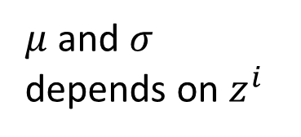

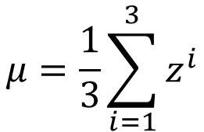
Batch normalization
$$μ=\frac{1}{3}\sum_{i=1}^{3}{z^{i}}$$
$$x^{1}$$
$$W^{1}$$
$$z^{1}$$
$$σ=\sqrt{\frac{1}{3}\sum_{i=1}^{3}{{\left(z^{i}−μ\right)}^{2}}}$$
$$x^{2}$$
$$W^{1}$$
$$z^{2}$$
Note: Batch normalization cannot be applied on small batch.
$$x^{3}$$
$$W^{1}$$
$$z^{3}$$
$μ$ and $σ$ depends on $z^{i}$
$$μ$$
$$σ$$
Notes:
上學期好多人做!
https://ntumlds.wordpress.com/2017/03/26/r05922005_rrrr/

Slide 8



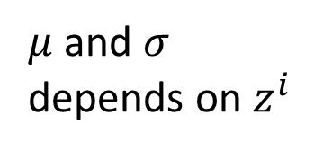




Batch normalization
$${\tilde{z}}^{i}=\frac{z^{i}−μ}{σ}$$
$$x^{1}$$
$$W^{1}$$
$$z^{1}$$
$${\tilde{z}}^{1}$$
Sigmoid
$$a^{1}$$
$$x^{2}$$
$$W^{1}$$
$$z^{2}$$
$${\tilde{z}}^{2}$$
Sigmoid
$$a^{2}$$
$$x^{3}$$
$$W^{1}$$
$$z^{3}$$
$${\tilde{z}}^{3}$$
Sigmoid
$$a^{3}$$
$$μ$$
$$σ$$
How to do backpropogation?
$μ$ and $σ$ depends on $z^{i}$
Notes:
上學期好多人做!
https://ntumlds.wordpress.com/2017/03/26/r05922005_rrrr/

Slide 9







Batch normalization
$${\tilde{z}}^{i}=\frac{z^{i}−μ}{σ}$$
$${\hat{z}}^{i}=γ⨀{\tilde{z}}^{i}+β$$
$$x^{1}$$
$$W^{1}$$
$$z^{1}$$
$${\tilde{z}}^{1}$$
$${\hat{z}}^{1}$$
$$x^{2}$$
$$W^{1}$$
$$z^{2}$$
$${\tilde{z}}^{2}$$
$${\hat{z}}^{2}$$
$$x^{3}$$
$$W^{1}$$
$$z^{3}$$
$${\tilde{z}}^{3}$$
$${\hat{z}}^{3}$$
$$μ$$
$$σ$$
$$β$$
$$γ$$
$μ$ and $σ$ depends on $z^{i}$
Notes:
上學期好多人做!
https://ntumlds.wordpress.com/2017/03/26/r05922005_rrrr/

Slide 10






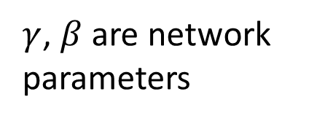






Batch normalization
Acc
$$μ_{300}$$
$$μ_{100}$$
$$μ_{1}$$
At testing stage:
Updates
$$\tilde{z}=\frac{z−μ}{σ}$$
$$\tilde{z}$$
$${\hat{z}}^{i}=γ⨀{\tilde{z}}^{i}+β$$
$$\hat{z}$$
$$x$$
$$W^{1}$$
$$z$$
$μ$, $σ$ are from batch
$γ$, $β$ are network parameters
We do not have batch at testing stage.
Ideal solution:
Computing $μ$ and $σ$ using the whole training dataset.
Practical solution:
Computing the moving average of $μ$ and $σ$ of the batches during training.
Notes:
上學期好多人做!
https://ntumlds.wordpress.com/2017/03/26/r05922005_rrrr/

Slide 11













Batch normalization - Benefit
BN reduces training times, and make very deep net trainable.
Because of less Covariate Shift, we can use larger learning rates.
Less exploding/vanishing gradients
Especially effective for sigmoid, tanh, etc.
Learning is less affected by initialization.
BN reduces the demand for regularization.
$$×k$$
$$×k$$
$$keep$$
$$x^{i}$$
$$W^{1}$$
$$z^{i}$$
$${\tilde{z}}^{i}$$
$${\hat{z}}^{i}$$
$$k$$
$$k$$
$${\tilde{z}}^{i}=\frac{z^{i}−μ}{σ}$$
$${\hat{z}}^{i}=γ⨀{\tilde{z}}^{i}+β$$
$$k$$
Notes:
Because the means and variances are calculated over batches and therefore every normalized value depends on the current batch. I.e. the network can no longer just memorize values and their correct answers.)

Slide 13
To learn more ……
Batch Renormalization
Layer Normalization
Instance Normalization
Weight Normalization
Spectrum Normalization

Slide 14
Activation Function: SELU

Slide 15





ReLU
Rectified Linear Unit (ReLU)
Reason:
$$a$$
1. Fast to compute
$$σ\left(z\right)$$
$$a=z$$
2. Biological reason
3. Infinite sigmoid with different biases
$$a=0$$
$$z$$
4. Vanishing gradient problem
Notes:
Parametric ReLU, -> PReLU
Ref: Glorot, Xavier, Antoine Bordes, and Yoshua Bengio. "Deep sparse rectifier neural networks." International Conference on Artificial Intelligence and Statistics. 2011.
No differentailalbe how about 0
Benefit:
2011
Where does it come from?
fast to compute
biology?
many sigmoid

Slide 16




ReLU - variant
$$Leaky ReLU$$
$$Parametric ReLU$$
$$a$$
$$a$$
$$a=z$$
$$a=z$$
$$z$$
$$z$$
$$a=0.01z$$
$$a=αz$$
α also learned by gradient descent

Slide 17
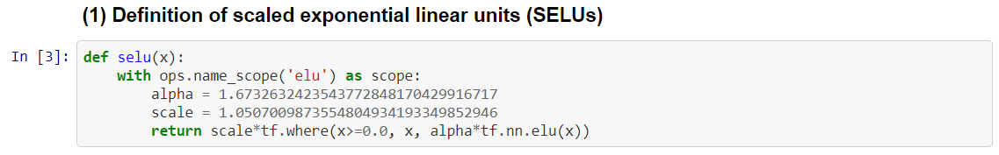





ReLU - variant
https://github.com/bioinf-jku/SNNs
Exponential Linear Unit (ELU)
Scaled ELU (SELU)
$$a$$
$$a$$
$$a=z$$
$$a=z$$
$$×λ$$
$$z$$
$$z$$
$$×λ$$
$$a=α\left(e^{z}−1\right)$$
$$a=α\left(e^{z}−1\right)$$
$$α=1.6732632423543772848170429916717$$
$$λ=1.0507009873554804934193349852946$$

Slide 18
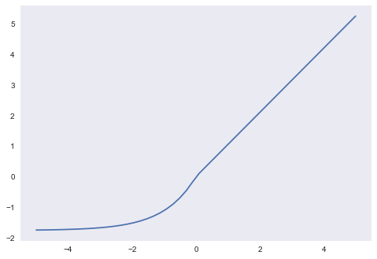




SELU
$$α=1.673263242…$$
$$λ=1.050700987…$$
$$a=λz$$
$$a=λα\left(e^{z}−1\right)$$
Positive and negative values
The whole ReLU family has this property except the original ReLU.
Saturation region
ELU also has this property
Slope larger than 1
Only SELU also has this property

Slide 19
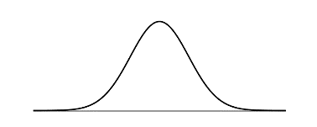




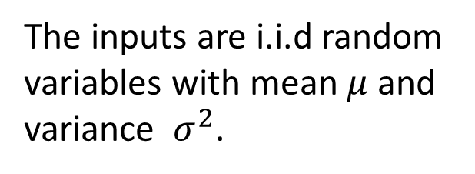

SELU
$$μ_{z}=E\left[z\right]$$
$$=\sum_{k=1}^{K}{E\left[a_{k}\right]}w_{k}$$
$$=μ\sum_{k=1}^{K}{w_{k}}$$
$$=μ∙{Kμ}_{w}$$
$$μ$$
=0
=0
The inputs are i.i.d random variables with mean $μ$ and variance $σ^{2}$.
=0
=1
…
…
…
…
Do not have to be Gaussian
Notes:
The intuition here is that high variance in one layer is mapped to low variance in the next layer and vice versa. This works because the SELU decreases the variance for negative inputs and increases the variance for positive inputs. The decrease effect is stronger for very negative inputs, and the increase effect is stronger for near-zero values.
Theorem 2 — the mapping of variance is bounded from above so gradients cannot explode
Theorem 3—the mapping of variance is bounded from below so gradients cannot vanish

Slide 20




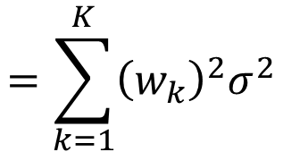











SELU
$$μ_{z}=0$$
$$μ_{w}=0$$
$$σ_{z}^{2}=E\left[{\left(z−μ_{z}\right)}^{2}\right]$$
$$=E\left[z^{2}\right]$$
$$=E\left[{\left(a_{1}w_{1}+a_{2}w_{2}+⋯\right)}^{2}\right]$$
The inputs are i.i.d random variables with mean $μ$ and variance $σ^{2}$.
$$=\sum_{k=1}^{K}{{\left(w_{k}\right)}^{2}σ^{2}}$$
$$=σ^{2}∙{Kσ}_{w}^{2}$$
$$=1$$
=0
=1
=1
=1
$$E\left[{\left(a_{k}w_{k}\right)}^{2}\right]$$
$$={\left(w_{k}\right)}^{2}E\left[{\left(a_{k}\right)}^{2}\right]$$
$$={\left(w_{k}\right)}^{2}σ^{2}$$
$$E\left[a_{i}a_{j}w_{i}w_{j}\right]$$
$$=w_{i}w_{j}E\left[a_{i}\right]E\left[a_{j}\right]$$
$$=0$$
…
…
…
target
…
Assume Gaussian
$$μ=0,σ=1$$
Notes:
The intuition here is that high variance in one layer is mapped to low variance in the next layer and vice versa. This works because the SELU decreases the variance for negative inputs and increases the variance for positive inputs. The decrease effect is stronger for very negative inputs, and the increase effect is stronger for near-zero values.
Theorem 2 — the mapping of variance is bounded from above so gradients cannot explode
Theorem 3—the mapping of variance is bounded from below so gradients cannot vanish

Slide 21
Demo
Notes:
http://140.112.21.35:6001/tree?token=6b1c4dc126a2a6aee2ecd04400b3c5998cebb20afbd487b8

Slide 22
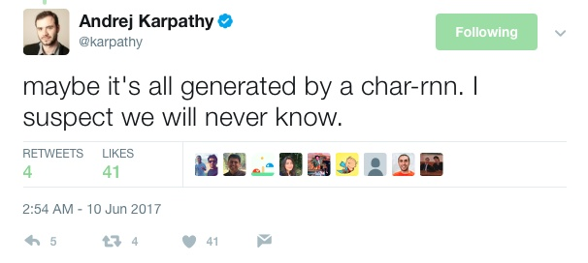
93 頁的證明
Source of joke: https://zhuanlan.zhihu.com/p/27336839
SELU is actually more general.

Slide 23
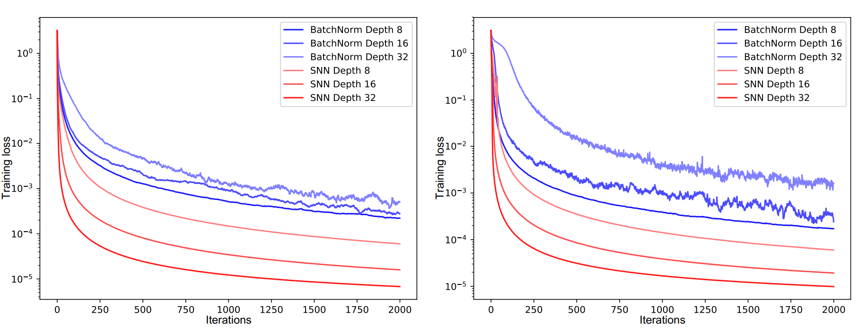
MNIST
CIFAR-10
最新激活神經元:SELF-NORMALIZATION NEURAL NETWORK (SELU)
Notes:
GELU:

Slide 24
Demo
Notes:
http://140.112.21.35:6001/tree?token=f75a8b24c45107363a1a26cc9ad2736bbe4e373ade6b24a7
http://140.112.21.35:6001/notebooks/SELU.ipynb

Slide 25
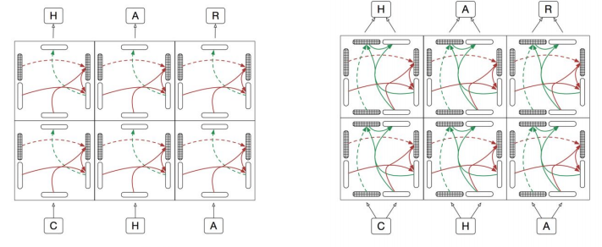
Highway Network & Grid LSTM

Slide 26
Feedforward v.s. Recurrent
1. Feedforward network does not have input at each step
2. Feedforward network has different parameters for each layer
x
f₁
a¹
f₂
a²
f₃
a³
f₄
y
$$a^{t}=f_{l}\left(a^{t−1}\right)=σ\left(W^{t}a^{t−1}+b^{t}\right)$$
t is layer
h⁰
f
h¹
f
h²
f
h³
f
y⁴
x¹
x²
x³
x⁴
t is time step
$$h^{t}=f\left(h^{t−1},x^{t}\right)=σ\left(W^{h}h^{t−1}+W^{i}x^{t}+b^{i}\right)$$
Applying gated structure in feedforward network

Slide 27





GRU $→$ Highway Network
y^{t}
No input x^{t} at each step
a^{t-1}
h^{t}
h^{t-1}
$$⨀$$
$$＋$$
a^{t}
No output y^{t} at each step
$$⨀$$
1-
$$⨀$$
a^{t-1} is the output of the (t-1)-th layer
reset
update
a^{t} is the output of the t-th layer
r
z
h'
No reset gate
a^{t-1}
h^{t-1}
x^{t}
x^{t}

Slide 28











Highway Network
$$h^{′}=σ\left(Wa^{t−1}\right)$$
$$z=σ\left(W′a^{t−1}\right)$$
$$a^{t}=z⊙a^{t−1}+\left(1−z\right)⊙h$$
Highway Network
Residual Network
$$a^{t}$$
$$a^{t}$$
+
$$z$$
$$a^{t−1}$$
$$h^{′}$$
Gate controller
$$h′$$
copy
copy
$$a^{t−1}$$
$$a^{t−1}$$
Training Very Deep Networks
https://arxiv.org/pdf/1507.06228v2.pdf
Deep Residual Learning for Image Recognition
http://arxiv.org/abs/1512.03385

Slide 29
output layer
output layer
output layer
Highway Network automatically
determines the layers needed!
Input layer
Input layer
Input layer
Notes:
There are many interesting thin in highway network

Slide 30
Highway Network
Notes:
Lesion 損害

Slide 31
Grid LSTM
Memory for both time and depth
depth
y
a’
b’
LSTM
c’
Grid
LSTM
c’
c
c
h^{t}
h’
h
h
x
a
b
time

Slide 32
a^{l+1}
b^{l+1}
a^{l+1}
b^{l+1}
c^{t-1}
Grid
LSTM’
c^{t}
Grid
LSTM’
c^{t+1}
h^{t-1}
h^{t}
h^{t+1}
a^{l}
b^{l}
a^{l}
b^{l}
c^{t-1}
Grid
LSTM
c^{t}
Grid
LSTM
c^{t+1}
h^{t-1}
h^{t}
h^{t+1}
a^{l-1}
b^{l-1}
a^{l-1}
b^{l-1}

Slide 33




Grid LSTM
h'
b'
a’
b’
c
c'
a
$$⨀$$
$$＋$$
$$⨀$$
a'
Grid
LSTM
c’
tanh
c
$$⨀$$
h’
h
z^{f}
z^{i}
z
zº
a
b
h
b

Slide 34
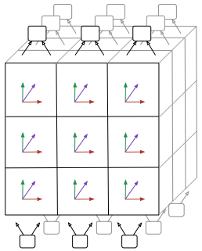
3D Grid LSTM
a’
b’
e’
f’
c
c’
h
h’
e
f
a
b
Notes:
When do we need this one??????

Slide 35
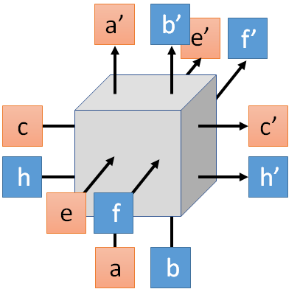
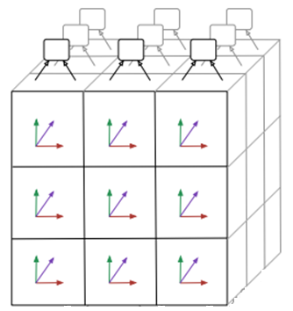
3D Grid LSTM
3 x 3 images
Images are composed of pixels

