Slide 1
Automatically Determining Hyperparameters
Notes:
Hyperparameters

Slide 2
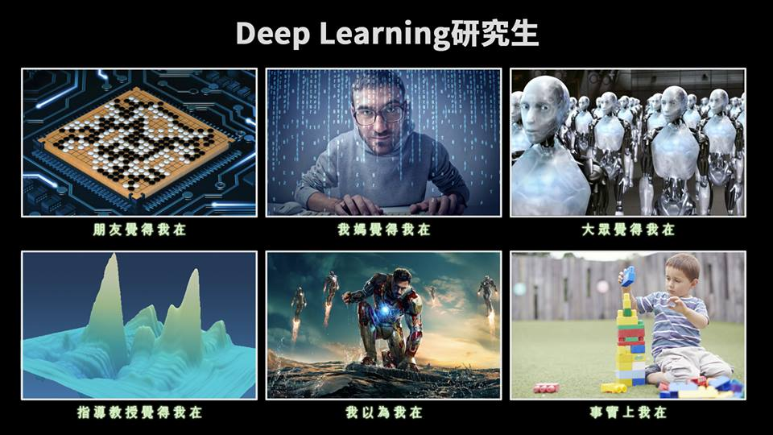
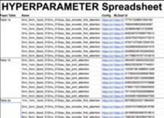
Source of iamge: https://medium.com/intuitionmachine/the-brute-force-method-of-deep-learning-innovation-58b497323ae5 (Denny Britz’s graphic)
感謝 沈昇勳 同學提供圖檔
Notes:
Graduent student descent
http://blog.districtdatalabs.com/visual-diagnostics-for-more-informed-machine-learning-part-3

Slide 3

Grid Search v.s. Random Search
http://www.deeplearningbook.org/contents/guidelines.html
Layer width
Layer width
Layer depth
Layer depth
Assumption: top K results are good enough
If there are N points,
probability K/N that your sample is in top K
Sample x times:
$$1−{\left(1−K/N\right)}^{x}$$
> 90%
If N = 1000, K = 10
x = 230
K = 100
x = 22
Notes:
autoML
Learning to learn / meta learning
If there are N points, how many samples we need to make sure the probability of sampling top K is above 90%.
Top are pretty much the same
Top 10 / 1000 is good enough!
90%
0.1 22
0.01 230
0.001 2302

Slide 4
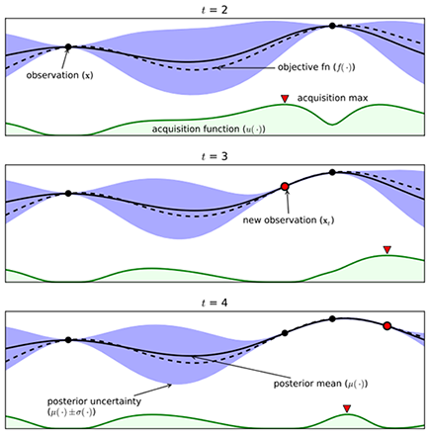
Model-based Hyperparameter Optimization
https://cloud.google.com/blog/big-data/2017/08/hyperparameter-tuning-in-cloud-machine-learning-engine-using-bayesian-optimization

Slide 5
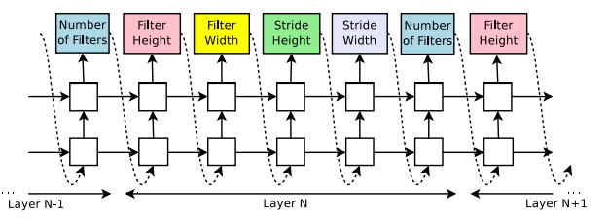
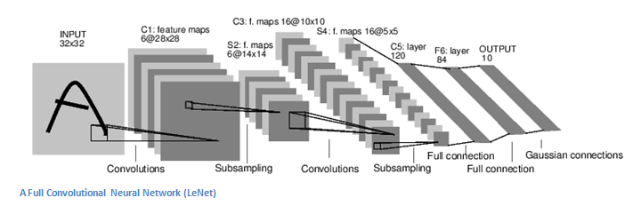
Reinforcement Learning
One kind of meta learning (or learn to learn)
Accuracy as reward
Design a network
Train the network

Slide 6
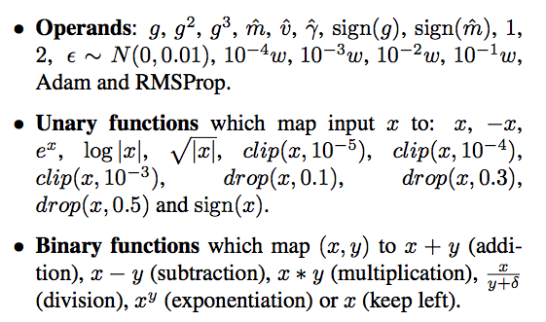
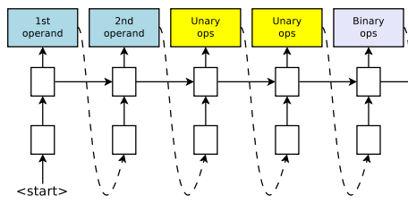
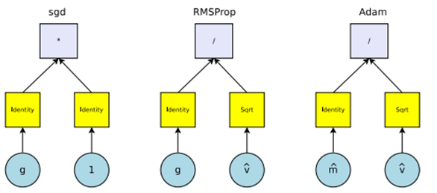
Learning Rate

Slide 7
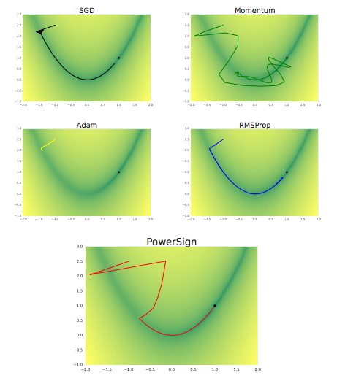

Can transfer to new tasks
Notes:
shake them all aggressively in a bag, and presto, you got your state-of-the-art (SOTA) optimization method! (Viewer discretion, do not do this from home without professional deep learning resources). The authors used a less lavish GPU cluster. That is 12 machines with 8 GPUs. That’s 96 GPUs if you do you multiplication right. An 8 GPU machine like Nvidia’s DGX-1 is listed at $150,000. In short, Cost of Twelve Nvidia DGX-1’s, 1.8 million dollars. Discovery of AddSign and PowerSign — Priceless.

Slide 8
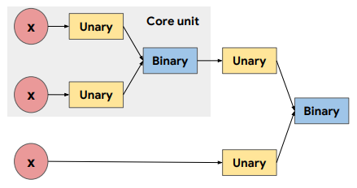
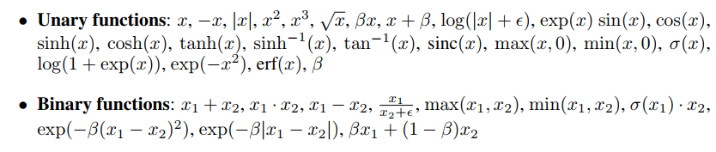
Activation Function

Slide 9
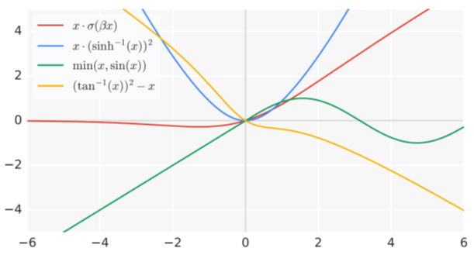
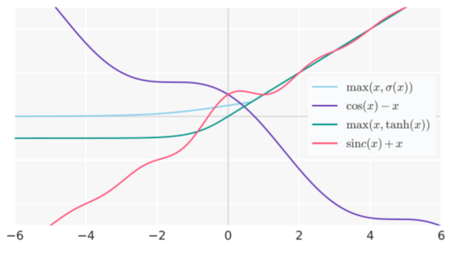
Activation Function
Notes:
Demo????

Slide 10

$$a=z∙sigmoid\left(βz\right)$$
Notes:
swish中文:發嗖嗖聲
GELU:https://arxiv.org/pdf/1606.08415.pdf

Slide 11
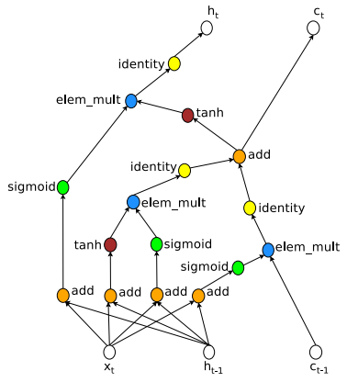
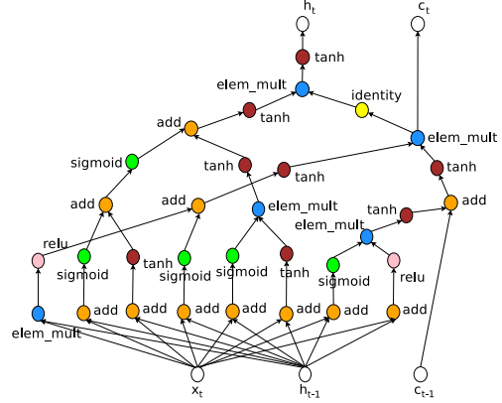
Neural Architecture Search with Reinforcement Learning
LSTM
From Reinforcement Learning

Slide 12
Computation Issue?
Original version: 450 GPUs for 3-4 days (32,400-43,200 GPU hours).
New version: Nvidia GTX 1080Ti GPU takes less than 16 hours.
Main idea: forcing all child models to share weights to instead of training from scratch.
Hieu Pham, Melody Y. Guan, Barret Zoph, Quoc V. Le, Jeff Dean, “Efficient Neural Architecture Search via Parameter Sharing”, arXiv, 2018
Notes:
https://scholar.google.com.tw/scholar?as_ylo=2018&hl=zh-TW&as_sdt=0,5&sciodt=0,5&cites=4164896773666247762&scipsc=

