Slide 1

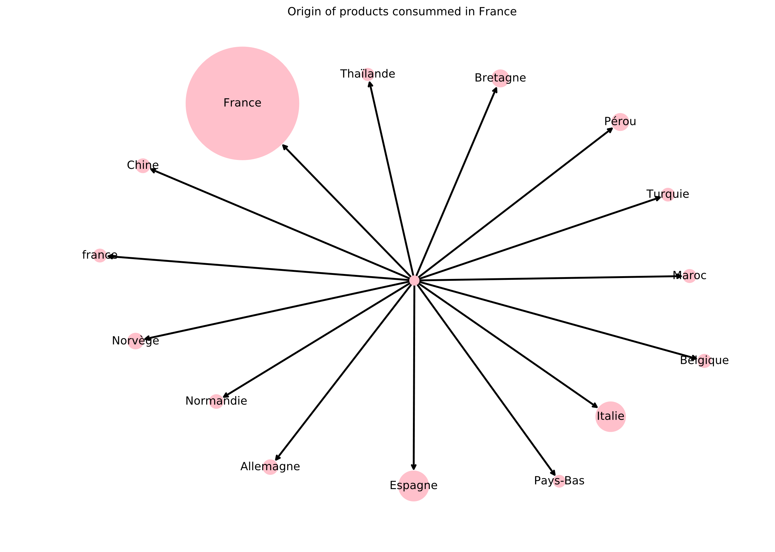
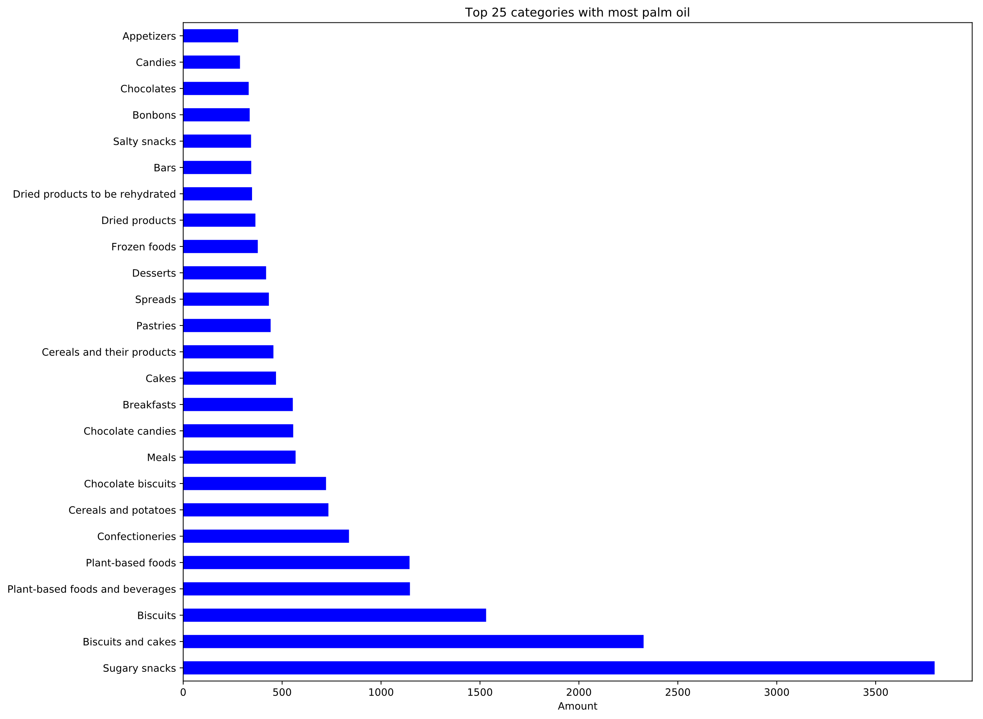
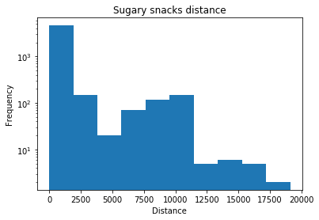
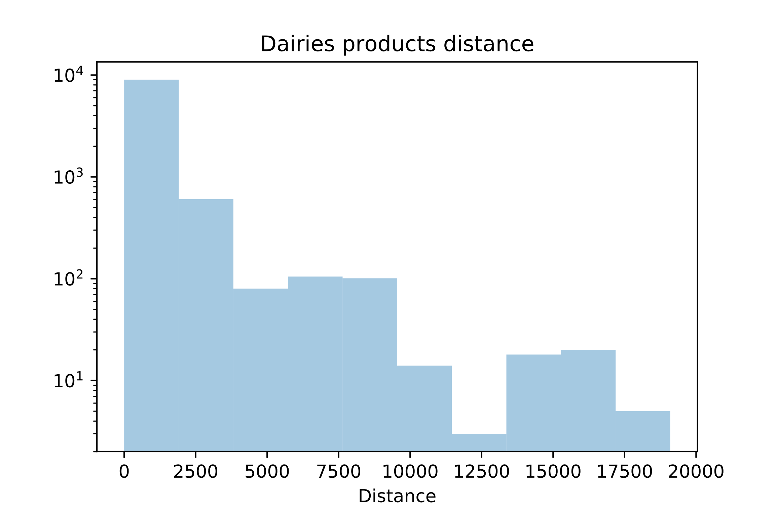
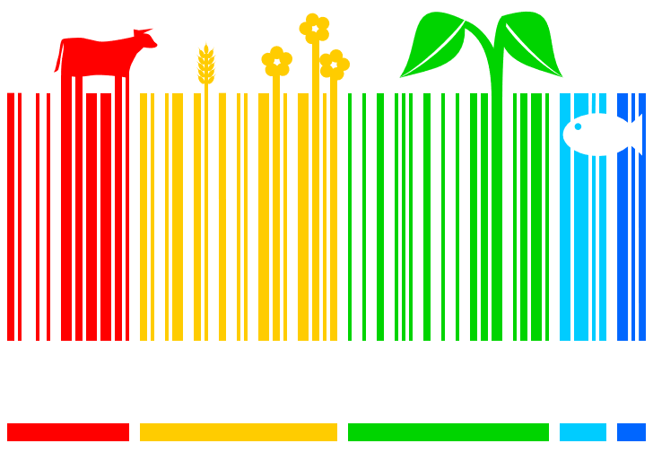
Distance computation
With the geopy library and some langage processing on the origin and destination of the products, we were able to compute how much the products travel.
Palm oil
As we know already, palm oil is a major reason for deforestation. Therefore we analyse what kind of products are more likely to contain palm oil.
Abstract
As ecology grows as a more important concern, populations need not only to focus on driving less or consuming less, but also on how they consume food. It is a known fact that consuming products derived from palm oil, or meat in general is much more damaging for the environment than growing your own vegetables. During this project, we aim to expose how to be more regarding towards the environment in our daily food consumption.
The main goal is to investigate the world of food and understand what are some hints to take when we want to consume more eco-friendly.
Methods
We explore the dataset using vairous tools, such as statistical analysis with PCA, or more basic statistics computation. We also use visualization to express our findings.
Distance by category
By looking into distance by category we can see what type of products tend to travel a bit less.
Vegan products
As we know already, palm oil is a major reason for deforestation. Therefore we analyse what kind of products are more likely to contain palm oil.
An ecological study of the food industry
Nicolas Freundler, Johan Lanzrein, Jennifer Veillard

