Slide 1
A simple raytracer COMS 336
Michael Entin, Johan Lanzrein
mentin@iastate.edu lanzrein@iastate.edu
Dec. 5 2017

Slide 2
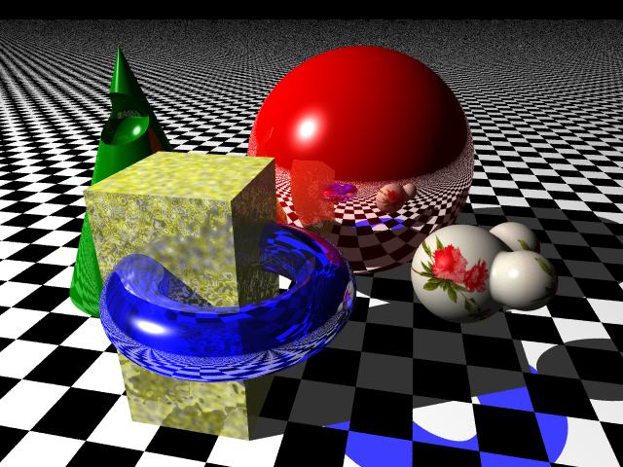

Slide 3
What is ray tracing ?
Ray tracing is a rendering technique.
Instead of computing triangles in the GPU and using the pipeline we learned in class. Most of the computation take place in the non – shading code. Here javascript.
We need knowledge about the scene therefore we can’t really use it in the shader code.
The main idea is to shoot a ray from the camera(eye) unto every pixel of the image and compute the result.
→ Algorithm coming up.

Slide 4
Why use or not use raytracing ?
Ray tracing makes properties such as shadow and reflections appear naturally during the computation.
Resulting images are very realistic. (In some cases…)
It is more of a research interest than an actual industry focus.
The computational cost is very high making it not suited for animation movies or video games.

Slide 5
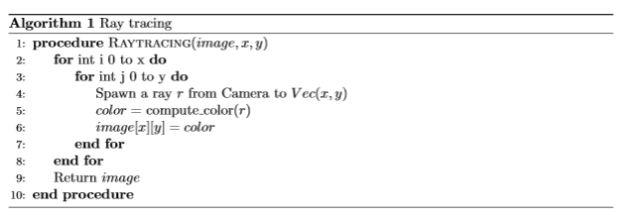
Let image be the image, x be the width, y the height.
The Camera is the position of the eye.
When we say Vec(x,y) we mean create a vector in world coordinate given the coordinate (x,y). In reality THREE.js does the hard work for us.

Slide 6
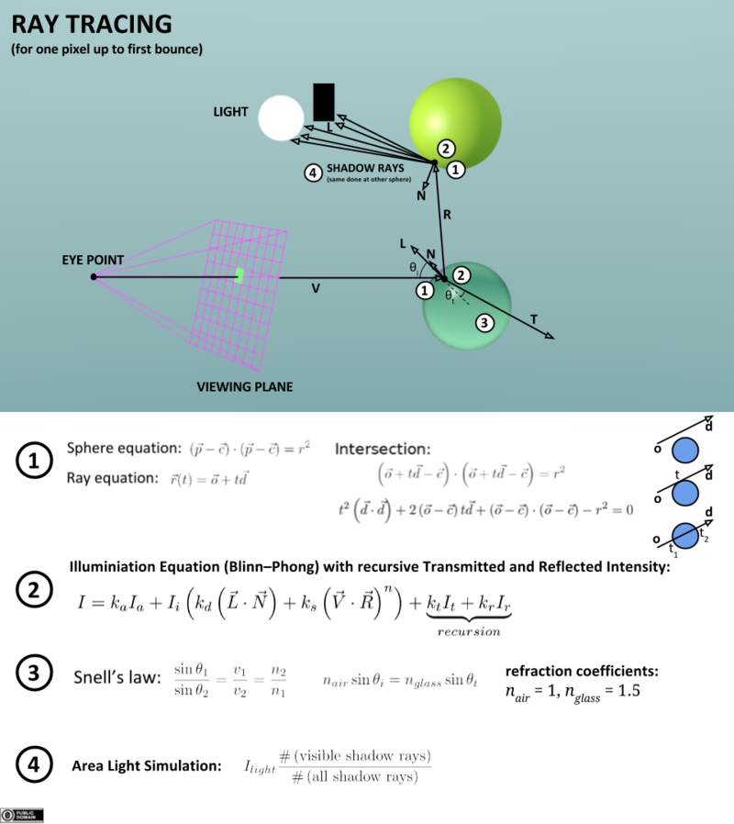
How to compute color ?
Alorigthm is recursive by nature.
We have to limit the recursivity in order not to have a too long computation time.
At every interesection we do the entire computation for the color
Ambient, Diffuse, Specular.

Slide 7
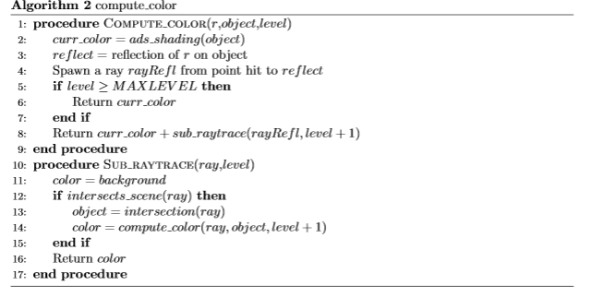

Slide 8
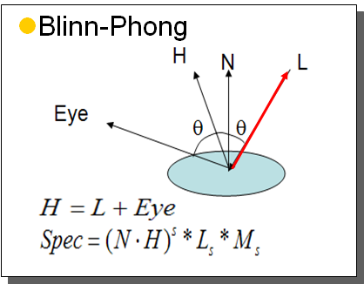
The function ads_shading
Nothing different than what we used to do in the shader code in many of our examples.
We use the Blinn-Phong. Because computing the half-way vector was easier.
Looks easy in theory. In practice, much harder than what we thought.
The results vary in effectiveness…
Reminder Blinn-Phong :
Compute ADS like for Phong but…
Specular is different

Slide 9
Further improvements (Assuming correctness)
Ray tracing is an algorithm that could very easily be parallelized.
In JS : WebWorkers ( But sadly we didnt have time to implement it with them). In other languages : multithreading, parallel collections etc...
Taking advantage of todays multi core computers would make it much faster. But still slower than some other rendering techniques.
Remember the shading computation of a specific face once it has been hit and store it. (This would however cause some more problem on the space complexity ).

Slide 10
Time for a demo.
- In our case the algorithm is painfully slow.
We only use the reflection and not the refraction.
Refraction wouldn’t necessary be much complicated. But we wanted to keep the code simple as it is a very basic raytracer.
Idea to make it look smoother : Gaussian blur (But loss for quality of the image)

Slide 11

QUESTIONS ?
Sources for images and informations :
https://www.tjhsst.edu/~dhyatt/superap/samplex.jpg
https://en.wikipedia.org/wiki/Ray_tracing_(graphics)#/media/File:Ray_Tracing_Illustration_First_Bounce.png
http://www.oyonale.com/modeles.php?lang=en&page=40
https://threejs.org/docs/
https://www.scratchapixel.com/lessons/3d-basic-rendering/introduction-to-ray-tracing/how-does-it-work
http://alteredqualia.com/three/examples/raytracer_sandbox_reflection.html
http://images.cnitblog.com/blog/424169/201307/07013515-c8d36d1cc7b14c5681d644ed25065a19.png

