Slide 1

E- Sumbong: An Android-Based Incident Report Mobile Application
Epir D. Abapo Jr.
Mae Jane P. Barrientos
Manilyn P. Joaquin
Negiel L. Labrada

Slide 2

Introduction
Technology has greatly aided in the betterment of people's daily life basis. People may utilize technology to accomplish their jobs more quickly and easily, as well as interact with their friends and family in an instant, and search for information as quickly as possible. Technology has been employed in both a life saving device and a criminal investigation.
Date
Research Title: E- Sumbong: An Android-Based Incident Report Mobile Application

Slide 3
Project Context
Police personnel were delayed in responding because of the process in reporting crimes that needed to check the specific location and time of the incident.
Lack of evidence if that occurrences actually happened.
Date
Research Title: E- Sumbong: An Android-Based Incident Report Mobile Application

Slide 4
Purpose and Description
to assist the police officers in obtaining information about occurrences and promptly correlating the incidents and crimes.
To provide pictures or videos of occurrences that occurred in the neighborhood.
All confidential records are safe. Only police officers or those assigned officers could access the Administrator system and receive those information sent by the witnesses.
Date
Research Title: E- Sumbong: An Android-Based Incident Report Mobile Application

Slide 5
Objectives of the Study
This research aimed to develop a mobile application named E-Sumbong: An Android-Based Incident Report Application for PNP Dumingag and it addressed the following specific objectives:
To capture or record a video clip of the incidence for quick and easy reporting.
To pinpoint the location using GPS technology, latitude and longitude coordinates of where the incident happen.
To generate incident reports.
Date
Research Title: E- Sumbong: An Android-Based Incident Report Mobile Application

Slide 6
Scope and Limitation
This research focused on the job of police officers within Dumingag Police Station in receiving information about the incidents as quickly as possible.
The Dumingagnons who can access internet connection and who have android mobile phones.
system's administrator would be the in-charge police officer, who have access to the system and would tell the chief of police to dispatch his personnel to the incident area.
Limitations:
IOs users can’t access the system, no internet connection, not accessible by phones that doesn’t have a camera, and only assigned officer can access the admin
Date
Research Title: E- Sumbong: An Android-Based Incident Report Mobile Application

Slide 7
Significance of the Study
The study would assist the following persons or groups:
Police personnel
Victims
Community of Dumingag
Date
Research Title: E- Sumbong: An Android-Based Incident Report Mobile Application

Slide 8
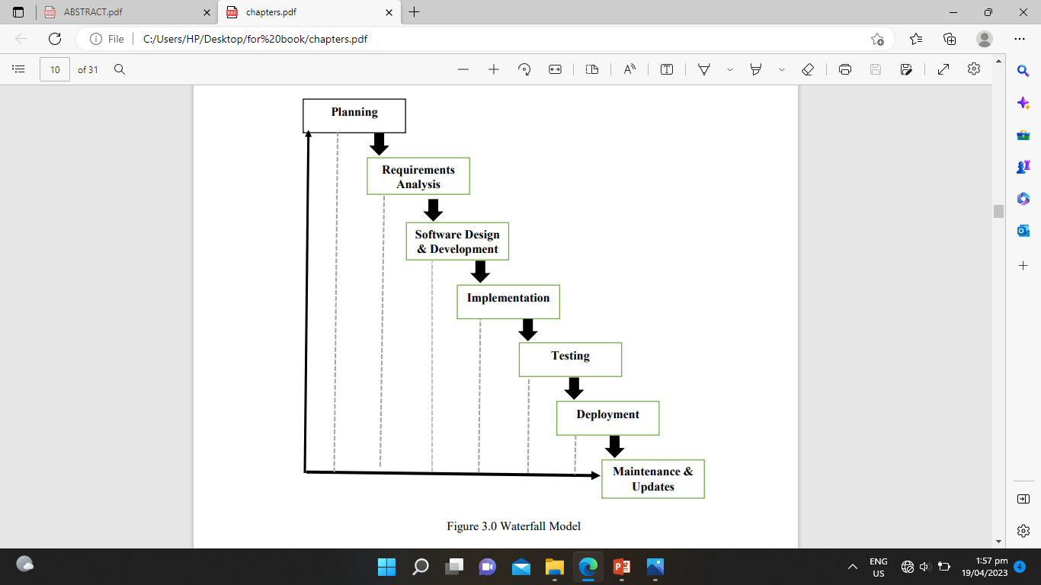
Methodology
Date
Research Title: E- Sumbong: An Android-Based Incident Report Mobile Application

Slide 9

THANK YOU FOR LISTENING!!!

