Slide 1


Slide 2
Knowledge
Retrieval

Slide 3


OpenAI Assistants
Knowledge Retrieval
A powerful capability of Assistants is to ask them information about files that you upload to OpenAI File Storage.
Before we dive into the coding of using files with our assistants, let’s get an overview of some key ideas on how knowledge retrieval works!

Slide 4
OpenAI Assistants
Knowledge Retrieval
There are two main methods of using files with an Assistant:
Passing the file ID directly within the message.
Upon creating the assistant, associated specific files with that assistant.

Slide 5
OpenAI Assistants
Knowledge Retrieval
For either version of knowledge retrieval you choose, you still must upload the files separately from your message and assistant creation.
The messages and assistants can only accept file ID values, which means the files must be uploaded and you need to retrieve the file id value.

Slide 6
OpenAI Assistants
Knowledge Retrieval
Let’s visualize the simpler method, which is to upload a file to OpenAI and then reference it in your message inside the thread.

Slide 7
OpenAI Assistants
GPT Model
GPT-4, GPT-3.5, turbo etc..

Slide 8
OpenAI Assistants
GPT Model
Name: Corp Bot

Slide 9
OpenAI Assistants
GPT Model
Name: Corp Bot
Thread

Slide 10
OpenAI Assistants
GPT Model
Name: Corp Bot
Thread
Message
User
Content: “What is the capital of France?”

Slide 11
OpenAI Assistants
GPT Model
Name: Corp Bot
Thread
Message
User
Content: “What is the capital of France?”

Slide 12
OpenAI Assistants
GPT Model
Name: Corp Bot
Thread
Message
User
Content: “What is the capital of France?”
Message
Assistant
Content: “Paris is the capital of France”

Slide 13
OpenAI Assistants
Assistant
Name: Corp Bot
Thread
Message
User
Content: “What is our vacation policy?”

Slide 14
OpenAI Assistants
Assistant
Name: Corp Bot
Thread
Message
User
Content: “What is our vacation policy?”

Slide 15
OpenAI Assistants
Assistant
Name: Corp Bot
Thread
Message
User
Content: “What is our vacation policy?”

Slide 16
OpenAI Assistants
Assistant
Name: Corp Bot
Thread
Tools
Type: Retrieval
Message
User
Content: “What is our vacation policy?”

Slide 17
OpenAI Assistants
Assistant
Name: Corp Bot
Thread
Tools
Type: Retrieval
Message
User
Content: “What is our vacation policy?”
Files
File_id: 123
Vacation_policy.pdf
File_id: 456
Office_policy.pdf

Slide 18
OpenAI Assistants
Assistant
Name: Corp Bot
Thread
Tools
Type: Retrieval
Message
User
Content: “What is our vacation policy?”
File_ids: [123]
Files
File_id: 123
Vacation_policy.pdf
File_id: 456
Office_policy.pdf

Slide 19
OpenAI Assistants
Assistant
Name: Corp Bot
Thread
Tools
Type: Retrieval
Message
User
Content: “What is our vacation policy?”
File_ids: [123]
Files
File_id: 123
Vacation_policy.pdf
File_id: 456
Office_policy.pdf

Slide 20
OpenAI Assistants
Assistant
Name: Corp Bot
Thread
Tools
Type: Retrieval
Message
User
Content: “What is our vacation policy?”
File_ids: [123]
Files
File_id: 123
Vacation_policy.pdf
File_id: 456
Office_policy.pdf
Message
Assistant
Content: “5 weeks PTO a year”
Annotation: File 123 pg 6.

Slide 21
OpenAI Assistants
System Message
“You are a helpful assistant”
Assistant
Name: Corp Bot
Thread
Tools
Type: Retrieval
Message
User
Content: “What is our vacation policy?”
File_ids: [123]
Files
File_id: 123
Vacation_policy.pdf
File_id: 456
Office_policy.pdf
Message
Assistant
Content: “5 weeks PTO a year”
Annotation: File 123 pg 6.

Slide 22
OpenAI Assistants
System Message
“Only answer questions about Vacations”
Assistant
Name: Corp Bot
Thread
Tools
Type: Retrieval
Message
User
Content: “What is our vacation policy?”
File_ids: [123]
Files
File_id: 123
Vacation_policy.pdf
File_id: 456
Office_policy.pdf
Message
Assistant
Content: “5 weeks PTO a year”
Annotation: File 123 pg 6.

Slide 23
OpenAI Assistants
System Message
“Only use the PDFs I’ve uploaded.”
Assistant
Name: Corp Bot
Thread
Tools
Type: Retrieval
Message
User
Content: “What is our vacation policy?”
File_ids: [123]
Files
File_id: 123
Vacation_policy.pdf
File_id: 456
Office_policy.pdf
Message
Assistant
Content: “5 weeks PTO a year”
Annotation: File 123 pg 6.

Slide 24
OpenAI Assistants
Assistant
Name: Corp Bot

Slide 25
OpenAI Assistants
Assistant
Name: Corp Bot
Tools
Type: Retrieval
Files
File_id: 123
Vacation_policy.pdf
File_id: 456
Office_policy.pdf

Slide 26
OpenAI Assistants
Assistant
Name: Corp Bot
Tools
Type: Retrieval
Files
File_id: 123
Vacation_policy.pdf
File_id: 456
Office_policy.pdf
[3,4,..6,1]
[5,1,..8,9]

Slide 27
OpenAI Assistants
Assistant
Name: Corp Bot
Thread
Tools
Type: Retrieval
Message
User
Content: “What is our vacation policy?”
Files
File_id: 123
Vacation_policy.pdf
File_id: 456
Office_policy.pdf
[3,4,..6,1]
[5,1,..8,9]

Slide 28
OpenAI Assistants
Assistant
Name: Corp Bot
Thread
Tools
Type: Retrieval
Message
User
Content: “What is our vacation policy?”
Files
File_id: 123
Vacation_policy.pdf
File_id: 456
Office_policy.pdf
[3,4,..7,1]
[3,4,..6,1]
[5,1,..8,9]

Slide 29
OpenAI Assistants
Assistant
Name: Corp Bot
Thread
Tools
Type: Retrieval
Message
User
Content: “What is our vacation policy?”
Files
File_id: 123
Vacation_policy.pdf
File_id: 456
Office_policy.pdf
[3,4,..7,1]
[3,4,..6,1]
[5,1,..8,9]

Slide 30
OpenAI Assistants
Assistant
Name: Corp Bot
Thread
Tools
Type: Retrieval
Message
User
Content: “What is our vacation policy?”
Files
File_id: 123
Vacation_policy.pdf
File_id: 456
Office_policy.pdf
[3,4,..7,1]
[3,4,..6,1]
[5,1,..8,9]

Slide 31
OpenAI Assistants
Assistant
Name: Corp Bot
Thread
Tools
Type: Retrieval
Message
User
Content: “What is our vacation policy?”
Files
File_id: 123
Vacation_policy.pdf
File_id: 456
Office_policy.pdf
[3,4,..7,1]
[3,4,..6,1]
[5,1,..8,9]

Slide 32
OpenAI Assistants
Assistant
Name: Corp Bot
Thread
Tools
Type: Retrieval
Message
User
Content: “What is our vacation policy?”
Files
File_id: 123
Vacation_policy.pdf
File_id: 456
Office_policy.pdf
Message
Assistant
Content: “5 weeks PTO a year”
Annotation: File 123 pg 6.
[3,4,..7,1]
[3,4,..6,1]
[5,1,..8,9]

Slide 33
OpenAI Assistants
Assistant
Name: Corp Bot
Thread
Tools
Type: Retrieval
Message
User
Content: “What is our vacation policy?”
Files
File_id: 123
Vacation_policy.pdf
File_id: 456
Office_policy.pdf
Message
Assistant
Content: “There is no information about vacations in our office policy, sorry!”
[3,4,..7,1]
[3,4,..6,1]
[5,1,..8,9]

Slide 34
OpenAI Assistants
Supported Files Types
You can view all the supported files in the documentation:
platform.openai.com/docs/assistants/tools/supported-files

Slide 35
OpenAI Assistants
Knowledge Retrieval
Now let’s visualize an assistant that is constructed to have knowledge retrieval from multiple files upon creating the assistant. An important note however!
This means you will be charged for these files, currently all the files attached will be automatically indexed and you will be charged the $0.20/GB per assistant per day.

Slide 36
OpenAI Assistants
Knowledge Retrieval
This pricing will very likely evolve with time, so make sure you check the official pricing documentation online on pricing of assistants, files, and knowledge retrieval!

Slide 37
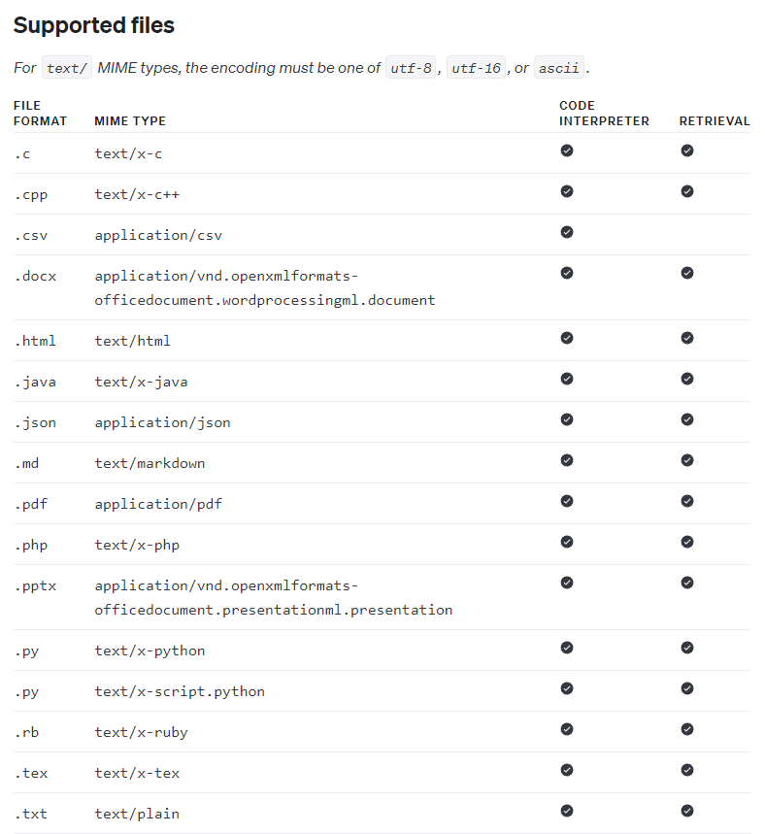
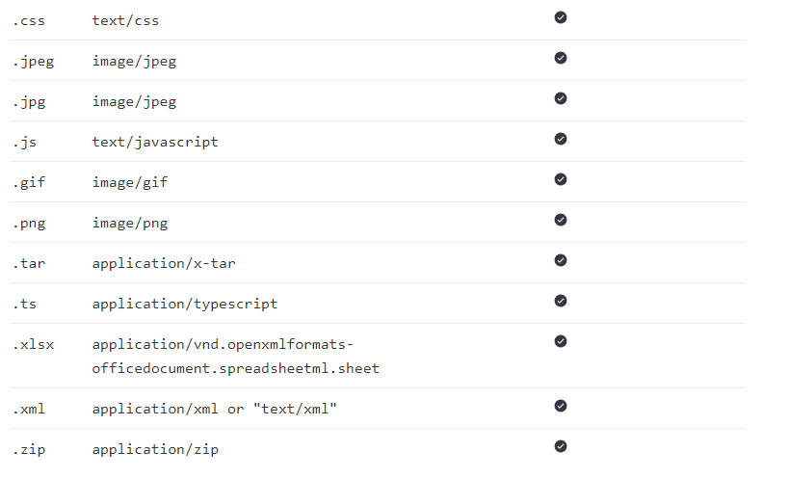
OpenAI Assistants
Supported Files Types
Code Interpreter Only:

Slide 38
Let’s get started!

Slide 39
Single File in Message

Slide 40
File with Code Interpreter

Slide 41
OpenAI Assistants
File with Code Interpreter
Just like in ChatGPT Plus online, you can let the models use files you’ve already uploaded and refer to them in a message and then let the code interpreter run relevant Python code that could use or manipulate the uploaded file.

Slide 42
OpenAI Assistants
File with Code Interpreter
To use a file with the code interpreter, you refer to the file via the message and make sure to add code_interpreter as a tool type for the assistant with some general instructions related to the uploaded file.

Slide 43
OpenAI Assistants
Important Note:
As of the beta assistant offering, it is unclear if the {‘type’:’retrieval’} is actually necessary for this to work, online examples show the “code_interpreter” as the only tool for the assistant.

Slide 44
Assistant with
Multiple Files

Slide 45
Assistant with Knowledge Retrieval
Exercise

Slide 46
Assistant with Knowledge Retrieval
Exercise Solution

