Slide 1
Overview for Today
Addendum:
Time series models
Evaluating classification models

Slide 2
Time series Models
Many different architectures can be applied to time series.
Lim et al., Time Series Forecasting With Deep Learning: A Survey. Philosophical Transactions A.

Slide 3
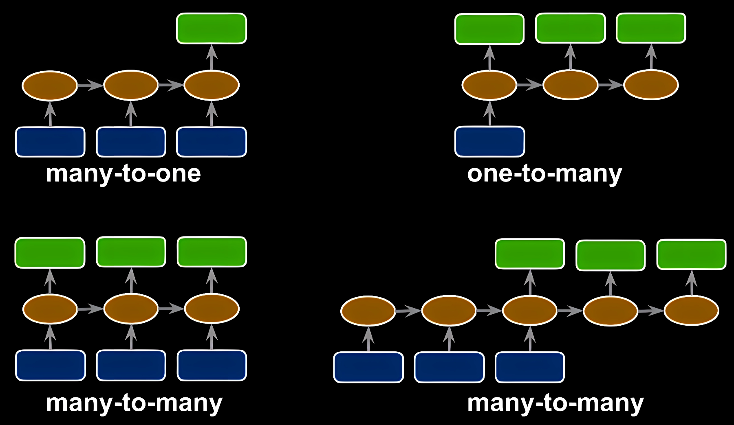
Time series Models
https://github.com/rasbt/python-machine-learning-book-3rd-edition/

Slide 4
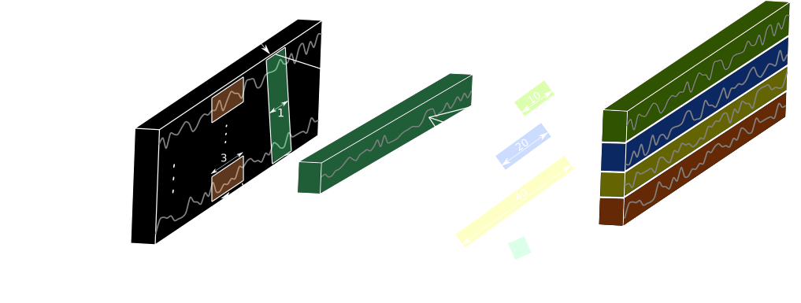
Time series Models
Deep Learning for Time Series Classification (InceptionTime) by Vasilis Stylianou,

Slide 5
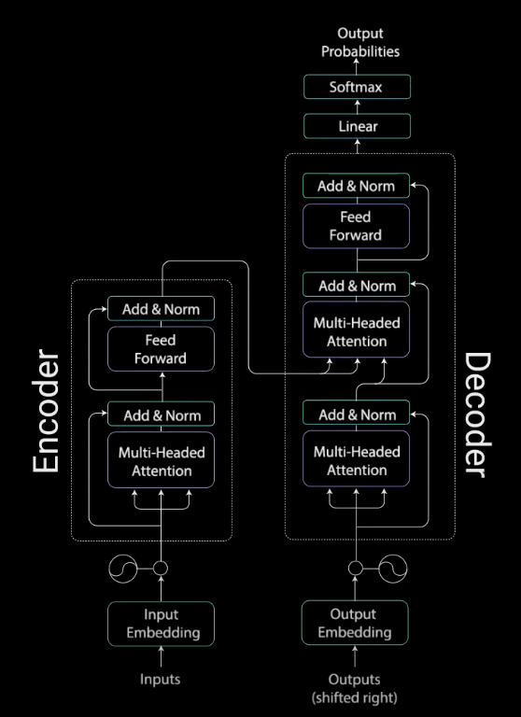
Time series Models
Transformers:
Aim to replace RNNs
Use attention layers
Positional encoding
Don’t scale well with long sequences
Illustrated Guide to Transformers- Step by Step Explanation | by Michael Phi |

Slide 6
Time series Models
Illustrated Guide to Transformers- Step by Step Explanation | by Michael Phi |

Slide 7
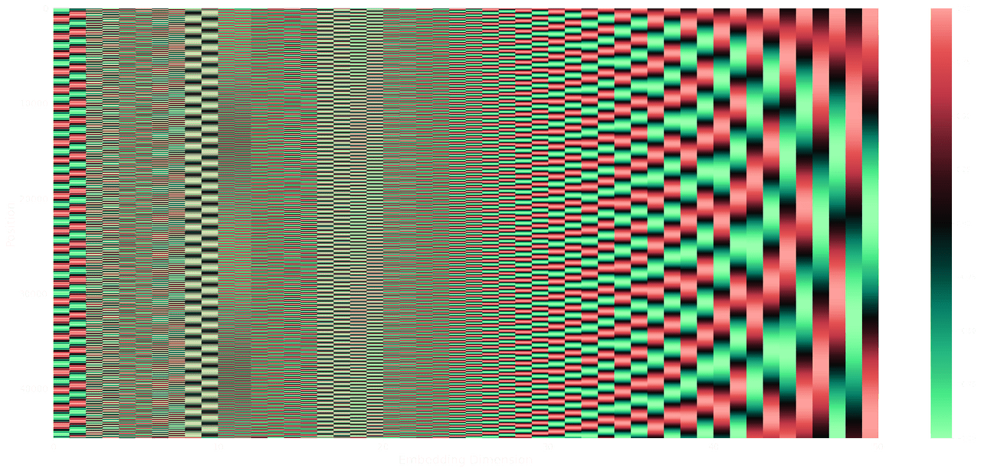
Time series Models
Understanding Positional Encoding in Transformers by Kemal Erdem

Slide 8


A note on Evaluating Classification
$$Accuracy=\frac{TP+TN}{TP+TN+FP+FN}$$
$$Precision=\frac{TP}{TP+FP}$$
Accuracy does not give the full picture if classes are imbalanced
Need to look at precision
Classification: Precision and Recall | Machine Learning | Google Developers

