Slide 1
Medical technology in smart cars
IMT3591 – Assignment 1 – Group 5
Jonas Helbig Laodice Melliti

Slide 2
Implementation scope
Algorithmic design
Updated system architecture

Slide 3
Implementation scope
Focus:
  long term monitoring of the driver's health
  Detection of unusual or harmfull health state
Doctor calibrates the system
  Set boundaries
User gives feedback

Slide 4
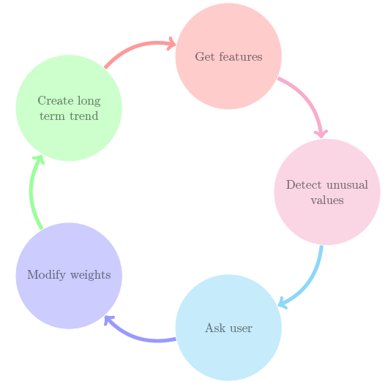
Implementation scope
Figure : process flow

Slide 5
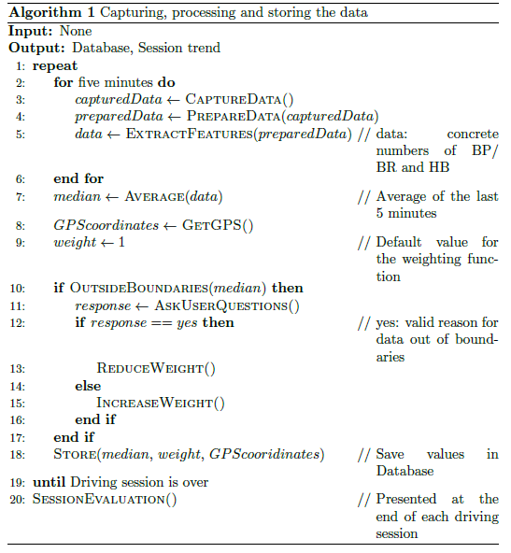
Algorithmic design

Slide 6
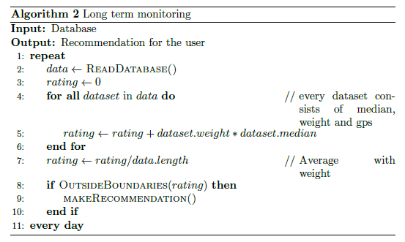
Algorithmic design

Slide 7
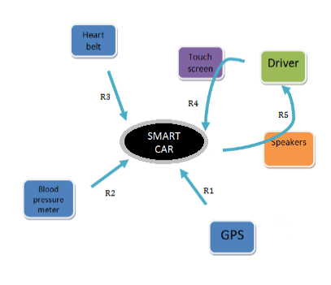
Updated system architecture
R1: Get the GPS position
R2: Get the extracted features for the blood pressure
R3: Get the extracted features for the breathing rate and the heart beat
R4: Receive responses from user
R5: Ask user questions
Figure : redifined system architecture

Slide 8
Thank you for listening
Any questions?

