Slide 1
CT026-3-2
Human Computer Interaction
Human Computer Interaction User Interaction
Level 2
Prepared by: RZW First Prepared on: December, 2007 Last Modified on: Feb 2018
Quality checked by: MOH
Copyright 2004 Asia Pacific Institute of Information Technology

Slide 2
Topic & Structure of the lesson
Norman’s Gulfs of Execution and Evaluation
Interaction Type
Instructing – command –based
Conversing – dialogue –based
Manipulating – static interaction with the environment
Exploring – dynamic interaction with the environment
Interface Style – GUI, Menu, Forms etc

Slide 3
Learning Outcomes
At the end of this lecture, you should be able to:
Select the appropriate interaction technique (type and style) for interface design

Slide 4
Key Terms you must be able to use
If you have mastered this topic, you should be able to use the following terms correctly in your assignments and exams:
Norman’s gulf of execution and evaluation
Interaction type and interaction style

Slide 5
Interaction Model
The most influential model of interaction is Donald Norman’s (http://www.jnd.org/) :
Execution-Evaluation cycle
Norman divides interaction into :
Execution
User activities aimed at making the system do something
Evaluation
Evaluating whether the system did actually do what they wanted

Slide 6
Understanding Interaction
Execution
If User cannot make system do what they want
e.g. cannot understand how to do it, unclear icons, unclear indication etc.
Will result in the Gulf of Execution
i.e. difference between the user’s formulation of the action and the actions allowed by the system

Slide 7
Understanding interaction
Evaluation
If user cannot see what happened to system
e.g. if system has done what they want but no feedback is given to the users etc.
Will result in the Gulf of Evaluation
i.e. difference between the representation of the system state/result and the expectations of the user
Good Design aims to reduce these gulfs

Slide 8
Models of interaction
Norman’s Gulfs of Execution and Evaluation
The user formulates a plan of action, which is then executed at the computer interface. When the plan, or part of the plan, has been executed, the user observes the computer interface to evaluate the result of the executed plan, and to determine further actions

Slide 9
Models of interaction - Execution
The seven stages of action
Forming the goal
Something to be achieved
E.g. “make a nice meal”
Forming the intention
Specific statements of what has to be done to achieve the goal
E.g. “make a chicken casserole using a can of prepared sauce”

Slide 10
Models of interaction - Execution
The seven stages of action
Specifying an action sequence
The precise sequence of operators that must be performed to effect the intention
E.g. “defrost frozen chicken, open can”
Executing an action
Actually doing something
E.g. “opening the can”

Slide 11
Models of interaction - Evaluation
The seven stages of action
5. Perceiving the state of the world
Perceiving what actually happened
E.g. the experience of smell, taste and look of the prepared meal
6. Interpreting the state of the world
Trying to make sense of the perceptions available
E.g. putting those perceptions together to present the sensory experience of a chicken casserole – thick sauce and smelled delicious

Slide 12
Models of interaction - Evaluation
The seven stages of action
7. Evaluating the outcome
Comparing what happened with what was wanted
E.g. did the chicken casserole match up to the requirement of “a nice meal”?

Slide 13
Quick Review Question
Donald Norman divides interaction into two cycles which are Execution and Evaluation. Explain the SEVEN (7) stages of Norman’s Gulf of Execution and Evaluation. Provide a scenario as an example to support your answer.
(16 marks)

Slide 14
Interaction Type & Style
Dialog between the computer and user.
Identification of interaction types:
Instructing – command –based
Conversing – dialogue –based
Manipulating – static interaction with the environment
Exploring – dynamic interaction with the environment
Interaction styles :
Command Line, Speech, Data entry, Query, Graphical, Web, Pen, Augmented reality, Gesture, Form fill-in, Menus, Questions and answers, WIMP and others

Slide 15
Interaction Type
Instructing
Where user issuing commands and selecting options to a system
Example: Typing in command, selecting options froms menus in a windows environment or on a multitouch screen, pressing button or using a combination of function keys and etc.
• Very common conceptual model, underlying a diversity of devices and systems
– e.g. word processors, VCRs, vending machines
• Main benefit is that instructing supports quick and efficient interaction
– good for repetitive kinds of actions performed on multiple objects
Conversing
Underlying model of having a conversation with another human. Where users have a dialog with a system.
Range from simple voice recognition menu driven systems to more complex ‘natural language’ dialogs
Example: speaking via an interface or typing in questions to which the system replies via text or speech output.
Also virtual agents, toys and pet robots designed to converse with you

Slide 16
Interaction Type Cont..
Manipulating
interacting with objects in a virtual or physical space by manipulating them
Involves dragging, selecting, opening, closing and zooming actions on virtual objects
Exploit’s users’ knowledge of how they move and manipulate in the physical world
Can involve actions using physical controllers(e.g. Wii) or air gestures (e.g. Kinect) to control the movements of an on screen avatar
Tagged physical objects (e.g. balls) that are manipulated in a physical world result in physical/digital events (e.g. animation)
Direct Manipulation
Exploring
moving through a virtual environment or a physical space
Involves users moving through virtual or physical environments
Example: 3D worlds, augmented and virtual reality systems
Physical environments with embedded sensor technologies
Context aware

Slide 17
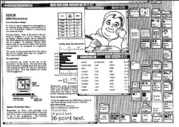
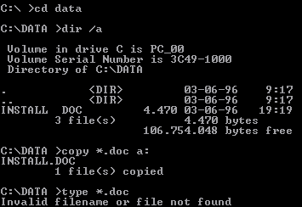
Interaction Style
COMMAND LINE First interactive dialog style to be used A mean of expressing instruction to the computer directly using function keys, single characters, abbreviations or whole word command user responds to a prompt on the screen by entering an appropriate command | WIMP Xerox Star first WIMP -> rise to GUIs Windows could be scrolled, stretched, overlapped, opened, closed, and moved around the screen using the mouse Icons represented applications, objects, commands, and tools that were opened when clicked on Menus offering lists of options that could be scrolled through and selected Pointing device a mouse controlling the cursor as a point of entry to the windows, menus, and icons on the screen

Slide 18
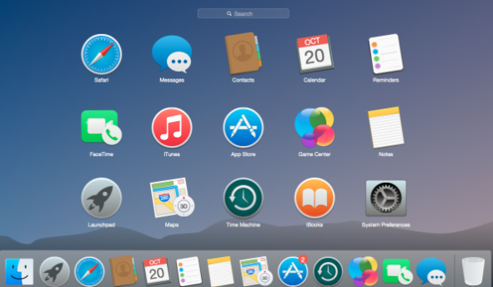
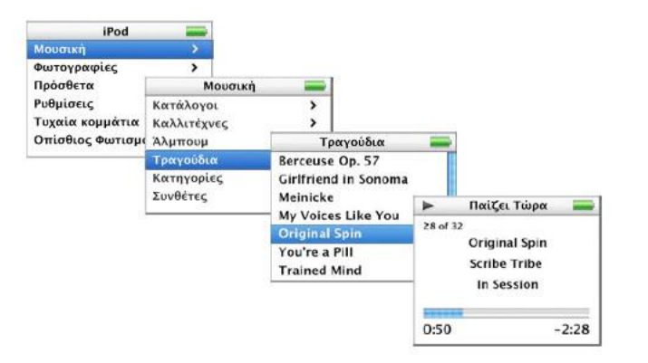
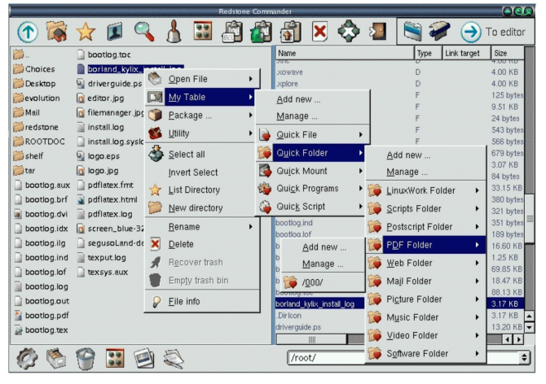
Interaction Style Cont..
GUI Same basic building blocks as WIMPs but more varied Color, 3D, sound, animation, Many types of menus, icons, windows New graphical elements, e.g. toolbars, docks, rollovers | MENU A number of menu interface styles flat lists, drop-down, pop-up, contextual, and expanding ones, e.g., scrolling and cascading Flat menus good at displaying a small number of options at the same time and where the size of the display is small, e.g. iPods but have to nest the lists of options within each other, requiring several steps to get to the list with the desired option moving through previous screens can be tedious

Slide 19
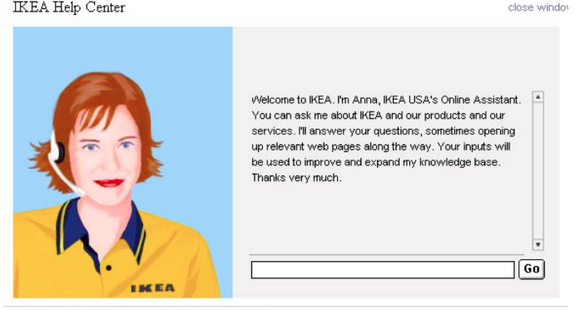
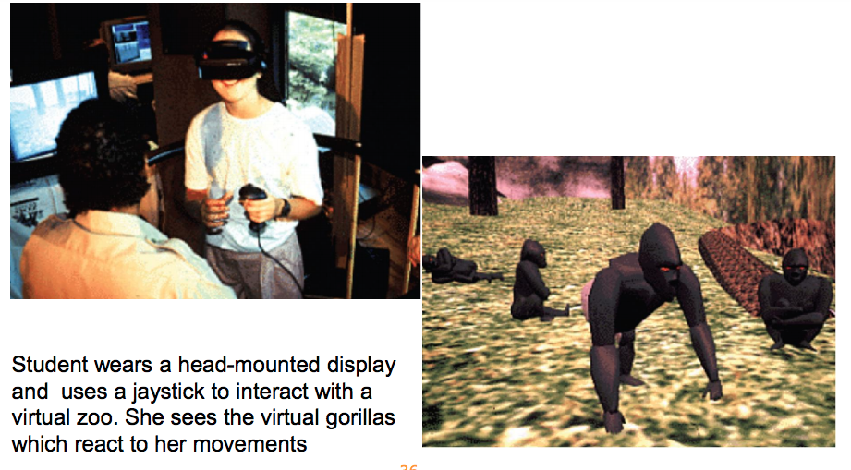
Interaction Style Cont..
SPEECH Where a person talks with a system that has a spoken language application, e.g., timetable, travel planner Used most for inquiring about very specific information, e.g. flight times or to perform a transaction, e.g. buy a ticket Also used by people with disabilities e.g. speech recognition word processors, page scanners, web readers, home control systems | VIRTUAL REALITY Computer-generated graphical simulations providing: “the illusion of participation in a synthetic environment rather than external observation of such an environment” (Gigante, 1993) provide new kinds of experience, enabling users to interact with objects and navigate in 3D space Create highly engaging user experiences

Slide 20
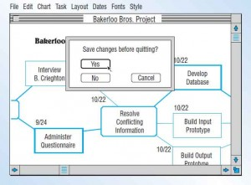
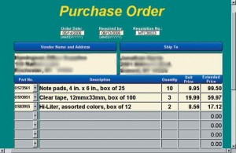
Interaction Style Cont..
QUESTION & ANSWER Computer displays a questions to the user and the user enters an answer via a keyboard stroke or a mouse click The computer acts on that input information in a preprogrammed manner, typically by moving to the next question | FORM-FILLS Is an on screen form or web-based form displaying fields containing data items or parameters that need to be communicated to the user. Often is a facsimile of a paper form which already familiar to the user.

Slide 21
Interaction Design VS Interface Design
Interaction design
Interface Design
Concerned about how the person interacts with what they see on the screen – whether they know what to tap, swipe or click, and whether what happens meets their expectation and moves them closer to their goals.
About figuring out how people need to use what you’re designing, and what cues (cause & effect) you can give them so they know how to take action
The visual styling on the screen. What things look like, how they’re arranged and how they relate to each other visually in terms of hierarchy.
Font choices, color schemes, graphic elements, button and menu styling all fall under the umbrella of interface design
Determines what’s on the screen and how people use those elements.
Determines what those elements look like.

Slide 22
Summary of Main Teaching Points
Interaction is the heart of all modern interfaces and is important at many levels from the ordering of screens to the clicking of a button.

Slide 23
Question and Answer Session
Q & A

Slide 24
Sample Question
In facilitating effective interaction, we need to think about how best to support the activities users will be doing when using a system, product or services.
A) Identify and describe the FOUR (4) common types of activities that users are likely to be engaged in when interacting with system with appropriate example?
(16 marks)
B) Describe THREE (3) interaction style, which reflect any of the above interaction types.
(9 marks)
(Total: 25 marks)

Slide 25
Next Session
Topic and Structure of next session
Usability & Usability Engineering
Notes:
Can proceed with the tutorial, get student to come back to the next class (during tutorial slot) to present their vending machine product

