Slide 1
Human Computer Interaction CT026-3-2-HCI and Version: September 2018
Introduction to Human Computer Interaction
Prepared by: RZW First Prepared on: December, 2007 Last Modified on: Feb 2018
Quality checked by: MOH
Copyright 2004 Asia Pacific Institute of Information Technology

Slide 2
Topic and Structure of the Lesson
Common issues in interface design
The reason behind HCI
HCI definition
The many scopes of HCI
Usability
Designing for usability
Understanding interaction

Slide 3
Learning Outcomes
At the end of this session, YOU should be able to:
Explain what HCI is
Explain what are the factors influencing HCI
Explain what usability is
Describe the major principles in designing for Usability
Explain what interactivity is, and how usability is important in designing interactive product

Slide 4
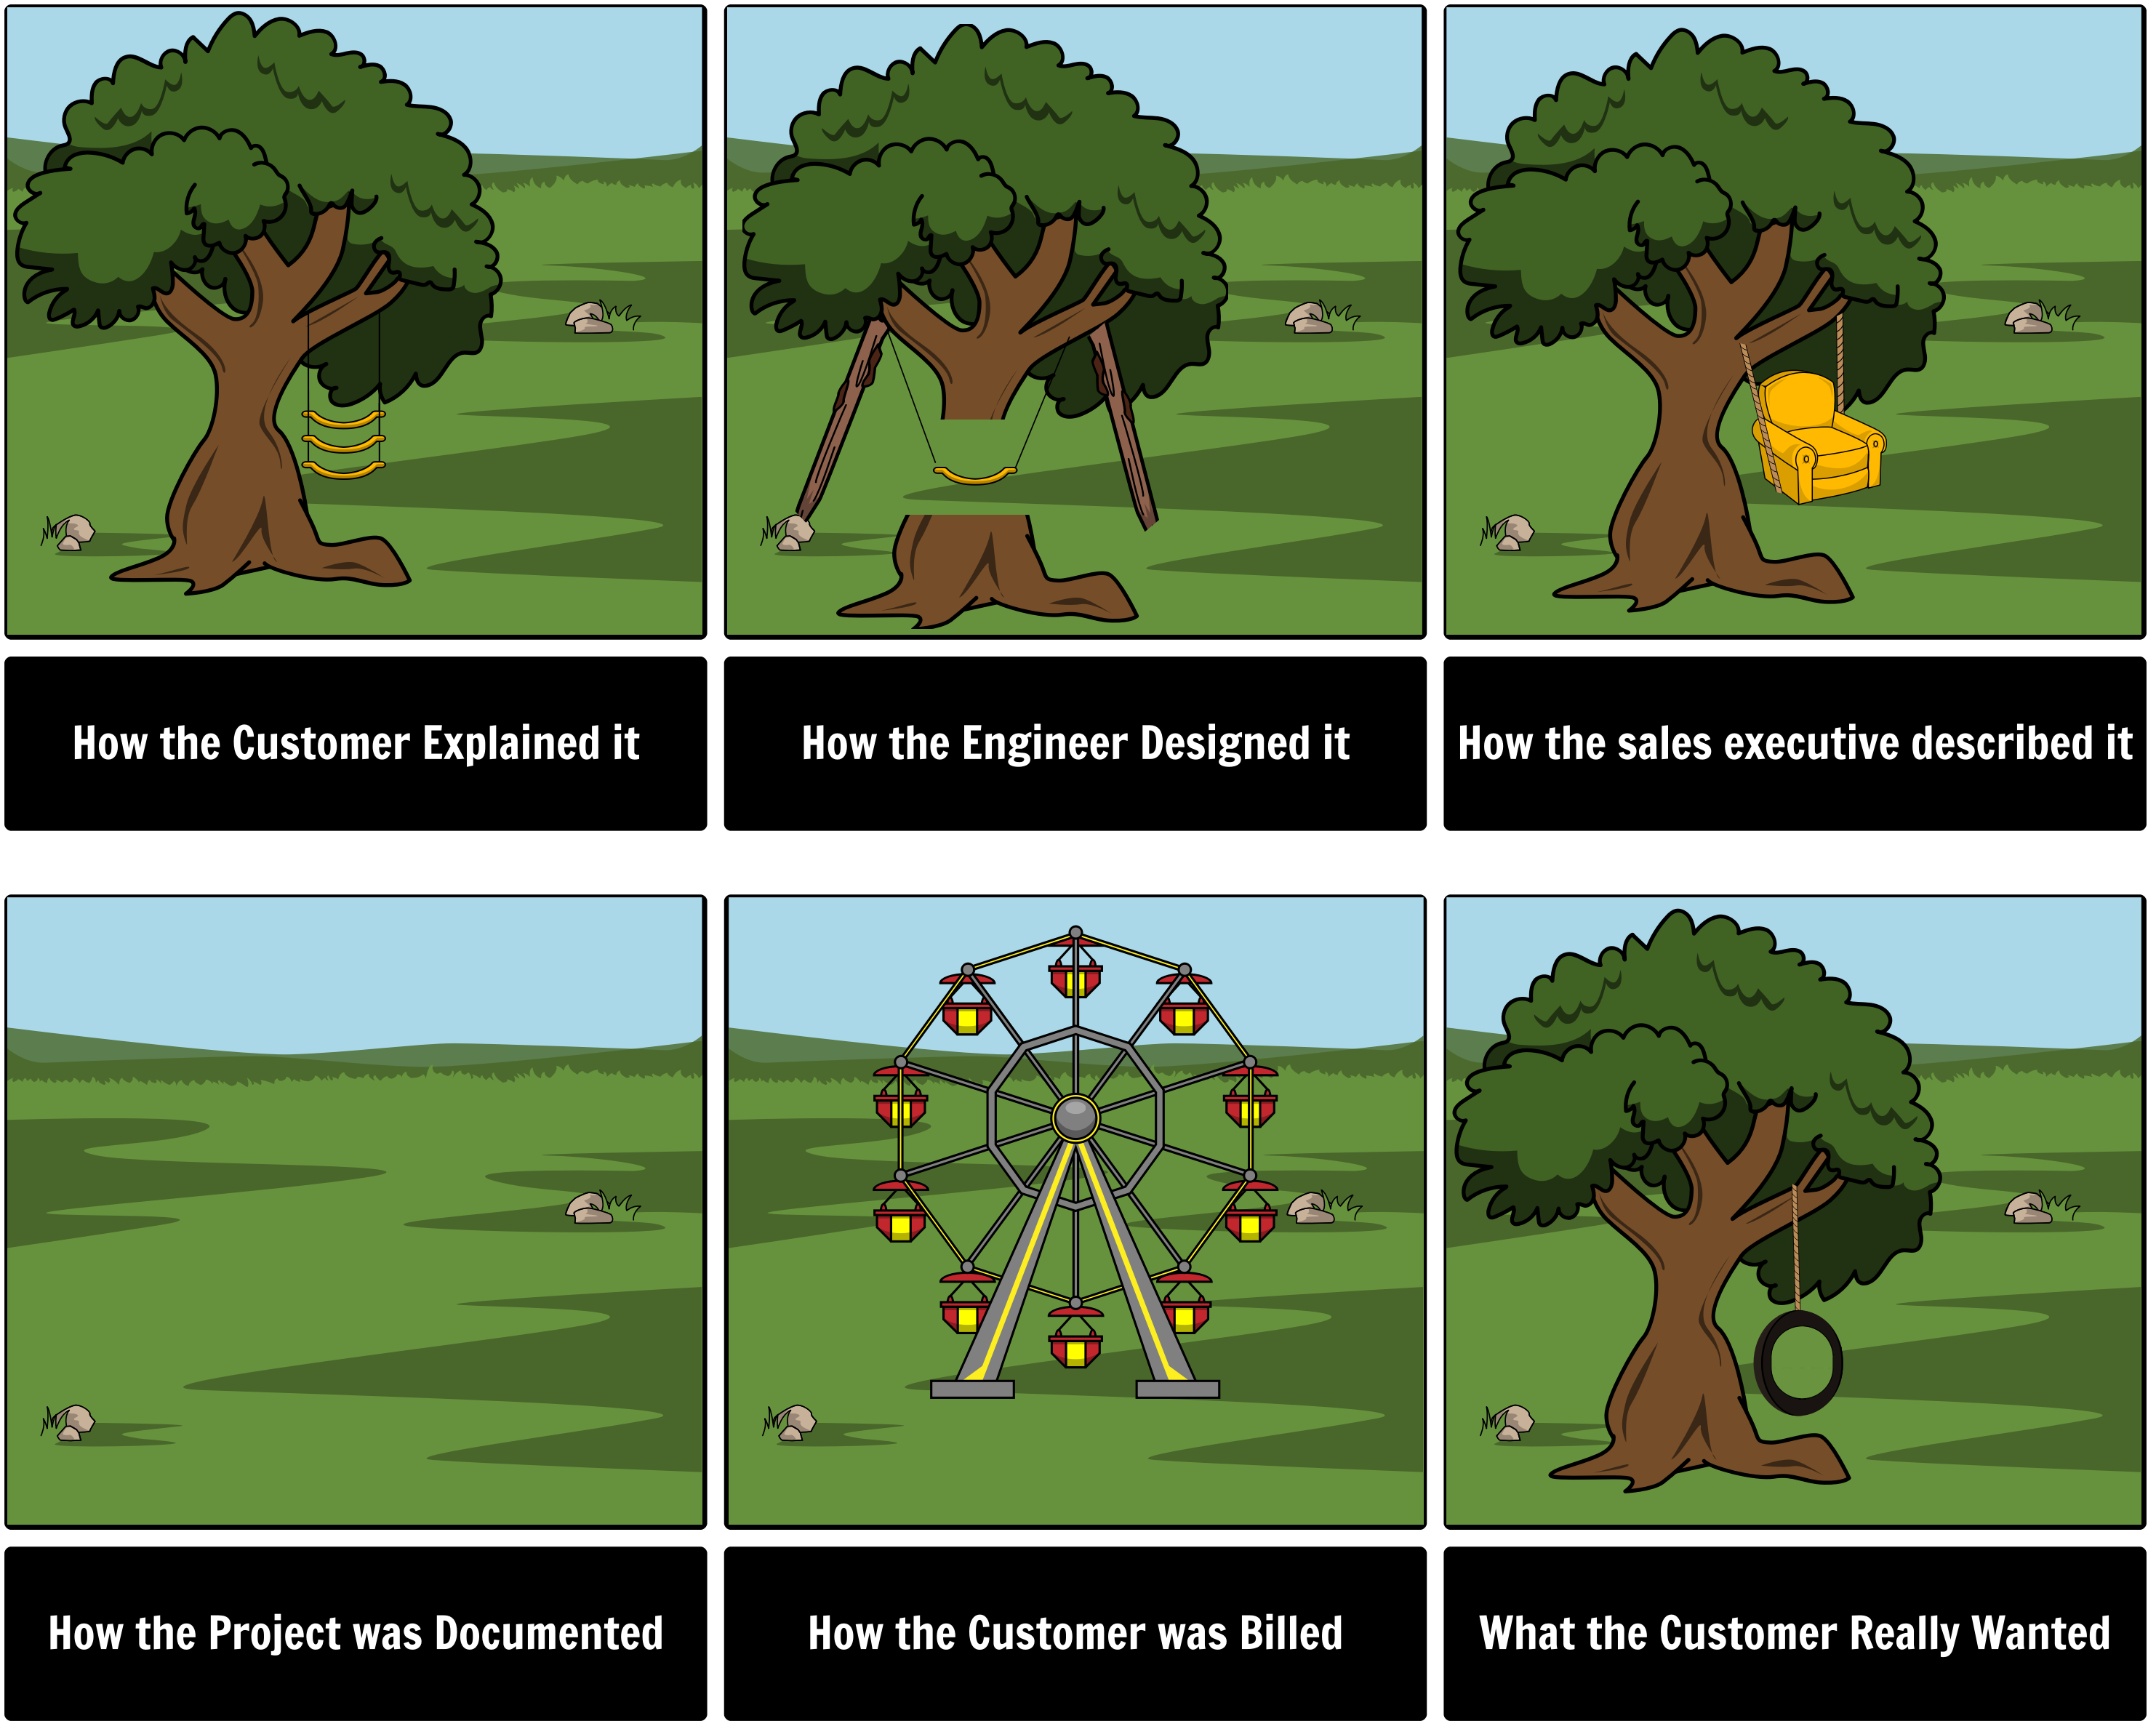
Why Bother?

Slide 5
Why Systems Fail?
Inadequate requirements 13%
Lack of user participation 12%
Inadequate resources 11%
Unrealistic expectations 10%
Lack of support at senior level 9%
Changing specification 8%
Lack of planning 8%
Notes:
What is the conclusion that can be derived from the statistics?

Slide 6
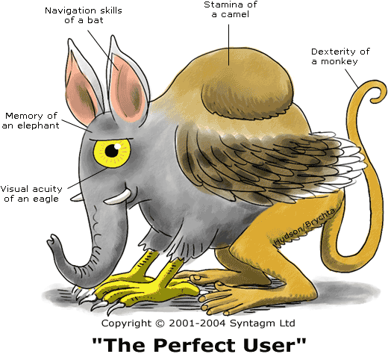
The Perfect User (that every designer wishes for)

Slide 7
Common Issues in User Interface Design
Software developers are forced to “do it all”
Often based on intuition and experience than on theory-based models
Tendency to let the art of interface design beats its usability
Inconsistent features that do not fit into a good user interface design criteria
Notes:
Now we are going to look at one common issue in user interface design.
An ideal setup of software engineering would require user interface experts to handle the interface development,
however in real life, not all software development projects can afford specialist for each and every development task,
hence it is very likely that the programmer will be pushed to do both codings and user interface designing.
Without the talents and proper training, the interface design will be based on intuition rather than the theory.
Which will result in the tendency to let the artistic features of user interface beats its usability.
This is usually where the inconsistent features that do not fit into a good user interface design criteria come from.

Slide 8
Why Study HCI?
Business view :
to employ people more productively and effectively
- people costs now far outweigh hardware and
software costs
people now expect “easy to use” systems
- generally, they are not tolerant of poorly designed
systems
- if a product is hard to use, they will seek other
products

Slide 9
Why Study HCI?
Human Factors view :
humans have limitations. Errors are costly in terms of
- loss of time & money
- loss of lives in critical systems
- loss of morale

Slide 10
What is HCI
Short for human-computer Interaction.
A discipline concerned with the study, design, construction and implementation of human-centric interactive computer systems.
Notes:
Short for human-computer Interaction, a discipline concerned with the study, design, construction and implementation of human-centric interactive computer systems.

Slide 11
Scope of HCI – many surrounding factors
HCI is a very broad discipline that encompasses different
fields with different concerns regarding computer
Development. Some of the contributing fields:-
computer science
sociology
ergonomics
psychology
Notes:
computer science is concerned with the application design and engineering of the human interfaces;
sociology and anthropology are concerned with the interactions between technology, work and organization and the way that human systems and technical systems mutually adapt to each other;
ergonomics is concerned with the safety of computer systems and the safe limits of human cognition and sensation;
psychology is concerned with the cognitive processes of humans and the behavior of users;
linguistics is concerned with the development of human and machine languages and the relationship between the two.

Slide 12
The goal of HCI
The goals of HCI are to develop or improve the safety, utility (function) and effectiveness of systems that include computers, often through improving usability.

Slide 13
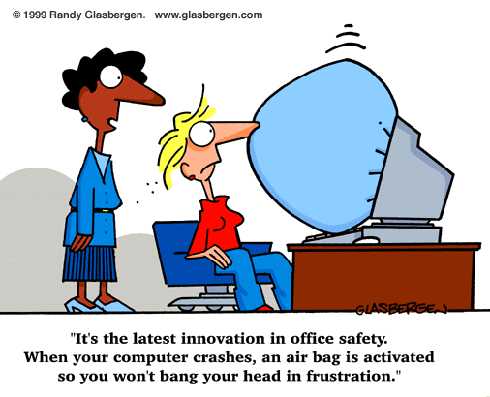
What is usability?
Usability can simply be thought of as the practical
implementation of good HCI, but, more formally :
Usability means easy to learn, effective to use and providing an enjoyable experience

Slide 14
How to design and build usable UIs?
UI Development process :
User Profiling
Usability goals
Task analysis & contextual inquiry
Prototyping
Evaluation
Programming

Slide 15
Important!!!
users should be involved throughout the development of the project (How?)
specific usability and user experience goals need to be identified, clearly documented and agreed at the beginning of the project

Slide 16
Understanding interaction
User centric design is the formula for usability
The key to User-centered Design is to understand Interaction
We need to understand :
What Interaction is
What are the elements involved

Slide 17
Interaction Model
The most influential model of interaction is Donald Norman’s (http://www.jnd.org/) :
Execution-Evaluation cycle
Norman divides interaction into :
Execution
User activities aimed at making the system do something
Evaluation
Evaluating whether the system did actually do what they wanted

Slide 18
Understanding Interaction
Execution
If User cannot make system do what they want
e.g. cannot understand how to do it, unclear icons, unclear indication etc.
Will result in the Gulf of Execution
i.e. difference between the user’s formulation of the action and the actions allowed by the system

Slide 19
Understanding interaction
Evaluation
If user cannot see what happened to system
e.g. if system has done what they want but no feedback is given to the users etc.
Will result in the Gulf of Evaluation
i.e. difference between the representation of the system state/result and the expectations of the user
Good Design aims to reduce these gulfs

Slide 20
Dimensions of Usability
Does the user feel in control of the application ?
To what extent can the user achieve their goals using the application ?
How far does the product appear to assist the user ?
How easy is the application to learn ?
How does the user respond emotionally ?

Slide 21
Summary of Main Teaching Points
Common issues in interface design
The reason behind HCI
HCI definition
The many scopes of HCI
Usability
Designing for usability
Understanding interaction

Slide 22
Question and Answer Session
Q & A

Slide 23
Next Session
Topic and Structure of next session
Human Factors
Notes:
Can proceed with the tutorial, get student to come back to the next class (during tutorial slot) to present their vending machine product

