Slide 1
CT026-3-2
Human Computer Interaction
Human Computer Interaction
Overview
Level 2
Prepared by: RZW First Prepared on: December, 2007 Last Modified on: JAN 2021
Quality checked by: MOH
Copyright 2004 Asia Pacific Institute of Information Technology

Slide 2
Topic & Structure of the lesson
Understanding user
Human factors
  Physiology
  Cognition
  Perception
Metaphors
Stakeholders

Slide 3
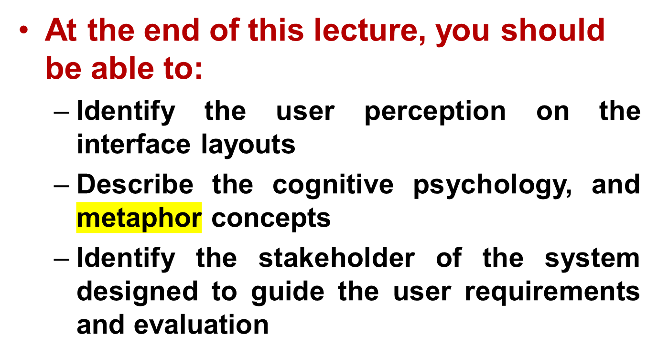
Learning Outcomes

Slide 4
Key Terms you must be able to use
If you have mastered this topic, you should be able to use the following terms correctly in your assignments and exams:
Metaphors
Stakeholder

Slide 5
Understanding Users
System User
  Individual user, a group of users working together or a sequence of user in organization each dealing with some part of the task or process.
  Hint: Users are limited in their capacity to process information

Slide 6
Understanding Users
In order to design, it is important to understand the capabilities and limitations of those we are designing for.

Slide 7
Human Factors
We look at the human factors that affect how people interact with computers and computer programs:
Human factors design (or people-centered design), specifically, focuses on improving areas within a product or design where interaction happens. Examples include when you use a touchscreen smartphone and when you perform tasks on your desktop computer.
The goal is to reduce the number of mistakes that users make and produce more comfortable interactions with a product. Human factors design is about understanding human capabilities and limitations, and then applying this knowledge to product design. It’s also a combination of many disciplines, including psychology, sociology, engineering, and industrial design.

Slide 8
Why Study Human Factors
Accommodation of human diversity
  Physical abilities and physical workplaces
  Cognitive and perceptual abilities
  Personality differences
  Cultural and international diversity
  Users with disabilities
  Elderly Users
3 areas of human factors are:
  Physiology - physical make-up, capabilities
  Cognition - thinking, reasoning, problem-solving, memory
  Perception - how a person perceives what input they get through their senses

Slide 9
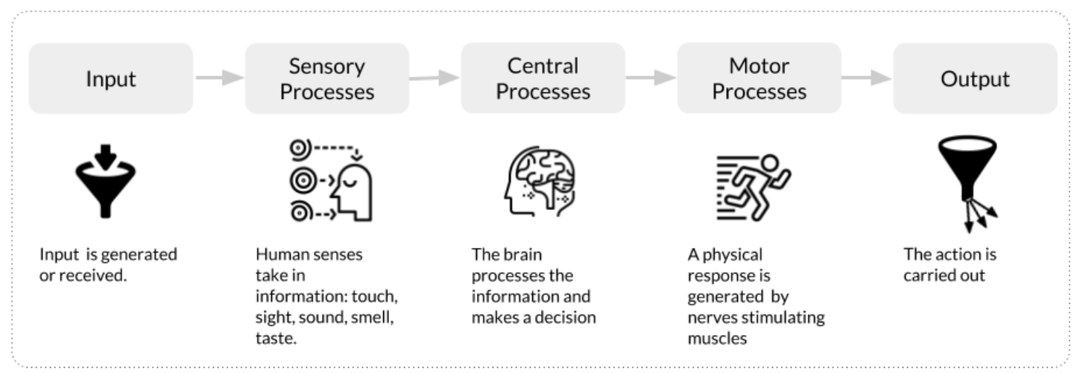
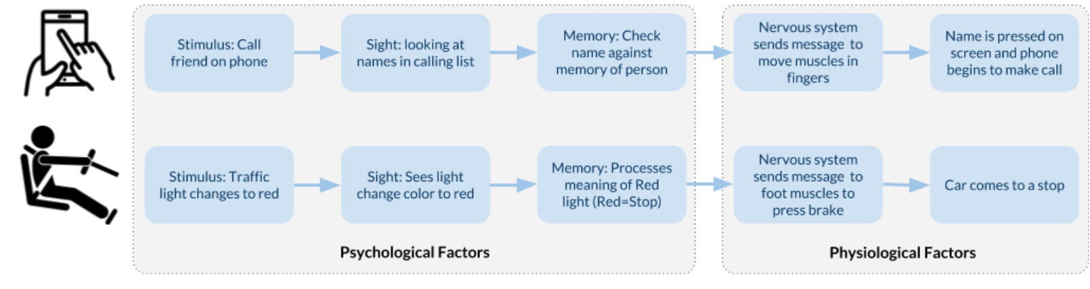
How the human mind processes and acts upon information which relates to the 3 factors?
Perception
Cognition
Physiology

Slide 10
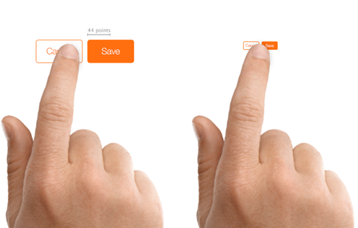
Human Factors : Physiology
The design of devices are often affected by the human physiology
Physical ergonomics refers to the human body’s responses to physical work demands—for example, using the physical muscles of your hand to hold your smartphone or touch a screen. Proper ergonomic design is necessary to create comfortable interaction with a product. To assess whether the product is good for the user, human factors specialists take into account:
  Specific operations that users complete with the product (for example, entering text into a web form)
  Physical characteristics of the product (for example, a mobile phone’s size, shape, and weight)
  Context of use, or how users interact with information on this device
This information helps human factor specialists design a product or device so that users can complete tasks efficiently and effectively. For example, when we apply human factors design in mobile app design, we size touch controls to minimize the risk of false actions.
Figure: Human factors design considers how a user interacts with the product, including using properly sized button versus buttons that are too small. Image credit Apple.

Slide 11
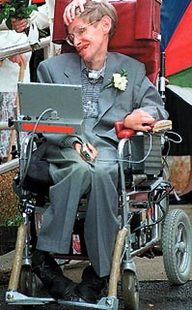
Human Factors : Physiology
Take into account dynamic measures such as reach, strength or speed Account for variances in sense perception
Some constraints can be introduced and applied based on the physical built up of the users
Example:
Keyboard keys cannot be smaller than finger size.
Smaller machines must use different input facilities.
Toilet for toddlers
Specific door widths and heights

Slide 12

Human Factors : Physiology:
Reaction Time
Human reaction times:
Audio signal - 150ms
Visual signal - 200ms
Pain - 700ms
Examples of use:
Design of video games
Traffic lights
Phone

Slide 13

Human Factors : Physiology: Movement
Speed of accuracy of movement important for interactive
systems.
Examples:
Mouse - keyboard movement (affects choice of which devices/controls operate which actions of the system)
Time taken to move to a target on screen
Careful arrangement of menu items so that frequent choices are placed first

Slide 14
Human Factors : Physiology: Disabilities
Designers must design so that disabled users can
achieve maximum functionality and usability from
computer systems
Also devices to assist disabled users:
Speech input and output systems (useful for blind people and those with severe motor impairment)
Keyboard pressing devices
Eye movement detection devices

Slide 15
Human Factors : Cognition
The processes by which we become acquainted with things, how we gain knowledge, familiarity
What goes in our heads when we carry out our everyday activities
Involves understanding, thinking, remembering, reasoning, memorizing, attending, awareness, acquiring skills, creating new ideas.

Slide 16
Human factors : Cognition
  Managing Attention
    Process of selecting things to concentrate on at a point in time
    Depends on:
      Users’ goals
        If we know exactly what we want to find out, we try to match this with the information that is available
      Information presentation
        Greatly influence how easy or difficult it is to digest appropriate pieces of information

Slide 17
Human factors : Cognition
Interface designers need to focus attention on the
right place:
Users’ goals
Try to read the sentences below…
Everyday my sister goes to shoocl
My two cats lvoe fish
I am a Sfrodatifhrse University graduate
They are sudtying at the UCTI

Slide 18
Human factors : Cognition
Try to read the paragraph below…
According to a rscheearch at Cmabrigde Uinervtisy, it deosn't mttaer in waht oredr the ltteers in a wrod are, the olny iprmoetnt tihng is taht the frist and lsat ltteer be at the rghit pclae. The rset can be a total mses and you can sitll raed it wouthit porbelm. Tihs is bcuseae the huamn mnid deos not raed ervey lteter by istlef, but the wrod as a wlohe and the biran fguiers it out aynawy.
How do you explain being able to read this?

Slide 19
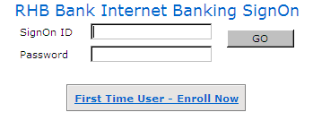
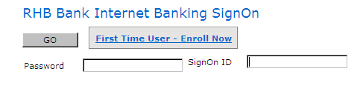
Human factors : Cognition
Interface designers need to focus attention on the
right place:
Structured information
VS

Slide 20
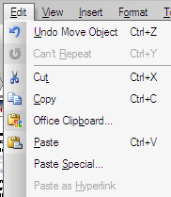
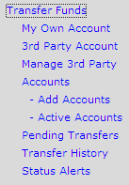
Human factors : Cognition
Interface designers need to focus attention on the
right place:- segmentation
Information grouped into meaningful parts

Slide 21
Human factors : Cognition
Interface designers need to focus attention on the
right place:
Amount of information presented not too much/little
Read the lists in the next slide, cover it up, and then try to recall as many of the items as possible

Slide 22
Human factors : Cognition
3, 12, 6, 20, 15, 49, 81, 76, 8, 97, 13, 56
Cat, house, paper, laugh, people, red, yes, number, shadow, broom, rain, plant, lamp, chocolate, radio, one, coin
T, k, y, w, n, o, c, d, e, q, p, r

Slide 23
Human factors : Cognition
According to George Miller’s (1956) theory, 7 ± 2 chunks of information can be held in short – term memory at any time.
How to apply this in interface design?

Slide 24

Human factors : Cognition
Design tips…
  Have only 7 options on a menu
  Display only 7 icons on a menu bar
  Place only 7 items on a pull down menu

Slide 25
Human factors : Cognition
Another useful design tips in managing the cognition
  Break down complex tasks into simple steps. By doing that, you can reduce the complexity and simplify decision-making.
  Guide the user. Guide your user to learn how to use the system by giving them all information upfront. Anticipate places where users might need extra help.
  Group related information together. For example, when your product uses a graphical user interface, you can place UI elements in a way that draws attention to the most important information. Use the Gestalt Principles to organize information on screens.
  Use Hick’s Law – Hick’s Law states that the number of choices available affect the time it takes for a user to make their decisions. The more the options, the more time it takes to decide

Slide 26

Human factors : Perception
How a person perceives what input they get through their senses
Capabilities and limitation of visual processing and understand how we perceive size and depth, brightness and colour

Slide 27
Human Factors : Perception
Input from the different senses
Auditory Perception
Haptic (Touch) Perception
Visual Perception
We need to understand how the input information
Is perceived by humans.

Slide 28

Human factors - Perception
Notes:
What can you see, ask each student

Slide 29
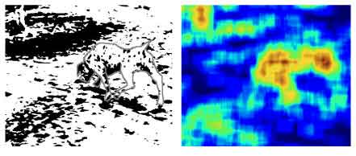
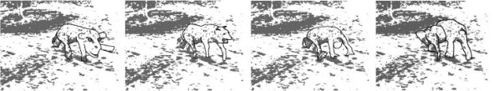
Human factors - Perception

Slide 30

Human factors - Perception

Slide 31
Human factors - Perception
Useful design tips in managing the perception
  PROXIMITY
    Rule of proximity indicates that items close together are perceived as being related or associated.
    Human perception works instantly and processes information on an eye-brain performance. The part of decomposing the elements is introduced later in the equation. Looking at the “big picture” influences humans to compose connections.
  SIMILARITY
    Rule of similarity indicates that items with a similarity are perceived as being related or associated.
    Based on that simple theory we can easily create groups of things in the GUI which will be identified as a unified group by the user. As a result, the data will be archived simultaneously and decoded faster.

Slide 32
Summary
“
The way humans interact with application (or product) are influenced by human factors. The manner an interface is developed can considerably shape how well users can perceive, learn and remember how to do their work.
Human Factors” are the capabilities of human’s mental, physical, and perceptual on the other hand “User Interface (UI) Design” is a design which creates the visual components for user and application (or product) to interact with each other.

Slide 33
Metaphors
A conceptual model that has been developed to be similar in some way to the aspects of a physical entity.
Maps elements of the real world on to elements of the system world
Dragging a document icon across the desktop screen was seen as equivalent to picking up a piece of paper in the physical world and moving it.

Slide 34
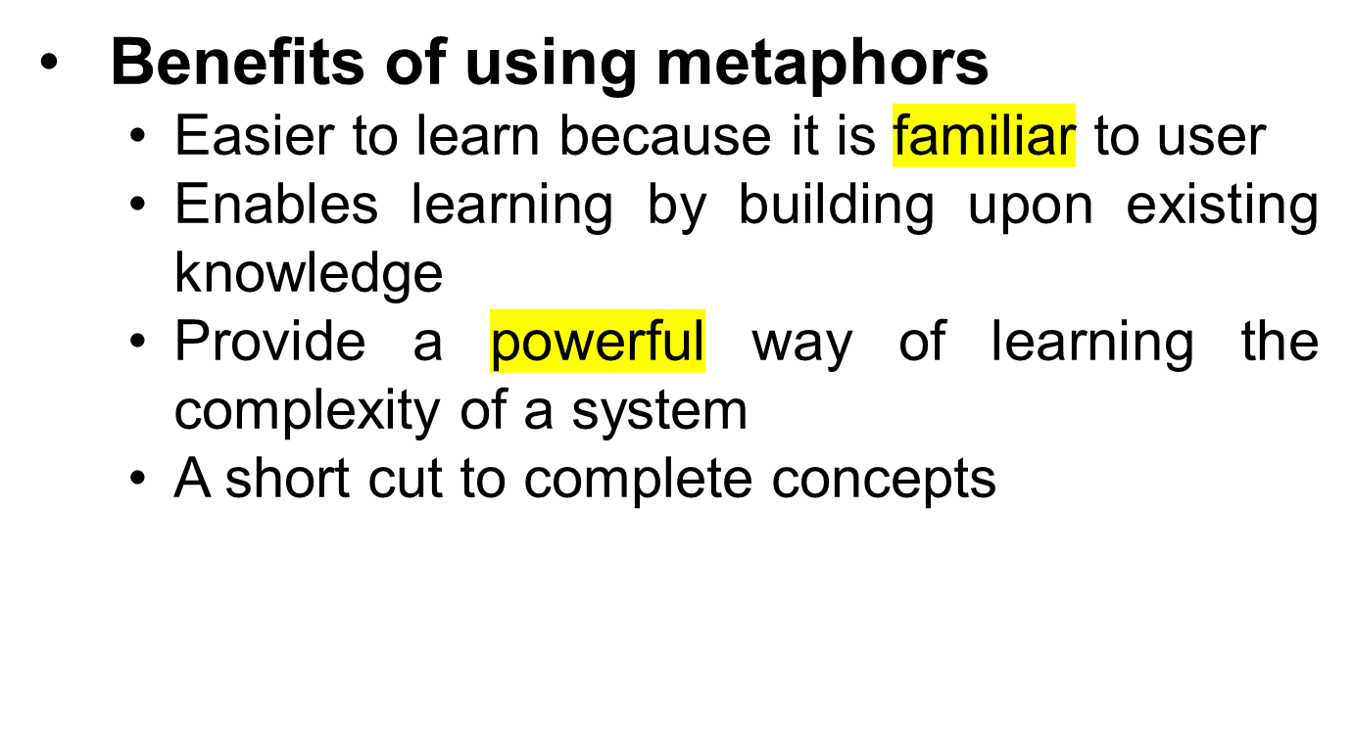
Metaphors

Slide 35
Cultural and International Issues
Beware of using text or alphabetic characters inside an icon. Different language versions of the icon will probably be needed. (e.g. H for home, H for help)
Hand symbols, facial appearances, etc. vary immensely from culture to culture! Don’t use them in icons. (may be offensive)
Beware also of metaphors dependent on a particular culture, for example the US mailbox for incoming mail. (Each country’s mailbox looks different)

Slide 36
Metaphors - Recognition & Recall
Where possible, choose a metaphor familiar to the viewer.
Use concrete objects wherever possible, abstract concepts and actions are difficult to visualise. (e.g. water tap with water drop instead of a river to represent water)
Provide textual labels (tooltips)

Slide 37
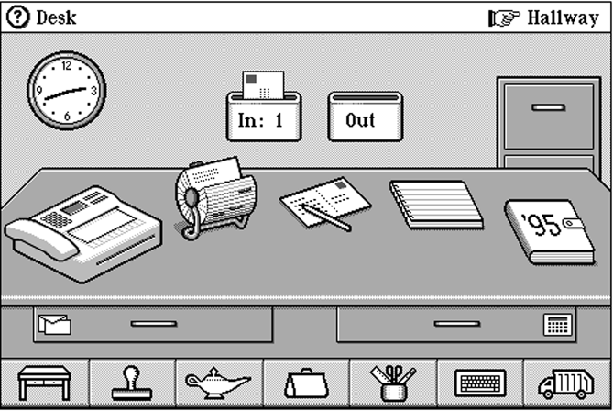
Desktop Metaphor

Slide 38
Stakeholder

Slide 39
What Is Stakeholder?
“A stakeholder is a party that has an interest in a company and can either affect or be affected by the business. The primary stakeholders in a typical corporation are its investors, employees, customers, and suppliers.”

Slide 40
Stakeholder
Stakeholders can be internal or external to an organization.
  Internal stakeholders are people whose interest in a company comes through a direct relationship, such as employment, ownership, or investment.
  External stakeholders are those who do not directly work with a company but are affected somehow by the actions and outcomes of the business. Suppliers, creditors, and public groups are all considered external stakeholders. In another word; external stakeholder is normally a person or organization affected by the operations of the business.

Slide 41
So, what is the Stakeholder Analysis ?

Slide 42
Stakeholder analysis is a process of identifying these people before the project begins; grouping them according to their levels of participation, interest, and influence in the project; and determining how best to involve and communicate each of these stakeholder groups throughout.

Slide 43
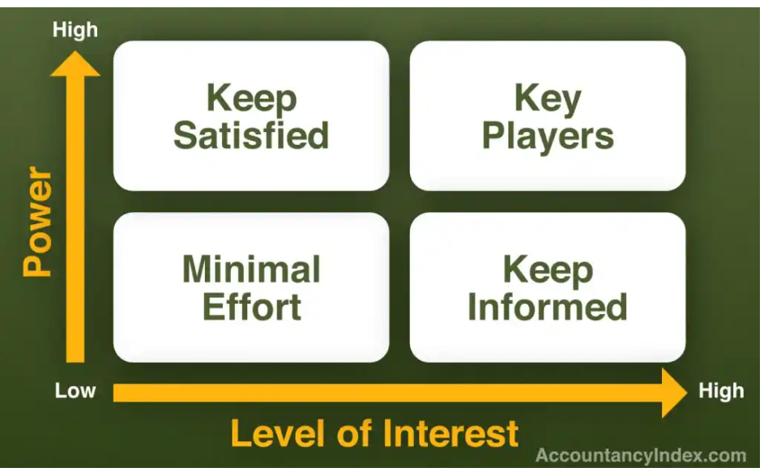
Mendelow’s Matrix

Slide 44
Using Mendelow’s Matrix to conduct Stakeholder Analysis
Step 1: Determine who is your stakeholder
  List down the potential group of user that have interest in the project proposed (do not exclude small or big user). – brainstorm people which involve in your scenario.
    Example: customer, marketing executive, finance manager, CEO, shareholders, competitor A, IT admin, helpdesk and others.
  Fill those users identified in the table of general list of stakeholder: See example below:
Name | Role | Internal / External | Reason chosen / relation
Eg: Eric Wong | Head Maintenance department | Internal | This group are responsible for planning and implementing the process of work being analyzed by the development team. They will affect the development in terms of the flow of the features/ function in the proposed application

Slide 45
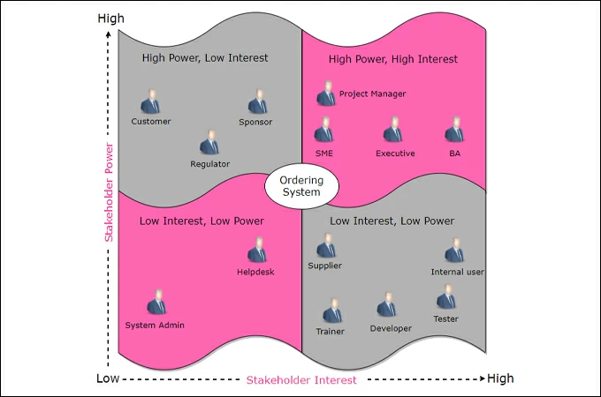
Using Mendelow’s Matrix to conduct Stakeholder Analysis
Step 2: group and Prioritize the stakeholder using the Mendelow’s matrix ( power/interest grid)
Group 1 High Power & High Interest | Group 2 High Power & Low Interest | Group 3 Low Power & High Interest | Group 4 Low Power & Low Interest
These are the high-power, high-interest individuals with whom you will want to collaborate and keep fully engaged. They are known as PLAYERS | These high-power, low-interest stakeholders (heads of departments, for example) can have a lot of influence over the project but don’t want to be involved in the details. Keep them up to date. They are known as the CONTEXT-SETTERS | These are the low-power, high-interest stakeholders who can offer great insights and ideas for the project but whom you don’t need to always say yes to. They are known as SUBJECT | The low-power, low-interest stakeholders are called the crowd. These individuals will require some ongoing communication about the project’s progress but probably the least of all stakeholders. They are known as the CROWD

Slide 46
Using Mendelow’s Matrix to conduct Stakeholder Analysis
Step 3: Finalize your finding by figure out how to communicate with each type of the stakeholder using the table below:
Stakeholder Name | Interest (Impact of project on them – low, medium, high) | Power (influence over the project – low medium, high) | What is important to the stakeholder | How could the stakeholder contribute to the project | Strategy for engaging the stakeholder
Eg: Eric Owen – Head maintenance dept | Med | High | Maintaining the work condition for the employees in executing their tasks within the purposed application | Agree for the application to be implemented Contribute towards the terms of the flow of the features/ function in the proposed application | Monthly round – table discussion – focus group
Eg: Riley Simpson – Head of finance department | High | Med | Keeping records of cash flow detail smoothy in the application with systematic and well structured. | Contribute towards what the detail needs to be present for the user to key in for the product need to be purchased or purchased | 15 mins debrief each work – informal interview

Slide 47
Example : Shopee Mobile Application Stakeholder
Internal Stakeholder
  Investor
  Employee
  Regulator
External stakeholder
  Customers
  Suppliers
  Local authors – government
  Media such as website, social media (Instagram, facebook, twitter, youtube).
  Shipment and delivery companies
  competitor

Slide 48
Stakeholder | Internal or External | Justification
Investor | Internal | This are the parties that fund the organization and project that are being run by the organization. The direction of the application is obtained from this parties in ensuring the investor will keep funding the development.
Employee – Marketing Department | Internal | Data and feedback from customers can flow from the customer through out the marketing department staff which have direct relationship with them. They have the up to date information on regards of the customer patterns, behaviours, preferences and other that will influence the customer interest in using the application.
Regulator | Internal | They are the parties from companies that regulate policies regarding privacy, product returns, service policies, advertising, etc. The information from the parties are crucial in designing the regulations towards the process in the Shopee application.

Slide 49
Government | External | This parties are the one that set out the laws, regulations, procedure and bureaucracies governing online shopping in the country. Since the application is not just on one countries and it serve whole wide country, the rules that need to be embedded and structure need to be ask from this parties for clear direction and clarification
Customer | External | These are the people who will consume the end products or use the services of the company. They, therefore, decide whether a business succeeds or not, even though they are not concerned with its day-to-day running.
Suppliers | External | This parties does not directly use the system but the information about their product, their credit terms, delivery times are other are crucial in developing the basic structure on what to display and how to display their product in the application. The information form the user are required by the seller also, therefore what information that is crucial to be send to the seller can be retrieve form them in avoiding cluttering of information.

Slide 50
Stakeholder | Internal or External | Justification
Suppliers | External | This parties does not directly use the system but the information about their product, their credit terms, delivery times are other are crucial in developing the basic structure on what to display and how to display their product in the application. The information form the user are required by the seller also, therefore what information that is crucial to be send to the seller can be retrieve form them in avoiding cluttering of information.
Shipment & delivery companies | External | They are the one that deals with the online shopping delivery and the information on regards of the condition that need to be meet in order to have a successful delivery process is needed to be retrieve from them.
Competitor | External | There to have any direct involvement but have a same share of target market and resources which will benefit the development.
Creditor – banks | External | This parties going to serve the development on the regulations, policy of their organization in allowing the payment process to pass thru

Slide 51
Exercise : Starbuck Application Scenario
Internal – within the organization
  The internal stakeholder will be everyone from the Board of Directors of the company, to the supervisors and team members that serve coffee at the customer interface (means at the physical store).
  This is due that the information and communication will flow from the board of directors to the people on the ground, and data and feedback from customers can flow from the people in the coffee shops back to the internal customers in the marketing department.
External - outside the organization
  customers and consumers will be the everyday public that come into the coffee shop and buy coffee for themselves and their friends. They are the parties that is one of the external stakeholder since they are the one that buy the product directly.

Slide 52
Exercise : Starbucks Scenario
So, by using the information in the previous page, continue to identify another stakeholder and place those stakeholder in the table and justify the relevancy of those stakeholder for this Starbuck application scenario.
You going to execute this exercise this within a group of 4 people to brainstorm the possible answer.
Present it at the end of the class.

Slide 53
Summary of Main Teaching Points
We must understand what is the strength and limitation of a user before we start to design any system.
A good system will be able to increase the effectiveness and efficiency of users and is able to accommodate a wide range of user

Slide 54
Question and Answer Session
Q & A

Slide 55
Next Session
Topic and Structure of next session
Design Principles
Notes:
Proceed with giving the students the task for their second tutorial (finding badly design product) as they are to present their work in the next tutorial session

