Slide 1
CT026-3-2
Human Computer Interaction
Human Computer Interaction
Usage Environment
Level 2
Prepared by: RZW First Prepared on: December, 2007 Last Modified on: Feb 2018
Quality checked by: MOH
Copyright 2004 Asia Pacific Institute of Information Technology

Slide 2
Topic & Structure of the lesson
Ergonomics
Computer input
  Keyboard
  Other text input devices
  Handwriting recognition
  Speech recognition
  Positioning and pointing devices
  Other ergonomics equipments

Slide 3
Learning Outcomes
At the end of this lecture, you should be able to:
  Describe the ergonomics concept
  Demonstrate the appropriate computer input and output resources to a design

Slide 4
Key Terms you must be able to use
If you have mastered this topic, you should be able to use the following terms correctly in your assignments and exams:
Ergonomics
Repetitive Strain Injury
Eyes disorder

Slide 5
Ergonomics
Ergonomics
  The study of human abilities and characteristics affecting the design of equipment or systems to improve efficiency and safety.
  Its role is to define and design tools that are used for different work, leisure and domestic environments to suit the needs and capacities if the user

Slide 6
Ergonomics
Repetitive Strain Injury (RSI)
  The amount of time spent at the keyboard appears to increase the risk of RSI
  with rates above 10,000 keystrokes per hour putting the operator at the highest risk of RSI

Slide 7
Ergonomics
Eyes disorders
  Loss of visual focus, sore eyes, double vision, seeing different colors, dry eyes, sore, red and watery eyes
  The eyes need to be focused at a fixed distance on a vertical image on a bright screen.
  This causes the eye muscles to be continually under tension

Slide 8
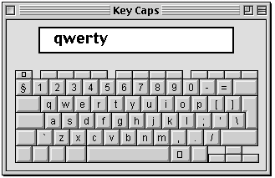
Computer Input - Keyboard
QWERTY Keyboard
Designed in 1870s, by Charles Sholes
It is called QWERTY because of the top – left hand keys
Designed to minimize typing speed, in order to prevent frequent jams of the typebars

Slide 9
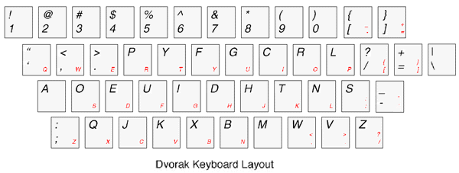
Computer Input - Keyboard
DVORAK Keyboard
It is arranged on the basis of the frequency usage of letters (in English)
Vowels and frequently – used consonants on the 2nd row
Advantages:
  Reduction in finger travel
  Consequent improvement in accuracy

Slide 10
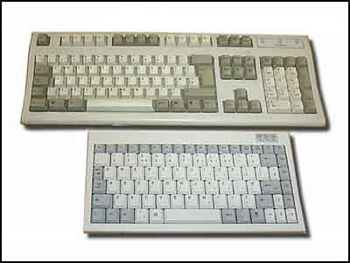
Computer Input - Keyboard
Mini Keyboard
Same layout as laptop computer keyboard
Lightweight
Useful for people with restricted arm, hand or finger movement

Slide 11
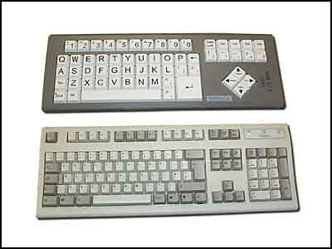
Computer Input - Keyboard
Big keys LX Keyboard
High contrast black lettering on white large keys
Useful for users with visual impairment

Slide 12
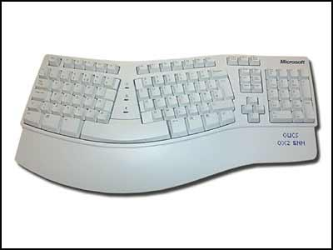
Computer Input - Keyboard
Ergonomics Keyboard
Ergonomic design allows hands and wrists to be held in more comfortable position
Useful for people suffering from RSI (Repetitive Strain Injury)/ carpal tunnel syndrome

Slide 13
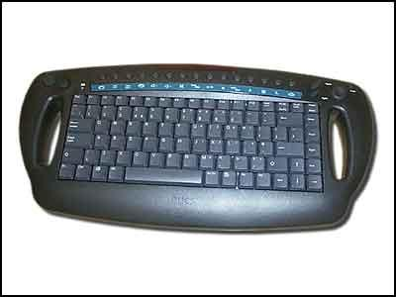
Computer Input - Keyboard
Cable Free Keyboard
Keyboard can be used away from desk (range 5 meters)
Useful for wheel chair users

Slide 14
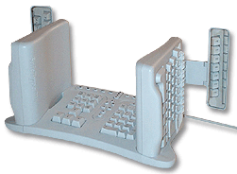
Computer Input - Keyboard
Vertical Split Keyboard
Compatibility: PC, both QWERTY and Dvorak
What is the orthopedic neutral position for the human body?

Slide 15
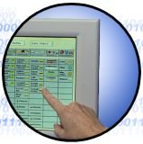
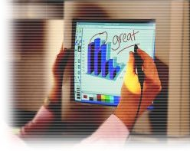
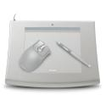
Other text entry devices

Slide 16
Handwriting recognition
Handwritten text can be input into the computer using a pen and a digitizing tablet.
Problems are in capturing useful information, segmenting join up writing into individual letters, interpreting individual letters and copying with different styles of handwriting.

Slide 17
Speech Recognition
Promising but only successful in limited situation - single user, limited vocabulary systems.
Problems with
  External noise interfering
  Imprecision of pronunciation
  Accents

Slide 18
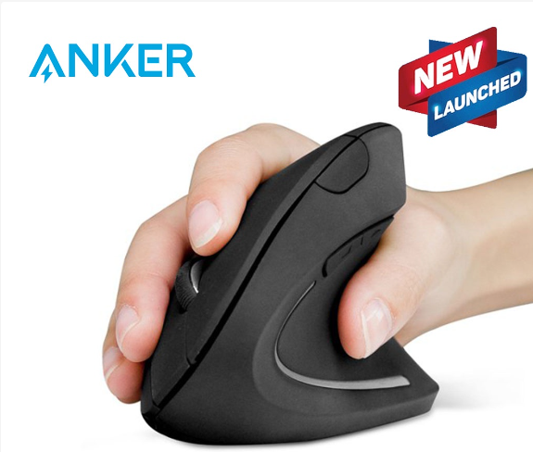
Positioning and pointing devices
Ergonomics Mouse
Thumb operated mouse
Ergonomic design
Useful for people suffering from RSI as hand remains vertical and strain on wrist and lower arm is reduced

Slide 19
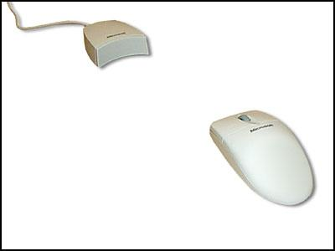
Positioning and pointing devices
Cable Free Mouse
Light weight
Portable
Useful for wheel chair users

Slide 20
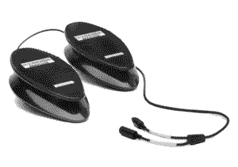

Positioning and pointing devices
The NoHands Mouse virtually eliminates stress on the delicate hand-wrist area by moving mouse control to the feet!

Slide 21
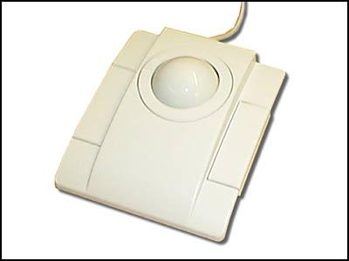
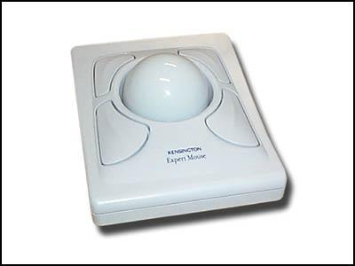
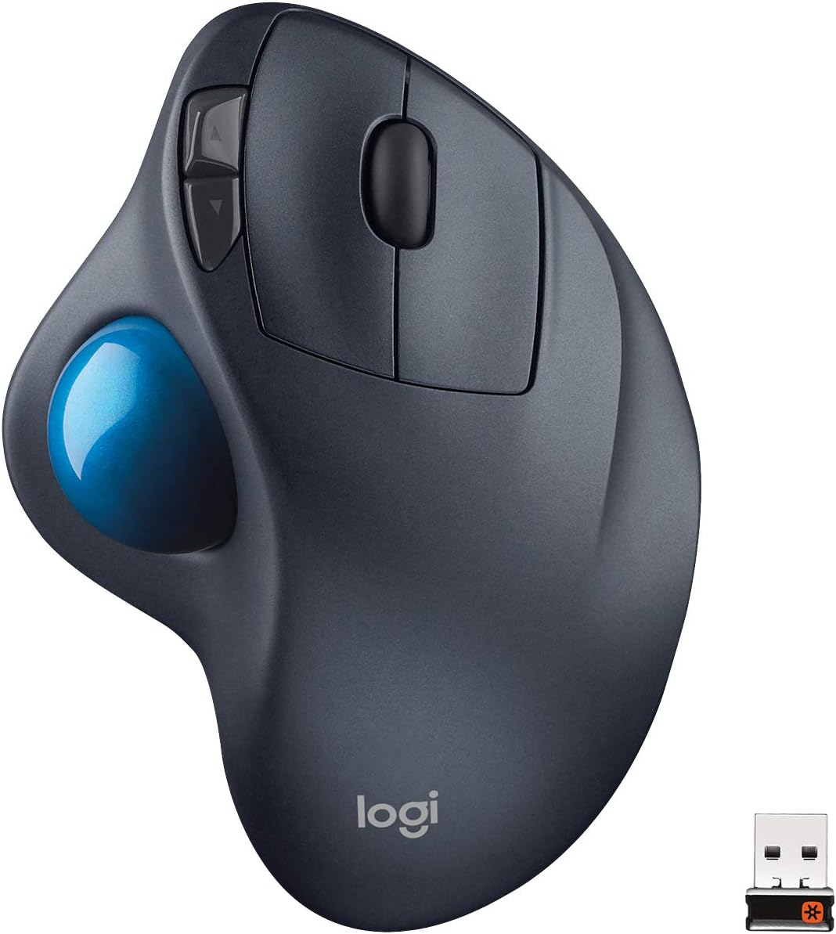
Positioning and pointing devices
Trackball
Only a small amount of movement is required to operate a tracker ball
useful for people with restricted movement who find moving the mouse difficult.

Slide 22
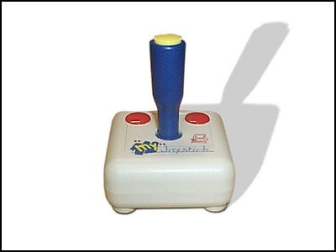
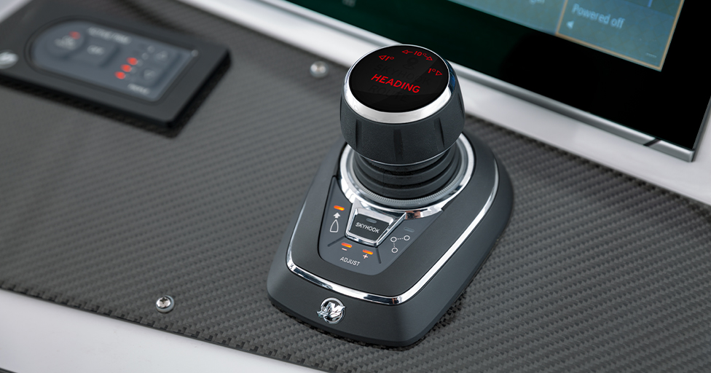
Positioning and pointing devices
Joystick
Can be used alongside standard mouse
Useful for people with limited motor control

Slide 23
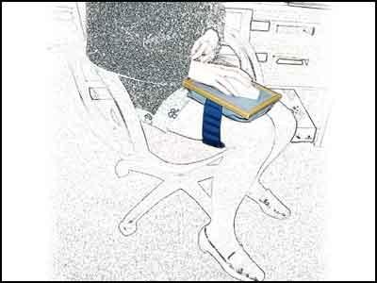
Positioning and pointing devices
Mouse Tray
Allows the mouse to be put into a comfortable position e.g on leg and there allowing arm to rest in its natural position
Flat working area with cushion on back
Useful for wheel chair users and people with upper limb discomfort

Slide 24
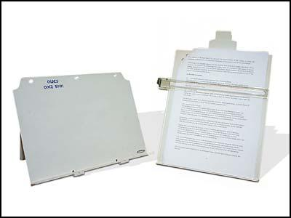
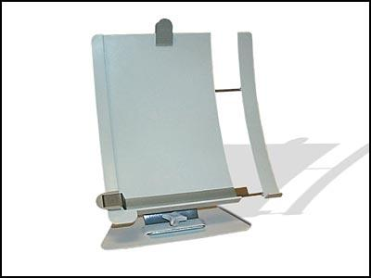
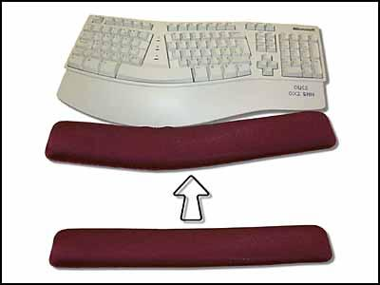
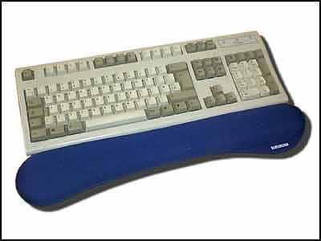
Other Ergonomics equipments

Slide 25
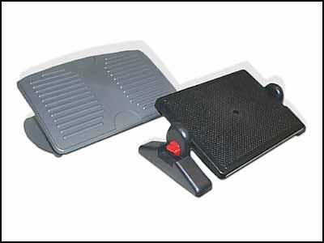
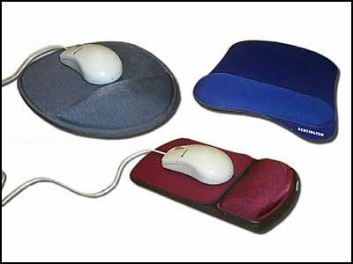
Other Ergonomics equipments

Slide 26
Summary of Main Teaching Points
Interface designer needs to be aware of the properties of the devices with which a system is built

Slide 27
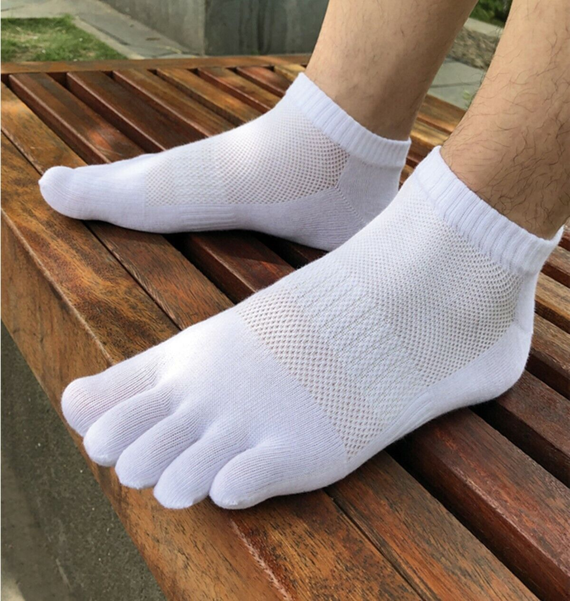
Question and Answer Session
Q & A

Slide 28
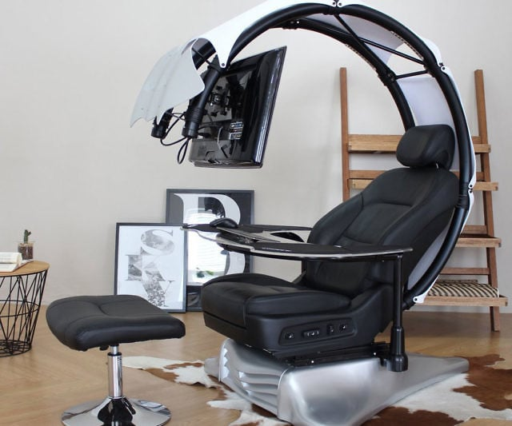

Slide 29
Next Session
Topic and Structure of next session
User Interaction
Notes:
Proceed with giving the students the task for their second tutorial (finding badly design product) as they are to present their work in the next tutorial session

