Slide 1
Heuristics for sliding-tile puzzles
Shaun Gause
Yu Cao
CSE Department
University of South Carolina

Slide 2
Contents
Introduction
Heuristic Search
Relaxed Heuristic Functions
Pattern Database Heuristic
Linear Conflict Heuristic
Gaschnig’s Heuristic
Conclusion

Slide 3




Sliding-Tile Puzzle
Introduction Heuristic Search Relaxed Heuristic Functions
Pattern Database Linear Conflict Gaschnig Conclusion
Invented by Sam Loyd in the 1870’s
The oldest type of sliding block puzzle

Slide 4
Solving Sliding Puzzle Problem
Introduction Heuristic Search Relaxed Heuristic Functions
Pattern Database Linear Conflict Gaschnig Conclusion
Brute-Force Search (Exhaustive Search).
Heuristic Search (A*, IDA*,etc).

Slide 5
Brute Force
(Exhaustive Search)
Introduction Heuristic Search Relaxed Heuristic Functions
Pattern Database Linear Conflict Gaschnig Conclusion
Brute-Force Search Time (10 million nodes/second)
Problem
Nodes
8 Puzzle: 10⁵ .01 seconds
15 Puzzle: 10¹³ 6 days
24 Puzzle: 10²⁵ 12 billion years
48 Puzzle: 10⁴⁸ why dinosaurs really went extinct

Slide 6
A*
Introduction Heuristic Search Relaxed Heuristic Functions
Pattern Database Linear Conflict Gaschnig Conclusion
Hart, Nilsson, and Raphael, 1968
Best-first search with cost function
  f’(s)=g(s)+h’(s)
  g(s) – length of the shortest path from initial state to s
  h’(s) – length of the shortest path from s to any goal state
A* stores all the nodes it generates, exhausting available memory in minutes.

Slide 7
Iterative-Deepening-A* (IDA*)
Introduction Heuristic Search Relaxed Heuristic Functions
Pattern Database Linear Conflict Gaschnig Conclusion
IDA* (Korf, 1985) is a linear-space version of A*, using the same cost function.
Each iteration searches depth-first for solutions of a given length.
IDA* is simpler, and often faster than A*, due to less overhead per node.
First to find optimal solution to random instances of 15-Puzzle (using Manhattan distance)

Slide 8
Heuristics (Wikipedia)
Introduction Heuristic Search Relaxed Heuristic Functions
Pattern Database Linear Conflict Gaschnig Conclusion
A method to help solve a problem, commonly informal.
It is particularly used for a method that often rapidly leads to a solution that is usually reasonably close to the best possible answer.
Heuristics are "rules of thumb", educated guesses, intuitive judgments or simply common sense.

Slide 9
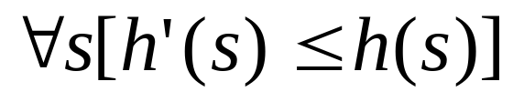
Admissible Heuristics
Introduction Heuristic Search Relaxed Heuristic Functions
Pattern Database Linear Conflict Gaschnig Conclusion
Never over estimated
Guaranteed to find optimal solutions (A* or IDA*)
Based on evaluation function: f’(s) = g(s) + h’(s)
  h’(s): estimate of length of shortest path from s to goal state
  h(s): actual length

Slide 10

Monotone Heuristic
Introduction Heuristic Search Relaxed Heuristic Functions
Pattern Database Linear Conflict Gaschnig Conclusion
Closed Set
Implies Admissible
  Not all Admissible are Monotone
Based on evaluation function: f’(s) = g(s) + h’(s)
  s’: successor of s
  f’(s): evaluation function
  f’(s’): evaluation function of the successor state

Slide 11
Relaxed Heuristic
Introduction Heuristic Search Relaxed Heuristic Functions
Pattern Database Linear Conflict Gaschnig Conclusion
Relaxed problem
A problem with fewer restrictions on the actions is called a relaxed problem.
The cost of an optimal solution to a relaxed problem is an admissible heuristic for the original problem.

Slide 12
Systematic Relaxation
Introduction Heuristic Search Relaxed Heuristic Functions
Pattern Database Linear Conflict Gaschnig Conclusion
Precondition List
  A conjunction of predicates that must hold true before the action can be applied
Add List
  A list of predicates that are to be added to the description of the world-state as a result of applying the action
Delete List
  A list of predicates that are no longer true once the action is applied and should, therefore, be deleted from the state description
Primitive Predicates
  ON(x, y) : tile x is on cell y
  CLEAR(y) : cell y is clear of tiles
  ADJ(y, z) : cell y is adjacent to cell z

Slide 13
Two simple relaxed models of Sliding Puzzle problems
Introduction Heuristic Search Relaxed Heuristic Functions
Pattern Database Linear Conflict Gaschnig Conclusion
We can generate two simple relaxed models by removing certain conditions:
Move(x, y, z):
precondition list : ON(x, y), CLEAR(z), ADJ(y, z)
add list : ON(x, z), CLEAR(y)
delete list : ON(x, y), CLEAR(z)

Slide 14
Introduction Heuristic Search Relaxed Heuristic Functions
Pattern Database Linear Conflict Gaschnig Conclusion
(1) By removing CLEAR(z) and ADJ(y, z), we can derive “Misplaced distance”.
Misplaced distance is 1+1=2 moves
15
1
2
3
1
2
3
4
5
6
7
4
5
6
7
8
9
10
11
8
9
10
11
13
14
12
12
13
14
15

Slide 15
Introduction Heuristic Search Relaxed Heuristic Functions
Pattern Database Linear Conflict Gaschnig Conclusion
(2) By removing CLEAR(z), we can derive “Manhattan distance”.
Manhattan distance is 6+3=9 moves
15
1
2
3
1
2
3
4
5
6
7
4
5
6
7
8
9
10
11
8
9
10
11
13
14
12
12
13
14
15

Slide 16
Three more relaxed heuristic functions
Introduction Heuristic Search Relaxed Heuristic Functions
Pattern Database Linear Conflict Gaschnig Conclusion
Pattern Database Heuristics
Linear Conflict Heuristics
Gaschnig’s Heuristics

Slide 17
Pattern Database Heuristics
Introduction Heuristic Search Relaxed Heuristic Functions
Pattern Database Linear Conflict Gaschnig Conclusion
The idea behind pattern database heuristics is to store these exact solution costs for every possible sub-problem instance.

Slide 18
Fringe Pattern
Introduction Heuristic Search Relaxed Heuristic Functions
Pattern Database Linear Conflict Gaschnig Conclusion
14
7
3
3
7
15
12
11
11
13
12
13
14
15
7
13
3
12
7
15
3
11
11
14
12
13
14
15
12
11
3
7
14
7
13
3
11
15
12
13
14
15

Slide 19
Disjoint Pattern Database Heuristics
Introduction Heuristic Search Relaxed Heuristic Functions
Pattern Database Linear Conflict Gaschnig Conclusion
Two or more patterns that have no tiles in common.
Add together the heuristic values from the different databases.
The sum of different heuristics results still be an admissible functions which is closed to the actual optimal cost.

Slide 20
Examples for Disjoint Pattern Database Heuristics
Introduction Heuristic Search Relaxed Heuristic Functions
Pattern Database Linear Conflict Gaschnig Conclusion
5
10
14
7
1
2
3
8
3
6
1
4
5
6
7
15
12
9
8
9
10
11
2
11
4
13
12
13
14
15
20 moves needed to solve red tiles
25 moves needed to solve blue tiles
Overall heuristic is sum, or 20+25=45 moves

Slide 21
Introduction Heuristic Search Relaxed Heuristic Functions
Pattern Database Linear Conflict Gaschnig Conclusion
A trivial example of disjoint pattern database heuristics is Manhattan Distance in the case that I view every slide as a single pattern database
5
10
14
7
1
2
3
8
3
6
1
4
5
6
7
15
12
9
8
9
10
11
2
11
4
13
12
13
14
15
Overall heuristic is sum of the Manhattan Distance of each tile which is 39 moves.

Slide 22
Introduction Heuristic Search Relaxed Heuristic Functions
Pattern Database Linear Conflict Gaschnig Conclusion
Linear Conflict Heuristic Function
Def. Linear Conflict Heuristic
--Two tiles t_{j} and t_{k} are in a linear conflict if t_{j} and t_{k} are the same line, the goal positions of t_{j} and t_{k} are both in that line, t_{j} is to the right of t_{k}, and goal position of t_{j} is to the left of the goal position of t_{k}.

Slide 23
Introduction Heuristic Search Relaxed Heuristic Functions
Pattern Database Linear Conflict Gaschnig Conclusion
Linear Conflict Example
3
1
1
3
Manhattan distance is 2+2=4 moves

Slide 24
Introduction Heuristic Search Relaxed Heuristic Functions
Pattern Database Linear Conflict Gaschnig Conclusion
Linear Conflict Example
3
1
1
3
Manhattan distance is 2+2=4 moves

Slide 25
Introduction Heuristic Search Relaxed Heuristic Functions
Pattern Database Linear Conflict Gaschnig Conclusion
Linear Conflict Example
3
1
3
1
Manhattan distance is 2+2=4 moves

Slide 26
Introduction Heuristic Search Relaxed Heuristic Functions
Pattern Database Linear Conflict Gaschnig Conclusion
Linear Conflict Example
3
1
3
1
Manhattan distance is 2+2=4 moves

Slide 27
Introduction Heuristic Search Relaxed Heuristic Functions
Pattern Database Linear Conflict Gaschnig Conclusion
Linear Conflict Example
3
1
3
1
Manhattan distance is 2+2=4 moves

Slide 28
Introduction Heuristic Search Relaxed Heuristic Functions
Pattern Database Linear Conflict Gaschnig Conclusion
Linear Conflict Example
1
3
1
3
Manhattan distance is 2+2=4 moves

Slide 29
Introduction Heuristic Search Relaxed Heuristic Functions
Pattern Database Linear Conflict Gaschnig Conclusion
Linear Conflict Example
1
3
1
3
Manhattan distance is 2+2=4 moves

Slide 30
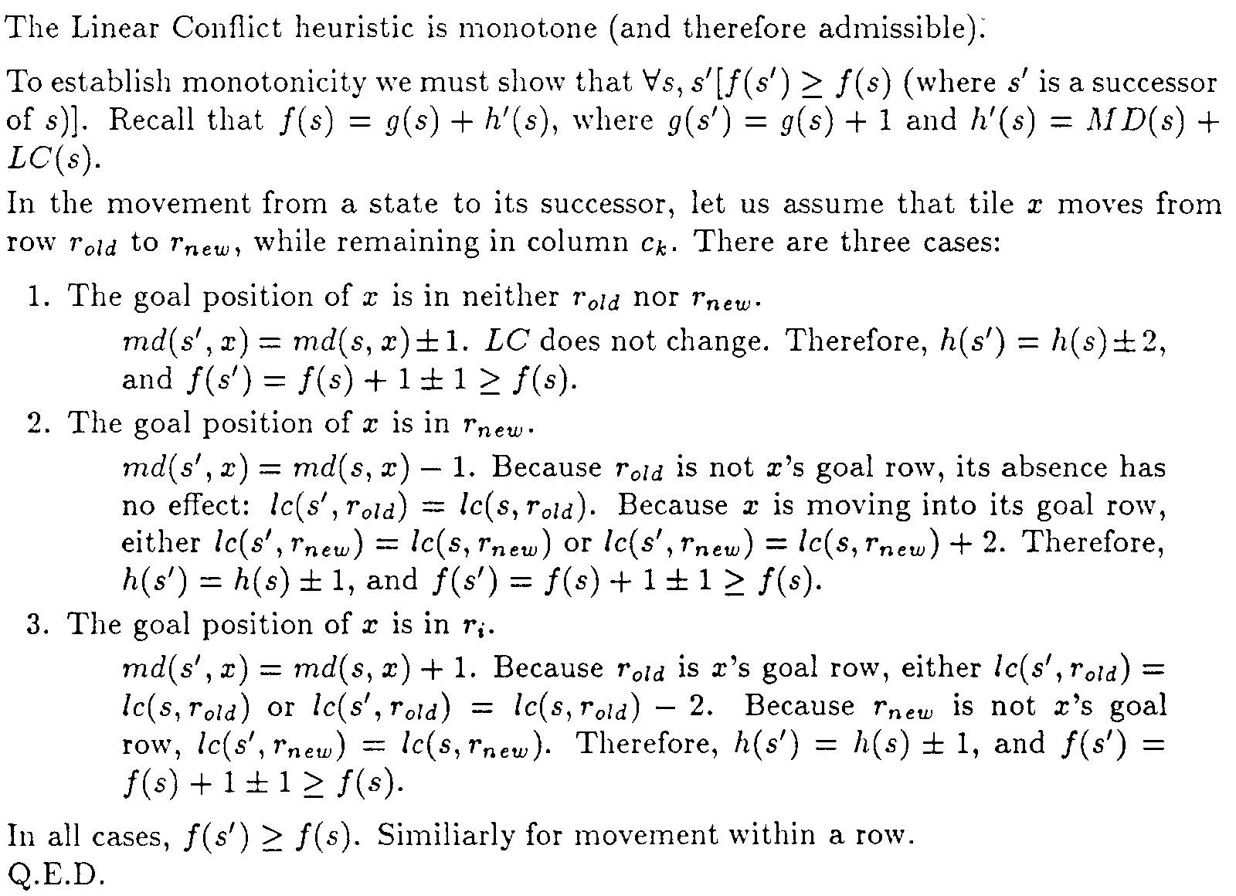
Introduction Heuristic Search Relaxed Heuristic Functions
Pattern Database Linear Conflict Gaschnig Conclusion
Consistency of Linear Conflict

Slide 31
Introduction Heuristic Search Relaxed Heuristic Functions
Pattern Database Linear Conflict Gaschnig Conclusion
Linear Conflict Heuristic Function
The linear conflict heuristic cost will at least 2 more than Manhattan distance.
Linear conflict heuristic is more accurate or more informative than just using Manhattan Distance since it is closer to the actual optimal cost.

Slide 32
Introduction Heuristic Search Relaxed Heuristic Functions
Pattern Database Linear Conflict Gaschnig Conclusion
Gaschnig’s Heuristic Function
Gaschnig introduced the 9MAXSWAP problem.
The relaxed problem assume that a tile can move from square A to B if B is blank, but A and B do not need to be adjacent.
It underestimates the distance function of 8-puzzle, it is a closer approximation of the 8-puzzle’s distance.

Slide 33
Introduction Heuristic Search Relaxed Heuristic Functions
Pattern Database Linear Conflict Gaschnig Conclusion
Maxsort Algorithm
One algorithm to solve 9MAXSWAP is Maxsort.
P: the current permutation
B: the location of element i in the permutation Array.
Basic Idea: swaps iteratively P[B[n]] with P[B[b[n]]] for n-puzzle.

Slide 34
Introduction Heuristic Search Relaxed Heuristic Functions
Pattern Database Linear Conflict Gaschnig Conclusion
Apply MAXSORT as A Heuristic
To apply MAXSORT as a heuristic for the 8-puzzle, we take the number of switches as the heuristic cost at any search node.

Slide 35
Introduction Heuristic Search Relaxed Heuristic Functions
Pattern Database Linear Conflict Gaschnig Conclusion
Gaschnig Heuristic Example
Current Node : Goal Node:
29613478 123456789
2 | 9 | 6
1 | 3 | 4
7 | 5 | 8
1 | 2 | 3
4 | 5 | 6
7 | 8 | 9

Slide 36
Introduction Heuristic Search Relaxed Heuristic Functions
Pattern Database Linear Conflict Gaschnig Conclusion
Gaschnig Heuristic Function
iteration | permutation | b array
1 | 296134758 | 415683792
2 | 926134758 | 425683791
3 | 126934758 | 125683794
4 | 126439758 | 125483796
5 | 129436758 | 125486793
6 | 123496758 | 123486795
7 | 123456798 | 123456798
8 | 123456789 | 123456789

Slide 37
Introduction Heuristic Search Relaxed Heuristic Functions
Pattern Database Linear Conflict Gaschnig Conclusion
Gaschnig Heuristic Function
In the previous example, the Gaschnig Heuristic cost for the node on the right side is 7 which is just the number of switches to make the sequence 296134758 to be 123456789. (9 means blank)
2 | 9 | 6
1 | 3 | 4
7 | 5 | 8

Slide 38
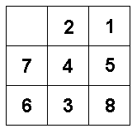
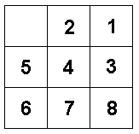
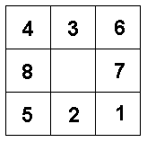
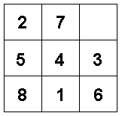
Comparison of Heuristic Estimates
Introduction Heuristic Search Relaxed Heuristic Functions
Pattern Database Linear Conflict Gaschnig Conclusion
Puzzle |  |  |  |  | Average | σ²
Misplaced Tiles | 4 | 4 | 8 | 7 | 5.75 | 4.25
Relaxed Adjacency (Gaschnig’s) | 6 | 6 | 10 | 10 | 8 | 5.33
Manhattan Distance (Subset of Pattern) | 6 | 6 | 22 | 14 | 12 | 58.67
Linear Conflict | 8 | 12 | 22 | 24 | 16.5 | 59.67
Actual Distance | 22 | 20 | 26 | 26 | 23.5 | 9

Slide 39
Sources
Introduction Heuristic Search Relaxed Heuristic Functions
Pattern Database Linear Conflict Gaschnig Conclusion
www.tilepuzzles.com
www.wikipedia.com
Sakawa, Masatoshi and Yano, Hitoshi. “Criticizing Solutions to Relaxed Models Yields Powerful Admissible Heuristics.” Information Sciences 63, 1992. 207-227
Korf, Richard E. “Recent Progress in the Design and Analysis of Admissible Heuristic Functions.” American Association for Artificial Intelligence, 2000.
Gaschnig, John. “A Problem Similarity Approach to Devising Heuristics: First Results.” International Joint Conferences on Artificial Intelligence, 1979. 301-307.
Pearl, Judea. “Heuristics: Intelligent Search Strategies for Computer Problem Solving.” Addison-Wesley, 1984. 118-125.
Hansson, Othar and Mayer, Andrew and Yung, Mordechai. “Criticizing Solutions to Relaxed Models Yields Powerful Admissible Heuristics.” Information Sciences: an International Journal. Volume 63, Issue 3. 207-227.
Valtorta, Marco. “A Result on the Computational Complexity of Heuristic Estimates for the A* Algorithm.” Information Science 34, 47-59(1984).
Hansson, Othar and Mayer, Andrew and Valtorta, Marco. “A New Result on The Complexity of Heuristic Estimates for The A* Algorithm.” Artificial Intelligence 55 (1992) 129-143.
Korf’s Slides for “Recent Progress in the Design and Analysis of Admissible Heuristic Functions”. http://sara2000.unl.edu/Korf-slides.ppt#295,49,Time Complexity of Admissible Heuristic Search Algorithms

