Slide 1
Explore Zomato restaurants dataset in the city of Ankara

Slide 2
Introduction
Ankara is the one of the biggest city of Turkey.
We plan to move to Ankara to live there. And it's important for us to know where to eat in different parts of Ankara
With it’s diverse culture , comes diverse food items. There are many restaurants in Ankara, each belonging to different categories like Chinese , Italian , French etc.
So as part of this project , we will list and visualise all major parts of Ankara.

Slide 3
Objectives
Questions that can be asked using the above mentioned datasets
What is best location in Ankara for Chinese Cuisine ?
Which areas have large number of Korean Resturant Market ?
Which all areas have less number of resturant ?
Which is the best place to stay if I prefer Chinese Cuisine ?
What places are have best restaurant in Ankara?

Slide 4
Data
For this project we need the following data :
Ankara Resturants data that contains list Locality, Resturant name,Rating along with their latitude and longitude.
Data source : Zomato kaggel dataset
Description : This data set contains the required information. And we will use this data set to explore various locality of Ankara.
Nearby places in each locality of Ankara.
Data source : Fousquare API
Description : By using this api we will get all the venues in each neighborhood.

Slide 5
Approach
Collect the Ankara city data from Zomato kaggel dataset
Using FourSquare API we will find all venues for each neighborhood.
Filter out all venues that are nearby by locality.
Using aggregative rating for each resturant to find the best places.
Visualize the Ranking of neighborhoods using folium library(python)

Slide 6
Results

Slide 7
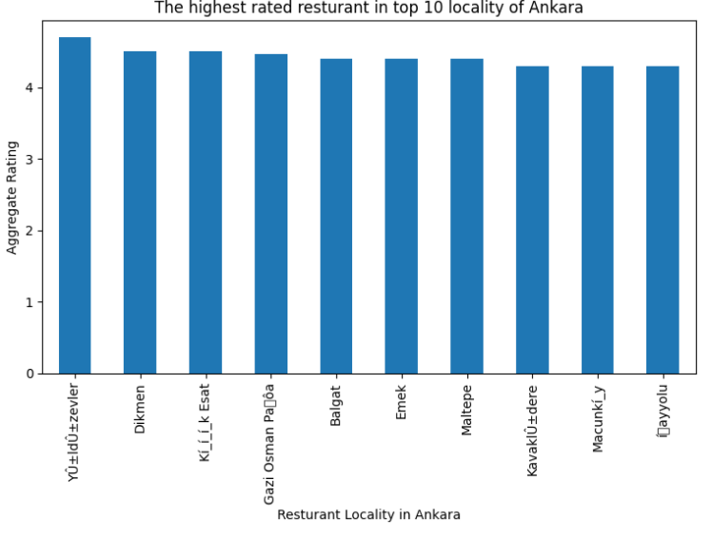

Slide 8
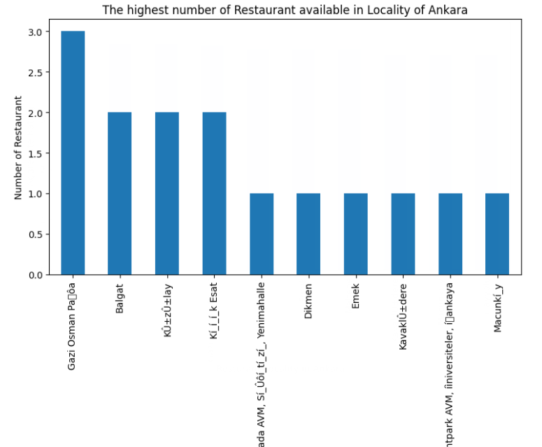

Slide 9
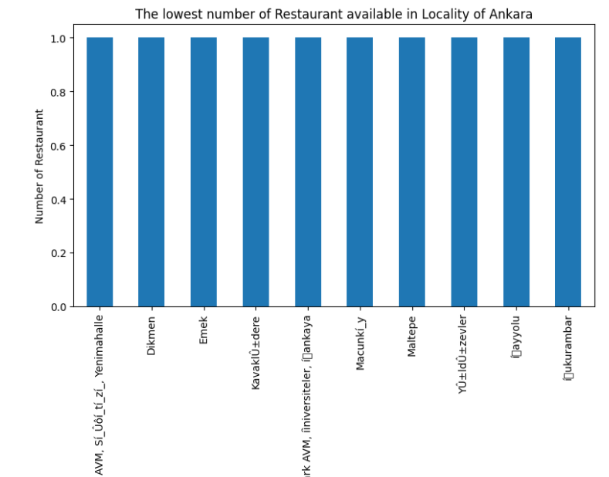

Slide 10
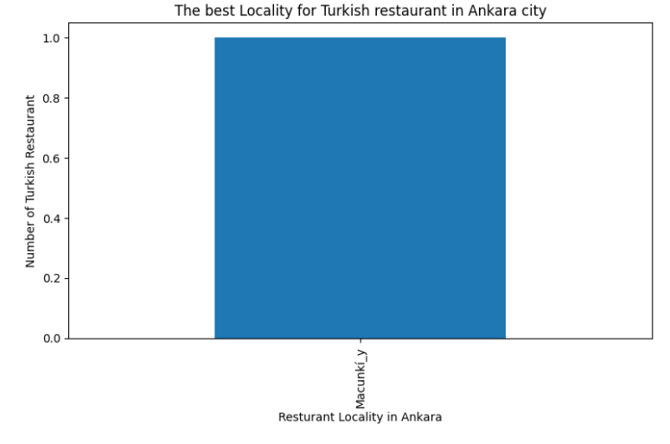

Slide 11
Conclusion
The best restarants are available in Zevler, Dikmen area.
The worst restarants are available in Emek, Balgat.
Machunki is best Turkish resturants.

