Slide 1
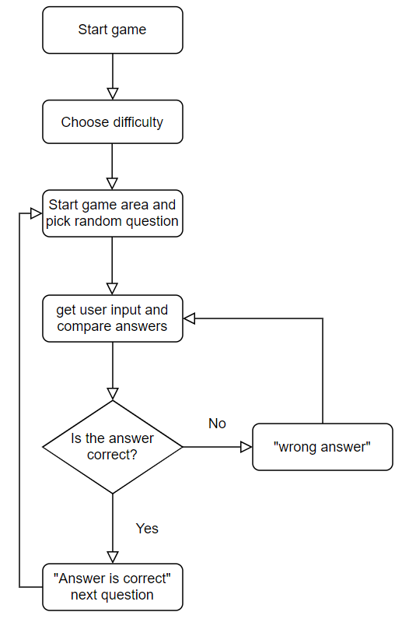
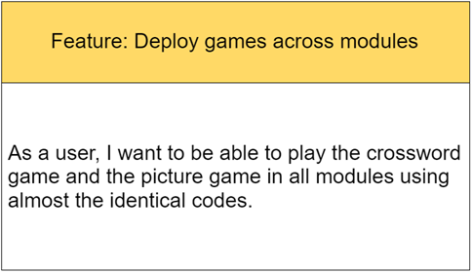
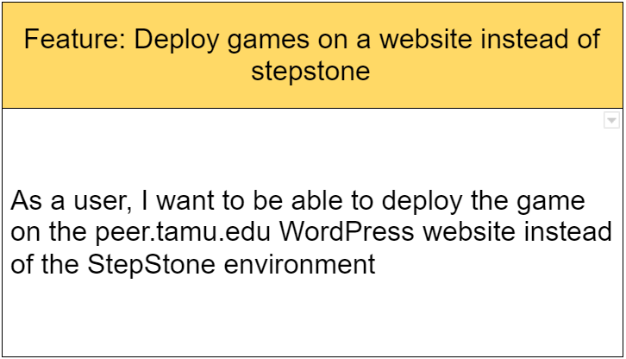
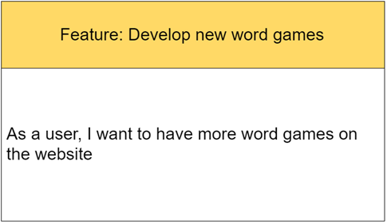
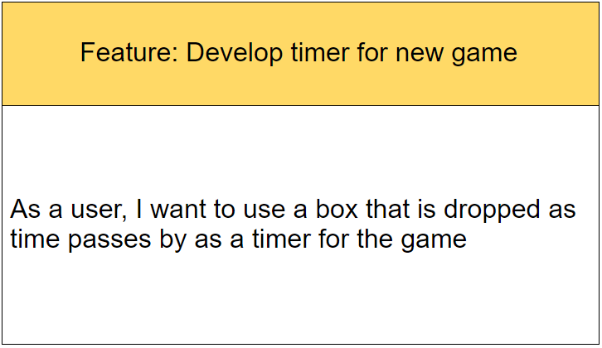
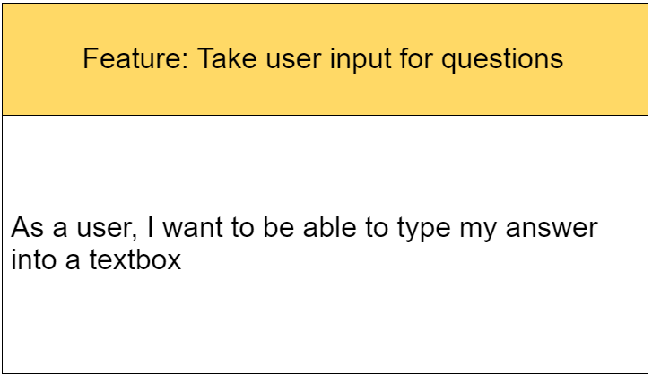
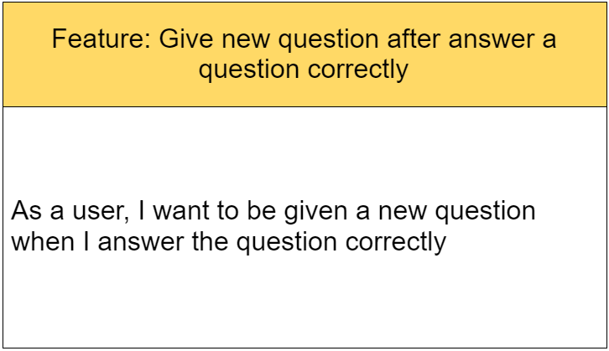
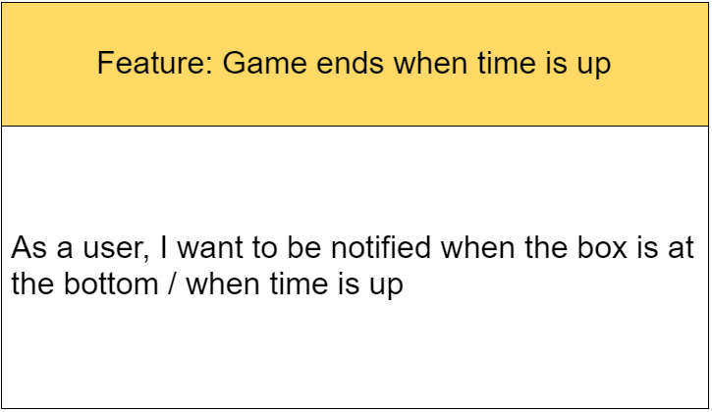
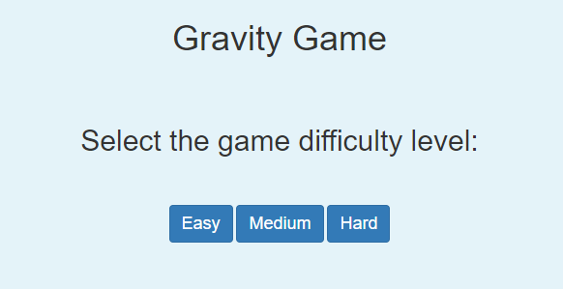
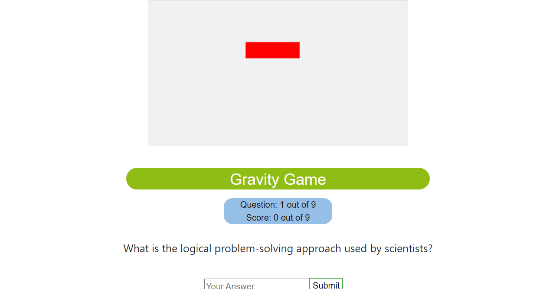
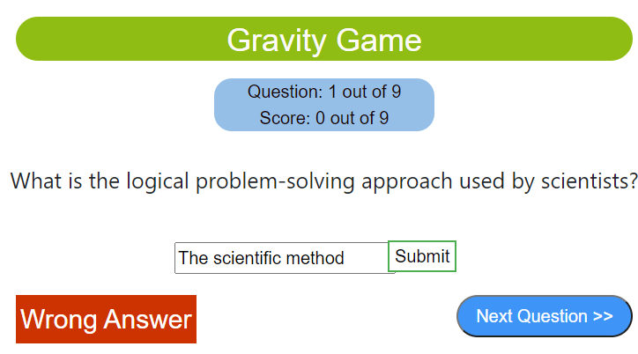
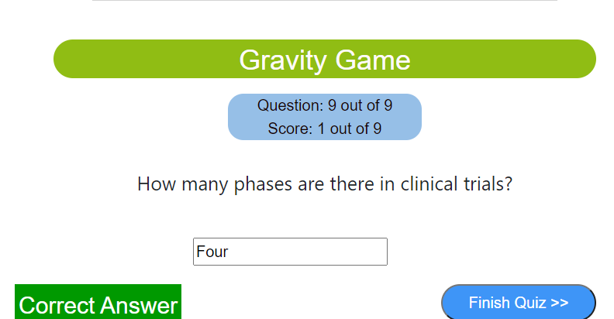
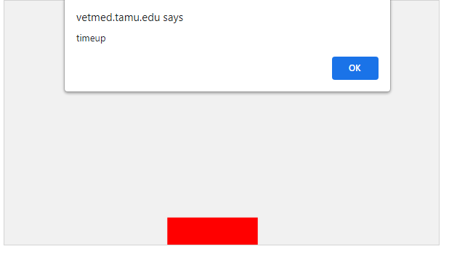
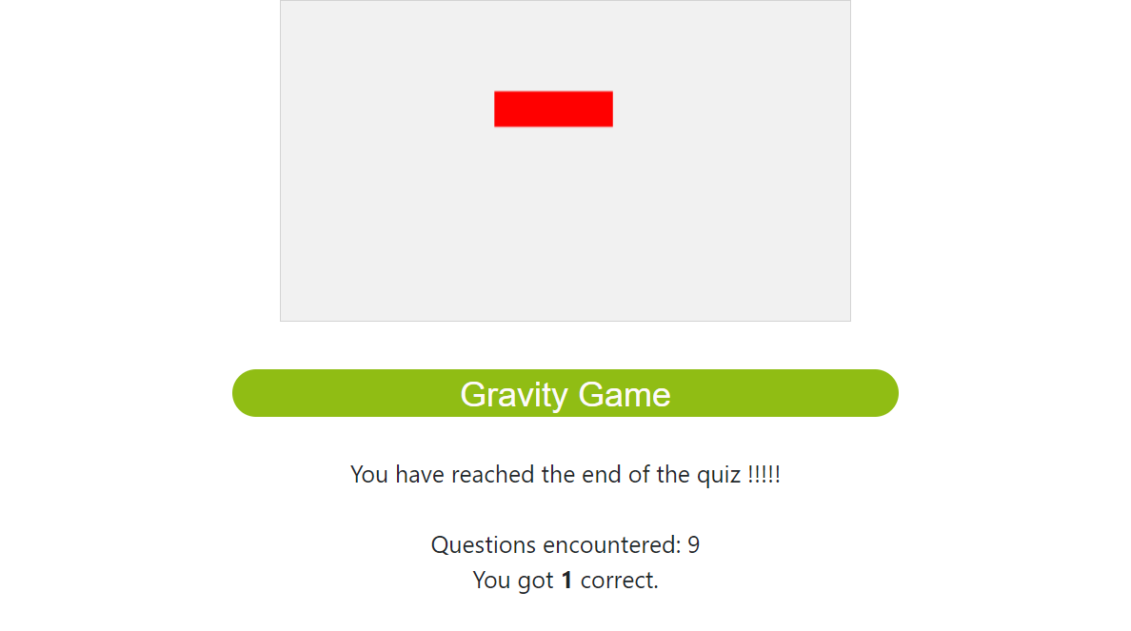
Team TensorFlow - Biology Games 2
Lu Zhang, Jiateng Sun, Jinjin Jiang, Zhenlei Song, Zhihao Li, Tzu-Shen Wang
CSCE606
Introduction
Design Diagram
User Story
For this project, our goals were to deploy games on websites instead of StepStone environment and to develop new games.
At the end of out project, we deployed all games across modules on WordPress sites by using a plugin that features easy deployment on the customer’s end. We also successfully developed the Gravity Game, which can help students memorize biology terminologies and their spellings.
Iteration Summary
Iteration 0:
The team focused on understanding the legacy code and communicating with the customers to create user stories. We created 4 user stories.
Iteration 1:
The team focused on deploying the existing code to WordPress instead of using StepStone. We did not use shortcodes, instead we changed to “wp-file-manager” because we can simply download the local wordpress server and the plugin, and then upload the code files to the plugin.
Iteration 2:
The team implemented a new word game, the Gravity Game. We were able to complete 4 user stories. We implemented a timer using a falling red rectangle, and indicated time is up with a popup window when the red rectangle hits the bottom of the game area. We implemented the basic user interface and created multiple test cases.
Screenshots
Challenges
Lack of enough information:
Not knowing what to develop, especially when the start of project.
Bypassed by communicating with customers, and try to build high-level ideas first then confirm it with the customer.
Lack of professional developers
Hard to make decisions when developing.
Bypassed by more communications within the team to make sure we stay on the right track
Size of user stories is too large(the user story of developing new game)
Hard to implement efficiently
Bypassed by cutting them to smaller user stories, enable us to build them more efficiently
Lack of precise role for team members
Hard for each team member to know that to do from time to time
Bypassed the same way as “Lack of professional developers”: more communication within the team
Fig.1 Difficulty Selection
Fig.2 Game Area
Fig.3 Wrong Answer Notification
Fig.4 Correct Answer Notification
Lesson Learned
Communication within team members is quite important to make decisions and getting precise role of each team member.
And it is also quite important to come up with some high-level ideas to have efficient communication with customers to quickly reach consensus on the goal of each iteration.
Fig.5 Time-up Notification
Fig.6 End Of Quiz Interface

