Slide 1
GEOG 475 Advanced GIS Lab4
Zhenlei Song, Ph.D Student
Department of Geography
Email: songzl@tamu.edu
Office: CSA 301F

Slide 2
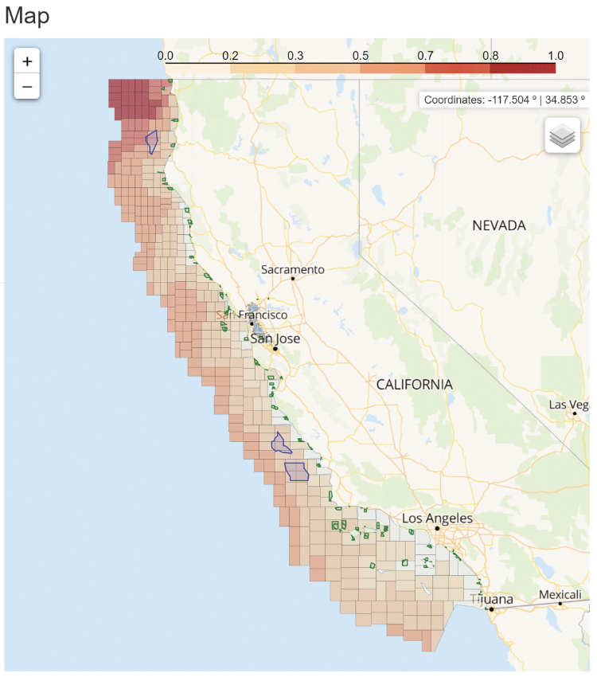
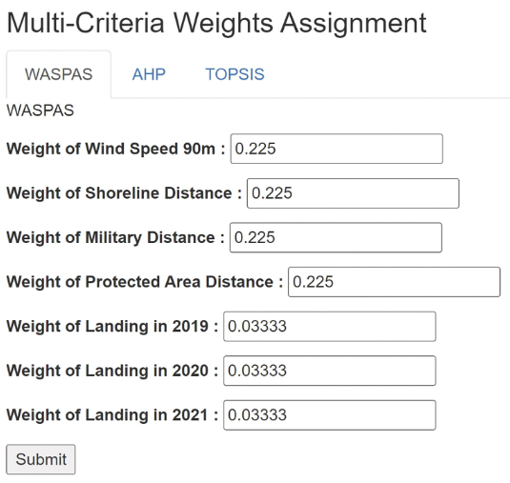
Multi-Criteria Decision Making
Song, Z., Chapman, P., Tao, J., Chang, P., Gao, H., Liu, H., … Zhang, Z. (2024). Mapping the Unheard: Analyzing Tradeoffs Between Fisheries and Offshore Wind Farms Using Multicriteria Decision Analysis. Annals of the American Association of Geographers, 114(3), 536–554. https://doi.org/10.1080/24694452.2023.2285371

Slide 3
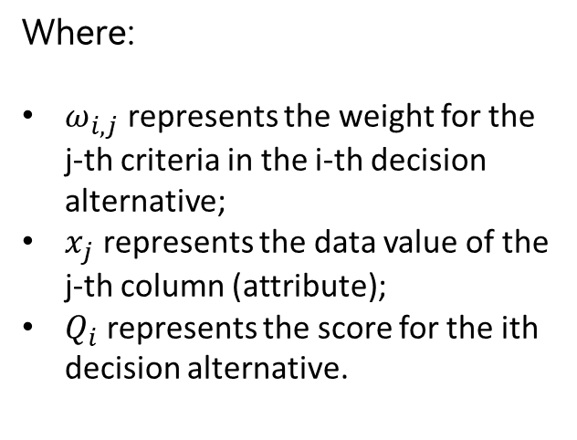
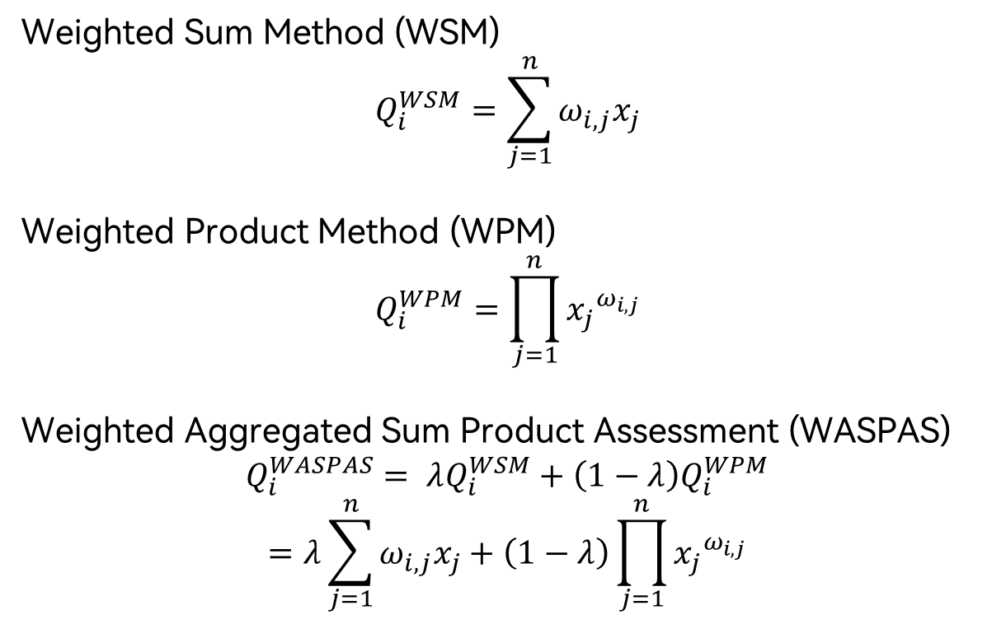
Multi-Criteria Decision Making
Weighted Sum Method (WSM)
$$Q_{i}^{WSM}=\sum_{j=1}^{n}{ω_{i,j}x_{j}}$$
Weighted Product Method (WPM)
$$Q_{i}^{WPM}=\prod_{j=1}^{n}{{x_{j}}^{ω_{i,j}}}$$
Weighted Aggregated Sum Product Assessment (WASPAS)
$$Q_{i}^{WASPAS}= λQ_{i}^{WSM}+\left(1−λ\right)Q_{i}^{WPM}$$
$$=λ\sum_{j=1}^{n}{ω_{i,j}x_{j}}+\left(1−λ\right)\prod_{j=1}^{n}{{x_{j}}^{ω_{i,j}}}$$
Where:
$ω_{i,j}$ represents the weight for the j-th criteria in the i-th decision alternative;
$x_{j}$ represents the data value of the j-th column (attribute);
$Q_{i}$ represents the score for the ith decision alternative.

Slide 4
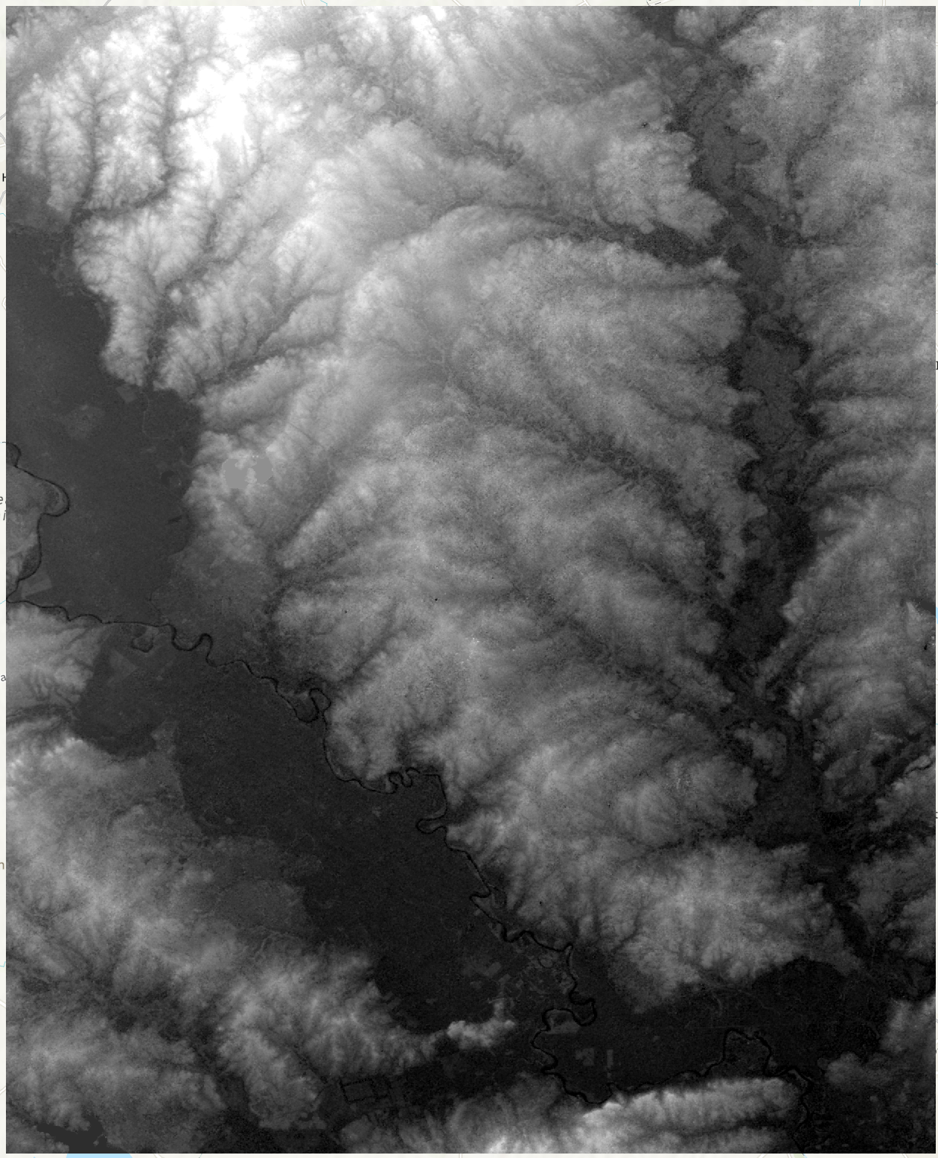
Data Source - DEM

Slide 5
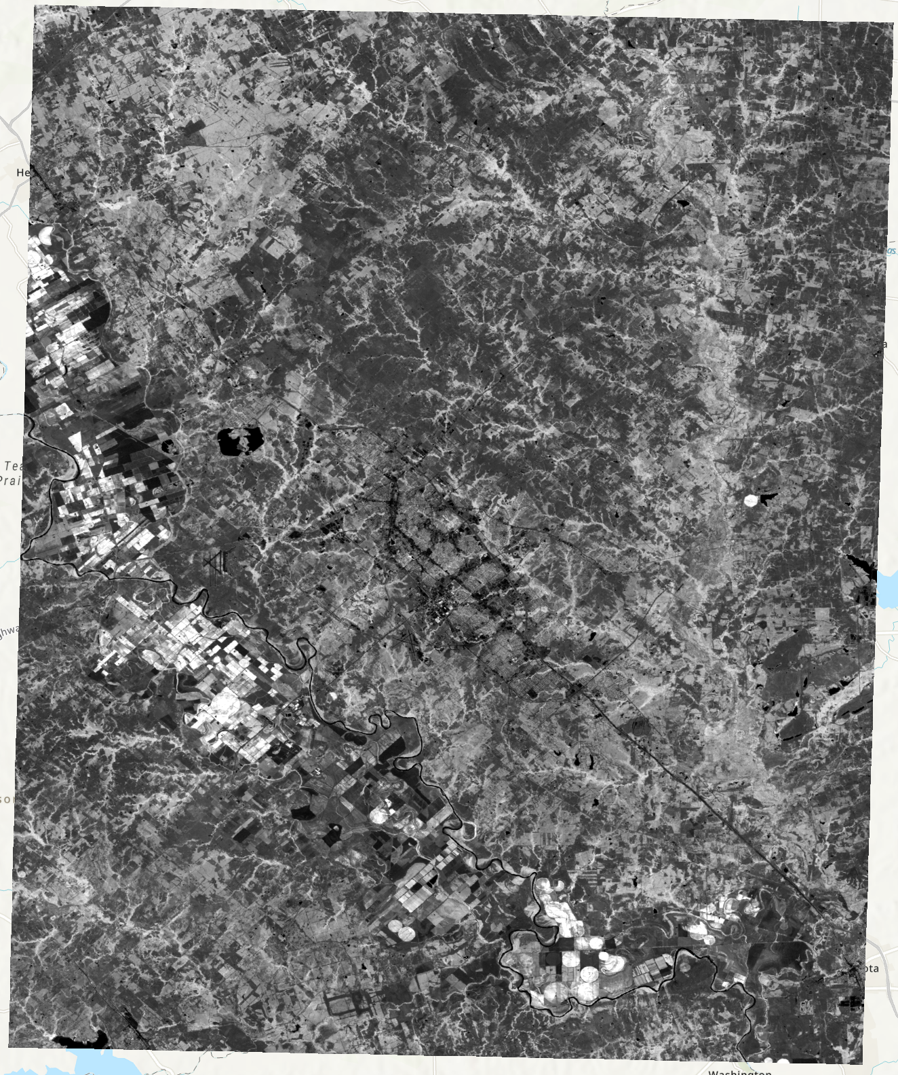
Data Source - NDVI

Slide 6
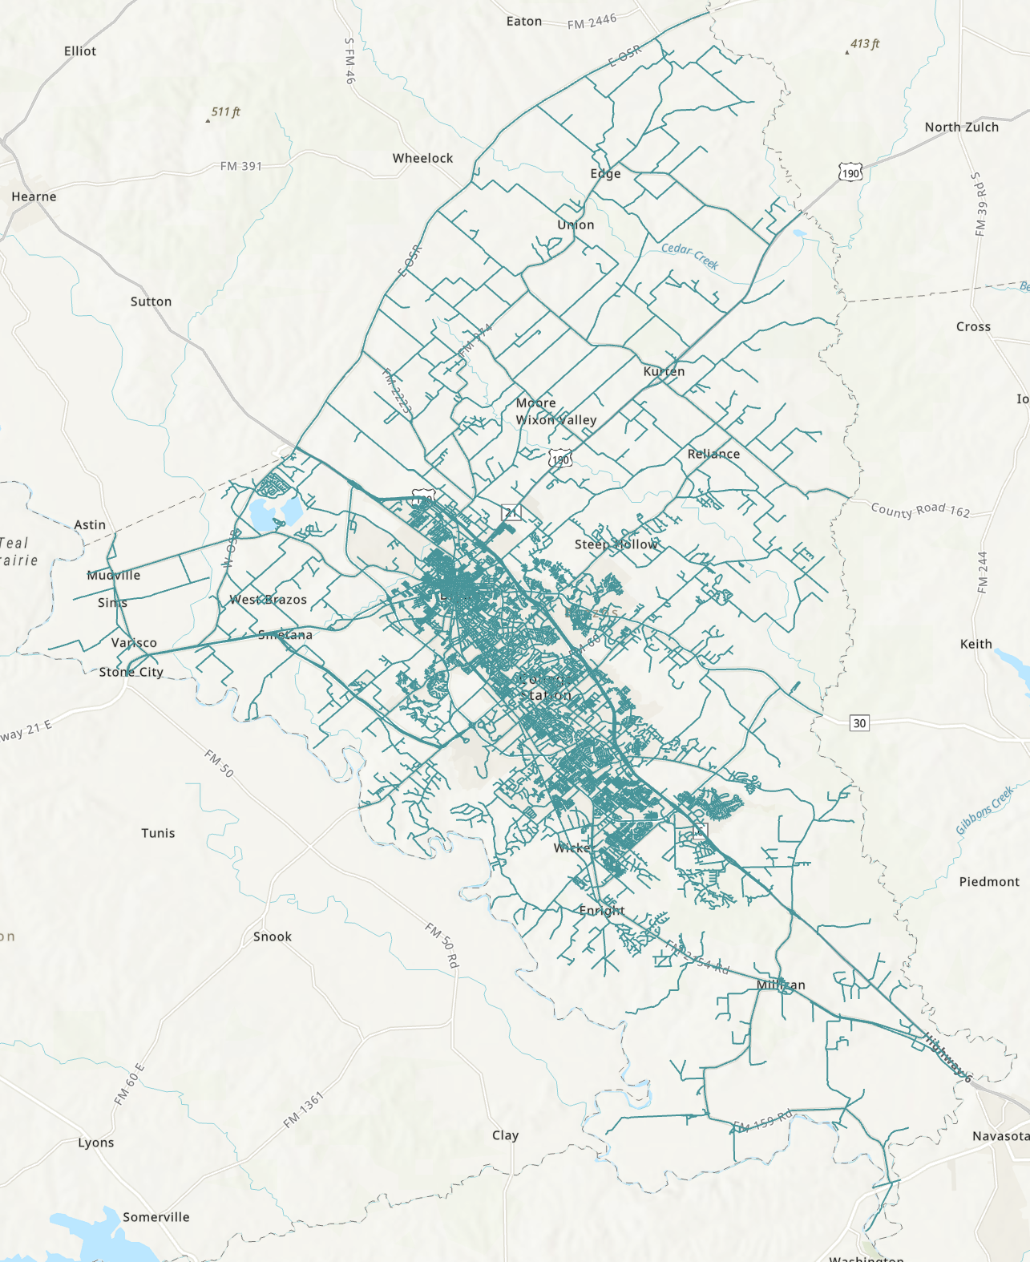
Data Source – Road Network

Slide 7
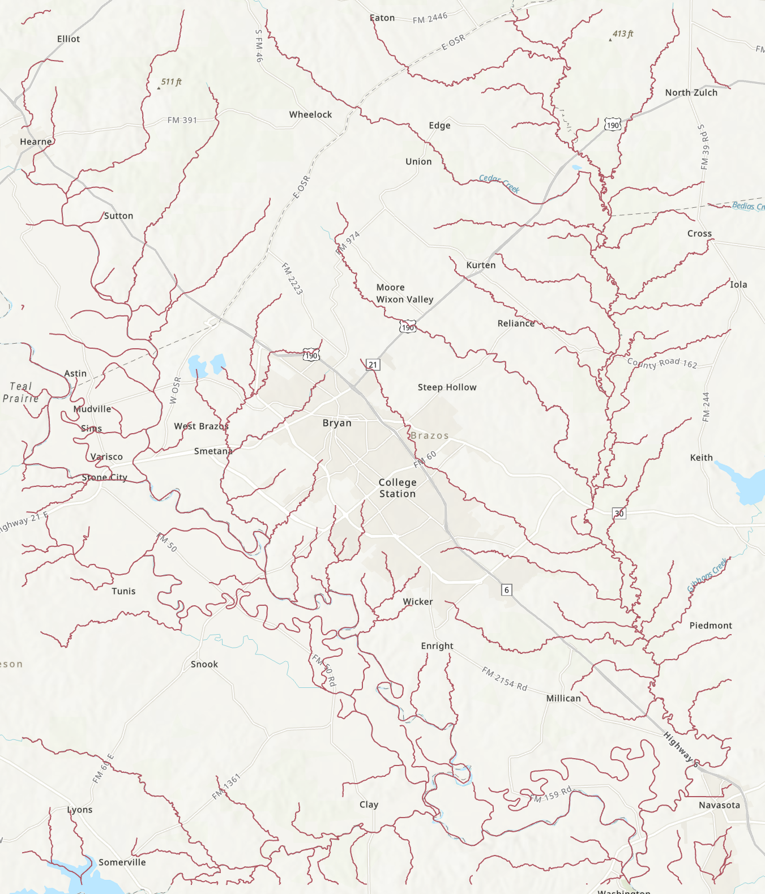
Data Source – River Network

Slide 8
Flowchart
It’s your job this time.

Slide 9
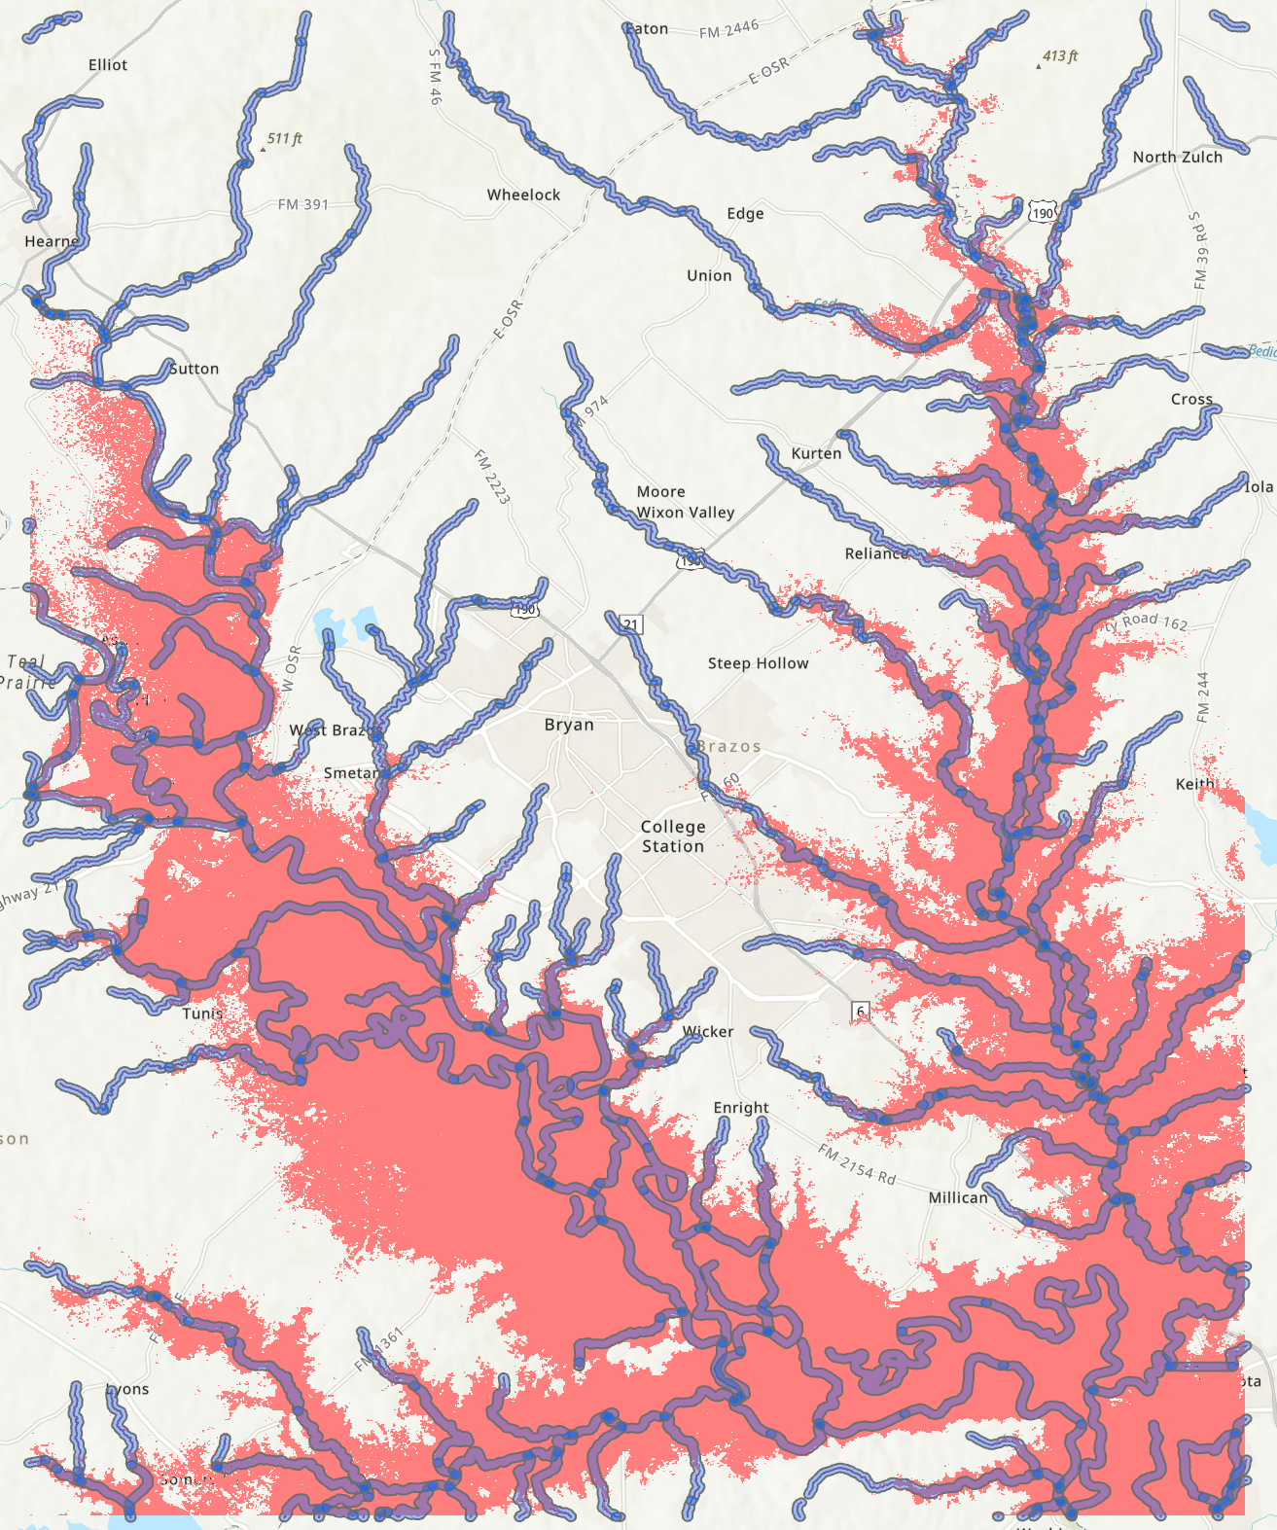
Criteria – Flood Map
From DEM:
Set an elevation threshold, filter elevation below this gauge.
Tune with this threshold, until you get a proper flood map (binary).
From River Network:
Set a buffer radius, which is the width of the banks when flooding occurs.
Intersect the 2 layers

Slide 10
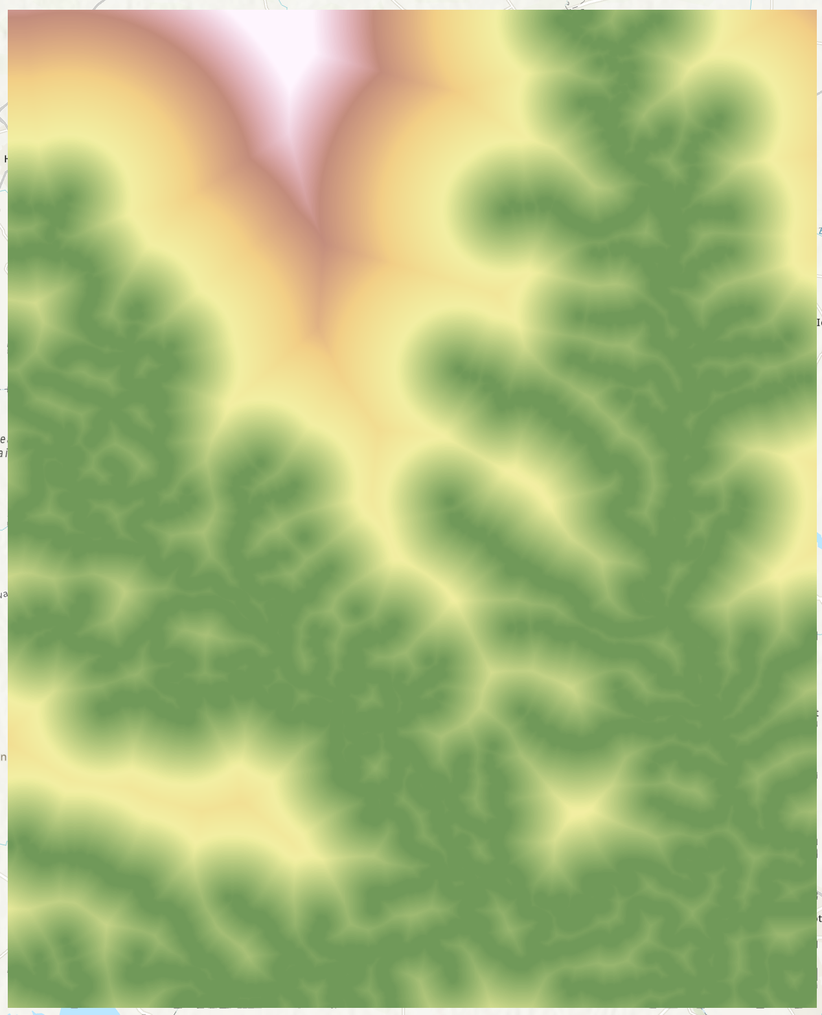

Criteria – Flood Map

Slide 11
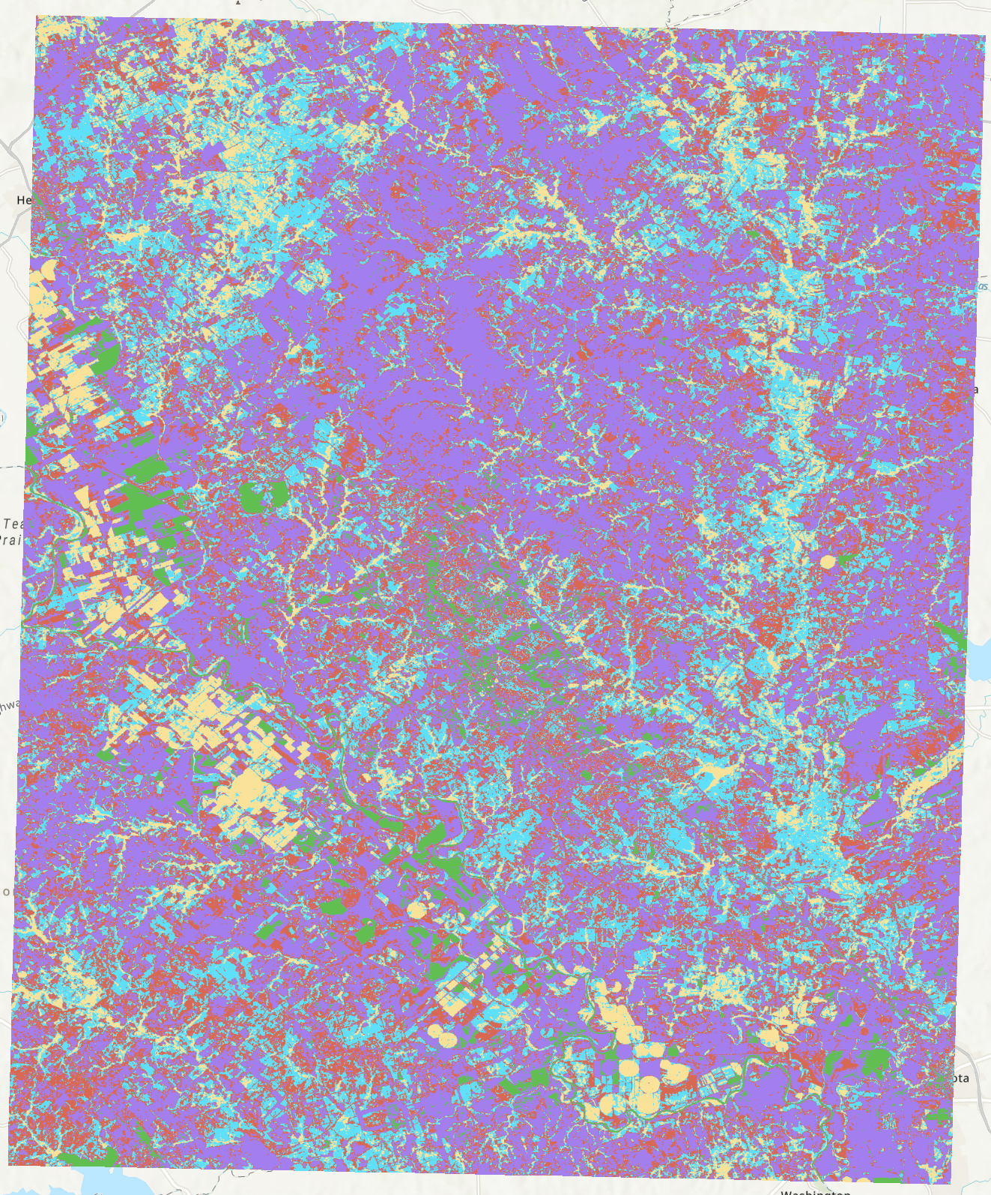
Criteria – Vegetation
From NDVI:
Reclassify it into 6 categories.
Be aware of the value meaning!!!
Should you prefer higher or lower value of this criteria?

Slide 12
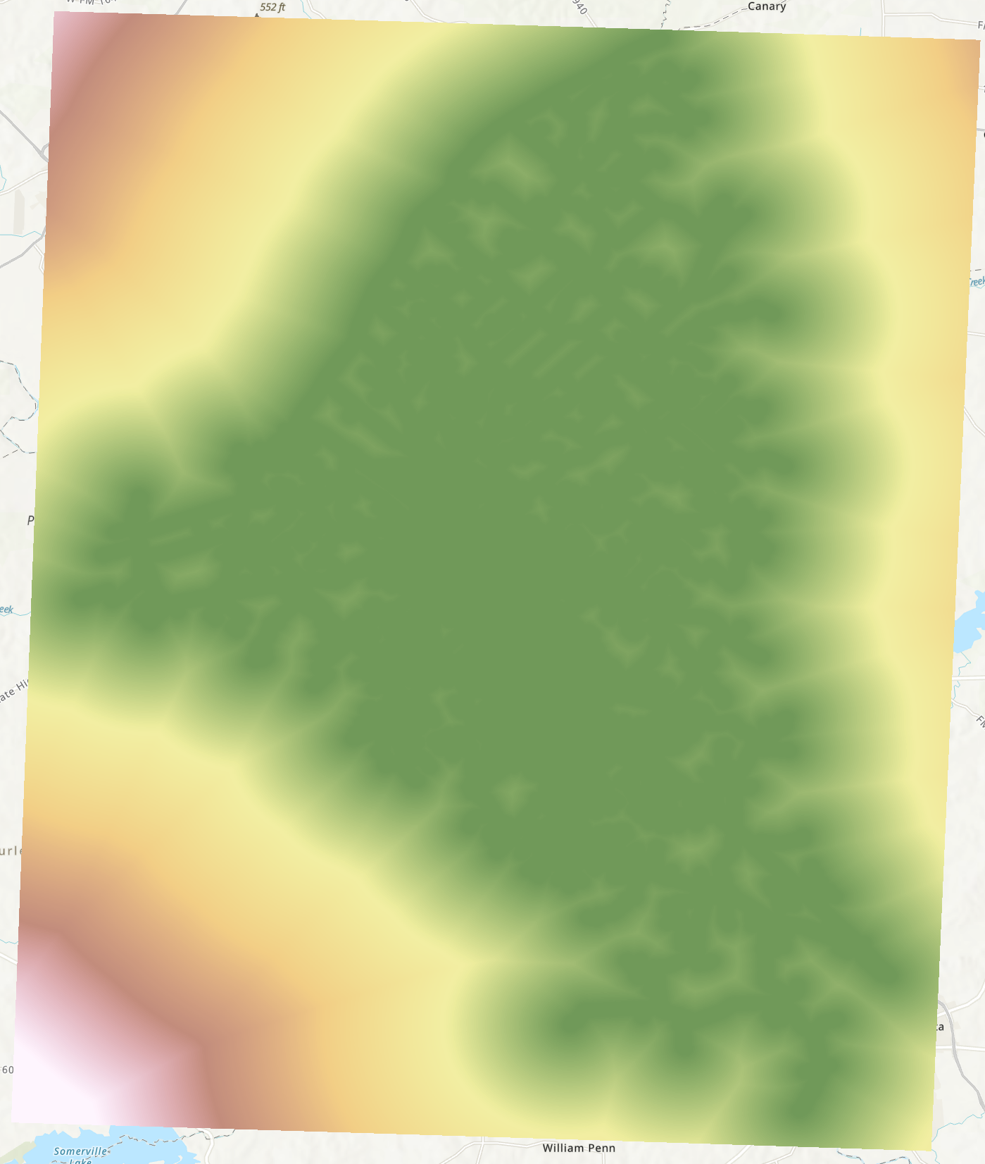
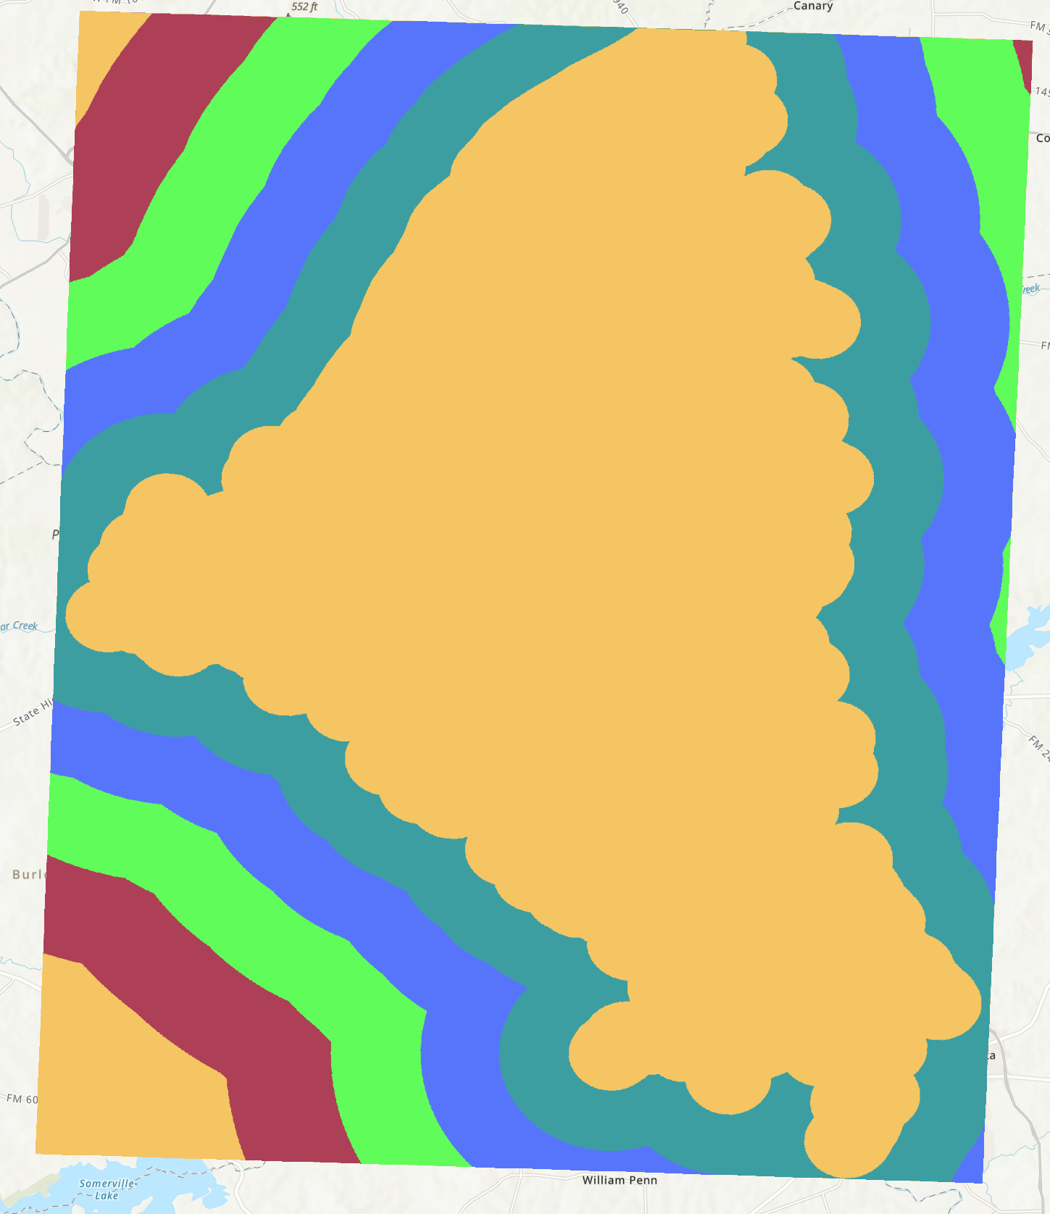
Criteria – Road Accessibility

Slide 13
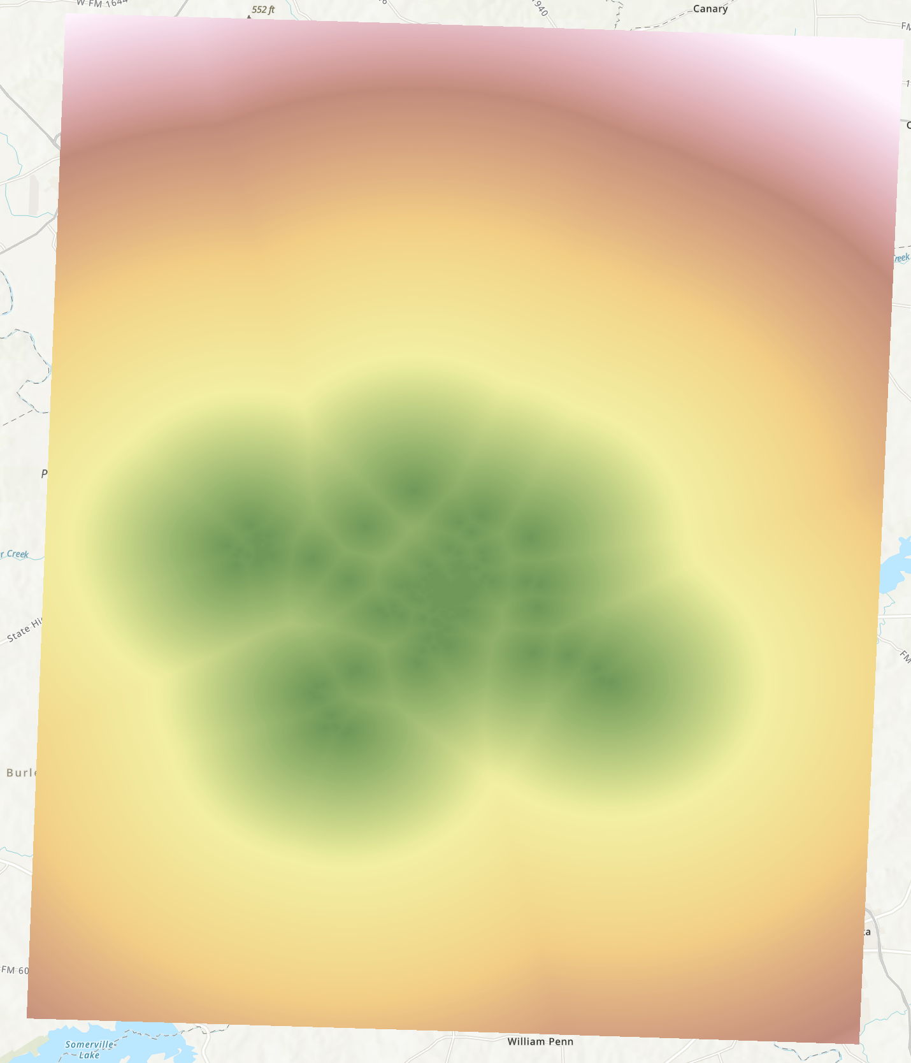

Criteria – Campus Accessibility

Slide 14
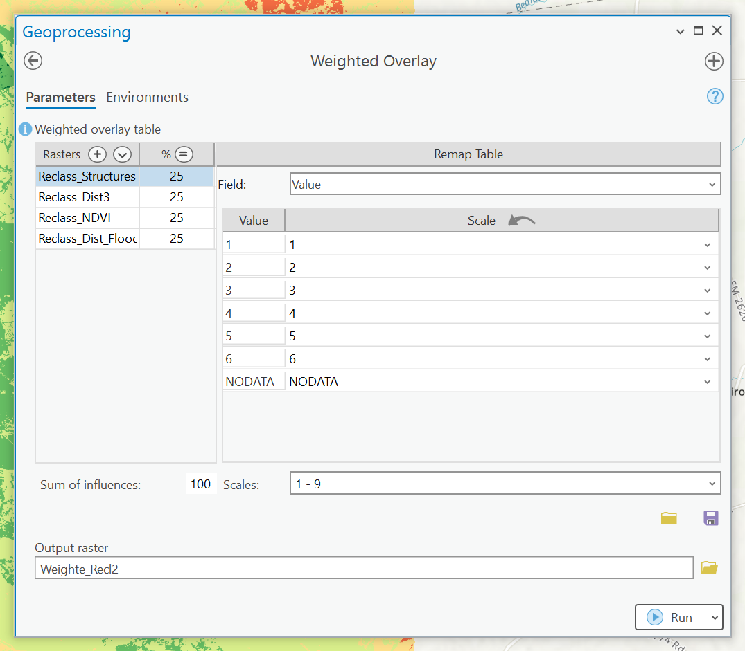
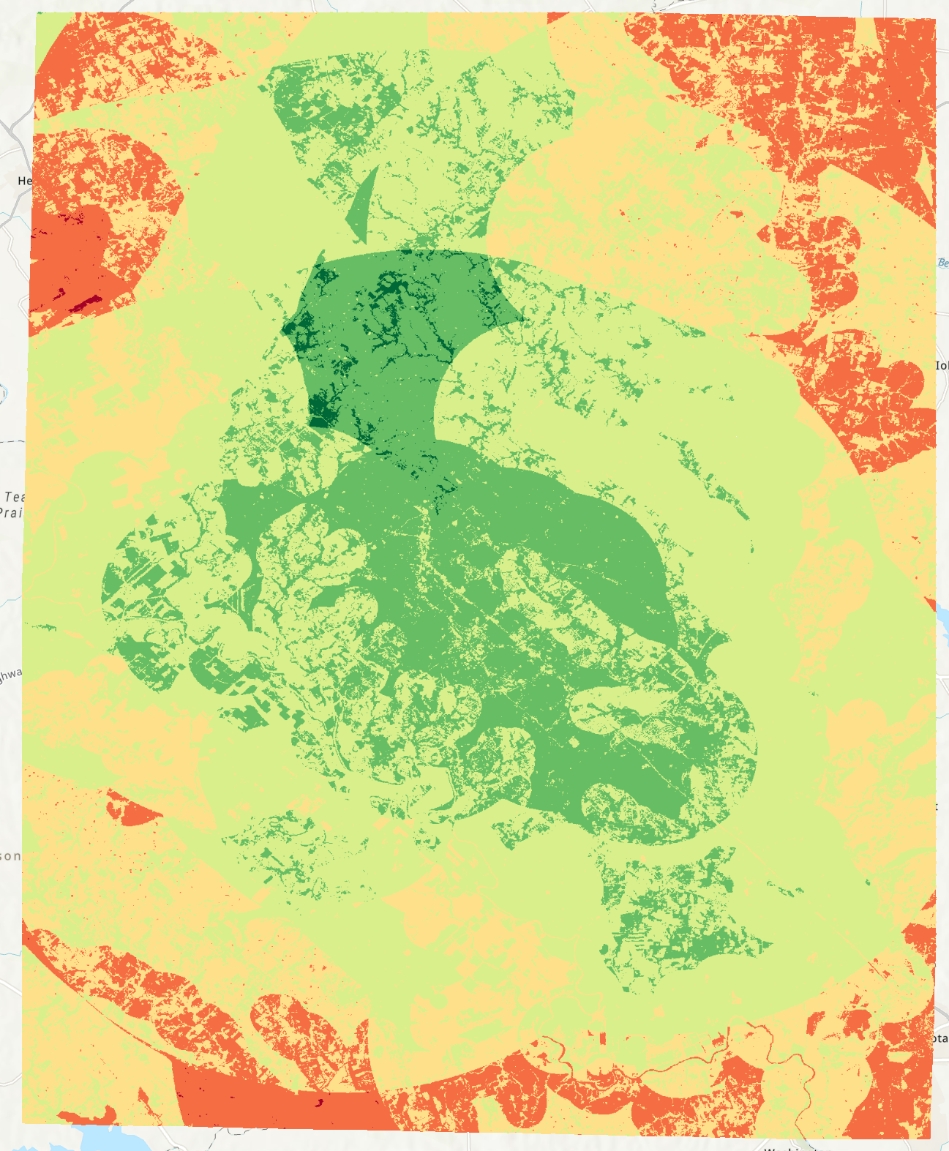
Weighted Sum
Try different weights

Slide 15
Tools
In ArcGIS Pro:
Raster Calculator: Documentation
Euclidean Distance: Documentation
Reclassify: Documentation
Buffer: Documentation
Raster to Polygon: Documentation
Weighted Overlay: Documentation
To draw flowcharts:
LucidChart
Draw.io

Slide 16
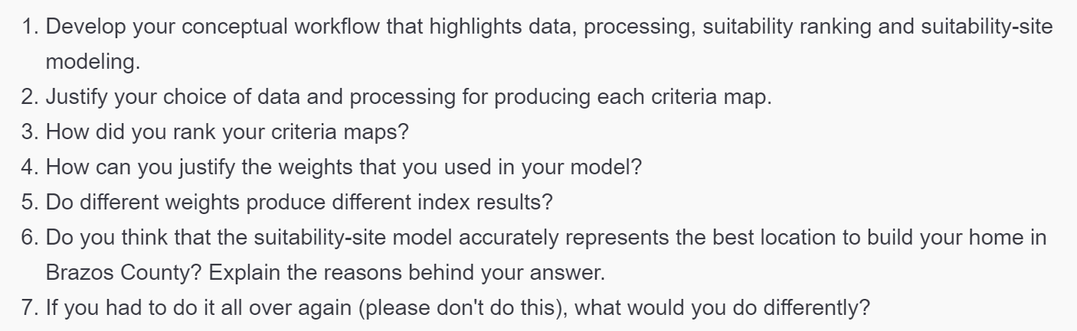
Expr Questions

Slide 17
Submission
A .doc/docx file includes:
Contexts and necessary screenshots (with captions) to prove you completed all required steps.
Comparisons of performances with different algorithms and parameter settings. Describe what changes did you make and what’s changed.
Answer the designated questions with YOUR OWN interpretation.

Slide 18
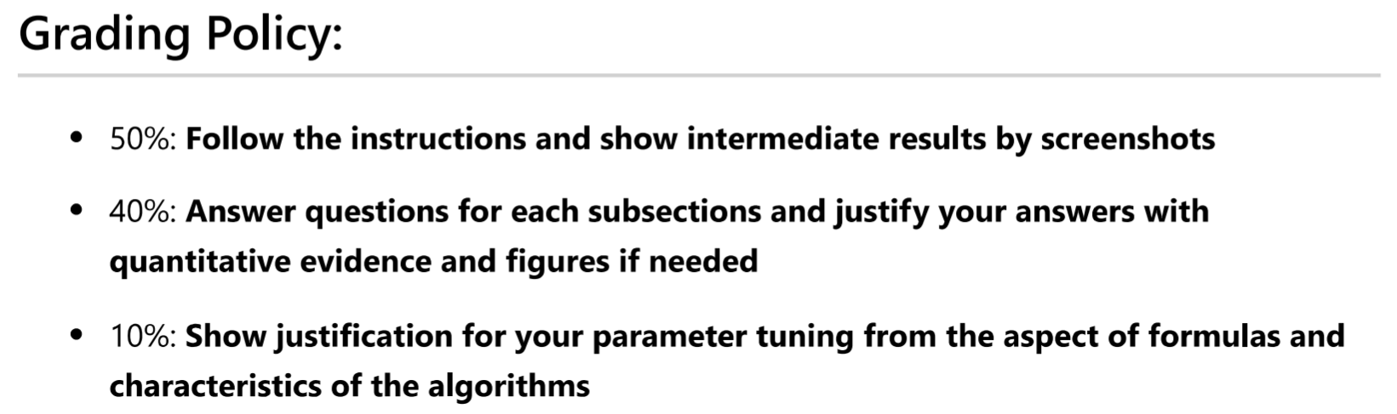
Grading Rule

Slide 19
The End

