Slide 1
Move Light Presentation
By Chrono Code

Slide 2

Movie Light Concept
The Challenge
Create an AIR Application using the Kinect
as3NIU API
Kinect Research and Proof of Concept
Game Environment setup

Slide 3
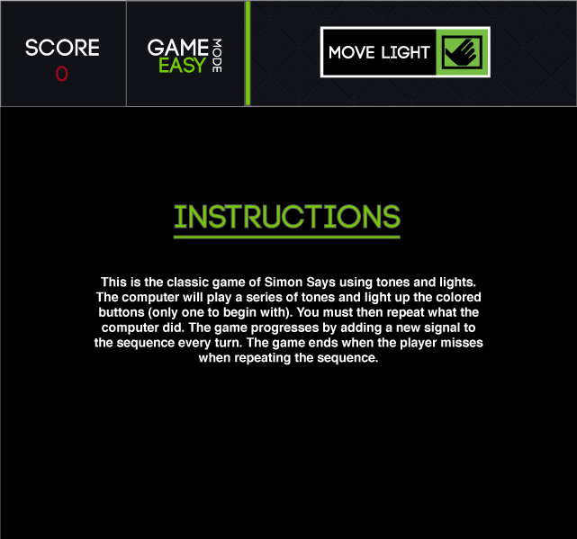
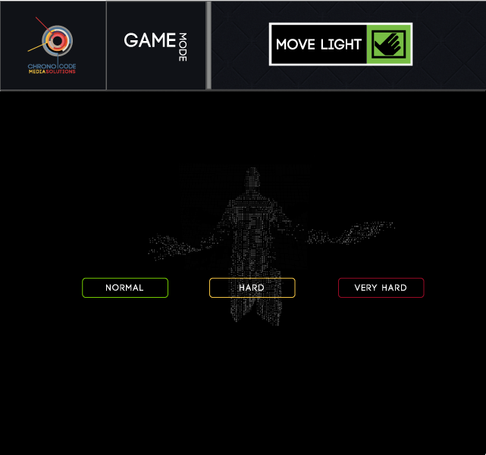
Design Composites

Slide 4
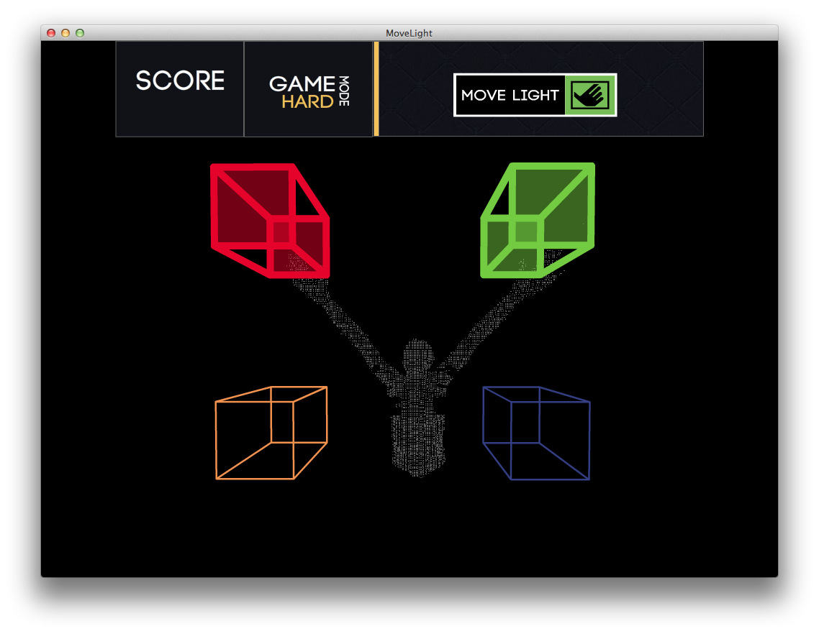
Game Play

Slide 5
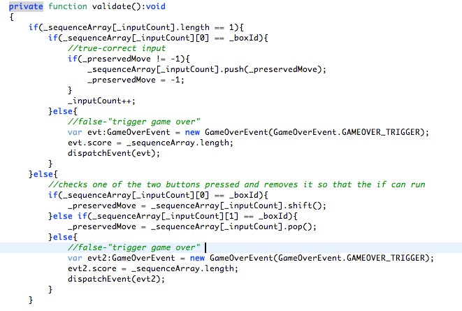
Game Code
Use of Timer Events
User Input
Hard Mode
Notes:
Checked what user input versus what was stored in the sequence.
For Hard mode we had to check what two they were putting in versus what the current sequence item is and the next one is and remove it to run a normal check

Slide 6
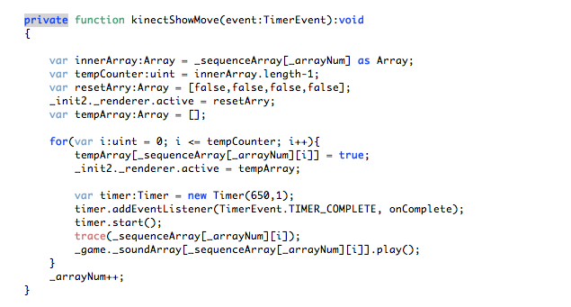
Game Code
Hit Detection Merger
Point Cloud vs. Hit Detection

Slide 7
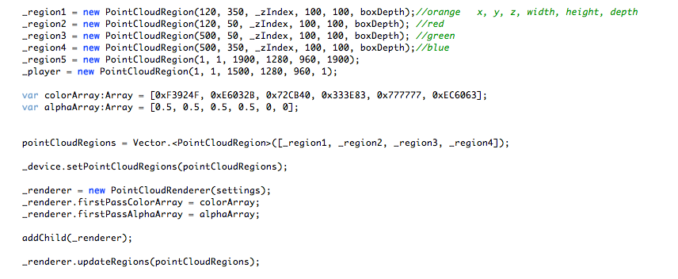
Create Game UI
Use of AIRKinect API
Create Hit Regions

Slide 8
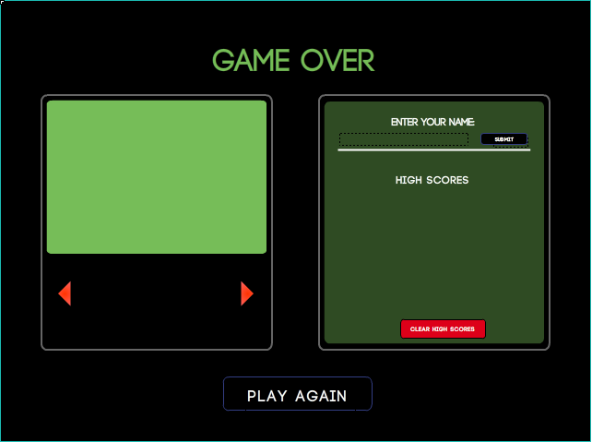
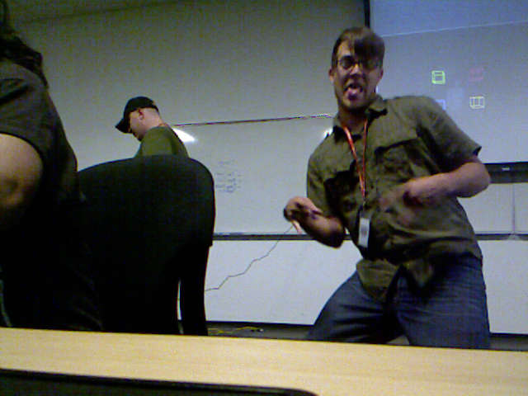
Image Viewer
Image capture
Image save
Movement through the list of items (pictures)

Slide 9

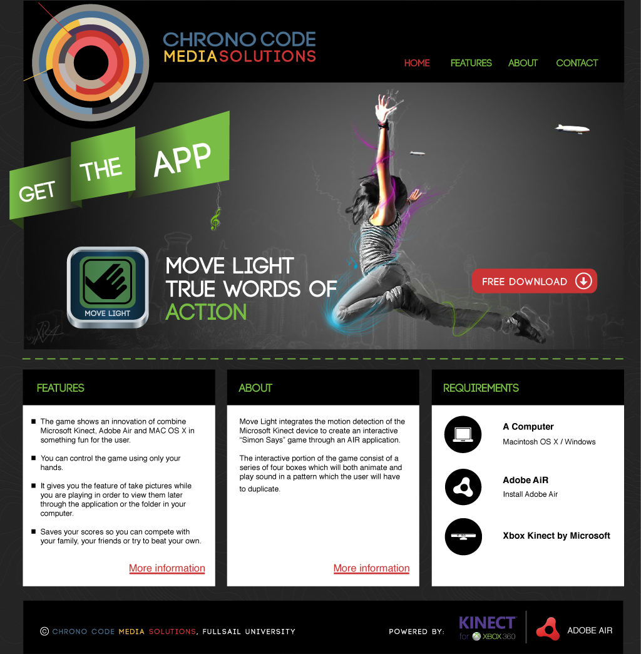

Chrono Code website – HTML/CSS

Slide 10
Shout outs and Thanks
Thank you to our testers long-term:
Grant, Donte.
Thank you for the help and the cool loader
Asa Davis.
Thank you for challenging us to something cool
Sean

