Slide 1
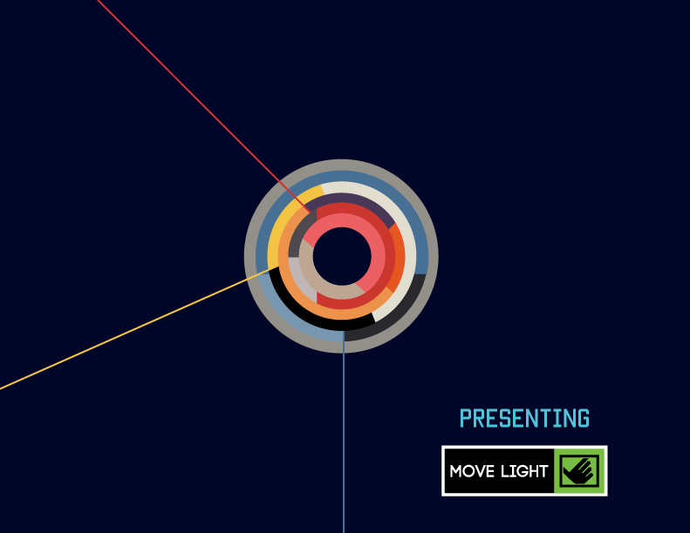

Slide 2


Slide 3
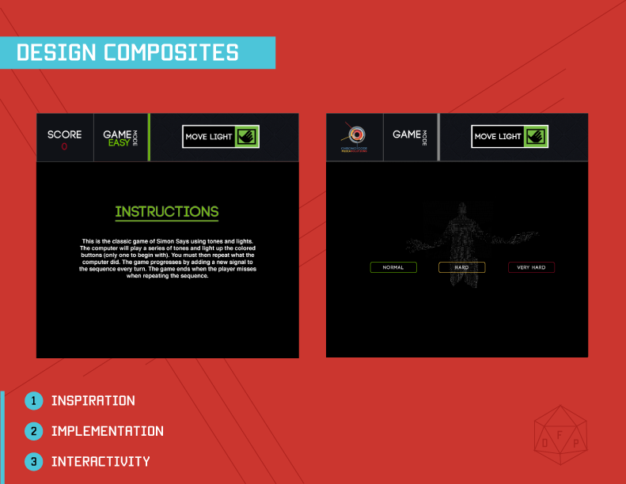

Slide 4
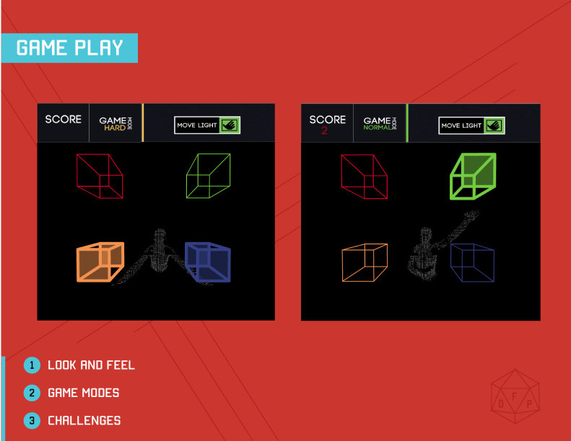

Slide 5
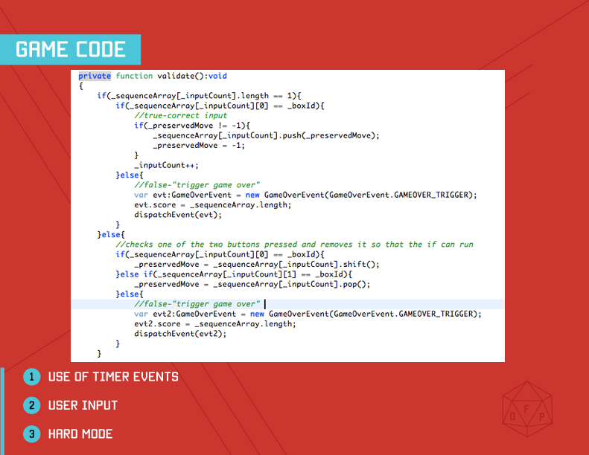
Notes:
Checked what user input versus what was stored in the sequence.
For Hard mode we had to check what two they were putting in versus what the current sequence item is and the next one is and remove it to run a normal check
When we first started, enterframe event, it wasn’t going to work, using timerclass, its used for validation and user interaction
Run through similarities between simple and hard mode

Slide 6
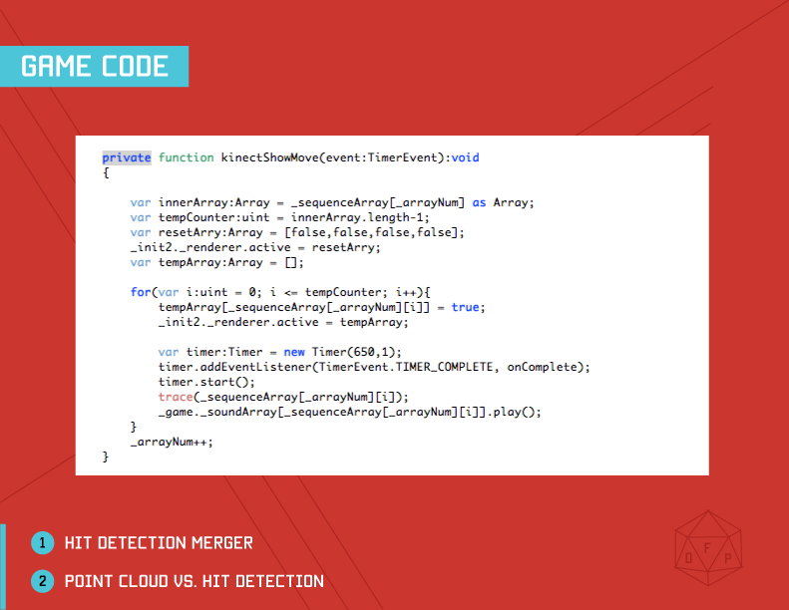
Notes:
The kinect show move runs off of timerevent
Discuss the logic of the code

Slide 7
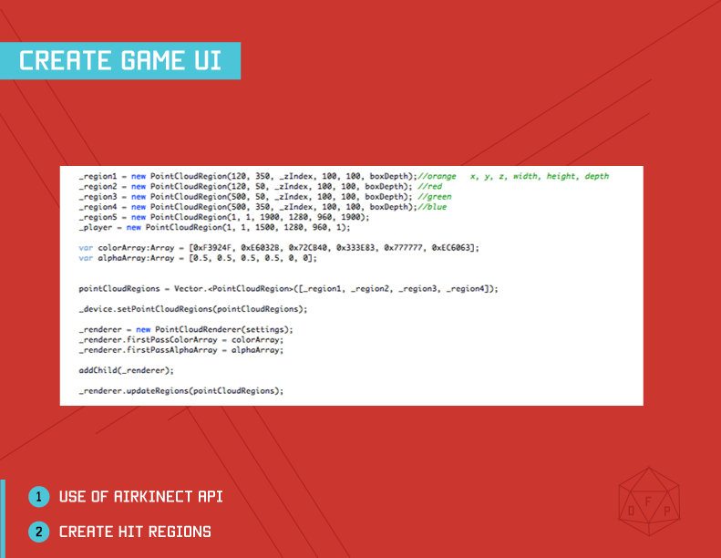

Slide 8
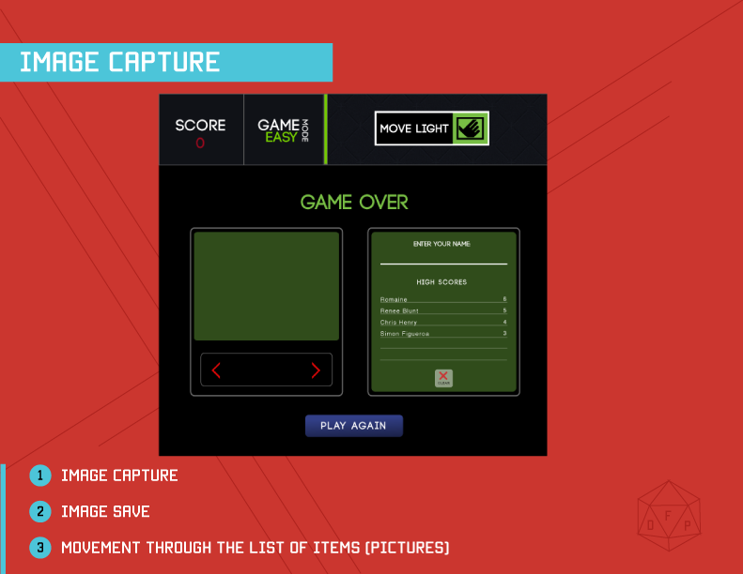

Slide 9


Slide 10
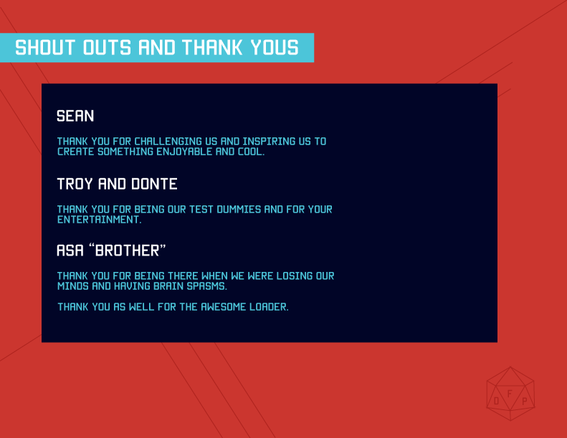

Slide 11


