Slide 1


Slide 2
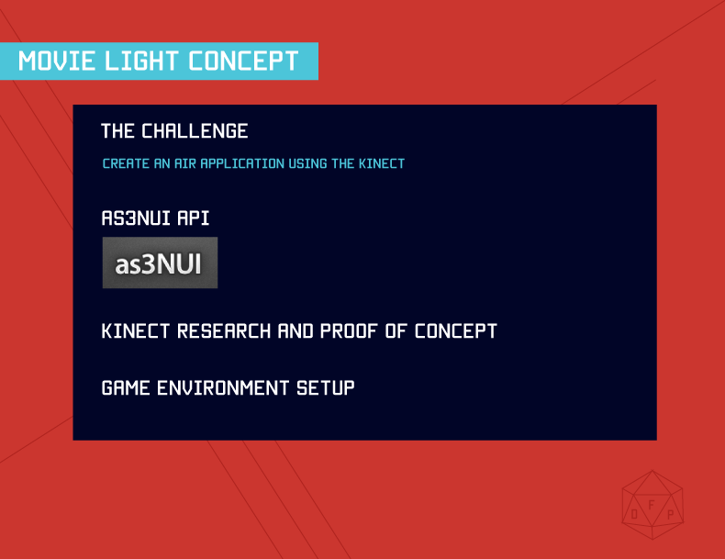

Slide 3
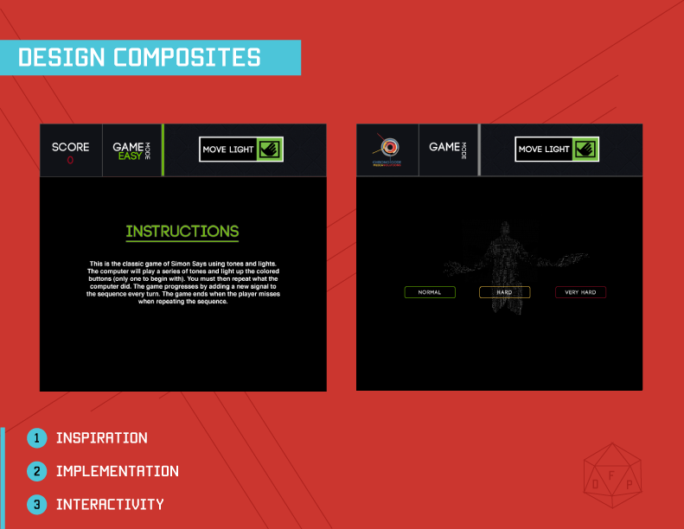

Slide 4
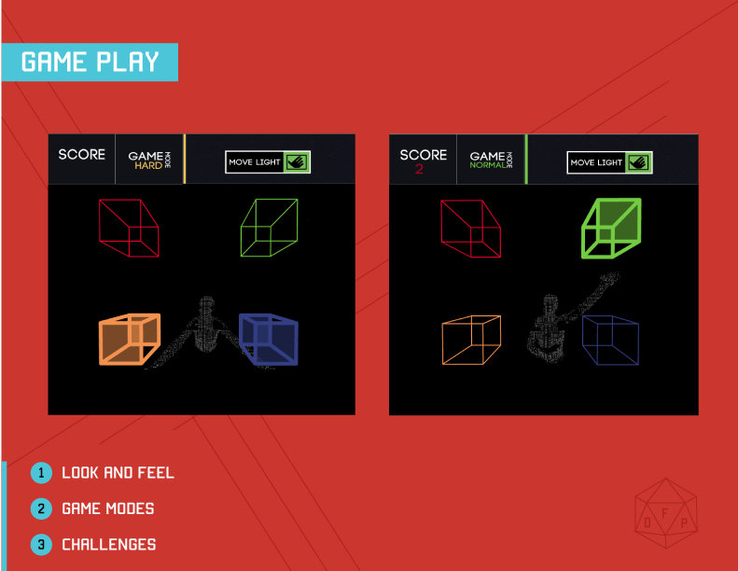

Slide 5


Slide 6
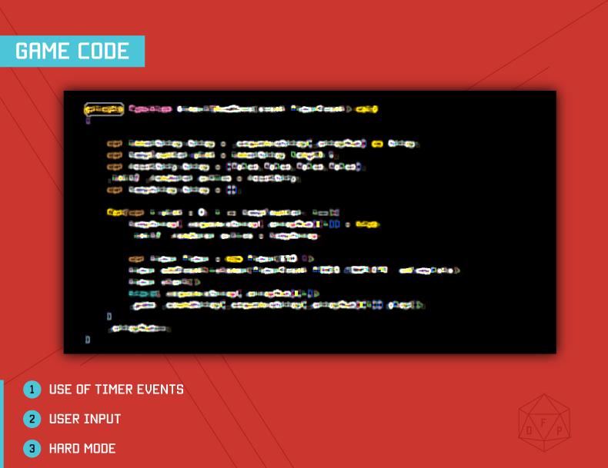
Notes:
Checked what user input versus what was stored in the sequence.
For Hard mode we had to check what two they were putting in versus what the current sequence item is and the next one is and remove it to run a normal check

Slide 7
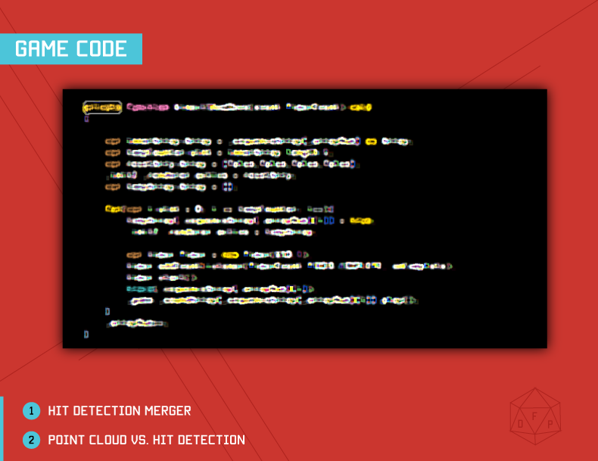

Slide 8
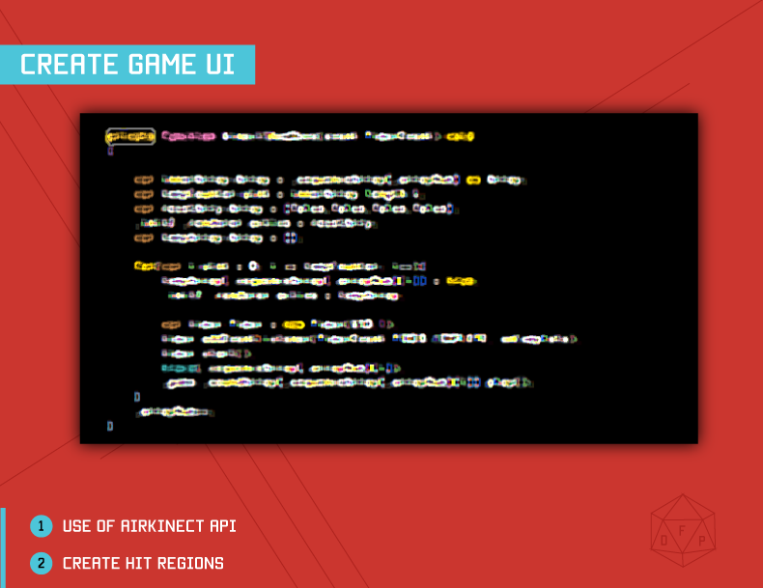

Slide 9
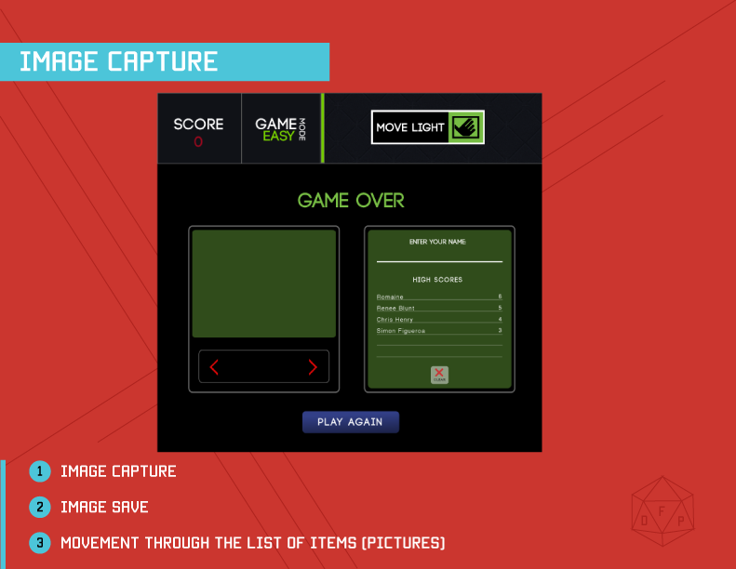

Slide 10


Slide 11
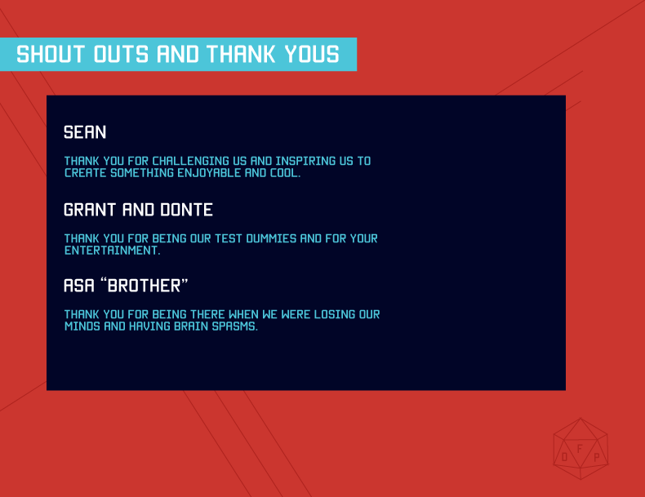

Slide 12


