Slide 1
A Just Culture in Software Development
Andrew Bach Module 9 7/15/2024

Slide 2
What is a Just Culture
A workplace culture that encourages reporting and learning to prevent errors.
Focused on assessing how an issue occurred and how we can learn from it instead of focusing on who caused the issue and how they can be punished.

Slide 3
Elements of a Just Culture
Encouraging staff to report and discuss issues and almost
Create an environment where there is no fear of retribution
Focus on behavioral choices and the reasons behind them
Remedy the error by fixing the system, not punishing the worker
All employees to deviate when appropriate
Look at the root cause of errors in a system
Encourage all involved to take responsibility/ownership
https://safetystage.com/safety-culture/just-culture-algorithm/#What_is_a_Just_Culture

Slide 4
Benefits of a Just Culture
Employees are more willing to report errors
Encourages discussion around these issues
Which leads to improvement to processes
Results in less error

Slide 5
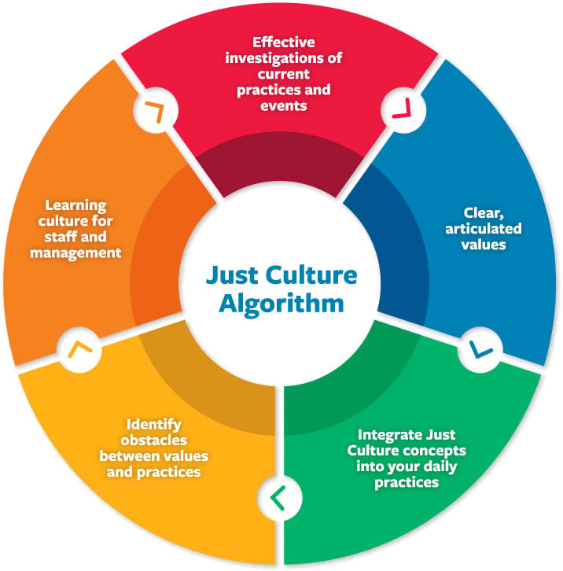
Implementing a Just Culture
Build it into organizational practices and processes
Get leadership buy-in
Don’t make Just Culture a buzz word
Focus on thinking “How would I apply a just culture to this situation.”
Encourage this line of thinking to other individuals
Review policies and ask how they work in a Just Culture
Make it standard that all policies moving forward comply with a Just culture
https://psnet.ahrq.gov/perspective/making-just-culture-reality-one-organizations-approach

Slide 6
What is the Learning Curve involved?
There are many learning opportunities that will present themselves when first implementing a Just Culture.
Lack of buy in from management
A culture of blame that needs to be overcome
Existing policies that are not just
Effort required to consider Just culture when creating new policies and processes

Slide 7
Conclusion
A Just culture enables employees to report errors with the goal of learning from and improving from the error.
Requires effort to implement
Buy in from leadership is necessary to succeed
Don’t make it a buzz word, but instead make it something you think about when dealing with problems.
Can be difficult to learn depending on the existing culture and managers.

Slide 8
References
https://safetystage.com/safety-culture/just-culture-algorithm/
https://psnet.ahrq.gov/perspective/making-just-culture-reality-one-organizations-approach

