Slide 1
Network-Simulation

Slide 2
Exp:1
Installation of NS2
Introduction (What is simulation, what are the file formats of NS2 (c++, tcl, nam, tr, awk)
Executing simple program to create a wired network program (TCL)
Adding UDP protocol and CBR traffic for packet transmission.
TCP protocol and FTP traffic
Nam file viewing

Slide 3
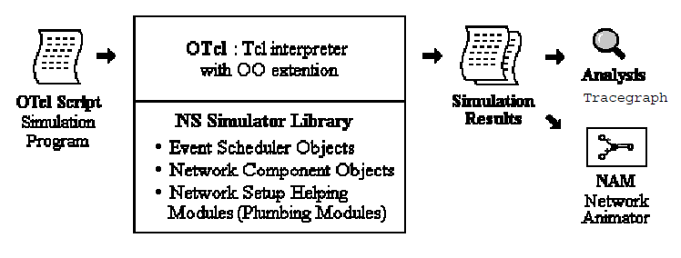

Slide 4
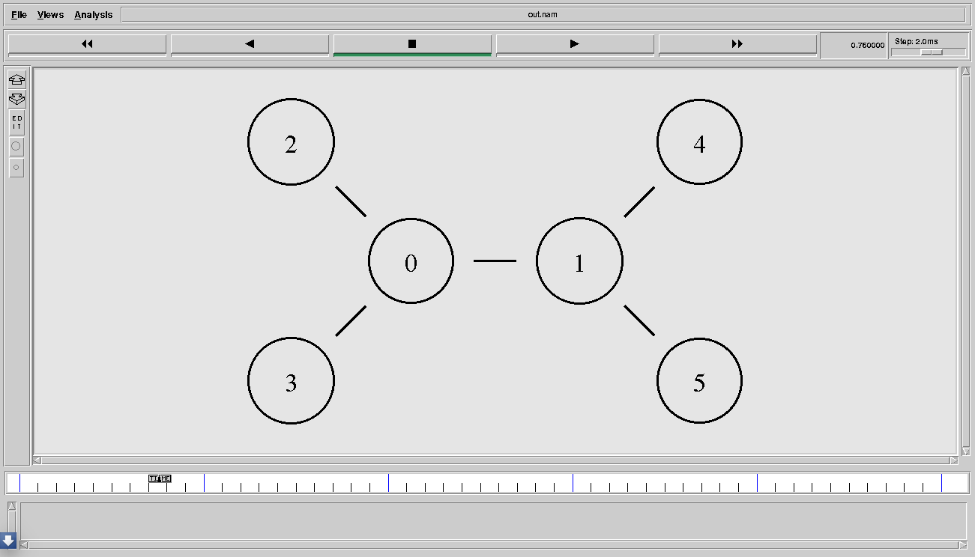
Source N3 (UDP 0)→destination N5(null 0) #CBR packets transform [fid=0]
Source N2 (TCP 0)→destination N4 (tcp sink 0) #ftp packets transform [fid=0]

Slide 5

Tr file format

Slide 6
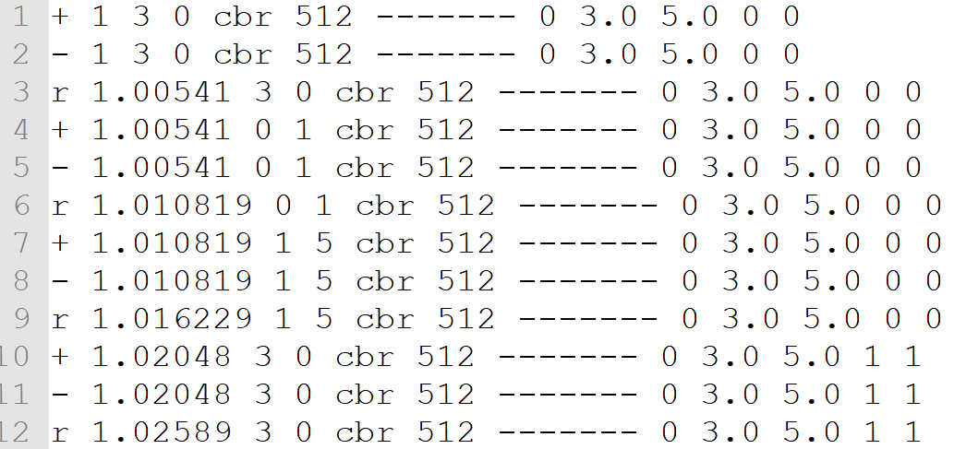

Slide 7
awk
AWK is a programming language designed for text processing and typically used as a data extraction and reporting tool.
According to The GNU Awk Users Guide it stands for Aho Weinberger And Kernighan

Slide 8
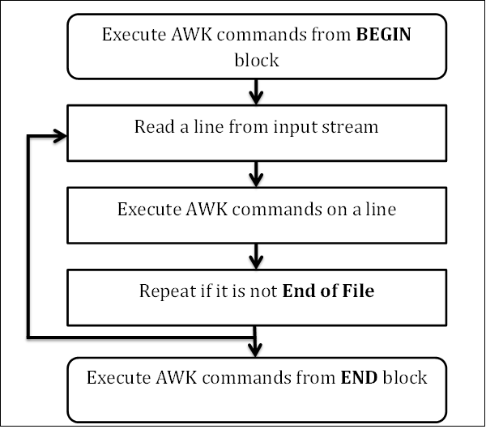
BEGIN {}
{ }
END { }

Slide 9
BEGIN {cbr_send = 0;
cbr_recv = 0;
tcp_send = 0;
tcp_recv = 0; }
{
if($1=="+"&&$3==3&&$4==0&&$5=="cbr") { cbr_send++; }
if($1=="r"&&$3==1&&$4==5&&$5=="cbr") { cbr_recv++; }
if($1=="+"&&$3==2&&$4==0&&$5=="tcp") { tcp_send++; }
if($1=="r"&&$3==1&&$4==4&&$5=="tcp") { tcp_recv++; }
}

Slide 10
END {
print "No of CBR packets send\t\t:" cbr_send
print "No of CBR packets received\t:" cbr_recv
print "Packet Delivery ratio\t\t:" (cbr_recv/cbr_send*100)
print "\n\n\nNo of TCP packets send\t\t:" tcp_send
print "No of TCP packets received\t:" tcp_recv
print "Packet Delivery Ratio\t\t:" (tcp_recv/tcp_send*100)
}

Slide 11
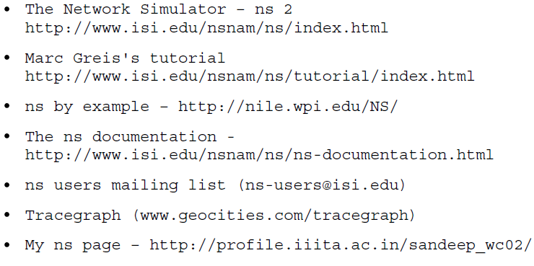

Slide 12
gedit exp1.tcl #for writing the program
ns exp1.tcl #two files created (tr and nam file)
nam exp1.nam #for viewing network flow (GUI window)
gedit exp1.awk #for writing awk script for analyzing tr file)
awk –f exp1.awk exp1.tr

Slide 13
Exp:2
Write a program for a simple network according to the following figures, n₀ node connected to n₄ by TCP and n₁ node connected to n₅ by UDP.

