Slide 1
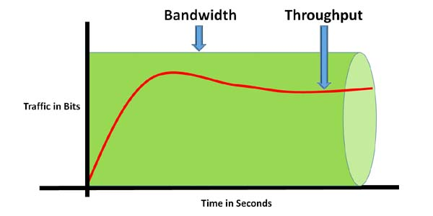
Bandwidth and Through

Slide 2
Bandwidth is defined as the maximum number of bits that can flow through a network connection in a given period of time. The fundamental unit of network bandwidth is bits per second (bps).
Throughput is defined as the actual number of bits that flows through a network connection in a given period of time. Throughput is always less than or equal to bandwidth but can never exceed bandwidth.
0 or 1 = 1 bit
8 bit = 1 Byte
1024 Byte = 1 KB
1024 KB = 1 MB
1024 MB = 1 GB
1024 GB = 1 TB
In NS2 wired network trace file 6filed (PKT SIZE) is in Bytes

Slide 3
BEGIN {
cbr_recv_bytes = 0;
tcp_recv_bytes = 0;
}
{
if($1=="r"&&$3==1&&$4==5&&$5=="cbr")
{ cbr_recv_bytes += $6; } if($1=="r"&&$3==1&&$4==4&&$5=="tcp")
{ tcp_recv_bytes += $6; }
}
END {
print "Throughput " (cbr_recv_bytes*8/4)
print "Throughput " (tcp_recv_bytes*8/3)
}
In tcl script:
$ns at 1.0 "$cbr0 start“
$ns at 5.0 "$cbr0 stop“
$ns at 2.0 "$ftp0 start“
$ns at 5.0 "$ftp0 stop"

Slide 4
Wireless simulations in ns2
Wireless Nodes
A mobile node consists of network components:
Link Layer (LL)
Interface Queue (IfQ)
the MAC layer
the PHY layer: the wireless channel that the node transmit and receive signals from

Slide 5
Wireless simulations in ns2
At the beginning of a wireless simulation, we need to define the type for each of these network components.
Additionally, we need to define other parameters like:
the type of antenna
the radio-propagation model
the type of ad-hoc routing protocol used by mobilenodes etc.

Slide 6
Wireless simulations in ns2
Configuring a Wireless Node
Creating wireless nodes is also achieved using the ns_ node command:
However:
BEFORE creating a wireless node you MUST first select (configure) the node configuration parameters to "become" a wireless node.
set ns_ [new Simulator] ;# Create a NS simulator object set n1 [ns_ node] ;# Create a WIRELESS node !!!

Slide 7
set ns_ [new Simulator] ;# Create a NS simulator object $ns_ node-config \ -llType LL -ifqType "Queue/DropTail/PriQueue" -ifqLen 50 -macType Mac/802_11 -phyType "Phy/WirelessPhy" -addressingType flat or hierarchical or expanded -adhocRouting DSDV or DSR or TORA -propType "Propagation/TwoRayGround" -antType "Antenna/OmniAntenna" -channelType "Channel/WirelessChannel" -topoInstance $topo -energyModel "EnergyModel" -initialEnergy (in Joules) -rxPower (in W) -txPower (in W) -agentTrace ON or OFF -routerTrace ON or OFF -macTrace ON or OFF -movementTrace ON or OFF
The NS2 command to select (configure) node configuration parameters is node-config and it is used as follows:

Slide 8
The topology is a Topography object that you must create.
Example:
set topo [new Topography] ;# Create a Topography object $topo load_flatgrid 500 500 ;# Make a 500x500 grid topology

Slide 9
The connectivity of wireless nodes is determined by their distance from one another.
Because wireless nodes can MOVE, their distances from one another change over time
To keep track of their positions in the topology grid, we need to create a General Operations Director (GOD) object.
Example : create-god $val(nn) ( before creating wireless nodes)

Slide 10
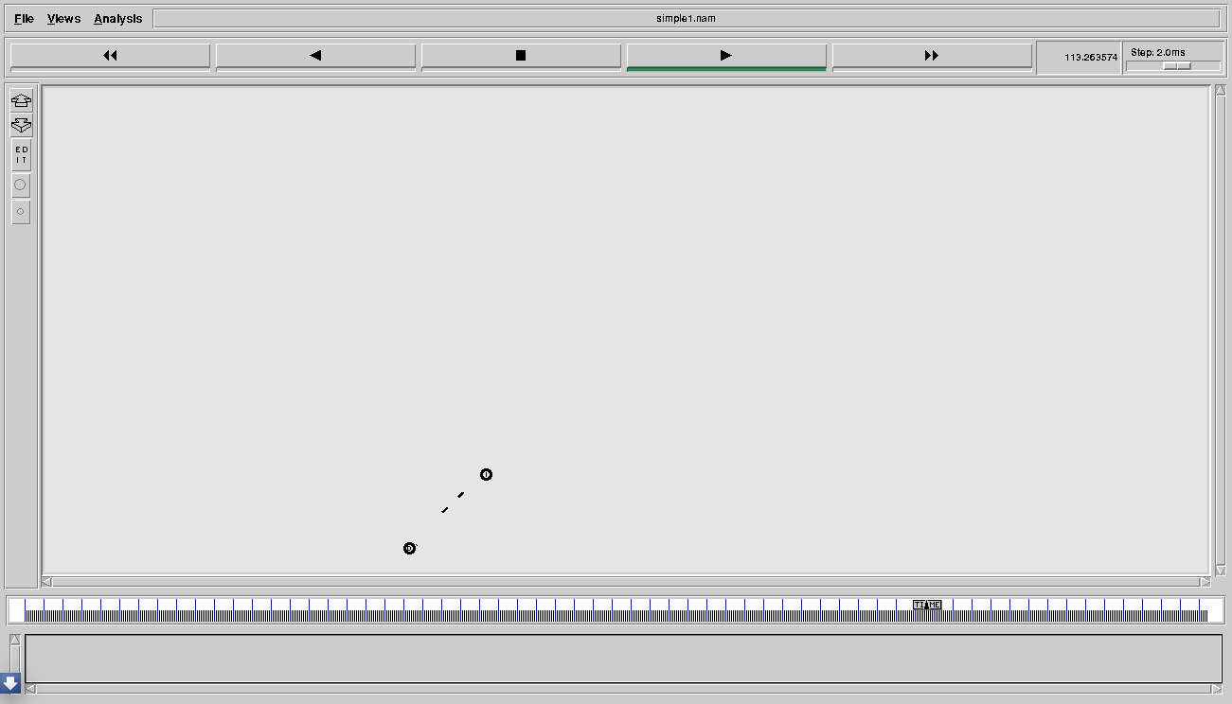
Wireless simulations in ns2

Slide 11
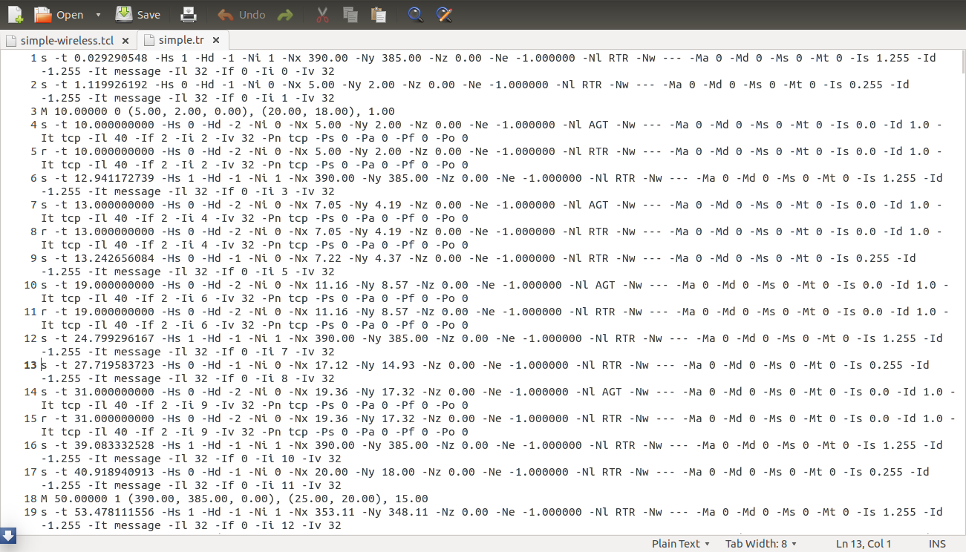

Slide 12
TO CHECK NEW TRACE FILE FORMAT FOR WIRELESS
https://www.isi.edu/nsnam/ns/doc/node186.html

Slide 13
Today Assignments
1. Create a 10 node wireless scenario. The nodes boundary area is set to be 500 * 500m. ( Use TCP connection on each link between any two nodes).
Use the following parameters :
Addressing type - Flat
Routing protocol - AODV, DSDV and DSR. ( Use seperate tcl file to run each one of them).
Mac Layer - 802.11
Propagation model - Two way ground
Antenna type - OmniAntenna
Note: Static nodes are to be taken in this question.

Slide 14
Today Assignments
2. Repeat the experiment 1 by taking mobile nodes
3. Compare the performance of three protocols ( AODV, DSDV and DSR) using three performance metrics - Packet delivery ratio, throughput and end to end delay.
End to End Delay: Packet receive time- Packet send time.

