Slide 1
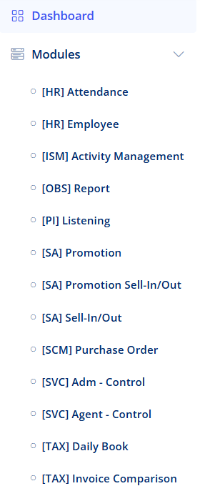
Daily Book Module
Daily Book Module
1. Select this area in Llamasys to open daily book module, which will be explained in the following pages.
1

Slide 2
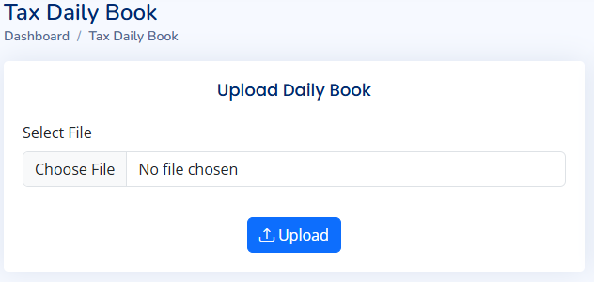
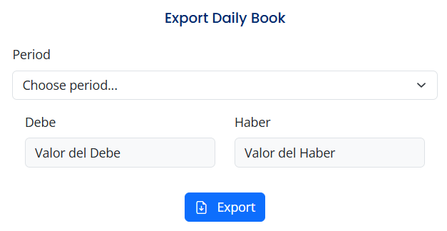
Daily Book Module
Upload Book Module
Choose daily book raw data.
Upload data to the system.
1
2
Export Daily Book
Choose period of the year.
Negative accumulated value of net accounted debit.
Positive accumulated value of net accounted debit.
Export buttom: click to download the daily book report.
1
2
3
4

Slide 3
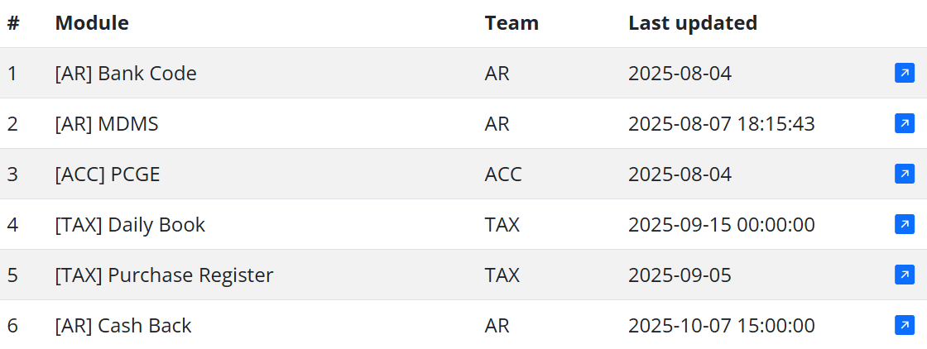
Daily Book Module
1
2
3
4
Data upload control for each module
Name of each module participating in the Daily Book process.
Name of the team responsible for sharing the updated data for each module.
Last data upload (or Last updated date) for each module.
Button to open the corresponding module in a new tab.

