Slide 1
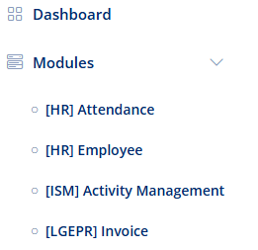
Lgepr Sovos Invoice
LGEPR Sovos Invoice
1. Select this option to open the scm sovos module.
1

Slide 2
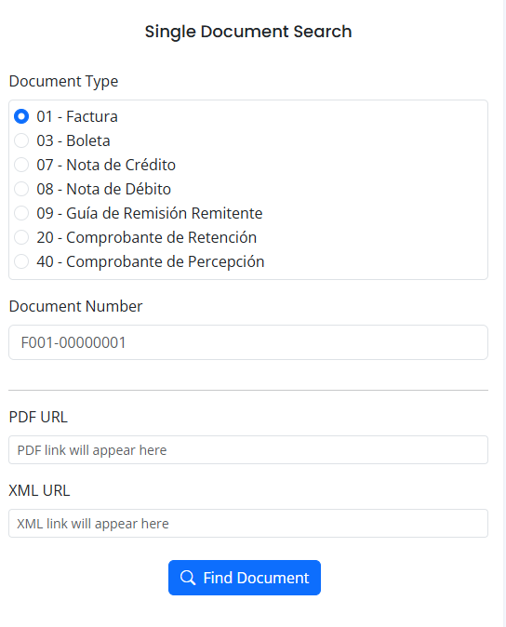
Lgepr Sovos Invoice
1
LGEPR Sovos Invoice
Individual Search Form.
Document Type Selector for SOVOS Search.
Enter the document number you need to download.
The PDF file URL is displayed.
The XML file URL is displayed.
Once the document type is selected and the number is entered, click on 'Find Document' to search for the requested file.
2
3
4

Slide 3
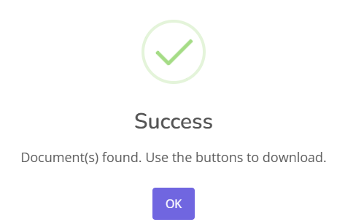
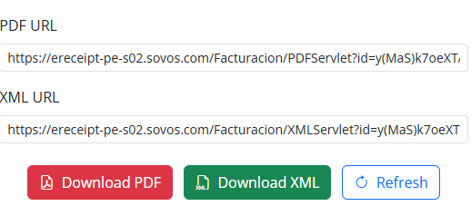
Lgepr Sovos Invoice
1
LGEPR Sovos Invoice
Success message indicating the requested documents were found.
Displays the PDF file URL.
Displays the XML file URL.
Button to open the PDF file link and download it.
Button to open the XML file link and download it.
Click button to request another document number.
2
3
4
5
6

Slide 4
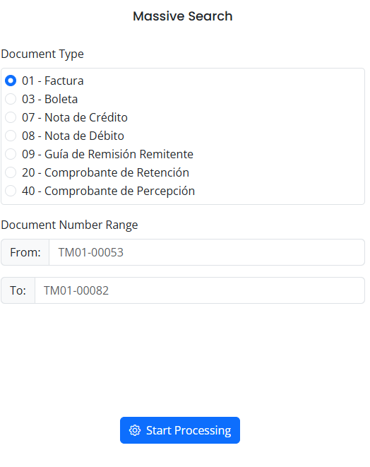
Lgepr Sovos Invoice
1
LGEPR Sovos Invoice
Massive Search Form.
The starting and ending document numbers must be entered, which will search for all numbers contained between them.
Document Type Selector for SOVOS Search.
Enter the starting document number.
Enter the ending document number.
Click the 'Start Processing' button to search for the requested document range.
2
3
4

Slide 5
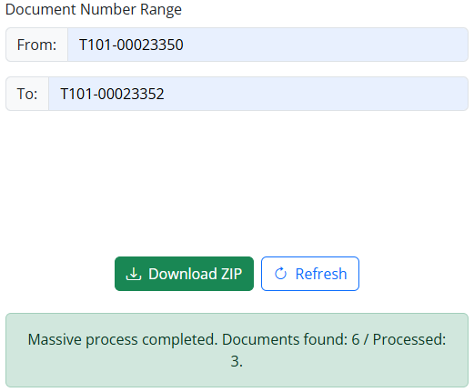
Lgepr Sovos Invoice
LGEPR Sovos Invoice
It will search for the XML and PDF files for every value within the given range.
Starting Value.
Ending Value.
Button that will download a zip file, which will contain all the corresponding PDF and XML files.
Click button to request another document number range.
Displays a message indicating the number of files found and the number of processed entries.
1
2
3
4
5

