Slide 1
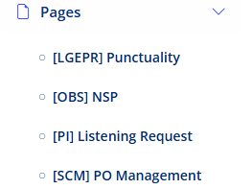
PO Management – Pages
Po Register
Select this section to open PO Management module.
1

Slide 2
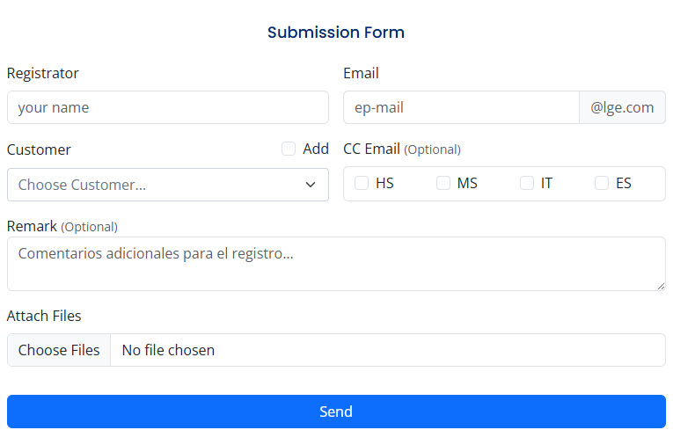
PO Management – Pages
Submission Form:
Registrant's name (KAM)
Enter registrant's email (KAM)
Select the customer associated with the PO..
Option to add new clients if they are not found in the list.
If the DP needs to be put in copy (CC'd), you can check the boxes you deem necessary.
You can enter any observations.
Attach the files.
Register the PO and send email.
1
2
4
3
5
6
7
8

Slide 3
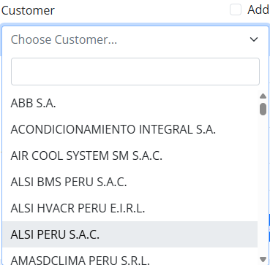
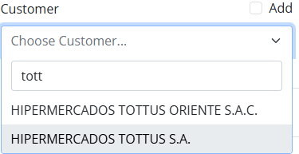

PO Management – Pages
3
a
a
Submission Form:
3. Select Customer
In this field, you can type the client to search for, and the total list will be filtered until the correct one is found, as shown in the second image
Complete list of all clients for PO (Purchase Order) registration
4. If the customer associated with the PO is not found in the list, you can check this box and a field will be enabled to manually enter the customer's name. Remember to report the absence of the customer so it can be included as soon as possible.
b
4

Slide 4
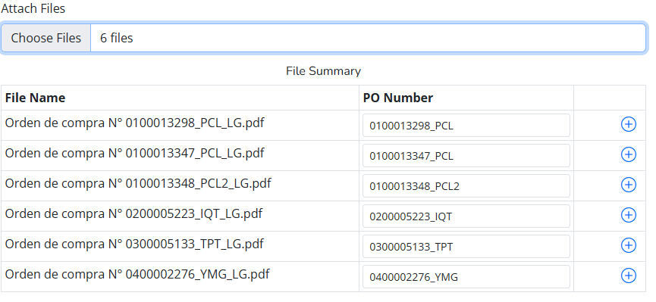
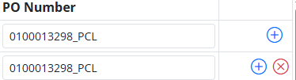
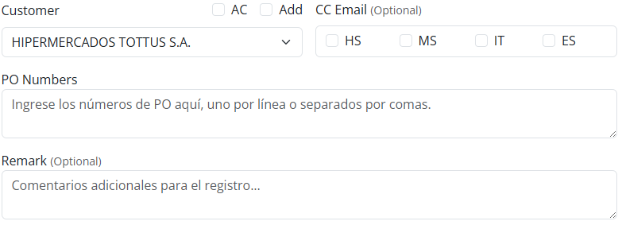
PO Management – Pages
1
2
Submission Form
Deployment of Extracted POs.
You can select multiple files.
A table will be displayed showing the name of each file and the PO number that was extracted in the second column.
Each extracted number is editable in case the automatic extraction was not accurate.
Button ("+") to add new lines if there are multiple POs in one file, and the button ("-") to delete new lines.
For the customers: Saga Falabella, Tottus, and Tiendas del Mejoramiento del Hogar (Sodimac). Manual entry of POs is allowed without the need to attach files. In this case, a box will be displayed where you can enter the POs separated by commas, and another box where you can write your observations..
3
4
5

Slide 5

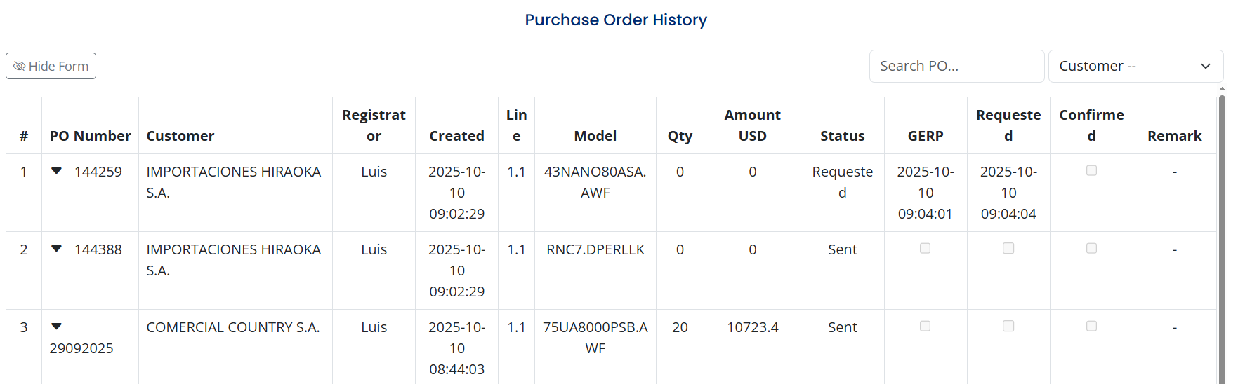
PO Management – Pages
1
Purchase history
We can view all records for each PO.
Filters to search by PO or to select a specific customer.
Table showing the registered POs along with the other data.
2
1

Slide 6
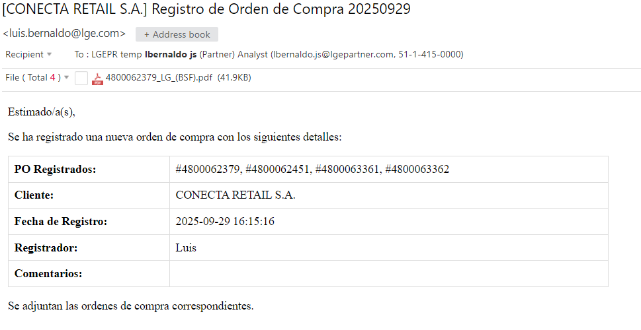
PO Management – Pages
Email
Example of email format to be sent once the PO registration is complete.

