Slide 1
lecture 1

Slide 2
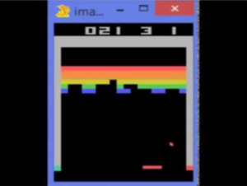
lecture 1
optimization
delayed consequences
Out of relative decisions → yield the decision with the best outcome
No immediate outcome feedback
Induces credit assignment problem
exploration
generalization
“Agent as a scientist”
Reward predictable only for what the system has experienced ( = outcomes based on previous decisions)
Too much representations without generalization → require too much computing power
Use a higher level representation of given task
Vs. exploitation

Slide 3

lecture 1
Markov assumption
Only require current state
For predicting the future
Independent of the past
Although may use aggregate statistics (may be record of history : previous state, actions, rewards)
Think of other Markov systems:
Knowledge of current blood pressure to determine medication control

Slide 4
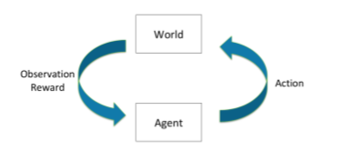
lecture 1
sequential decision making
MDP
Markov decision process
Refer to Markov assumption
Actions chosen in order to maximize total expected future reward
POMDP
Bandit
Partially observable MDP
Many unknown factors of the world that can determine the observation & reward
Actions have no influence on next observation & reward

Slide 5
lecture 1
deterministic policy
stochastic policy
state
state
action1
action2
action3
action1
action2
action3
0.4
0.4
0.4
0.4
0.4
0.3
0.4
0.3
0.3
state1
state2
state3
state1
state2
state3
100% certainty
Definite next state
Many possible outcomes with relative probabilities
Cannot be sure of next state

Slide 6
lecture 1
Value function
“expected discounted sum of future rewards under a particular policy”
Discount factor gamma weighs immediate vs future rewards

Slide 7
lecture 2

Slide 8
lecture 2
Simple definitions
Model : “Mathematical models of dynamics and reward” = expected rewards from particular action and current state
Policy : “Function mapping agent’s states to actions”
Model : “future rewards from being in a state and/or action when following a particular policy” = expected discount sum

Slide 9

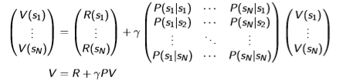

lecture 2
(S, P)
MRP
Markov chain
(S, P, R, gamma)
Markov chain + rewards
Memoryless random process(not totally) with no rewards and no actions
Markov reward process
No actions
Value function = expected return
Markov chain + rewards + actions
Simulation
Analytic
Iterative
(S, P, R, gamma, A)
MDP
Markov decision process
MRP + actions
MDP + policy

Slide 10
lecture 2
Within MDP…
There exists a unique optimal value function
=
Optimal policy in infinite horizon problem is deterministic

Slide 11


lecture 2
Policy Iteration
Q-function
Policy improvement
Note:
Different to gradient based approaches – no problem with local minimum vs. global minimum / maximum

Slide 12
lecture 2
Policy Iteration
Policy improvement
Pi_i+1 only for the first action, and then follow pi_i
Instead follow pi_i+1 onwards and it still monotonically improves

Slide 13
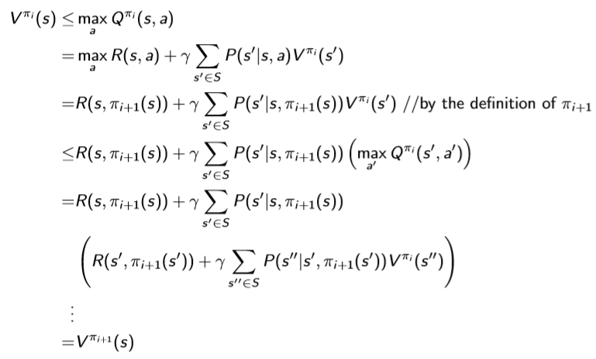
lecture 2
Policy Iteration
Monotonic improvement in policy value
Q. How many iterations should be required?
Or
Q. How many iterations with improvement can there be?
Pi_i+1 only for the first action, and then follow pi_i
Instead follow pi_i+1 onwards and it still monotonically improves

Slide 14
lecture 2
Value iteration
“ Idea : maintain optimal value of starting in a state s if have a finite number of steps k left in the episode.”
= assuming finite horizon?
“ value iteration update is equal to policy evaluation update “
“ value iteration update is equal to Bellman optimality equation into an update rule “
Sutton, 82-83
“ value iteration combines one sweep of policy evaluation and one sweep of policy improvement “

Slide 15

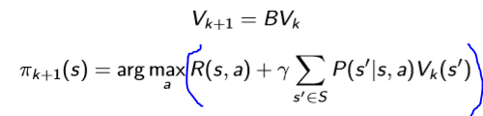

lecture 2
Value iteration
Bellman backup operator
BV yields a new value function
Direction of understanding
Direction of application
Value iteration
Until V stops changing vs. no significant difference

Slide 16
lecture 2
Policy iteration vs. Value iteration
“ value iteration update is equal to policy evaluation update “
Generally same thing
But policy iteration is focused on updating the policy (given that value monotonically improves)
And value iteration is focused on improving the value (utilizing a method that is same as updating and using the improved policy)

Slide 17
앞으로…
날짜 시간: 금 1400 ZOOM
어떻게 공부 할 것인가: 강의 2개 일단 다음부턴 무조건 3개씩
광훈 : 백준 100개 마스터 7월 31일까지
힘들면 편하게 얘기하기
frozen lake 7월 31일까지
목표… 완강 assignment 따라하기

