Slide 1
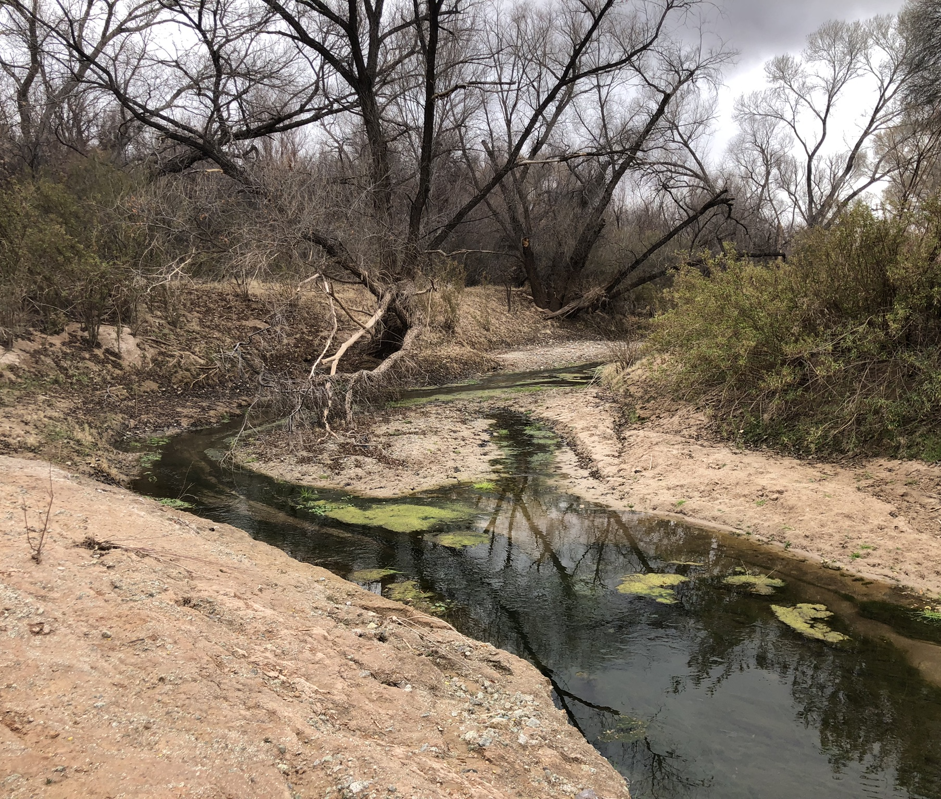
What we did
Calculated spatial correlations and composite anomaly plots of wet/dry percentage of
SRPNCA
Full length
Tributaries
with various gridded climate products to look at the spatial signature of climate signature.
We did this for the year of, and year prior seasons of atmospheric pressure, sea surface temperatures, precipitation, temperature, soil moisture.

Slide 2
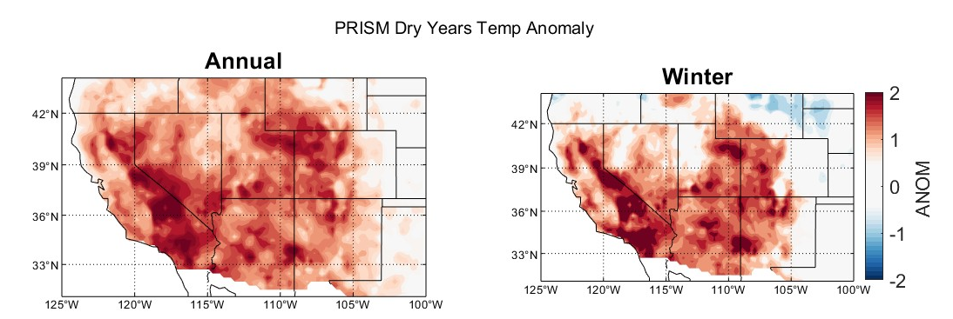
What we found
SPRNCA/Full Length
°C
Temperature has a big influence on full wetted length
Negative correlations with prior winter and fall temperatures
Pacific Ocean/Atmosphere plays a role in moisture delivery in winter and spring
Tributaries have a positive relationship Pacific SSTs (El Niño= more water)
Tributaries have a stronger climate signal (less influence from pumping/local geology?)

Slide 3
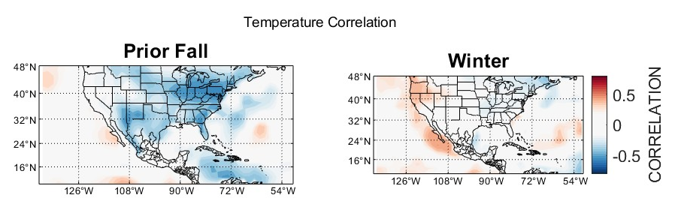
What we found
SPRNCA/Full Length
Temperature has a big influence on full wetted length
Negative correlations with prior winter and fall temperatures
Pacific Ocean/Atmosphere plays a role in moisture delivery in winter and spring
Tributaries have a positive relationship Pacific SSTs (El Niño= more water)
Tributaries have a stronger climate signal (less influence from pumping/local geology?)

Slide 4
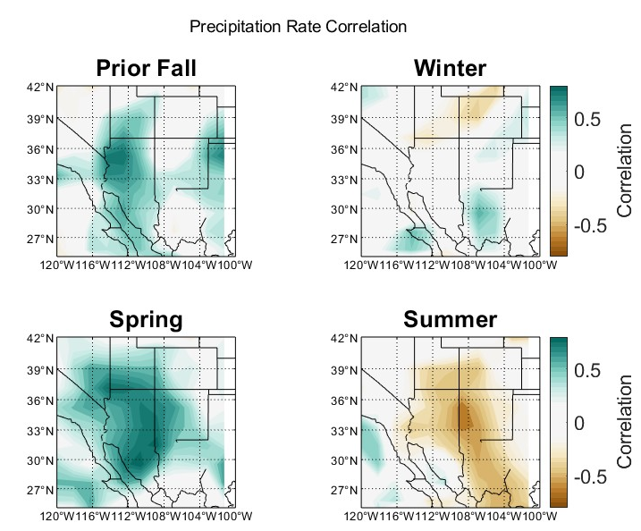
What we found
TRIBUTARIES
Temperature has a big influence on full wetted length
Negative correlations with prior winter and fall temperatures
Pacific Ocean/Atmosphere plays a role in moisture delivery in winter and spring
Tributaries have a positive relationship Pacific SSTs (El Niño= more water)
Tributaries have a stronger climate signal (less influence from pumping/local geology?)

Slide 5
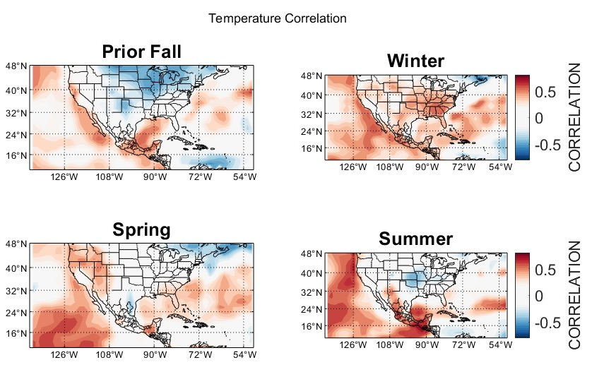
What we found
TRIBUTARIES
Temperature has a big influence on full wetted length
Negative correlations with prior winter and fall temperatures
Pacific Ocean/Atmosphere plays a role in moisture delivery in winter and spring
Tributaries have a positive relationship Pacific SSTs (El Niño= more water)
Tributaries have a stronger climate signal (less influence from pumping/local geology?)

Slide 6
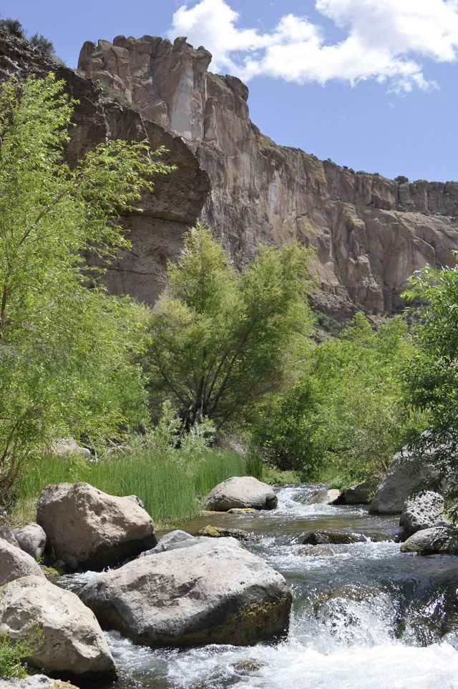
What we want to do
Is the presence of surface water in the channel a reliable proxy for alluvial groundwater elevations? (Turner and Gungle)
how does this relationship change with changes to underlying bedrock?
Spatial patterns of wetted river length, what more can they tell us? quantitative wetted length/fragmentation metric with the three riparian health condition classes ?
how do these spatial patterns of water presence play out for native fish presence/absence and/or abundance?
Has climate change impacted mountain front recharge rates for a major undeveloped Huachuca tributary, like Ramsey Canyon (USGS gauge is located on the preserve)?
we would need long data sets to get a good idea of what natural variability in recharge rate is without climate change before we can lead to attribution studies

