Slide 1


Embedded Intelligence at the Edge
Dr.Pratibha Kantanavar

Slide 2
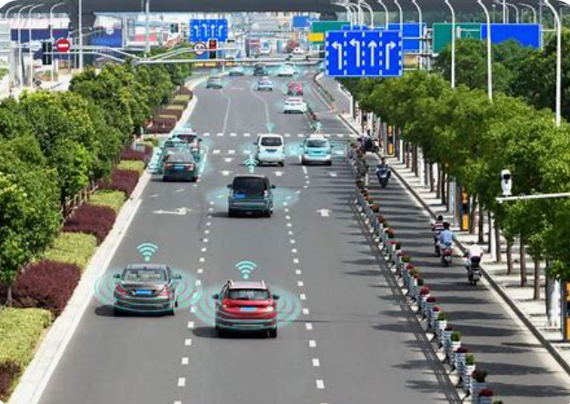
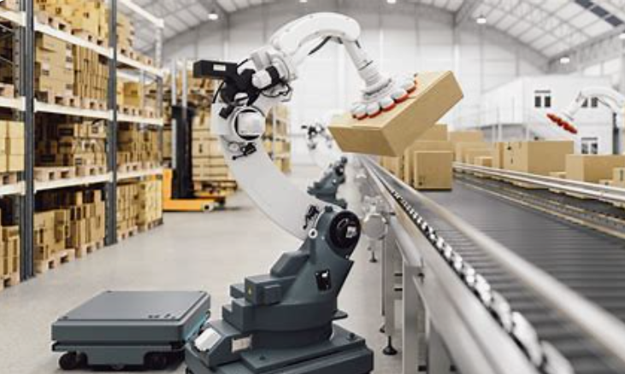
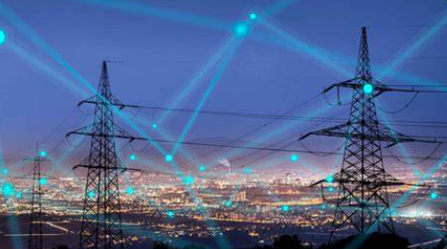
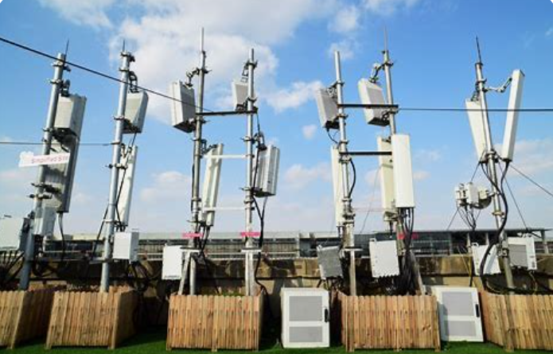
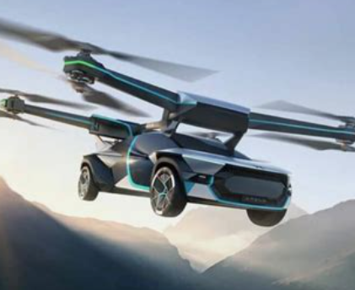
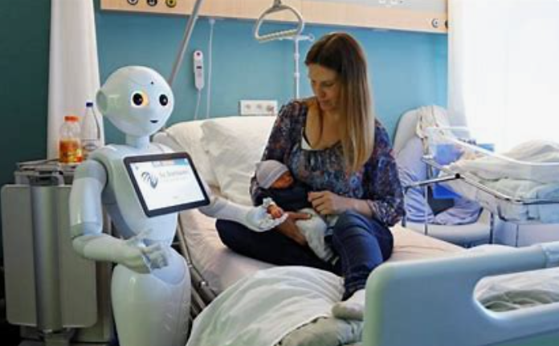
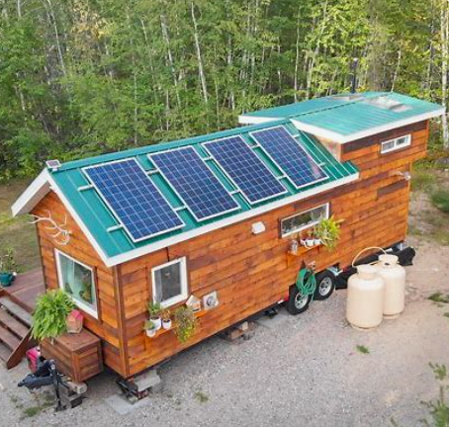
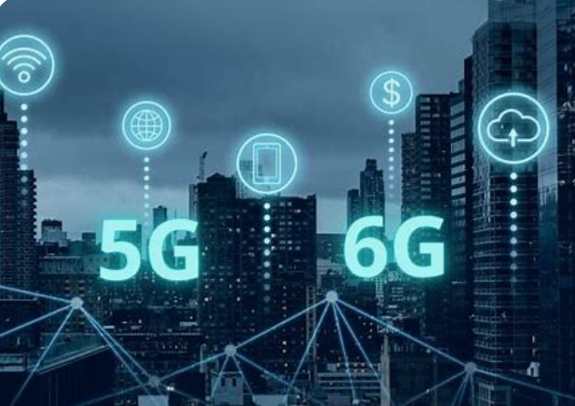
"The future of embedded systems lies in their increasing integration with AI and IoT, transforming everything from healthcare to transportation, with the promise of smarter, more efficient, and more connected devices that will reshape industries and everyday life."

Slide 3
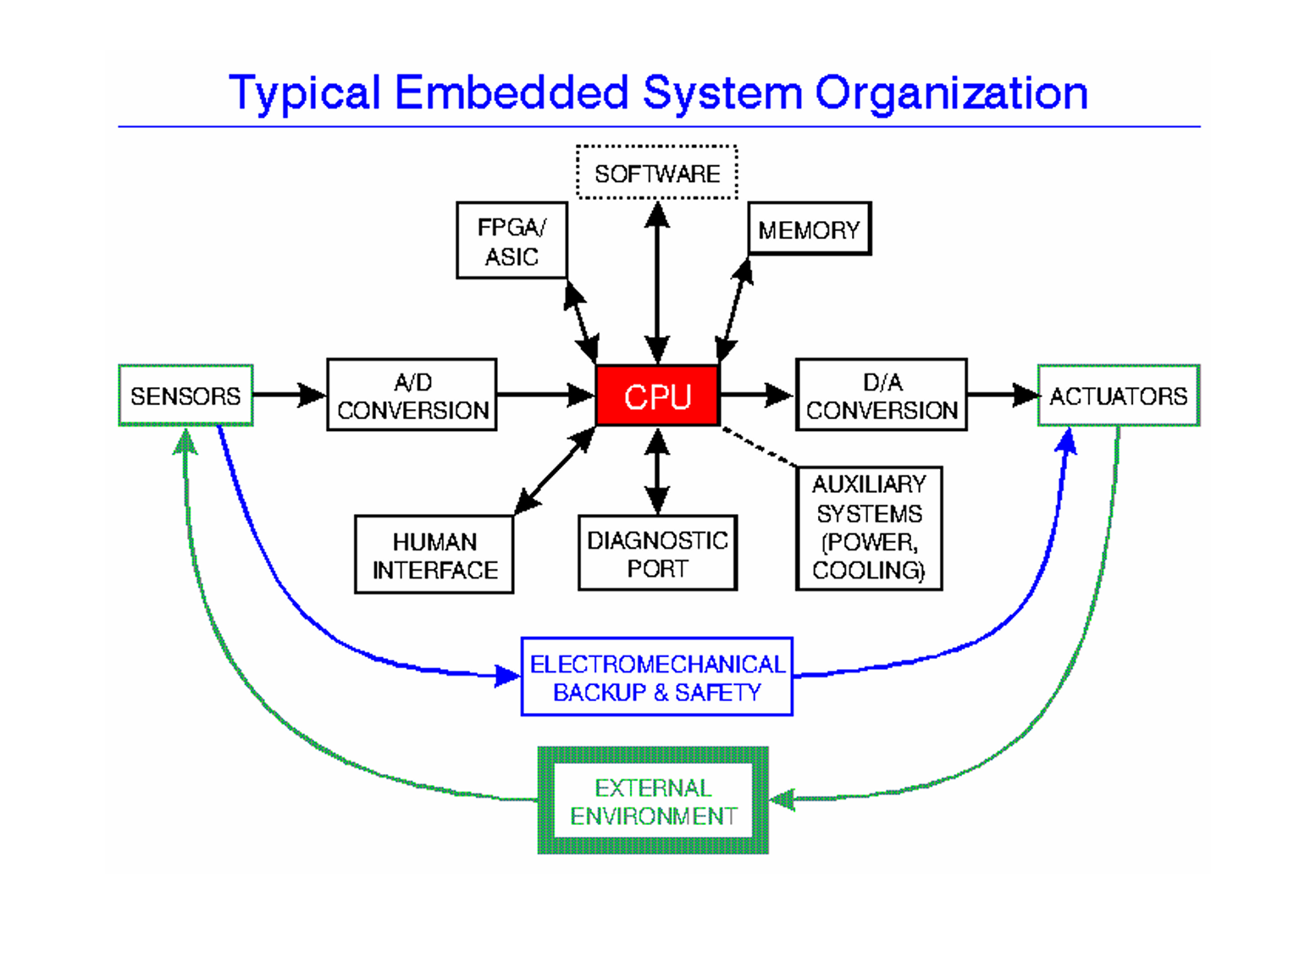

Slide 4
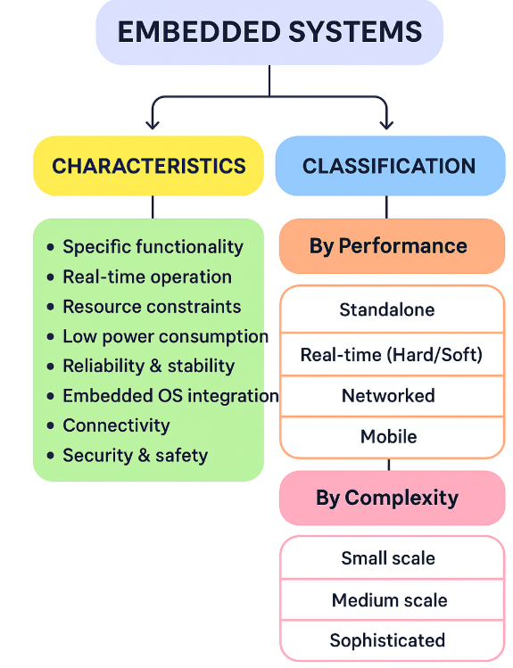
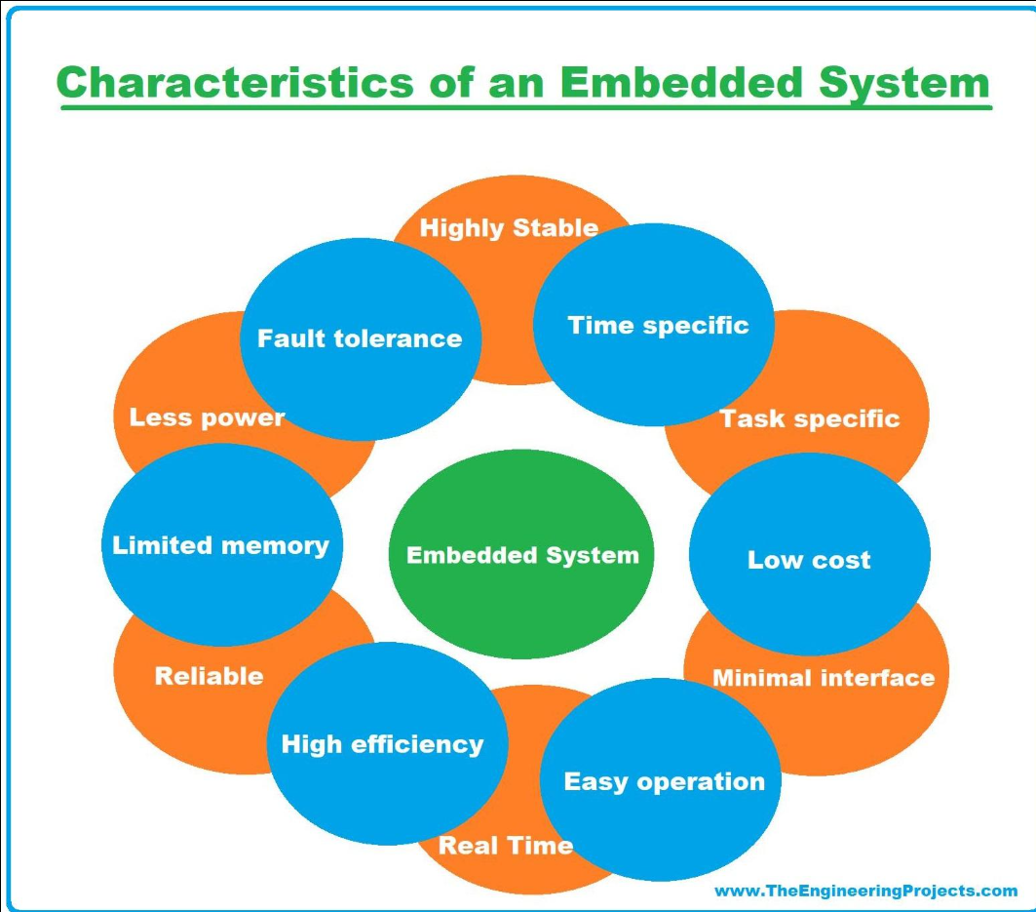

Slide 5
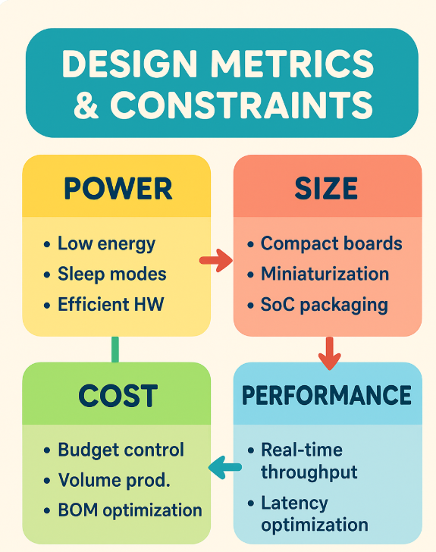
Metric | Technical Description | Key Considerations
1. Power | Measures energy consumption in active, idle, and sleep modes. Vital for battery-powered and IoT devices. | Power budgeting, dynamic power management (DPM), use of low-power ICs, efficient clock gating.
2. Size | Physical footprint of the hardware (PCB area, SoC package size). Smaller size improves portability and integration. | PCB layout, system-on-chip (SoC) integration, MEMS, and packaging technologies.
3. Cost | Total system cost including hardware, software, and production. Critical in consumer electronics and large-volume markets. | Trade-off between performance and affordability; economies of scale; use of off-the-shelf components.
4. Performance | Ability to meet throughput, latency, and real-time deadlines efficiently. | Choice of microcontroller architecture, optimized code, pipelining, hardware accelerators, cache tuning.

Slide 6
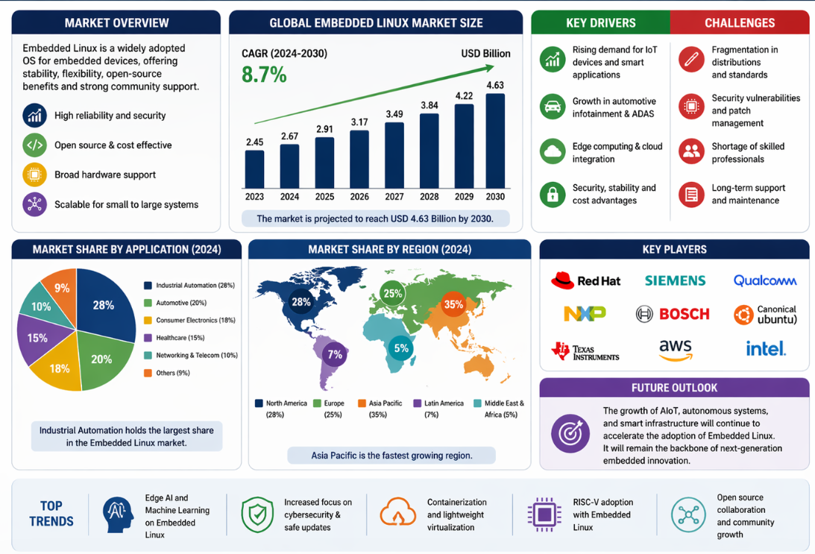
Embedded Linux

Slide 7
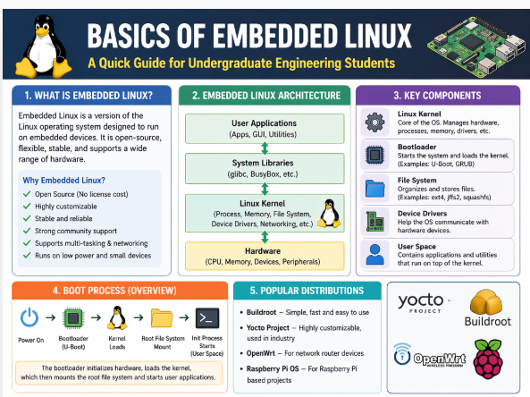

Slide 8
Component | Technical Description | Examples
Bootloader | Initializes hardware, loads the kernel into memory during system startup. | U-Boot, Barebox
Linux Kernel | Core of the OS, managing processes, memory, I/O, and drivers; often customized and cross-compiled for target hardware. | Linux Kernel (mainline or vendor-specific)
Root Filesystem (RootFS) | Contains user-space utilities, libraries, and applications. | BusyBox, Buildroot, Yocto-based rootfs
Device Drivers | Interfaces between hardware peripherals and the OS for communication and control. | GPIO, UART, SPI, I2C drivers
Libraries & Middleware | Provides APIs for application development. | glibc, uClibc, musl
Application Layer | User-developed applications specific to the embedded product. | Industrial control apps, IoT data processing apps

Slide 9
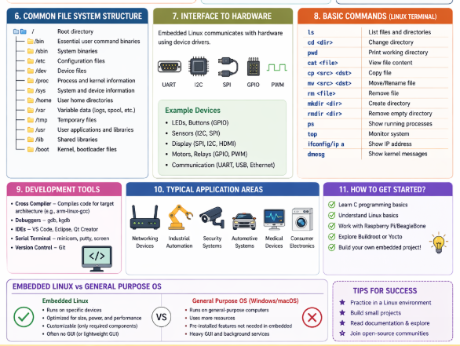

Slide 10
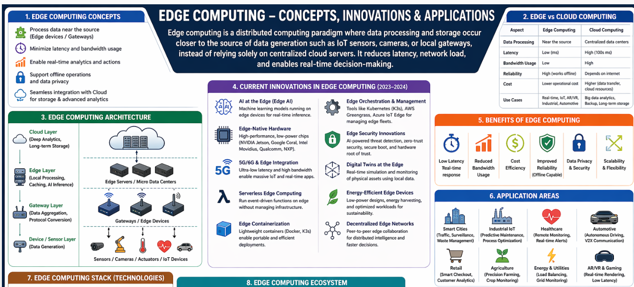



Embedded Edge Computing

Slide 11
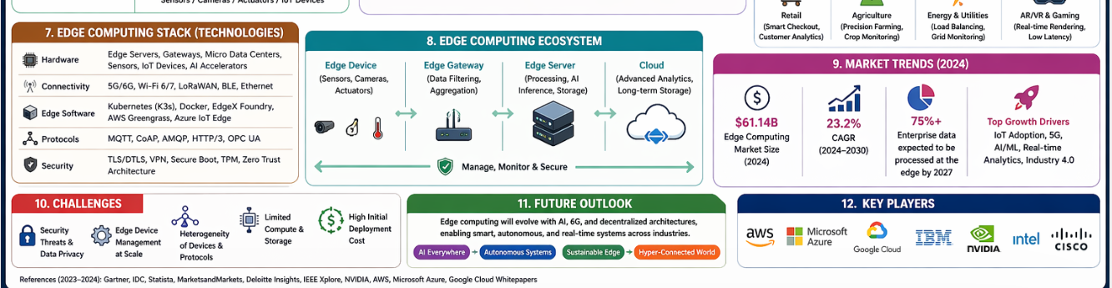






Embedded Edge Computing

Slide 12
Challenges
Challenge | Explanation
Limited Compute Resources | Edge nodes have constrained CPU, memory, and power.
Complex Management | Orchestrating thousands of distributed devices is challenging.
Security Vulnerabilities | Increased attack surface due to distributed endpoints.
Interoperability | Diverse hardware and software stacks require standardized frameworks.
Component | Description
Edge Devices | IoT sensors, embedded devices that generate raw data.
Edge Nodes/Gateways | Intermediate devices with limited compute power for local analytics and filtering.
Edge AI | AI inference engines deployed locally to make predictions in real-time.
Cloud Backend | Handles deeper analytics, storage, and model training.

Slide 13
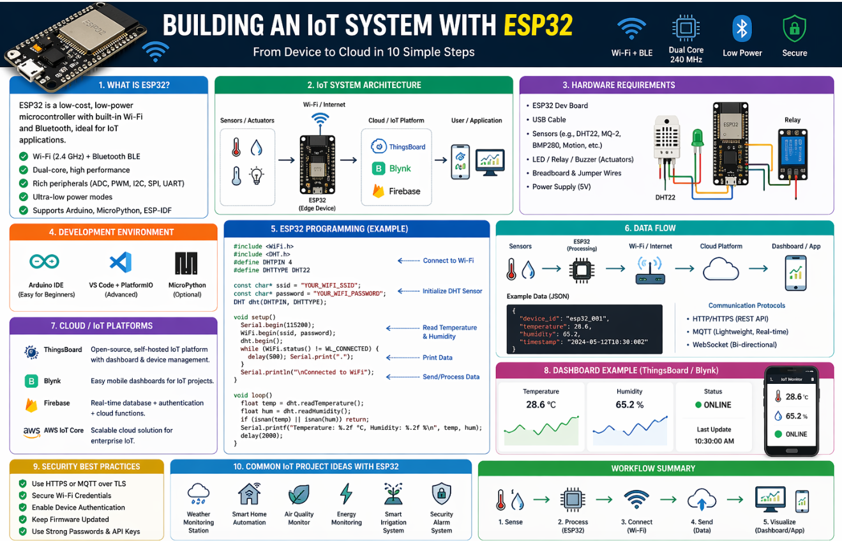

Slide 14
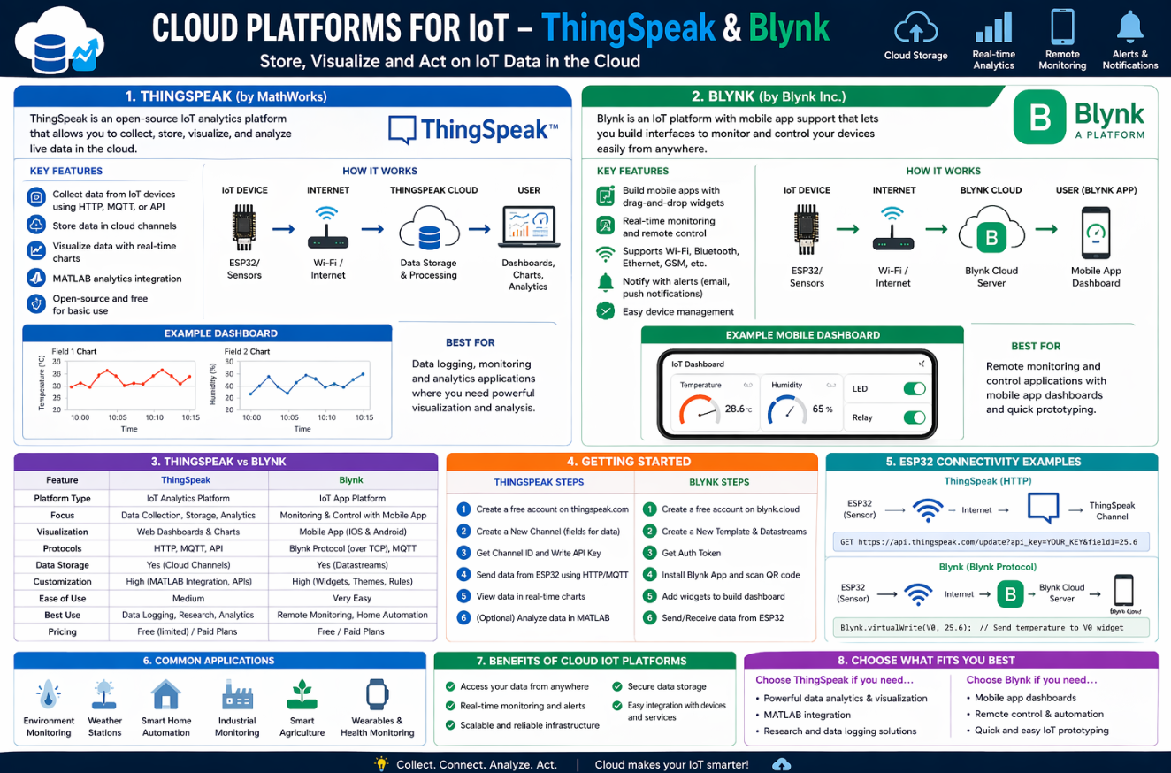

Slide 15
Questions?

