Slide 1
Movie
Recommender
IDSS- MAI
Niko Picello
Salma Waqif
Lapo Carrieri
Yasmine Souabi
Hanaa Al Zahabi

Slide 2
Briefing
Domain of application: Entertainment (Films) Industry
Problem: Suggesting movies to the user
Dataset: The dataset is a collection of movies containing various fields such as the genre, the title, runtime, the overview, and so on and so forth
GOAL: We want our program to be able to suggest to the user the movies that best fit the request from the user

Slide 3
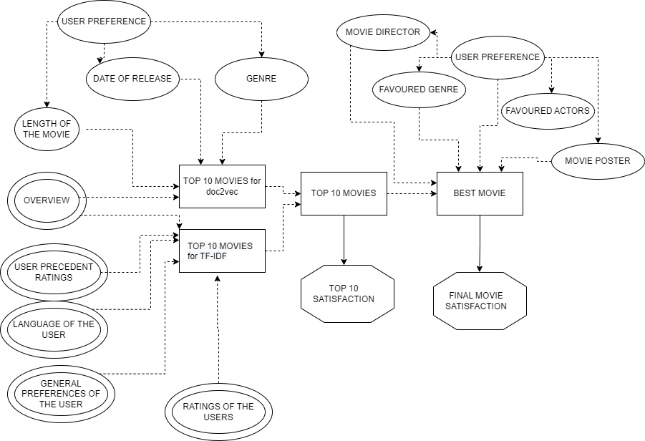
Influence Diagram

Slide 4
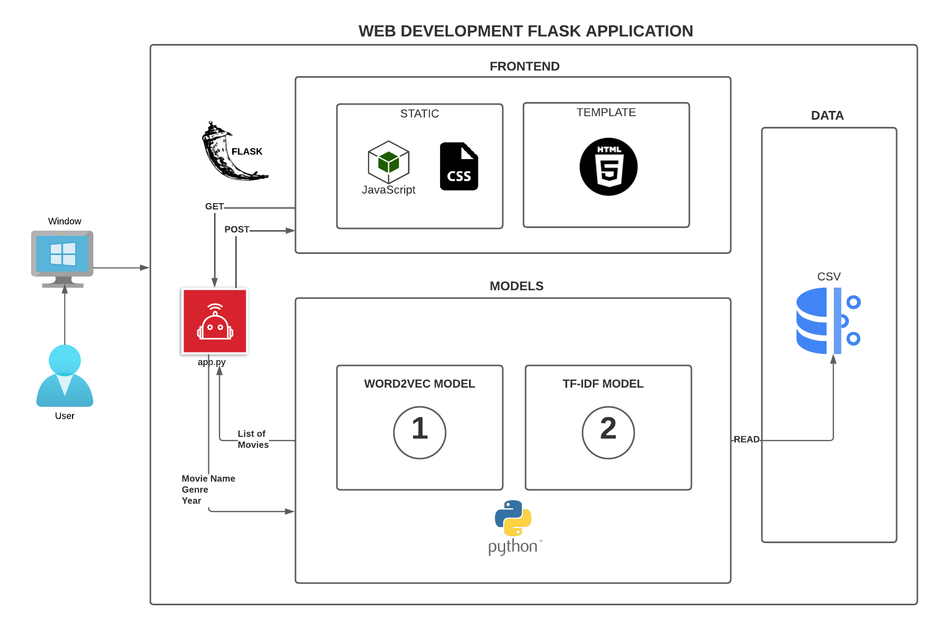
Functional Architecture

Slide 5
Dataset - Word2Vec
The dataset having the overviews for the movie contains ~45000 entries
Each movie is defined through 24 fields, here we cite the most important ones, and in particular the ones that we used to retrieve a list of results.
original_title | overview | genres | release_date | runtime | average_vote
The user is responsible for the filtering: one can choose to modify the dataset according to what he/she wants to watch
A user-independent filtering is also needed to reduce the size of the dataset and to remove those movies for which the overview is everything but useful [NaN, empty, not found].

Slide 6
Dataset for our second model tf-idf:
-the Netflix Prize Data dataset & movie-metadata(movie title, abstract)
-the reviews and ratings of all the users for many movies (userid, rating , movieid,date)
-movie titles dataset

Slide 7
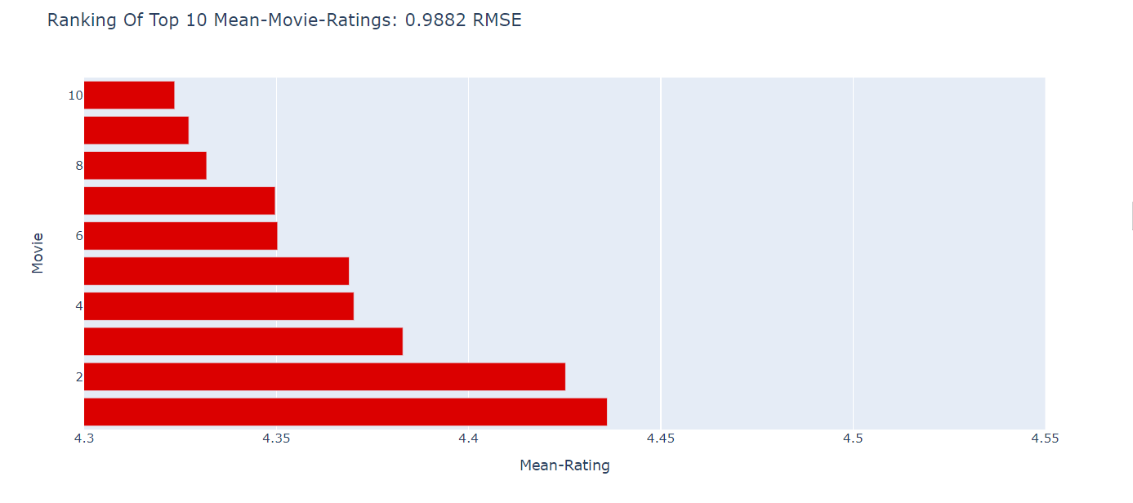
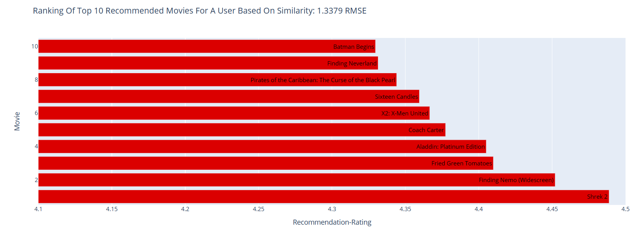
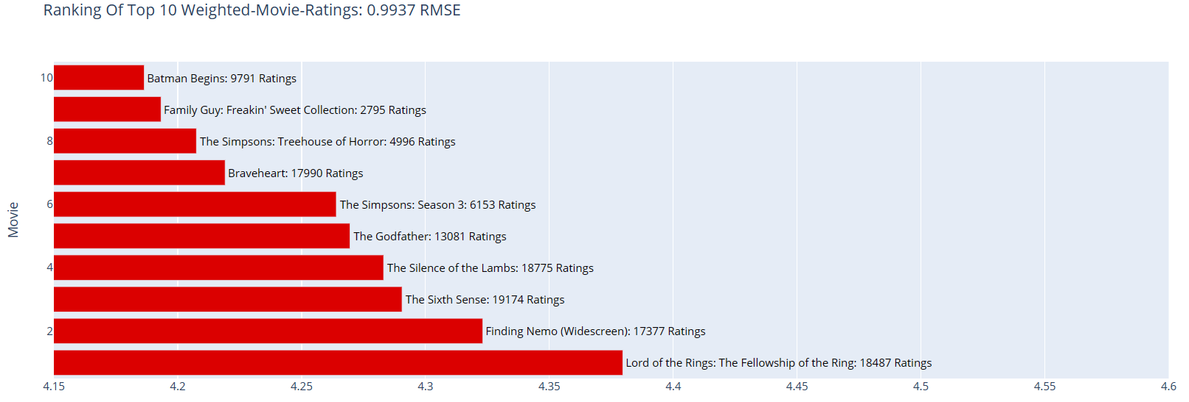
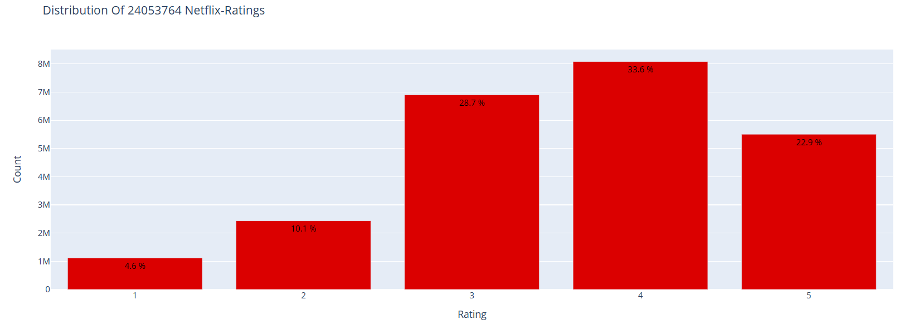
Data analysis

Slide 8
Results for Tf-IDF & Cosine similarity:
Top 10 of recommended movies for :
‘Assasins’: ['Der blaue Engel', 'Sharpshooter', 'Kinatay', 'Bad Teacher', 'Killers', 'MONDAY', 'King of the Ants', 'Colombiana', 'The Assassination of Jesse James by the Coward Robert Ford', 'Blast of Silence']
‘Batman Begins’ :['Batman Unmasked: The Psychology of the Dark Knight','Batman: The Dark Knight Returns, Part 1', 'Batman: Bad Blood', 'Batman: Year One', 'Batman: Under the Red Hood', 'Batman Beyond: The Movie', 'Batman Forever', 'Batman: Mask of the Phantasm', 'Batman & Bill', 'Batman']
Tf-IDF scores for some words in summaries:
HIGH SCORES: astrology : 10.287532867806089 | barbarism : 10.287532867806089 | barca : 10.287532867806089 | astronomer : 8.783455471029814
LOW SCORES: balance : 6.761172343189927 | bands : 7.845185832436884 | barely : 6.973346863133562
Notes:
we also talk about evaluation here

Slide 9
Results for word2vec:
Word2Vec uses a shallow neural network to embed words into vectors.
The model we used specifically uses the WMD distance, which enable to compute the distance between 2 documents using the aforementioned model.
In this sense, the input of the user will be a paragraph describing what he/she wants to watch, and the program should suggest him/her movies related to what was written
Here the results related to the input “space battle and aliens fighting humans”:
Survivor | 0.774
The Ledge | 0.789
Invaders from the Deep | 0.816
Gojira: Fainaru uozu | 0.817
The Beast with a million eyes | 0.831
All of them are movies related to aliens and battles between humans and aliens indeed.
Only the second one is a bit misleading since it doesn’t involve any intergalactical war

Slide 10
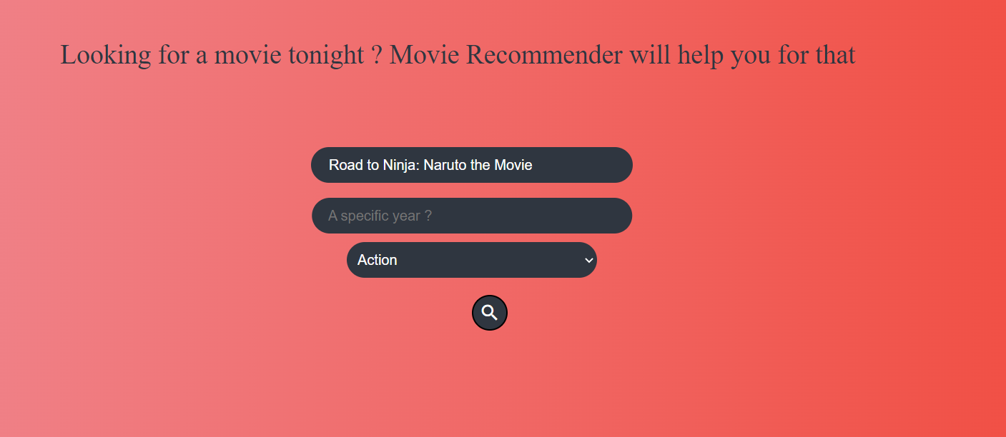
User Interface (Frontend)

Slide 11
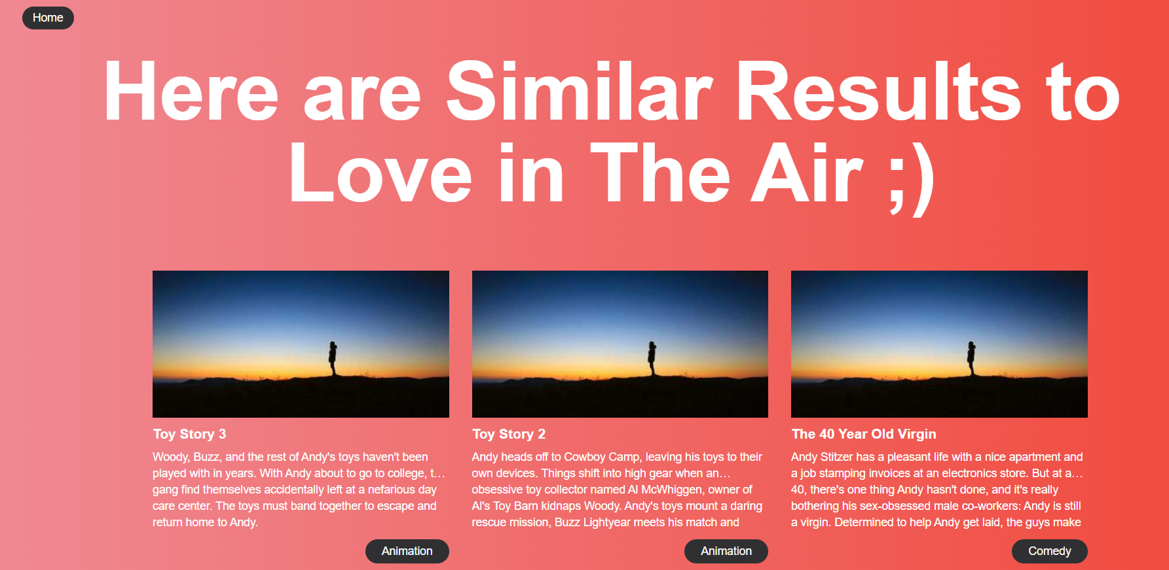
User Interface (Frontend)

Slide 12
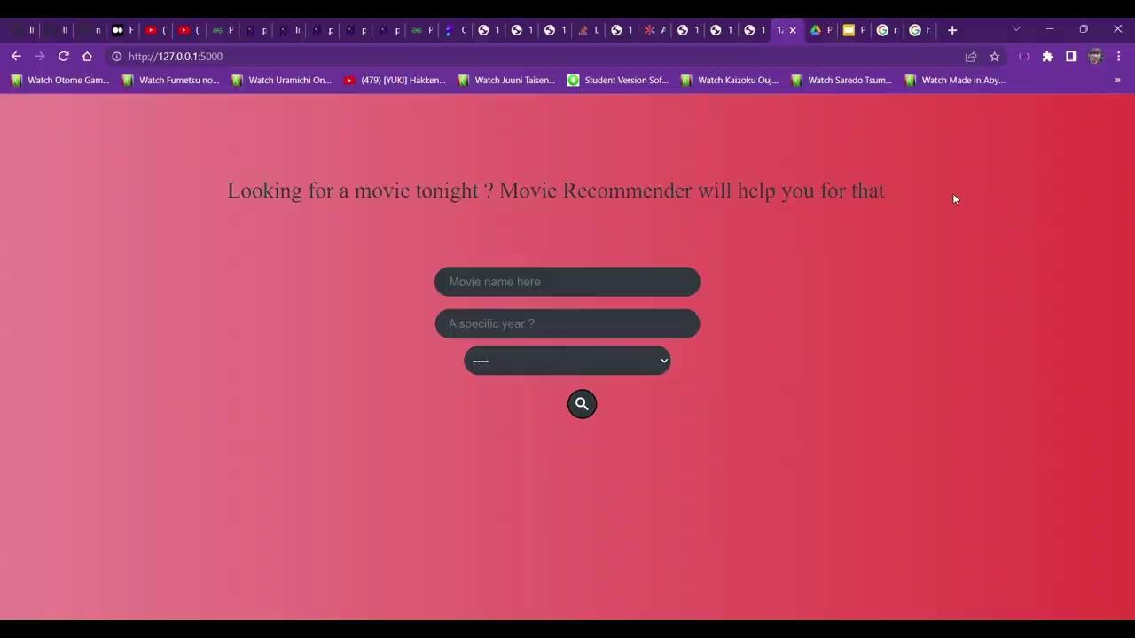
Demonstration

Slide 13
Future work and improvements
Different measure of similarity:
-other type of distances (euclidean distance, jaccard distance..)
Different models:
-other deep neural network
Filtering extension:
-add filters of our choices during the user selection
Functionality Extension:
-set all the hyperparameters and changing them to obtain better performance.
Performance improvements:
-Fine tuning or Domain Adaptation
Dataset quality:
-other richer and bigger datasets that can be exploited better.

Slide 14
CONCLUSION
TeamWork
Building an IDSS
Project Management
Front End Development
Data Analysis

