Slide 1
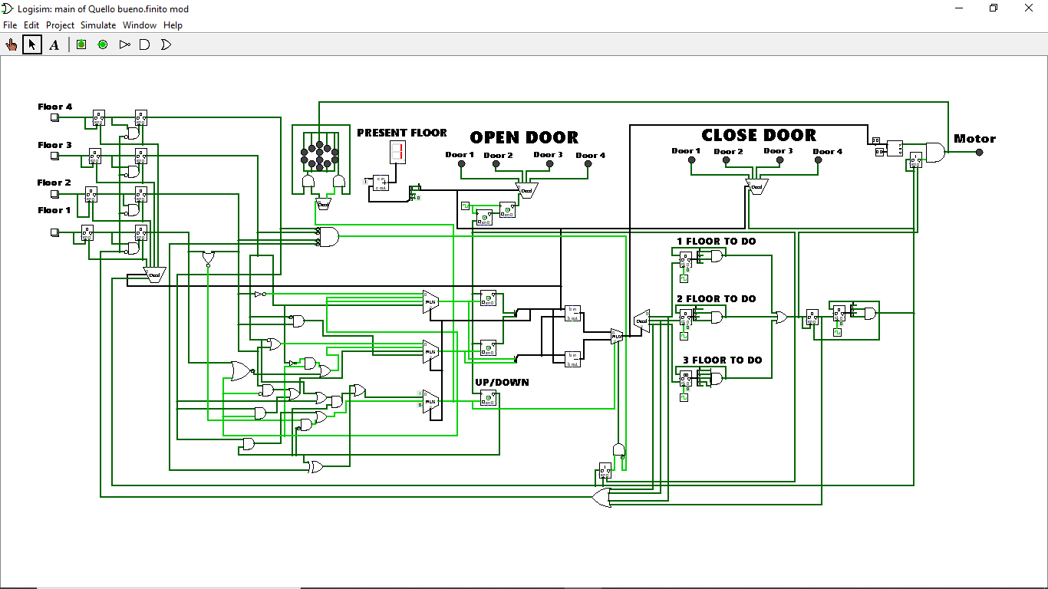

Slide 2
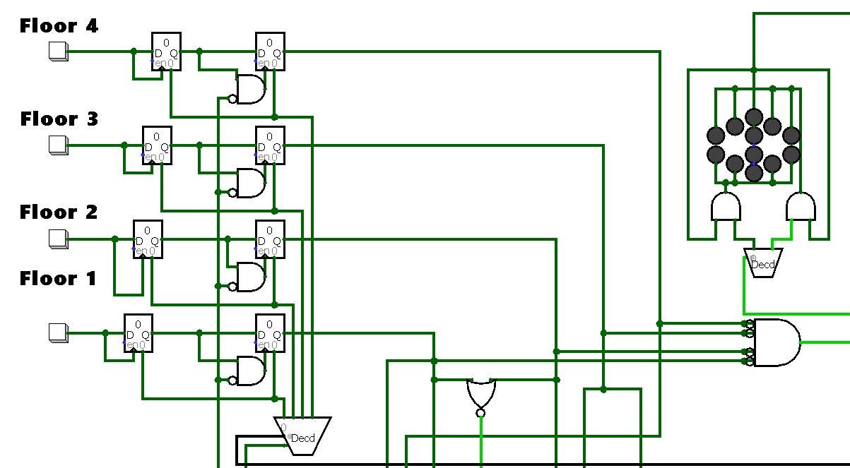

Slide 3
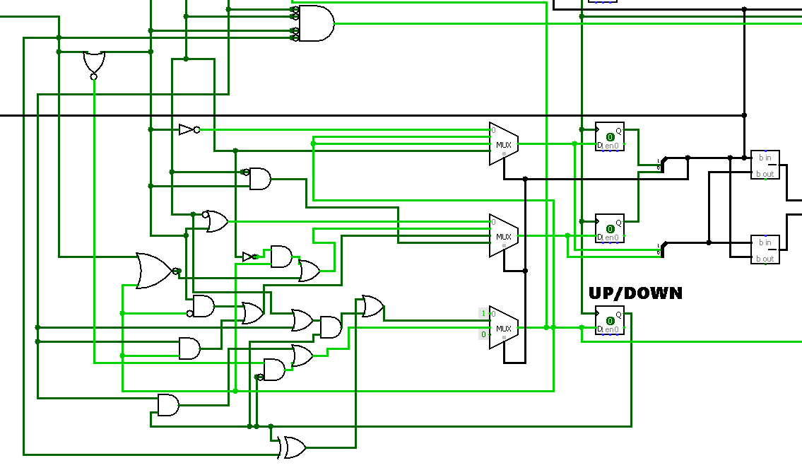
Bit 1
Direction
Bit 0

Slide 4
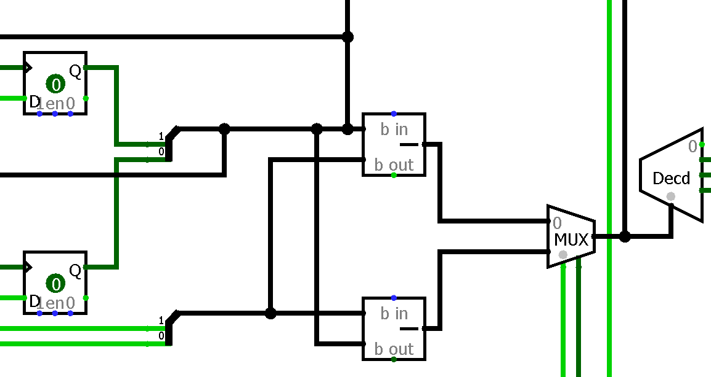
Calculation of how many floors the lift must do to know how many seconds the engine must remain on.

Slide 5
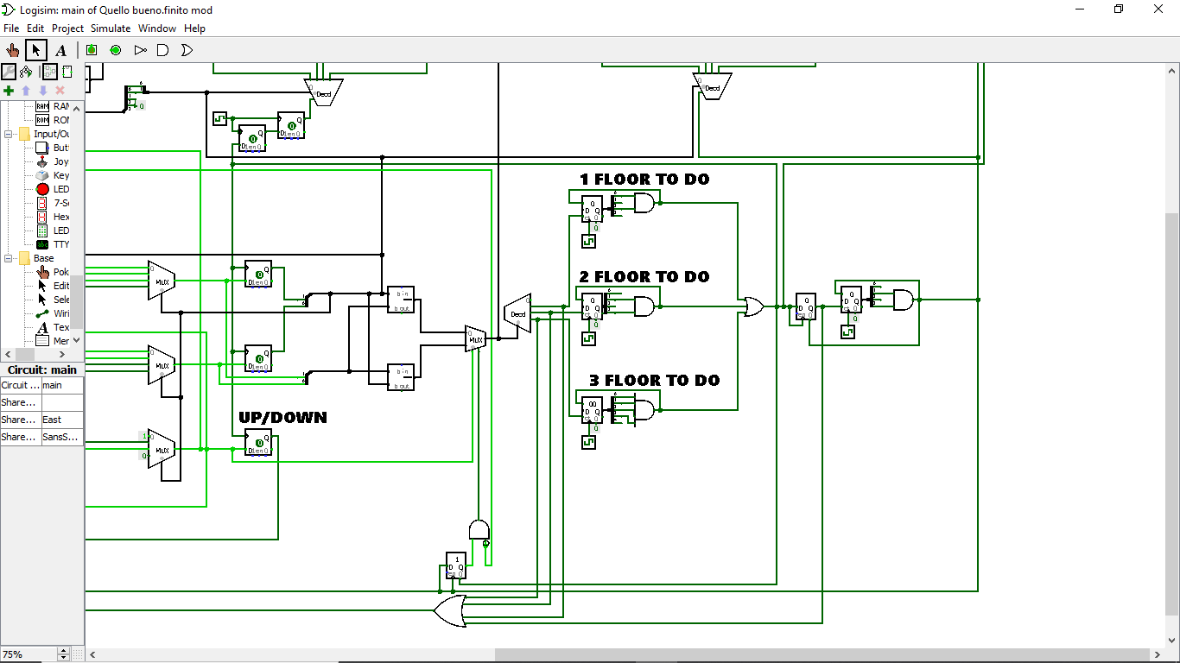
The heart of the circuit.
From here the signal goes to the close door , to the open door and to the motor

Slide 6
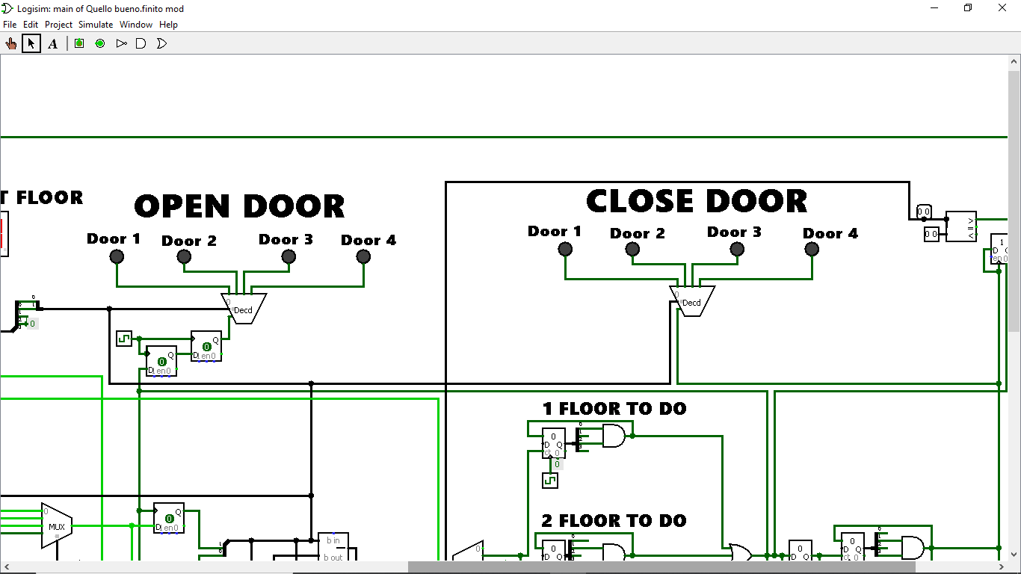
Present floor

Slide 7
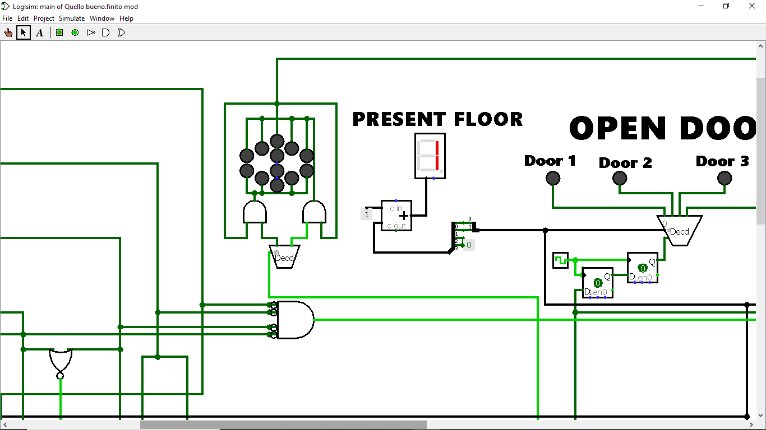

Slide 8
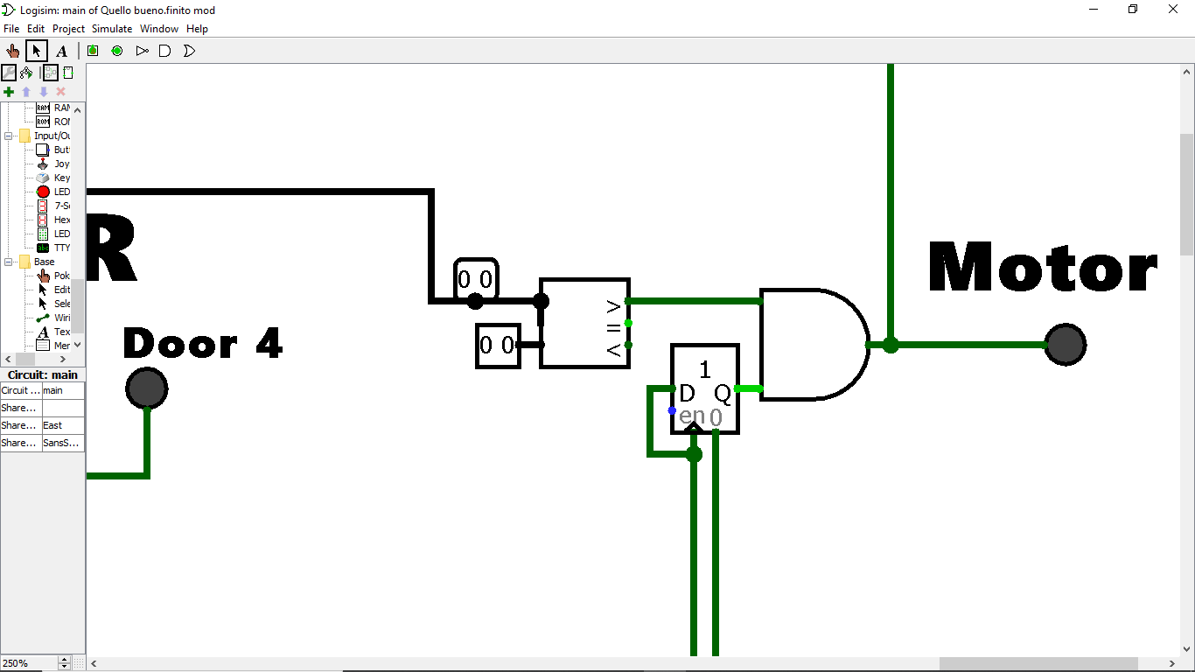
The motor is switched on if someone called it and if the doors are closed

