Slide 1
Project: Clock
Developer: Sunil Thapa

Slide 2
Introduction
Analog Clock
Displays clock of Sydney, Berlin, New York and Kathmandu
Displays digital clock at bottom of analog clock

Slide 3
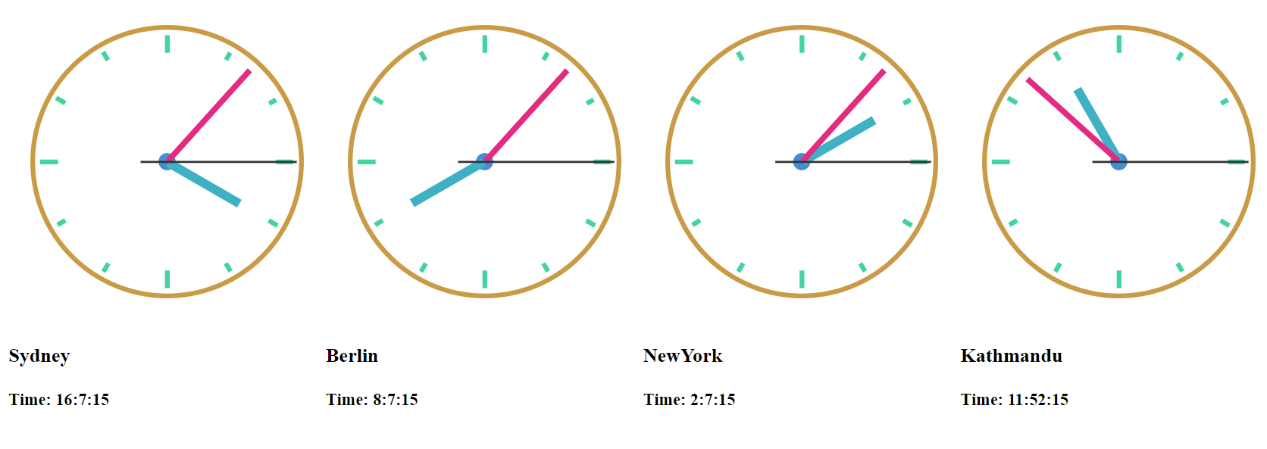
Design
There are different div for each state
Content for these classes will be loaded when js is run and these clocks are created

Slide 4
Thank You

